Slide 1
EXPERT LEVEL TRAINING ON TELECOM NETWORK COST MODELLING FOR THE HIPSSA REGIONS
Arusha
15-19 July, 2013
Introduction to the Workshop

Slide 2
Session 1: Welcome and Introduction

Slide 3
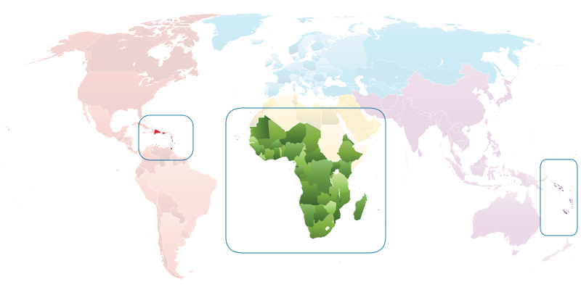
ITU-EC Project for Harmonization of ICT Policies in ACP
ITU and the European Commission project to provide “Support for the establishment of harmonized policies for the ICT market in the ACP states”
Launched in December 2008
a component of the “ACP-Information and Communication Technologies” programme (ACP-ICT) within the framework of the 9th European Development Fund
three regional sub-projects addressing specific needs of each region
HIPSSA (Sub-Saharan Africa)
HIPCAR (Caribbean)
ICB4PIS (Pacific Island States)

Slide 4
HIPSSA Objectives
Global objective
Support towards harmonised policies for ICT and an efficient regulatory environment conducive to investment in infrastructure and applications
Detailed objectives:
Supporting regional integration organizations to develop and promote the use of harmonized ICT policies and regulations in their region
Assisting individual beneficiary countries to adopt and implement ICT policies and regulatory guidelines
Building human and institutional capacity in the field of ICT through targeted training and knowledge sharing measures at regional and national level
ITU-EC Project for Harmonization of ICT Policies in ACP countries
Builds on experience gained from previous project in West Africa
Uses a demand-driven bottom-up approach
Incorporates all past and current projects and pays specific attention to capacity building

Slide 5
Common priority content
N° | Subjects
1 | Licensing: Technology neutral licensing
2 | Universal service: Best practices for selection and funding of universal access or service providers
3 | Spectrum management: Harmonized Calculation Method for Africa, HCM4A: cross-border frequency coordination
4 | Numbering: Regional numbering plans and planning guidelines
5 | Interconnection: Access to submarine cables, cost modeling and roaming
6 | Cybersecurity: cybercriminality and computer emergency response teams
7 | Analog to Digital Broadcasting Migration: Regional strategies and national roadmaps
8 | Statistics: Monitoring and evaluation

Slide 6
Assessment Study on Regulatory Auditing and Cost modeling in Sub-Sahara Africa
Support for Harmonization of ICT Policies in Sub-Saharan Africa

Slide 7
Background to the HIPSSA project
The ITU-EC joint project for “Harmonisation of ICT Policies in Sub-Sahara Africa” (HIPSSA) is building on the experienced gained with a pilot project funded by European Commission (EC) and ITU that led to the adoption of Additional Acts for telecommunications to the ECOWAS Treaty.
It aims at developing and promoting harmonized policies and regulatory guidelines for the ICT market as well as building human and institutional capacity in the field of ICT through a range of targeted training, education and knowledge sharing measures.
This project will result in the creation of harmonized regional and national policy, legal and regulatory frameworks conducive to significant investments in the ICT infrastructures and services.

Slide 8
Background to the development of the assessment study - 1
Tariff regulation calls on two main activities in the region:
and
ITU has been for a long time the primary forum of discussion on tariff and accounting principles including related telecommunication economic and policy issues (the ITU-D Regulatory and Market Environment Division (RME), ITU-D Study Group 1 Question 12-3/1 on Tariff policies, tariff models and methods of determining the costs of services on national telecommunication networks, including next-generation networks, and the ITU-T Study Group 3 Activities and Recommendations, Regional Tariff Groups such as SG3RG-AFR, etc.)
Regulatory auditing
Cost modeling

Slide 9
Background to the development of the assessment study - 2
Liberalization of telecommunications in Africa has induced the need for nascent regulators to build up capacity in cost modeling and regulatory accounting for them to be in the situation of regulating tariffs of operators.
ITU has responded to this need by running training workshops, proposing tools, such as COSITU, WB Cost Model and a didactic Cost Model (based on Excel), building up expertise within its network of Centers of Excellence (CoE).
In this sense, Regional Organizations across Africa have started to harmonize cost modeling like ECOWAS, adopting on methodology standard for West Africa (the Supplementary Act on Interconnection refers to a Bottom-Up LRIC model).

Slide 10
The ITU’s actions and objectives
Within the framework of this joint project with the EU, ITU is ready to respond once again to the needs of HIPSSA beneficiaries and its members by providing regional organization with an up-to-date review of regulatory practices in the respective regions identifying trends on which they could build a common approach on regulatory auditing and cost modeling, with the development and dissemination of this Assessment.
Based on the results from this assessment, updated training material will be developed, delivered and embedded into the respective networks of regional associations of regulators and ITU Centers of Excellence (CoE) to ensure a sustainable mechanism of delivery and support.

Slide 11
Key tasks for the HIPSSA project
Understanding the competitive electronic communications services provision market and price regulation in the region.
To identify the regulatory auditing, accounting separation and cost modeling mechanisms appropriate, as well as cost model development accounting standards, concepts and key assumptions.
Review of existing public available cost models in the region and beyond, model comparisons and future challenges.
Define price control mechanisms and its relation to cost modeling, accounting and regulation.

Slide 12
Implementation -1
Regional assessment studies
Data collection process
Analysis and benchmarking
First Phase
Consolidation of the regional studies
Comparative analysis across the region and beyond
Identifying best practices
Conclusions and recommenda-tions
Second Phase
Development of training material
Regional capacity building programme
Face-to-face five days training workshop in each region
Third Phase

Slide 13
Implementation - 2
First phase: Development of regional assessment studies on costing strategies and cost model application and processes
In this first phase, data collection will be conducted through surveys and interviews (based on a common template) with regulators and operators and analysis.
The study will be divided geographically into four regions as defined by the African Union (AU): West Africa, Central Africa, East Africa and Southern Africa.
Second phase: Consolidation of the regional studies’ findings in a final report providing an overview of the whole Sub-Sahara Africa.
Identifying best practices (from the region and beyond) and presenting the conclusions and recommendations of comparative analysis.
Third phase: regional capacity building includes preparation of training material taking in to account the regional assessment studies and best practices developed in phase 1 and 2.
This material will be delivered in face-to-face five days training workshops in each region.

Slide 14
Project management plan
Regional Coverage
West Africa Benin, Burkina Faso, Cape Verde, Côte d'Ivoire, Gambia, Ghana, Guinea, Guinea-Bissau, Liberia, Mali, Niger, Nigeria, Senegal, Sierra Leone and Togo
Central Africa Burundi, Cameroon, Central African Republic, Chad, Congo, The Democratic Republic of Congo, Equatorial Guinea, Gabon and Sao Tome and Principe
Project management
Team coordination and establishing a common methodology for survey and regional assessments preparation
East Africa Comoros, Djibouti, Eritrea, Ethiopia, Kenya,
Madagascar, Mauritius, Rwanda, Seychelles, Somalia, Sudan, Tanzania and Uganda
Southern Africa Angola, Botswana, Lesotho, Malawi, Mozambique, Namibia, South Africa, Swaziland, Zambia and Zimbabwe

Slide 15
Project team members
Senior Project Co-ordinator: Ida Jallow
Regional Experts
English Speaking Africa: Christopher Kemei
French Speaking Africa: Alain Sawadogo
International English-Speaking Expert and Coordinator of the Training Workshops: David Rogerson;
International French-Speaking Expert: Abdelmounaim El Haffaf
International Portuguese-Speaking Expert: Pedro Seixas
Assisted by Carmen Wagner Prado at ITU in Geneva (Switzerland)

Slide 16
Planned costing workshops
Portuguese workshop in collaboration with ANAC
Cape Verde, 6th- 10th May 2013.
French-Speaking West and Central Africa workshop in collaboration with the Centre of Excellence ESMT in Senegal
Dakar, 27th -31st May 2013.
English-Speaking East and Southern Africa in collaboration with …
Arusha, 15th-19th July 2013.
English-Speaking West and Central Africa in collaboration with …
Banjul, 19th – 23rd August 2013.

Slide 17
Participants in this week’s workshop
Add list of participants when we have them

Slide 18
Contacts
For more information: http://www.itu.int/ITU-D/projects/ITU_EC_ACP/index.html
Sandro Bazzanella ITU-EC Project Manager
sandro.bazzanella@itu.int
Phone: +41 22 730 6765
Fax: +41 22 730 5484
International Telecommunication Union
Headquarters Place des Nations
CH-1211 Geneva 20
Switzerland
Ida Jallow HIPSSA Senior Project Coordinator
Ida.jallow@itu.int
Phone: +251 11 551 4977
Fax: +251 11 551 7299
International Telecommunication Union
Regional Office for Africa P.O. Box 60 005
Addis Ababa
Ethiopia
ITU-EC Project - Harmonization of ICT Policies in ACP countries

