Slide 1
Enhancing ICT Development and connectivity for the land locked developing Countries Global South-South Development Expo Mini partnership forum =26097788597
Milner M. Makuni,
milnermakuni@mct.gov.zm
260977788597

Slide 2
What We will talk about.
Introduction
National Development
ICT Infrastructure
E-Government
Challenges
Lessons learnt

Slide 3
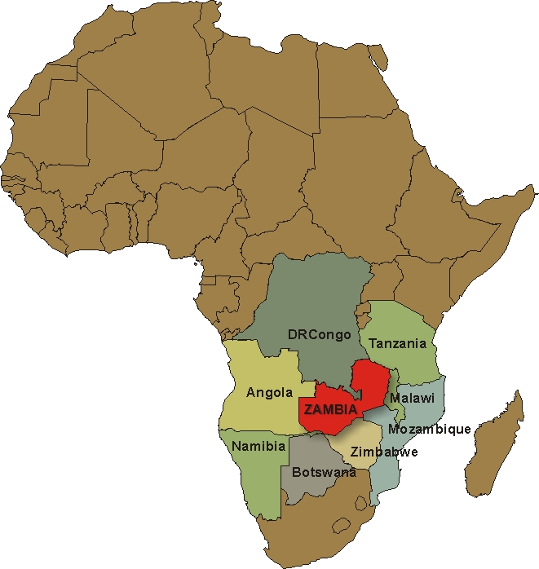
Located in Southern Africa between 8◦ S and 18◦ S and between 20◦E and 35◦E.
752,618 square kilometres
Surrounded by 8 neighbors
GDP growth rate - 7.3
Annual Aver. Inflation (%) - 6.6
Exchange Rate;
1USD is equal to 5.12 ZMK

Slide 4
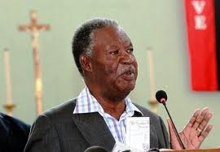
Government Vision
Overall Goal: To accelerate and streamline Government service delivery to meet the real needs of citizens and business for socio-economic development regardless of geographical location.
National Development Plan
ICT Policy and implementation;
ICT Infrastructure
Universal Access
E-Government
H.E President Michael C. Sata
President of Republic of Zambia

Slide 5
How about Universal Access?
Universal Access:
Universal Access and Service Fund to address the provision of electronic communications services in un-served or under-served areas and communities. 169 chiefdoms tender awarded in 2013.
Interconnecting and Sharing of ICT Infrastructure
legal and regulatory framework for interconnecting and sharing of ICT infrastructure amongst the operators to support growth of the sector,

Slide 6
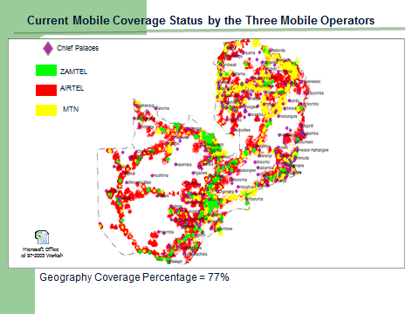
Mobile Communication Services?
Mobile Operators and subscriber base:
There are three Mobile service providers namely; ZAMTEL, MTN and AIRTEL which collectively have a subscriber base of over 10,666,580 Million, reflecting a penetration of 78.05% per 100 inhabitants

Slide 7
Internet penetration?
There are more than 27 licensed Internet service providers.
The traditional fixed internet subscription stood at 17, 717 in the second quarter of 2013.
The mobile internet segment had 2,626,840 subscribers as of June 2013.

Slide 8
National Connectivity – Optic Fibre
In terms of national fibre backbone infrastructure, three operators namely ZESCO, ZAMTEL and CEC -Liquid have optical fibre networks providing the backbone infrastructure.
On fibre connectivity, 35 districts are connected to fibre either through ZESCO, ZAMTEL or CEC Liquid and 7 additional districts will be connected by December, 2013.

Slide 9
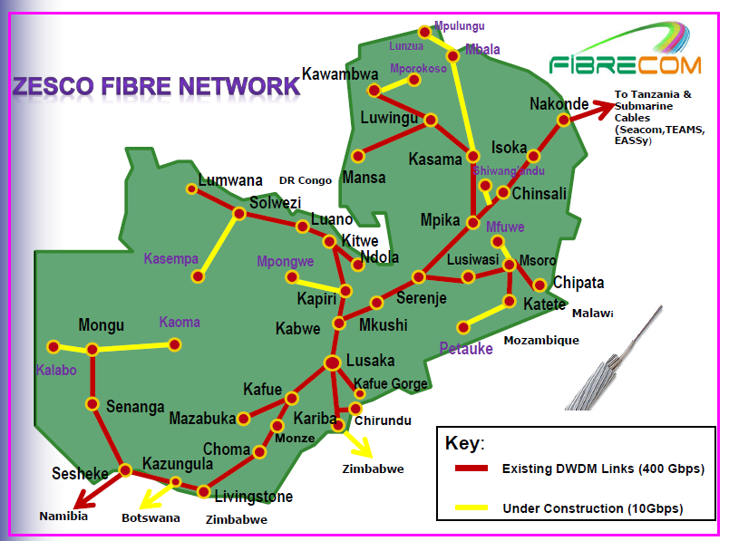
National Connectivity – Optic Fibre

Slide 10
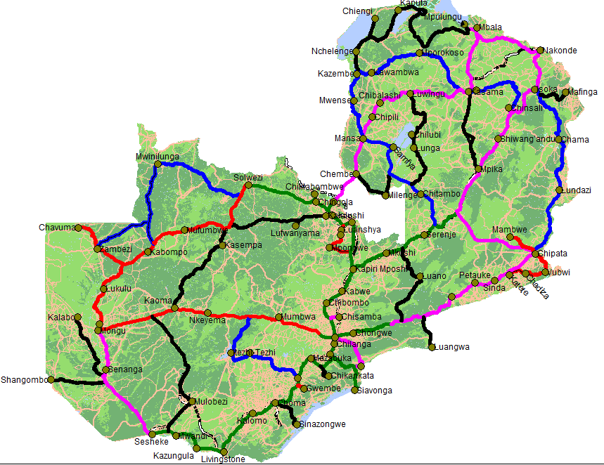
National Connectivity – Optic Fibre

Slide 11
OPTICAL FIBRE –International Connectivity
There are a number of existing optical fibre cables on both the eastern and western Africa seaboard linking Africa to Europe (Seacom, EASSy, SAT 3, SAFE and WASC.
Zamtel, MTN as well as Airtel have capacity investments in some of the undersea cables,
Zambia is currently connected to the undersea fibre cables through Namibia and Tanzania.
Once the sufficient interconnection with undersea fibre cables is done it is anticipated that there will be abundant bandwidth and that prices for internet connectivity will substantially reduce.

Slide 12
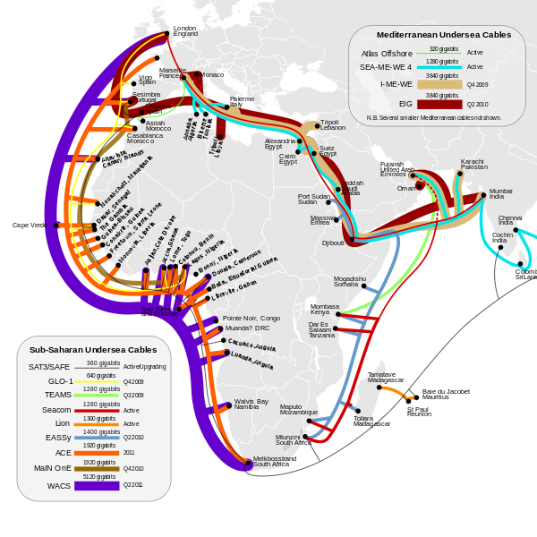
OPTICAL FIBRE –International Connectivity

Slide 13
What about E-Government?
Common ICT Platform
Government Wide Area Network and Unified Internet
Electronic Services
Government Informational Web Portal
Government Transactional web Portal
National Identification system ( INRIS)
Lands Management ( ZILMIS)
Taxation (Tax Online)
Motor Vehicle and Driver Licensing ( e-ZAMTIS)
Business and Company Registration (e-Trade)
Tax Online web interactive system – Zambia Revenue Authority

Slide 14
What are the challenges?
Inadequate ICT skilled human resource
High cost of service provision
Limited broadband infrastructure across the country
Lack of local content targeting citizens and businesses
Poor utilisation of ICTs in public service delivery
Lack of weather data capture and processing facilities; and
Limited utilisation of ICTs for commerce by private sector

Slide 15
Lessons Learnt?
Internet service costs inland proved more expensive than internet service through access to the sea cable hence need to review some of our carrier of carrier service provider cost structure in country.
Government provision of appropriate electronic services can enhance relevant content on internet
Collaborative initiative with private sector can facilitate extension of ICTs to un served and under served areas in a more cost effective way
Success of E-Government depends on greater business preparedness, competency in change management and effective business process re-engineering. Managing the many linked dependencies and risks between individual service delivery areas of the E-Government strategy and realizing the benefits of change poses a number of challenges.
The increased mobile growth is an opportunity for mobile applications deployment and access of electronic services by the majority citizens and businesses.
Appropriate ICT for development policy, regulatory environment and strategies are required to exploit the use of ICT in socio-economic development.

Slide 16
Recap
Introduction
National Development
Infrastructure
E-Government
Challenges
Lessons Learnt

