Slide 1
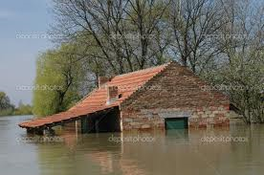
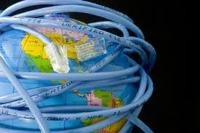
Enhancing ICT development and connectivity for the Landlocked Developing Countries (LLDCs)
Ms. Gisa Fuatai Purcell
Head, LSE Division
International Telecommunication Union
In partnership with UNORHLLS
GSSD2013 28Oct – 1 Nov 2013, Nairobi

Slide 2
Order of Presentation
Brief on Information and Communication Technologies (ICTs)
Land locked countries
Challenges
ICT Development in LLDC
Policies, regulations, legislation
ICTs and Climate Change
ITU and Almaty PoA

Slide 3
ICTs
Information and Communication Technologies (ICT).
refers to technologies that provide access to information through telecommunication networks
Fibre optic, submarine cables, satellite etc.
focuses on communication technologies delivering not only voice but data including multimedia.
include but not limited to:
i. the Internet – e-applications
ii. Infrastructure - mobile network, VSAT, BGAN
iii. The People Factor – inclusive including disability
Iv. Must be affordable, secure and

Slide 5
COMMON ICT SERVICES:
society enjoy a vast array of new communication capabilities.
people communicate and do business in real-time with others anywhere in the world 24/7
instant messaging (viber) voice over IP (VoIP), and video-conferencing
social networking – Facebook, Twitter etc. allow users to communicate on a regular basis.
Saving Lives
early warning systems
Coordination of relief efforts during disasters

Slide 6
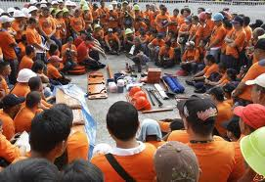
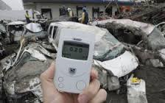
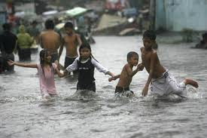
ROLE OF ICTS IN CLIMATE CHANGE
PREPAREDNESS
Vital role – Governments develop disaster management policies, regulation, and legal frameworks development. Implementation of ICT projects and capacity building activities for all
COMMUNICATION
MITIGATION
Early Warning Systems, Establish Evacuation Centers – Advise people. Radio, Mobile
Communication with people affected is critical. Radio, Television, mobiles – Internet.

Slide 7
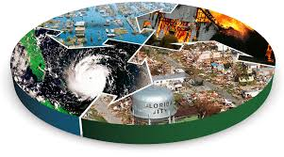
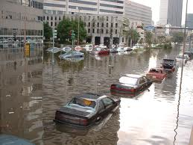
ROLE OF ICT IN EMERGENCIES
Reports of a disaster to governments/partners from anywhere in the country
Photos and videos from anywhere in the country to relief organizations
Coordinate assistance and relief work
More importantly; Communicating with people affected.

Slide 8
But what is the cost of ICTs?
Recent studies – cost of ICTs are too expensive in developing countries
Bandwidth for one person in Korea may be the total bandwidth available in one developing country
Satellite costs – very high; unaffordable but most useful during disasters
Submarine cables and fibre optics – even higher in developing countries
Notes:
This slide points out one factor – ICTs is affordable and widely available in developed countries, while it is quite the opposite in developing countries

Slide 9
And what of Land Locked Countries?

Slide 11
Notes:
The Broadband commission is aiming at lowering the cost of satellite broadband by 2015 as mentioned by the Secretary General of ITU

Slide 12
Notes:
There are 31 LLDCs in the world. As you can these countries face challenges that are unique to their geographical locations as mentioned by various speakers in the earlier panel so I will not repeat these challenges.

Slide 13
Notes:
The challenges have been mentioned by various speakers, so I do not need to talk about this slide

Slide 14
Notes:
All is not lost. ITU through its main international conferences have come up with resolutions that are specific to LLDCs as well as LDCs and SIDS. These were mentioned by the distinguished of Nepal, and I will not spend more time on this slide.

Slide 19
What is the contribution of ITU in implementing the Almaty Plan of Action?

Slide 20
ITU ACTIVITIES FOR ALMATY PoA
PRIORITY AREAS
ACTIVITIES
FUNDAMENTAL TRANSIT POLICY ISSUES
ICT Global Policy and Regulatory Framework Harmonization
Human and Institutional Capacity Bulding
INFRASTRUCTURE DEVELOPMENT AND MAINTENANCE
Infrastructure Development Projects
Introduction of Sustainable Business Models
National Broadband Plans and Strategies
INTERNATIONAL TRADE AND TRADE FACILITATION
E-Business, e-Government, e-Banking, e-Trading, PKI for Secure Transactions, Cybersecurity
INTERNATIONAL SUPPORT MEASURES
Facilitating Access to technologies and transfer of know how.
Forging Partnerships (Gvts, IGOs, Industry)
IMPLEMENTATION AND REVIEW
Concentrated Assistance, reporting.

Slide 21
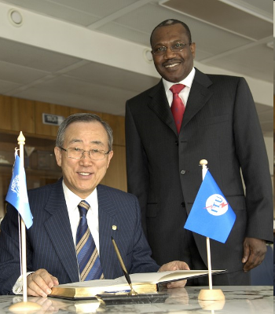
The ITU Works in Partnership
UN agency for ICTs
Members:
193 Member States (Governments and regulatory bodies) 700 Private Sector (Sector Members and Associates) 63 Academia
ITU works collaborattely with other UN agencies
Takes part in other UN agencies conferences
Provides input into UNGA various reports
Partnership with member states and private sector, civil society, academia
Play its role on developing telecommunications and ICTs for all
Mr. Ban Ki-moon,
Secretary-General of the United Nations
and Dr. H. Touré, Secretary-General of ITU

Slide 22
ICTs also Save Lives in LLDCs
Thank you

