Slide 1
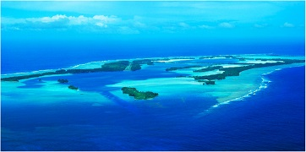
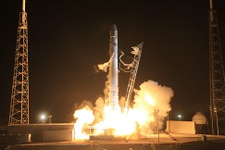
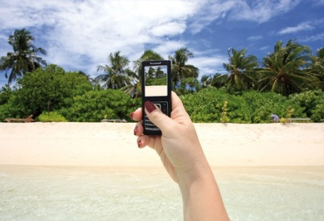
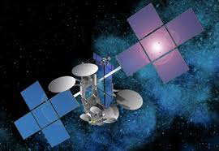
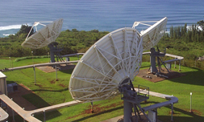
Kacific
A High Speed Broadband Satellite
for the Pacific Islands
Kacific / Fiber complementarity
Christian Patouraux
PITA, Suva, Fiji – 06 Oct 2014

Slide 2
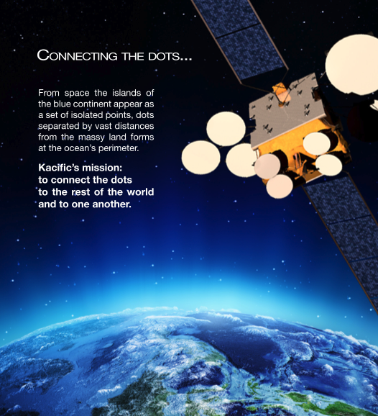
Kacific: “Connecting the Dots”
The Kacific promise
Proven HTS technology for Pacific
Complete Pacific coverage
Complementary to fiber
Launch in 2017 (payload split)
Radically Affordable
High speed broadband internet access
Direct-to-the-premise
Easy and rapid rollout
75-98cm terminal
20-30 minutes installation
A genuine game-changer

Slide 3
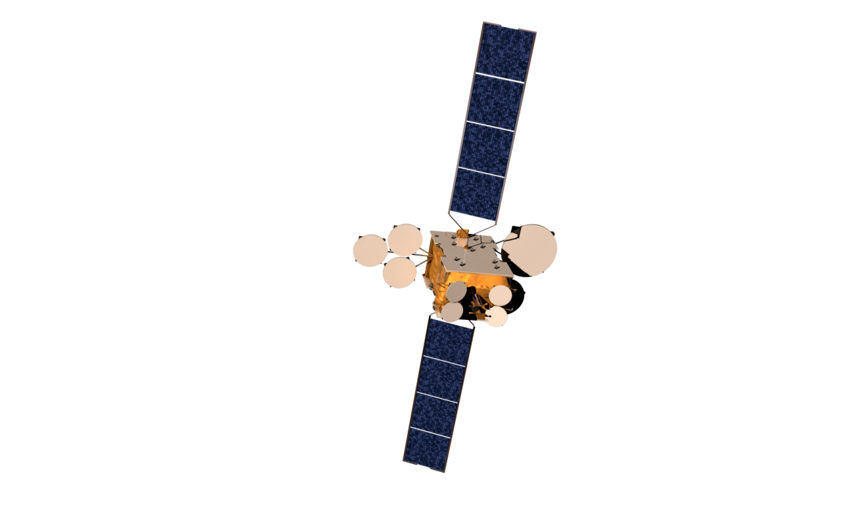
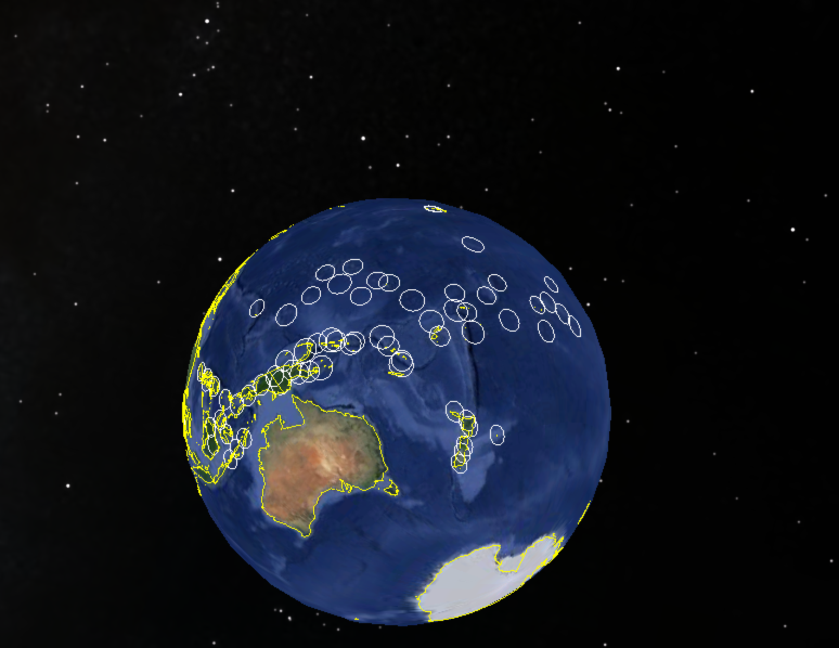
Coverage / Payload split
Kacific-K1b – Geo Ka HTS
Ka-Band / 15Gbps
Kacific-K1a – Geo Ka HTS
Gateway
Ka-Band / 10Gbps

Slide 4
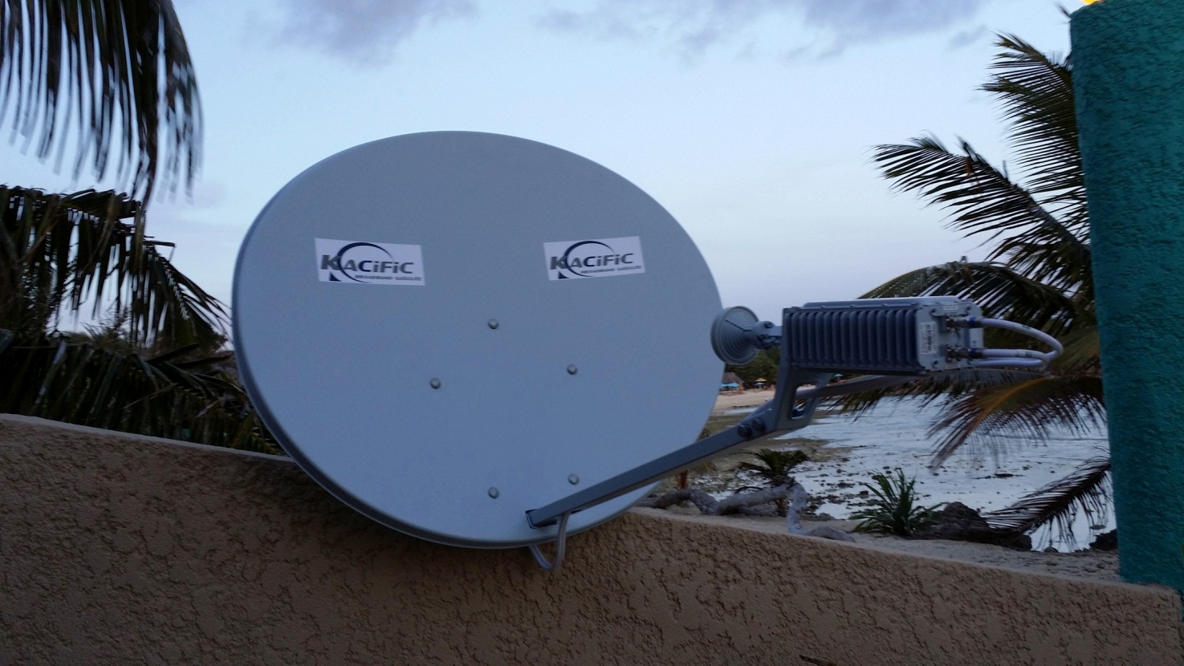
Simple 350-450$, 75-98cm terminal
Up to 40Mbps FWD / 10Mbps RTN per site
Plug and play, 20-30min installation

Slide 5
The cost of large trans-pacific fiber ($/Mbps)
Source – Worldbank, 2009
versus

Slide 6
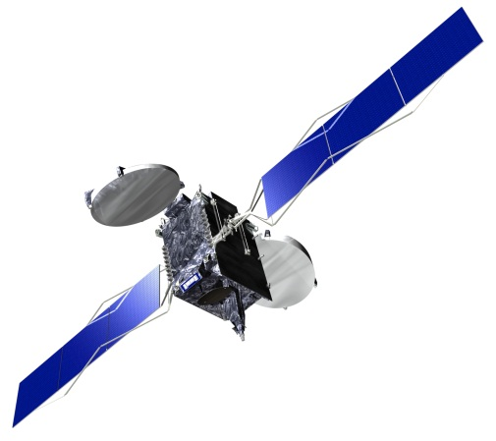
Pls map out total cost given links, adding whatever labels / lines etc
The cost of cable distribution
Kacific (direct to premise)
Hawaii
Other Satellites
(direct to teleport)
~$400-550/Mbps
Community / SME
Internet
Consumption
Point
~$500-5,000/ Mbps
$1 - 10/ Mbps
Hawaii /
Los Angeles
Cable
Island
Landing
Point
Large Island City
(e.g. Suva, Guam)
USA
Local / National
Distribution Network
Main Cable
e.g. Southern Cross Cable
Inter-
Island
Cable
Average $500 – 1,000 / Mbps
$20-75/ Mbps
~$300 - 500/ Mbps

Slide 7
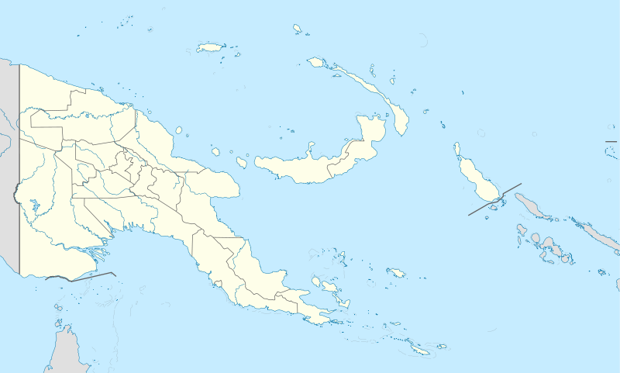
Ka Geo HTS – A Complementary Technology to Fiber
Kacific: PREPARES fiber arrival, COMPLEMENTS fiber infrastructure, SECURES fiber networks
Kacific fuels demand for broadband in rural locations and outer islands. As local content is developed and local online services are offered the entire population embraces a growing need for connectivity.
Kacific-1
Terminals ~$350-450 a piece
Hundreds or thousands of sites per province
10Mbps
10Mbps
10Mbps
10Mbps
10Mbps
10Mbps
10Mbps
10Mbps
10Mbps
Other satellites, (few sites connected)
10Mbps
Undersea
cable
10Mbps
Kacific easily secures any undersea cable

Slide 8
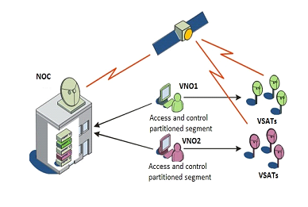
Kacific – Cable backup service
Kacific Gateway
& Gateway Network Operations center (NOC)
Kacific backs-up Cable with
1.5 to 3 Gbps Satellite Trunking
Capacity
Hawaii & Auckland
Undersea cables
Kacific
supplies
1.5Gbps trunking
in case of
cable traffic
disruption
Kacific Island Gateway
Island Undersea Cable secured by Kacific
Kacific User Terminal Network in Customer Beam

Slide 9
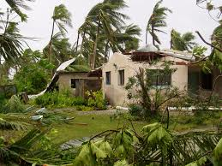
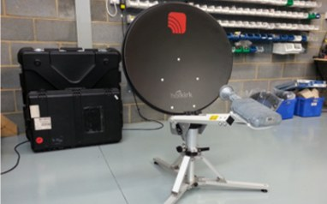
Kacific – Disaster and Emergency Recovery
>
Islands are vulnerable to disasters
Kacific builds outstanding resiliency
20 - 30 special carbon fiber terminals ready to install
Secured in bunker, installed in 5 minutes
Possibility of ship mount with powerful wifi

Slide 10
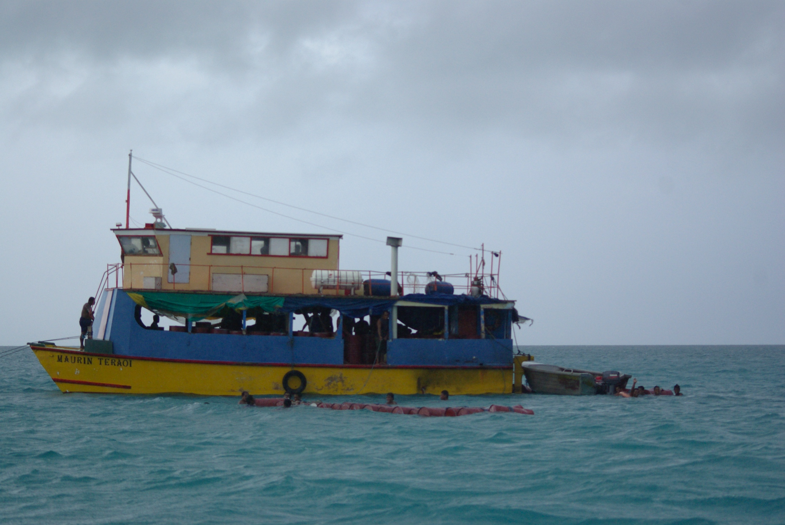
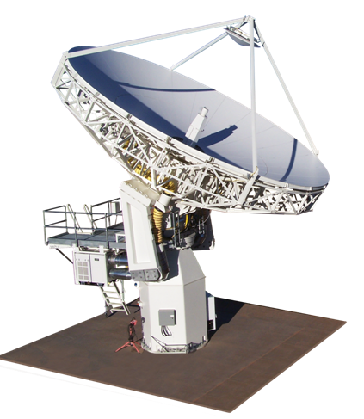
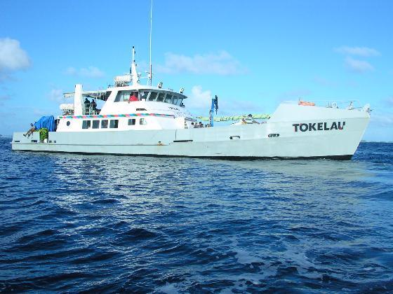
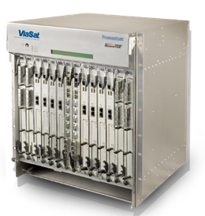
Kacific – Affordable Broadband in Local Passenger Vessels
High Speed Kacific broadband in local vessels
Same cost and quality as terrestrial broadband
Another game-changing service to the residents of the Pacific

Slide 11
Kacific’s Vision
Enabling prosperity throughout the nation
Equipping children for a digital future
Delivering health services more effectively
Preparing for and recovering from natural disasters
Engaging and empowering remote communities

Slide 12
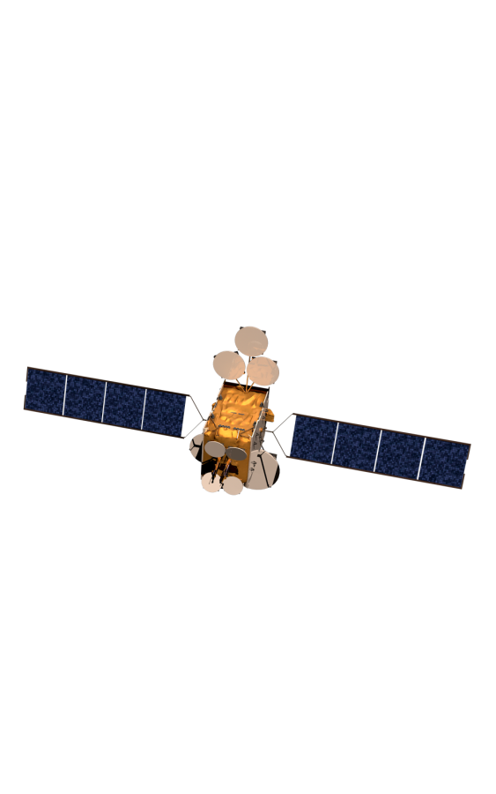
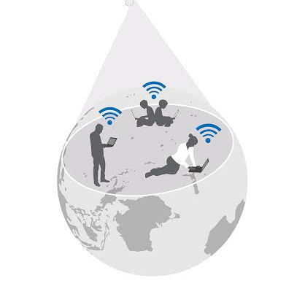
Thank You !
“From space the islands of the blue continent appear as a set of isolated points, dots separated by vast distances from the massy land forms at the ocean’s perimeter.
Our mission – to connect the dots
to the rest of the world, to one another.”
Christian Patouraux
chris@kacific.com
Kacific Broadband Satellites Pte Ltd
32A Kandahar Street
Singapore 198891

