Slide 1
Radioamateurs and Disasters
Presentation to ITU’s FG DR&NRR
Santiago, Chile, October 2013
Dr. Galdino Besomi
IARU R2, Director
Radio Club de Chile, President

Slide 2
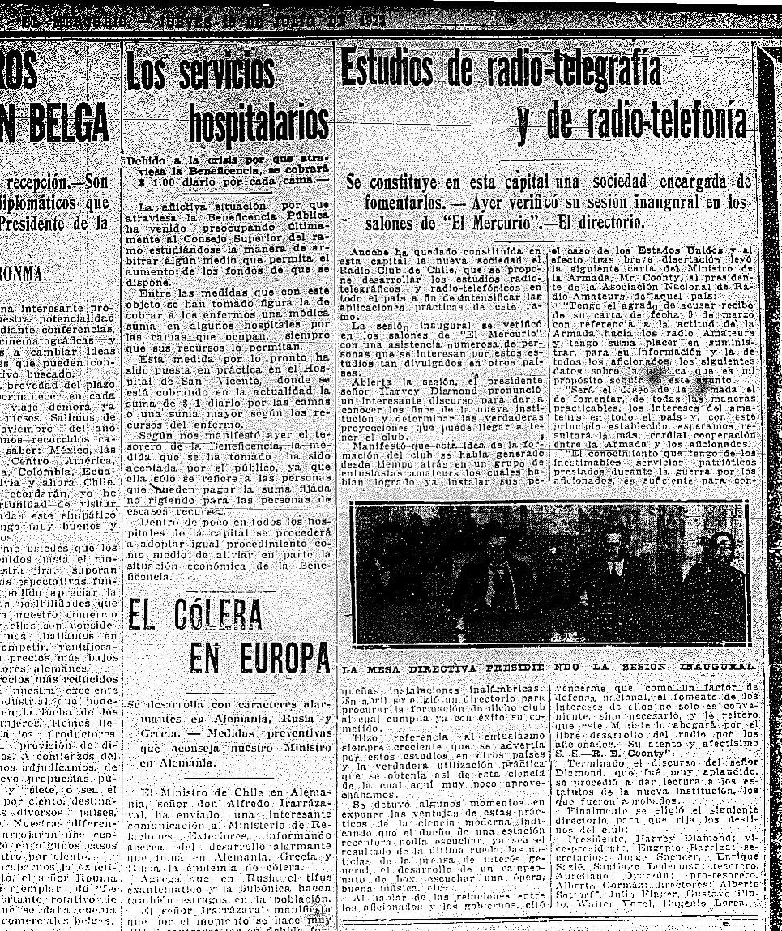
Radioamateurs in Chile
A long standing history
  Fundación Radio Club de Chile 1922
  Firtst public transmisison pública 1922
IARU founded 1964

Slide 3
Purposes of the Service
Radio communications
Technical and scientific experimenting
Colaboration with the authority in cases of Disaster or Emergency, Art 53, DS 523.

Slide 4
Regulation

Slide 5
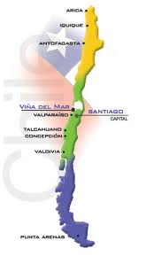
Geographic coverage
Clubes Asociados y amigos:
  RC Cavancha de Iquique
  RC La Portada de ANF
  RC La Serena
  RC Los Andes
  RC Manquehue
  RC San Cristóbal
  Circ. Afics. Hannover
  Circ. Afics. OasisHam
  RC Ñuble
  RC Los Heroes
  RC G. Saez
  RC Concepción
  RC Talcahuano
  RC Los Angeles
  RC Villarrica
  RC Mallolafquén
  RC Los Ríos de Valdivia
  RC Volcán Osorno
  RC Punta Arenas

Slide 6
Why Amateur Radio?
1.- Amateurs can operate on a local, regional, national or international level.
2.- We are authorized and regulated operators
3.- We are technically qualified
4.- We are on permanent activity and preparation
5.- We are independent from the mainframe structures.
6.- Our system is practically inmune to overload
7.- We may provide the interoperability that countries like Chile still dont have on the public system institutions (police, firefighters, ambulances, etc.)
8.- At no cost for the Government

Slide 7
February 2010 Earthquake
Minute 0: Inmediate operation of the chilean RadioAmateur Emergency Network on VHF and HF; local, national and intenational.
Minute + 3: Radio dead zone between Rancagua y Valdivia, first hints of the epicenter location.
Minute +10: Magnitud and epicenter collected. via USGS accessed by internet on the northernmost part of the country and relayed to us via HF.
4:10 AM, one hour after the hit, first information about tsunami, relayed to ONEMI.

Slide 8
Radioamateurs and 2010 megaearthquake
Pros:
  Big enthusiasm
  Thousands or forwarded messages
  Great public exposure, due to:
    Continuity of the services provided
    Free to the public, operated by volunteers
    In spite of its limitations, a service that can be trusted on
Cons
  Organizational level:
    Lack of organization and discipline
  Operational level:
    Some confusión between raw data and useful info
Solutions:
  Organization and Capacitation

Slide 9
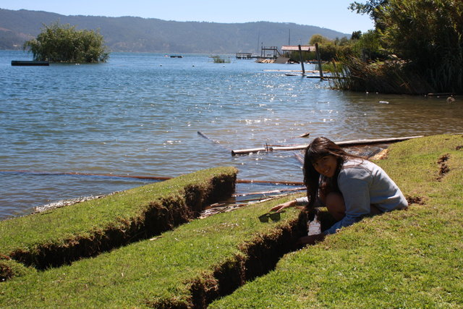
Radioamateur Antonia Besomi, CD5731, sitting at the crevasses left by the February 2010 Mega-earthquake, at Vichuquen (FF35xe). The island at the back used to be a weeping willow in the hollow that can be seen next to Antonia.

Slide 10
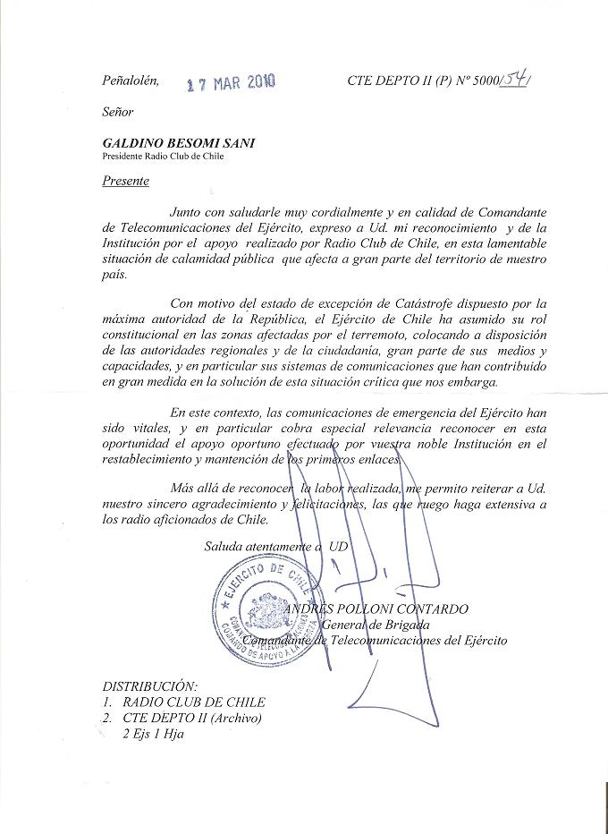
Febrero 2010, the real thing!
A letter of gratitude to Radio amateurs signed by Brigade General Andres Polloni, Chief of the Chilean Telecomunications Army Comand.

Slide 11
Thankyou!
Presented at ITU Focus Group DR-NRR meeting in Santiago de Chile, October 2013.-
Dr. Galdino Besomi, CE3PG
IARU R2, Director
Radio Club de Chile, President

