Slide 1
Disaster Connectivity Map
The pitch
October 2023 | v5 | short version
Notes:
18 October 2023

Slide 2
The problem:
When disaster strikes, telecom networks are impacted. Emergency responders and affected people do not have a clear picture of where mobile networks are down at a critical time.
Our solution:
A mapping service that shows where telecom network outages are happening in disaster affected areas.

Slide 3
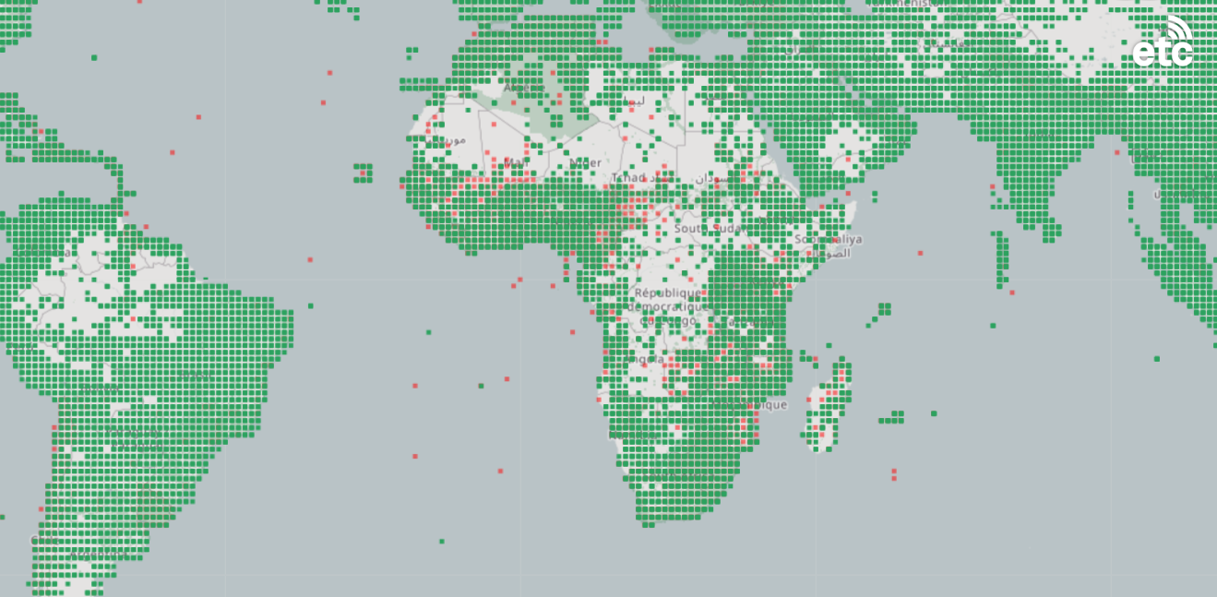
Introducing...
Disaster Connectivity Map
We affectionately call it DCM
https://dcm.itu.int
Notes:
Disaster Connectivity Map is a joint initiative of the International Telecommunication Union (ITU), the Emergency Telecommunications Cluster (ETC), and GSMA.

Slide 4
Hungry for data!
Disaster Connectivity Map
Notes:
Currently working on getting data from the following additional sources:
JRC netBravo: https://netbravo.jrc.ec.europa.eu/en/MapHome/Index#/49.39438049650778,18.588867187499996,5
Google
Mobile network operators
Crowdsourced data.
(Hippo image obtained from: https://drukowanka.pl/en/kolorowanka/hungry-hippo/)

Slide 5
The high level:
Online platform
Hosted and developed by the ITU
Combines multiple data sources
Presents near real-time information on a map
Password protected (for sensitive information)
Activated manually upon request (in response to a disaster)
Want to know more? Contact: vanessa.gray@itu.int

