Slide 1

Challenges in Deploying Telecommunication ICT for Disaster Response
Mohammad Allataifeh
Public Safety & Safe City

Slide 2
CONTENTS
Emergency Challenges
Broadband LTE Trunking Standard
eLTE Solution Highlights
Successful Deployments

Slide 3
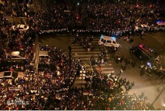
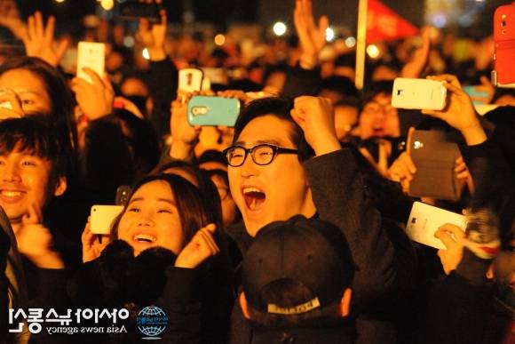
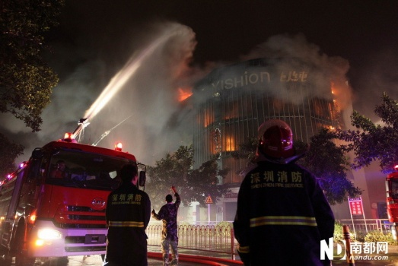

The Challenge of Public Safety
Difficulty in Cross-department Collaboration
Lack of Warning
Slow Response
2015 Shanghai New Year's Eve stampede
2014 New Year’s Eve Seoul, South Korea
2013.11 Fire in Bao’an, Shenzhen
2015.1 Charlie hebdo Attack
Notes:
2015 Shanghai New Year's Eve stampede
36 dead, 47 injured
Unable to detect security risks and generate warnings promptly
2014 New Year’s Eve Seoul, South Korea
Public mobile network congestion resulting in police service unavailable
2013.11 Fire in Bao’an, Shenzhen
Command at the scene efficiency was bad due to voice only communication
2015.1 Charlie hebdo Attack
5 killed and 11 wounded
Unsmooth corss-agency collabration inefficent response
No onsite coordination, chaotic scene

Slide 4
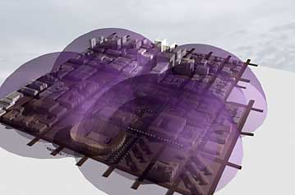
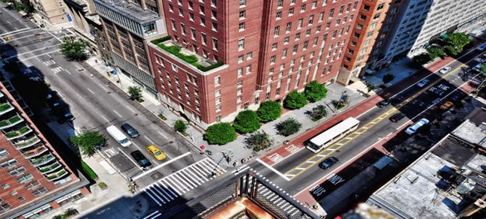
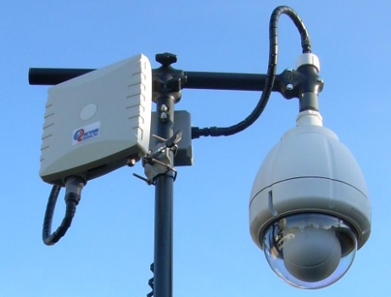
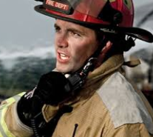




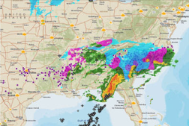
  Disaster Response Requires a Better ICT Network
Ubiquity
Broadband
Private
Interconnected
Aerial & Ground
Fixed & Mobile
Voice
Video
Data
High Security
High Reliablity
High Resilience
Cross-department Information Sharing, dispatching, Collaboration

Slide 5
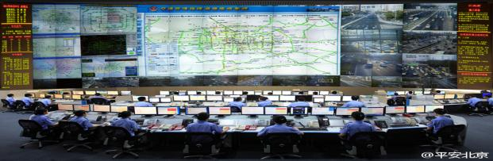





Professional Performance KPI’s to Quickly Respond to Emergency
Command Center
eLTE
Data service latency <50ms
Voice service latency <80ms
Group calls setup <300ms
Pre-emptive call <150ms
Downlink: 100Mbps
Uplink: 50Mbps
Notes:
yufuyong

Slide 6
CONTENTS
Emergency Challenges
Broadband LTE Trunking Standard
eLTE Solution Highlights
Successful Deployments

Slide 7




LTE Broadband Trunking Standardization is Accelerating
Officially set LTE-TDD broadband trunking as China's national standards
2012.12
2012.10
2014.11
2015.03
2016.03
Standardization Initiation
Air Interface Standard Release
Standard included in ITU-R
B-TrunC V1.0
Voice, Video, SMS
B-TrunC V2.0
Interconnection
Set LTE as the standard for future broadband critical communication
Rel-12
(D2D/ProSe, GSCE)
Rel-13
(MCPTT / IOPS, GCSE/PROSE Enhancement)
Rel-14
(Mission Critical Video/Data)
2014.12
2016.03
2017.06
GCSE: Group Communication System Enabler. MCPTT: Mission Critical Push To Talk . IOPS: Isolated E-UTRAN Operation for Public Safety. PROSE: Proximity-based Service SC-PTM: Single-Cell Point-to-Multipoint

Slide 8
CONTENTS
Emergency Challenges
Broadband LTE Trunking Standard
eLTE Solution Highlights
Successful Deployments

Slide 9








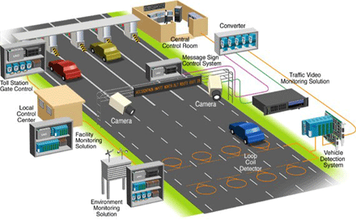



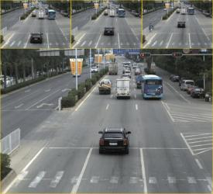







eLTE is part of Huawei Safe City Solution
①Convergent Command Center
⑥Secure CloudCenter
Cloud
Cloud
Call Center
Common Operation Center
Video Consultation
Video Dispatching
Cloud Data Center
D.R. Center
MW
⑤Agile NetConnect
Transmission Network
Video Trunking
eLTE
Intelligent Analysis
Video Cloud
Mc 9527
Multi-agency Collaboration
Field Access Infrastructure
Physical Security
Checkpoint
e-Police
Road Traffic
eLTE Terminal
ECV
②Intelligent SenseAlert
③ Smart RoadSafety
④Mobile MediaShare
Notes:
The convergent command center is the core of the entire safe city. It converges multi-source information into a common operating picture and maximizes the operational efficiency of the ECC.
We also bring you our Intelligent SenseAlert solution. It works like the “eye and ear” of the safe city. This sub solution integrates video surveillance, physical security, sensors and other data sources into one control center under the banner of data fusion. Intelligent SenseAlter solution will allow law enforcement to quickly retrieve intelligence to support live operations, daily operations, or investigative work.
For first responders, we also provide Mobile MediaShare solution. First responders are the executive units on site, are the “arms and legs” of safe city. Our Mobile MediaShare solution provides first responders a mission-critical wireless broadband network. First responders can access actionable intelligence through this network anywhere, any time. This would empower the front-line and make them more productive and more safe.
The smart RoadSafety can capture illegal activies and protect traffic safety, secure the main artery of safe city.
Secure cloud center and agile net connect provide the cutting edge ICT infrastructures to support the daily operation of the entire safe city.

Slide 10






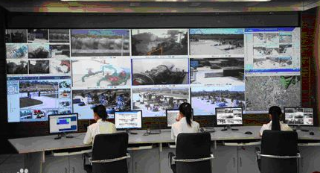




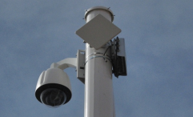

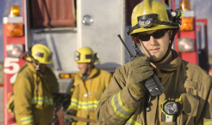
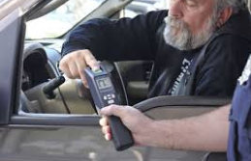
  Leading Huawei eLTE Solution Supports Multi-services in One Network
IPCC
Command Center
Telepresence
IVS
PLMN
TETRA
eLTE
Internet
PSTN
Panoramic Monitoring
Integration
Command
Mobile law enforcement

Slide 11
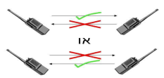
Enhanced Trunking Features for Higher Efficiency and Better Experience
Group Call
Dynamic change crew
Enhanced Dynamic Regrouping
Half-duplex P2P Voice Call
Broadcast Call
Emergency Call
Pre-emptive Priority Call
Dynamic change group member
PTT for talking
Half-duplex P2P Voice Call
Enhanced Dynamic Regrouping
Multiple Call On-hold
Dispatcher dynamic group modification, add or delete the temporary group members
Half-duplex P2P calling consistent with user habits
Force Release/ Insert
Attendant Forwarding
Analogy DMO
Digital DMO
Attendant Forwarding
Digital DMO
Remote Activation & Deactivation
Time Based Call
Group Call Scanning
Restriction on Incoming & Outgoing Call
I am going to call ***
User Status Display
Vulnerable to noise signal
Anti-interference
Display of Group & Speaker Name
Imperceptible Monitoring

Slide 12
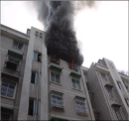
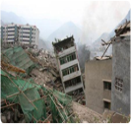
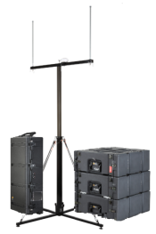


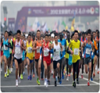


eLTE Rapid for Emergency Dispatching
Fast Deployment
Deployment in 15 minutes
Roller and backpack design
No car-tuning for all mainstream SUVs
ECV communication in both static and moving state
Antenna
Disaster
Incidents
Bracket
Professional Performance
Antenna Box
40 groups, 100 users and 20 video uploading
Group setup time < 300 ms
3~5km coverage
RF Box
Main Box
Power Box
Rich Services
Trunking voice
Video dispatching
Data access
Events
VIP

Slide 13


High Network Resilience, Available Communication in Disaster
Digital DMO Mode
Fall Back Mode
FAIL!!
Voice
DMO
Group call with strong Anti-interference capability
PTP + Group call + Monitoring
Digital DMO to enable group voice communication in field where network is not available
Fallback to ensure available communication under the same eNode B if core network fails
Notes:
特性

Slide 14






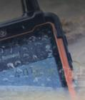
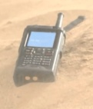
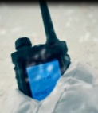


Ruggedized Devices & Professional Accessories for Harsh Environments
Ruggedized Devices
Ruggedized Devices
Professional Handset Accessories
EP820\EP680\EP681
Hand speaker/shoulder speaker
IP67, 0.5m deep water < 30 minutes
Compliance with MIL-STD 810F
Working temperature: －20℃～＋60℃
EG860
Throat vibration Mic headphone
Anti-lightning, shock proof, dust proof and water proof
Working temperature: -40℃～60℃
Noise-cancelling headphone
Notes:
添加恶劣环境，典型的IP67终端放上去，其他的产品干掉

Slide 15

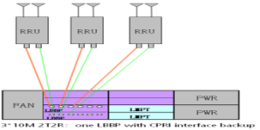
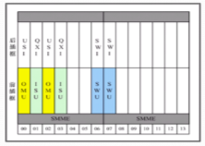
High Reliability with Remote Disaster Recovery and Self-Healing
99.999% Availability
Active
Standby
Failure
Active
NE-level backup
Board-level backup
Board backup for CN
Board backup for base station
Notes:
主控板单板热备

Slide 16
CONTENTS
Emergency Challenges
Broadband LTE Trunking Standard
eLTE Solution Highlights
Successful Deployments

Slide 17
Comprehensive Industry Applications Worldwide
eLTE: 141 Contracts, 76 Enterprise Networks
( As of Q2 2015)
Applications
Nan Jing Municiple in Government
Zhengzhou Metro in Metro
China Shuohuang Railway in railway
China Southern Power Grid in Grid
China Weijiamao Coal Mine in Mine
Norway Tampnet Oilfield in Oil & Gas
Kenya Police in Government
Norway
Russian
USA
Spain
Poland
Italy
China
Libya
Pakistan
Kenya
UAE
Laos
Ghana
Congo
Ethiopia
9
Brazil
Grid
Oil & Gas
10
68
Bolivia
Madagascar
South Africa
Transport
21
Government
WISP
33
Notes:
宽带接入重点项目：spain, Russian, Poland, USA, Norway
宽集大项目: Kenya, Ghana，UK，Egypt

Slide 18


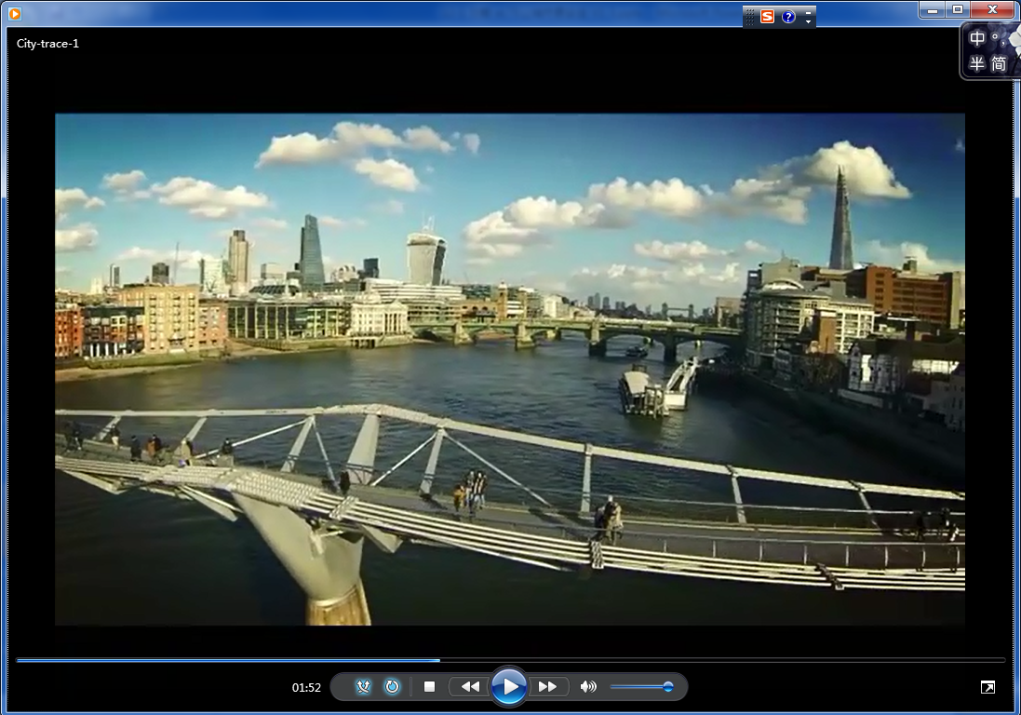
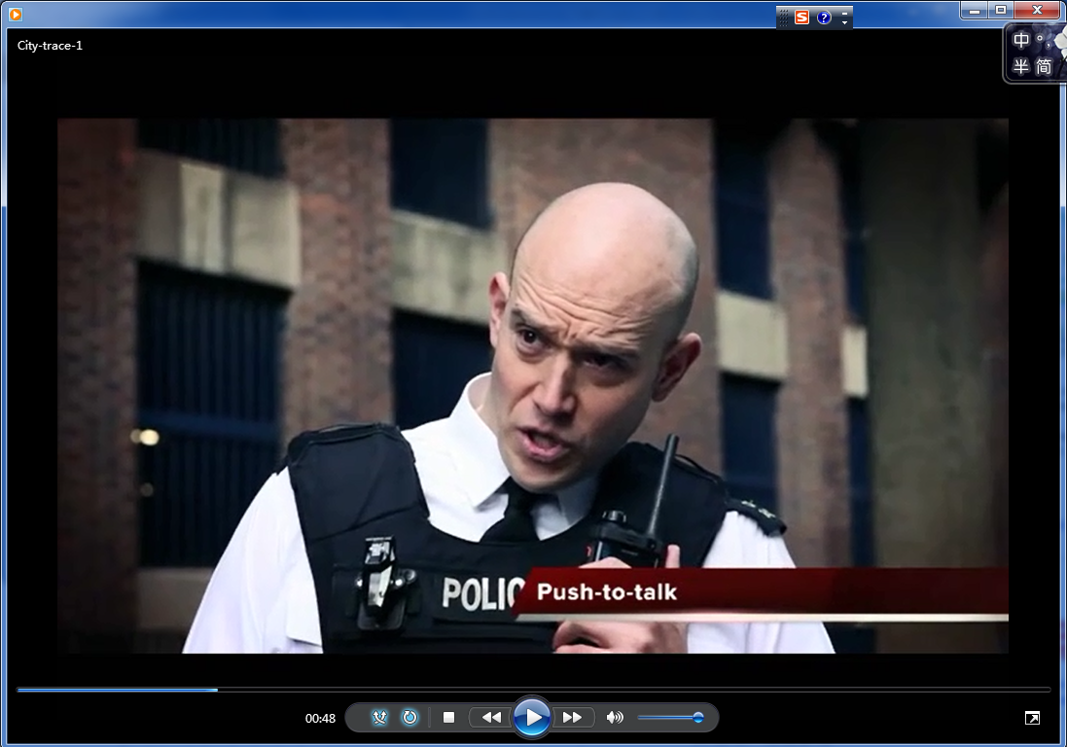
Huawei eLTE for UK Broadband
UK Broadband eLTE · UK
Requirements & Challenges:
To cover Central London 3 KM2 Economic zone
Existing TETRA to be replaced by 2020
Home Office need LTE Trunking Network
Solution:
3.5GHz , LTE TDD E2E Network
Full security and functionality as TETRA.
eLTE solution supports video surveillance, visual dispatching , and other high speed data services.
Benefits:
One Network for all service, improves efficiency and customer experience
Professional eLTE terminal and service satisfies customer’s critical requirements
eLTE PTT
UAV Video Surveillance

Slide 19
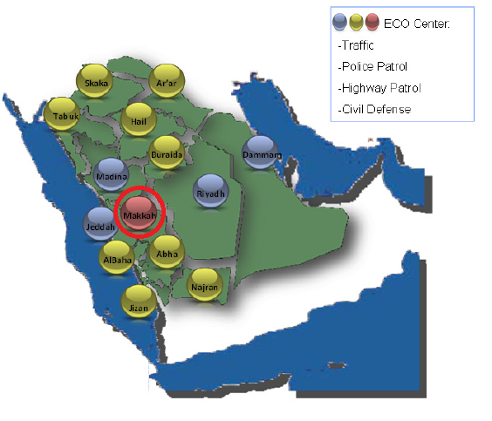
MoI 911 – Saudi Arabia
KSA Emergency Command Center
Requirements & Challenges:
14 sites Unified Command Centers in 13 cities
Each 300+ call Takers & Dispatchers
Unified Emergency No. 911
Multi Agency dispatching including Traffic , police patrol, highway security and civil defense
Solution:
Build up unified call-taking & dispatching platform
Deployment of advanced CAD/GIS , eLTE , IVS , VCM systems
eLTE system for Multimedia dispatching system.
Command system integrated with existing TETRA system and additional system (eLTE, IVS, IPCC, VC, TP)
Benefits:
Unified call-taking & dispatching Command Center
Real time monitoring of policeman and police vehicle
Multi-Resources and Unites displayed on one GIS Map
Notes:
Base on Huawei and Saudi MOI’s NDA agreement, we can’t tell the specific details about this project to other country or governments.
But we can provide what kinds of capabilities and features already be used to enhance our customer’s next generation safe city solution.

