Slide 1
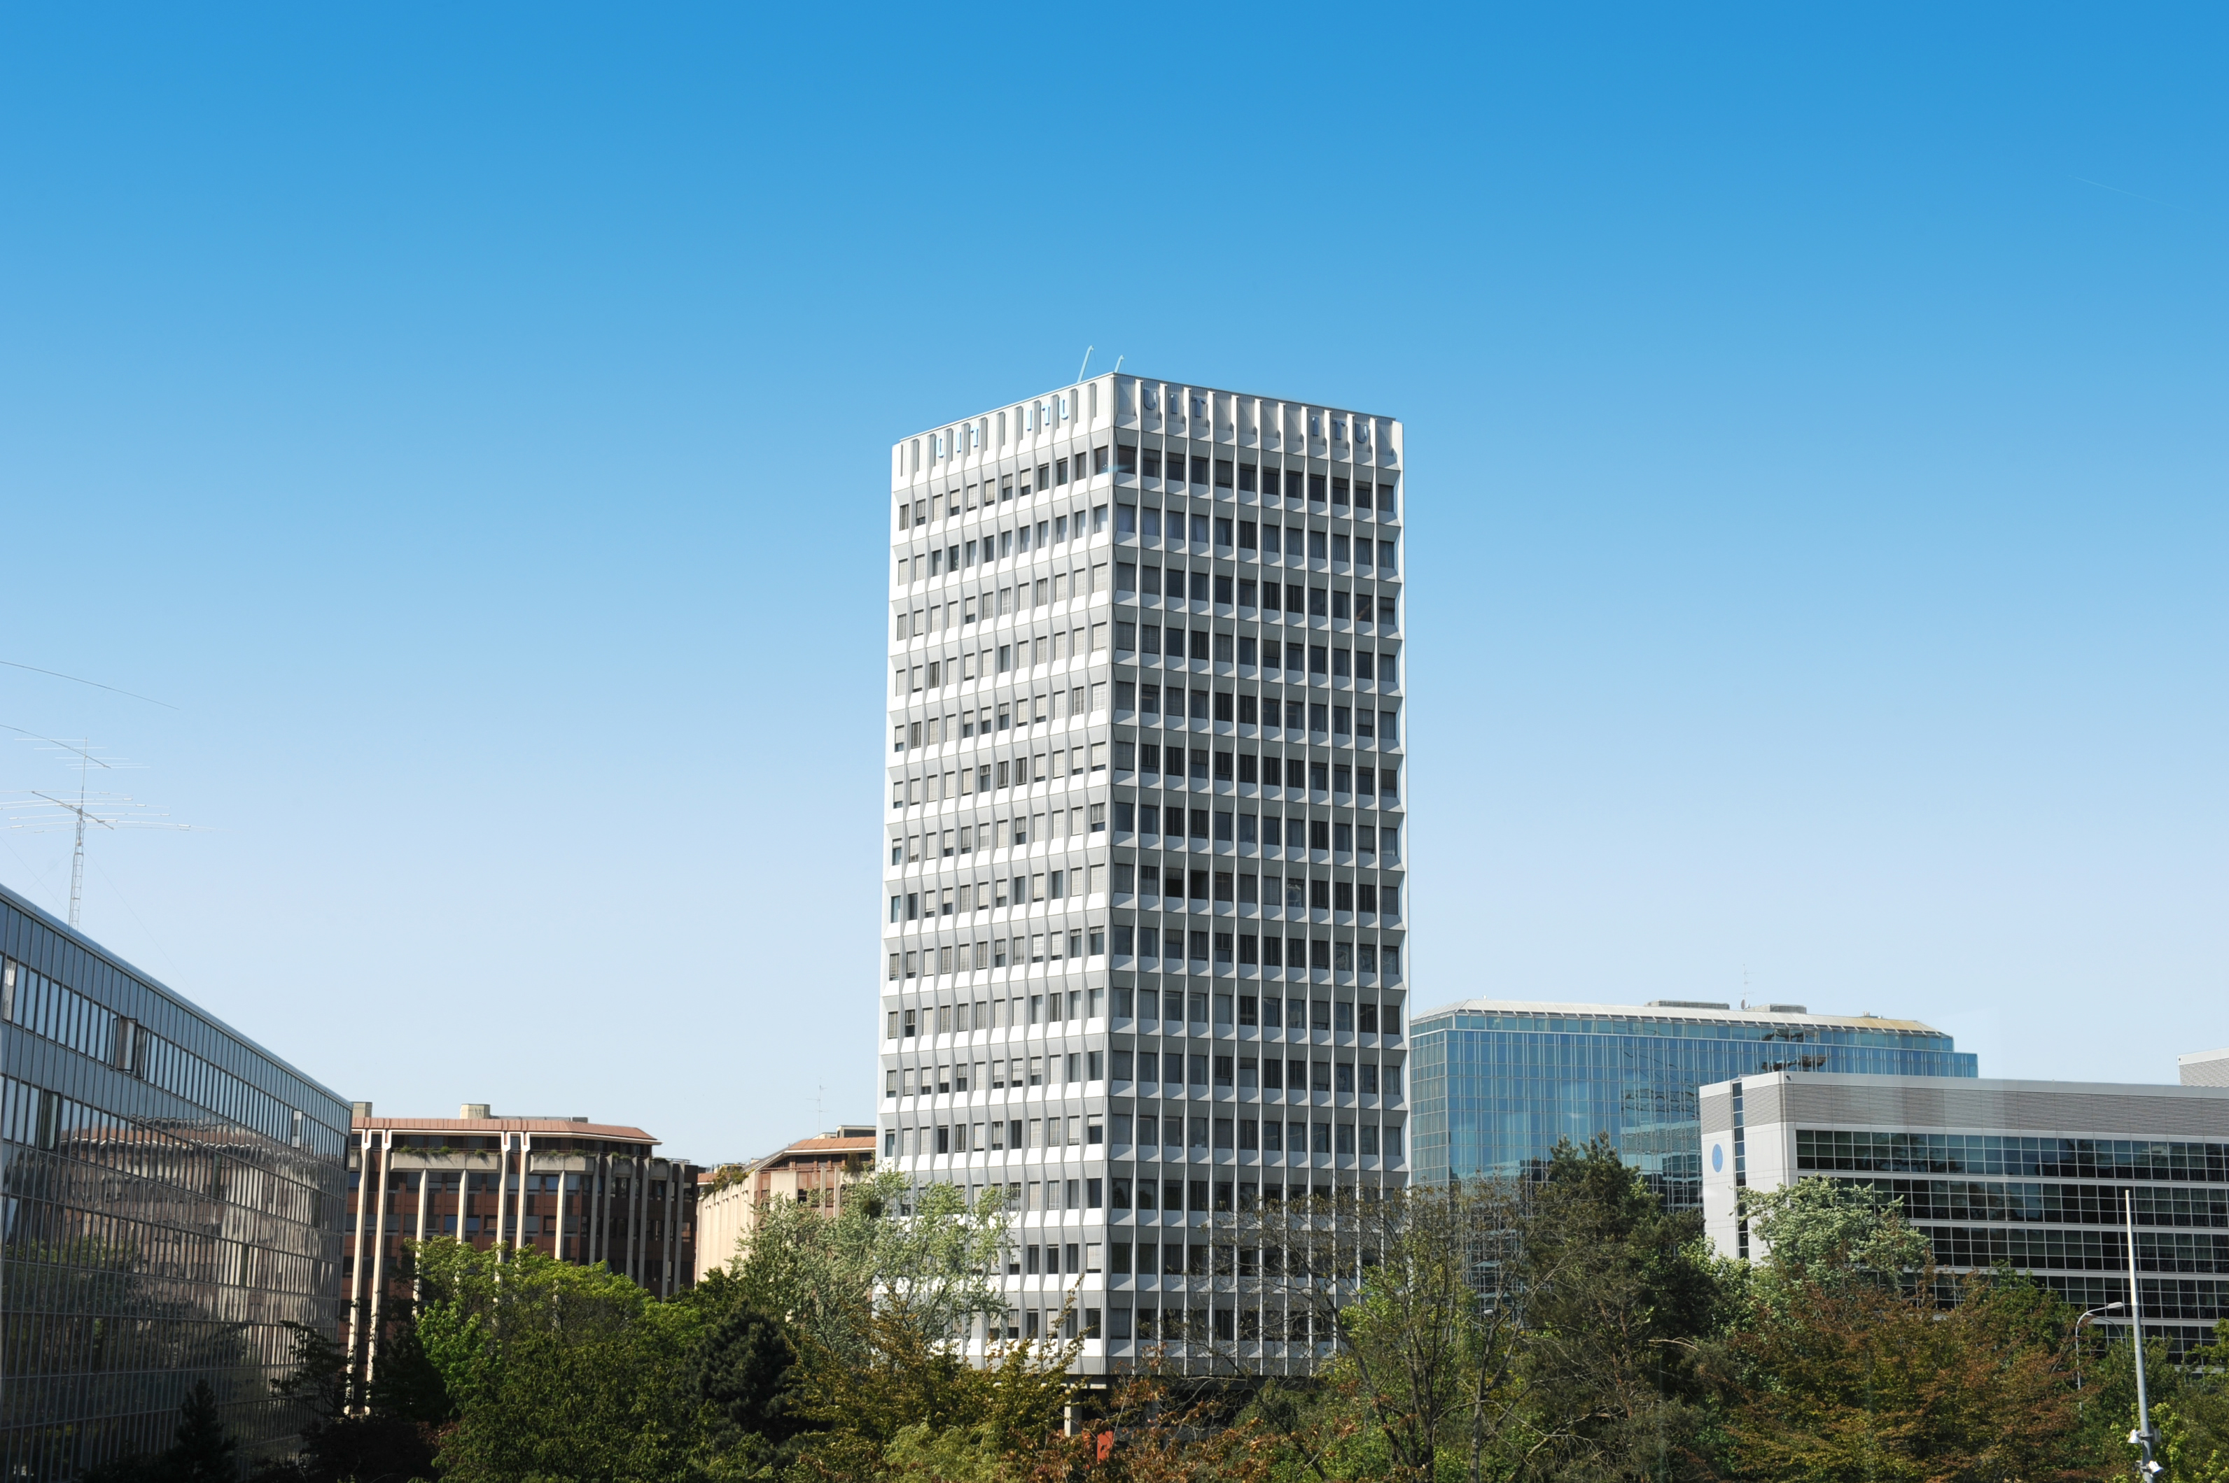
ITU PROGRAMMES
ITU Network of Volunteers for Emergency Telecommunications
Global Emergency Fund for Rapid Response

