Slide 1
Technology enablers for emergency alerting
Emanuele Di Liberto
Global Enterprise & Public Sector Business Development, Nokia
26-01-2015

Slide 2
About Nokia
Technology
Enablers
for Emergency
Telecom
Cooperation
Agreement
with ITU
Notes:
First we will present an overview of the service portfolio, then cover our offerings in more detail, with key sales messages, references and capabilities. Thereafter we cover key topics re G2M, portffolio changes and contract consolidation, and of course contacts and sources for more information.

Slide 3
About Nokia
Key facts (combined company) (*)
Net sales in 2014
R&D expenses in 2014
Employees
#R&D resources
40,000+
#countries
140
€26,0bn
€4,7bn
end of September 2015
113,000
(*) Based on Nokia’s and Alcatel-Lucent’s most recent annual reports on Form 20-F

Slide 4
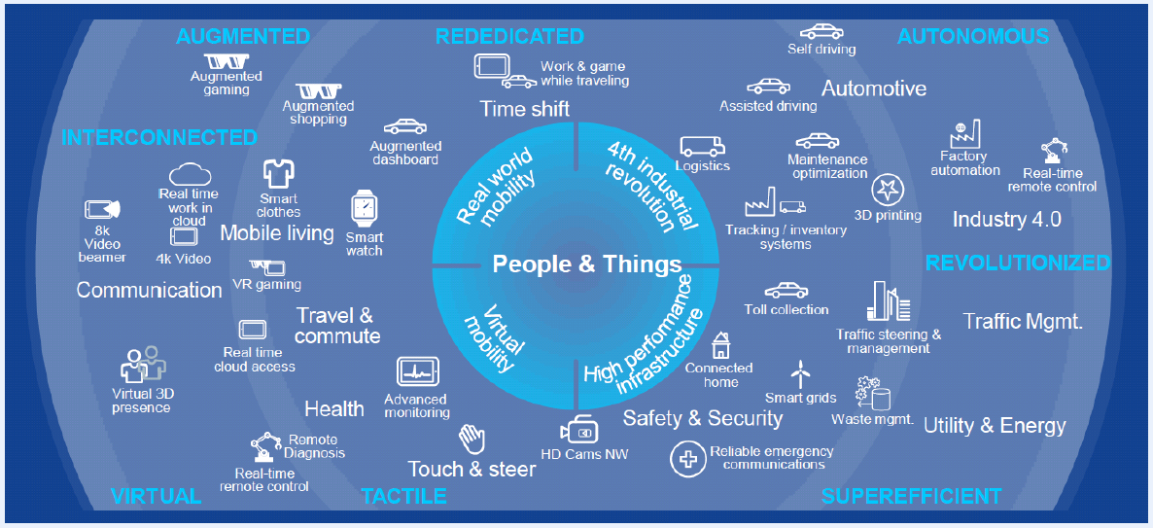
About Nokia
Scope to create seamless connectivity for people and things wherever they are
Requirement for real time and resilience
Capacity for exponential growth in future
Enable seamless, ubiquitous access
Intelligent adaptive service

Slide 5
About Nokia
Technology
Enablers
for Emergency
Telecom
Cooperation
Agreement
with ITU
Notes:
First we will present an overview of the service portfolio, then cover our offerings in more detail, with key sales messages, references and capabilities. Thereafter we cover key topics re G2M, portffolio changes and contract consolidation, and of course contacts and sources for more information.

Slide 6
Universal Message Broadcaster (UMB) for Emergency Alerting
A bit of history
Several research initiatives got launched in EU to stimulate innovation in the domain of Emergency alerting
Nokia (formerly Alcatel-Lucent) contributed as key stakeholder with a solution named “Universal Message Broadcaster” (UMB)
Leveraging multiple channels of communication
Able to handle all applications requiring the broadcast of messages
Using standard protocols and infrastructures (e.g. Internet, PSTN) available in any country
Available to Governments and Emergency International Bodies as “Software As A Service”

Slide 7
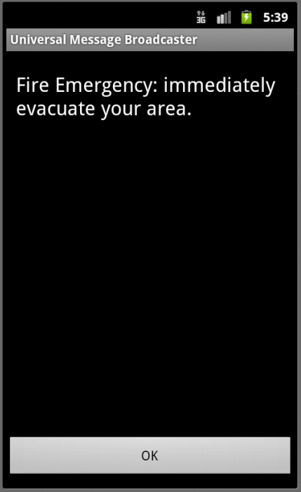
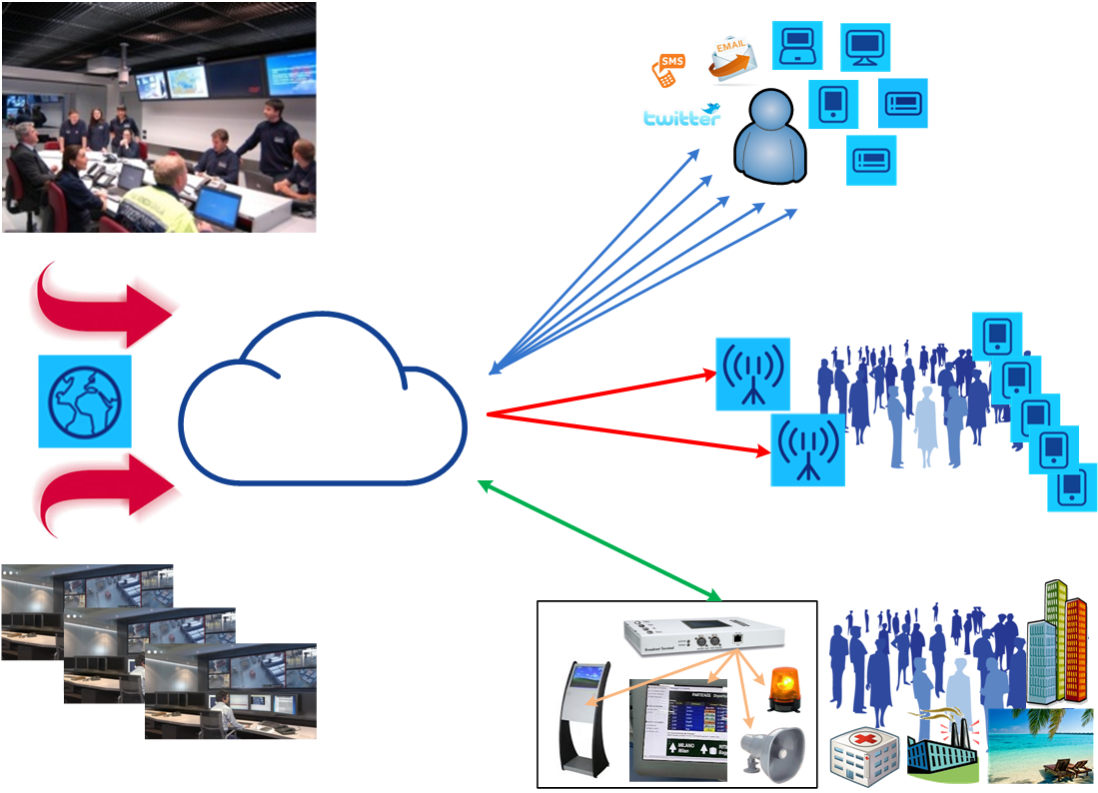
Reaching as many citizens as possible is the key principle
Individual
messages
Universal Message Broadcaster (UMB)
Emergency Organizations
Cell
Broadcast
Authorities and citizens
Broadcast
Terminal
Communities

Slide 8
Research projects with deployment of UMB
(Emergency Support System)
(Total Airport Security)
Public Safety
& Security
Public Safety
& Security
Smart Cities & Healthcare
Enterprise
security
Early Warning for emergencies
International project for emergency with 9 countries involved
Telco Partner:
Field Trials held in Germany, France, Italy
Early Warning for earthquakes
Italian Research project focused on earthquakes and volcanic eruptions
Telco Partner:
Final trial held in Italy
Smart Cities services
EU project for Smart Services
Sensor Network (20k sensors)
Telco Partner:
Field trial held in Spain
Public & Enterprise security
International project focused on Airports security
Airport partners: Heathrow and Athens
Field trial held in Heathrow

Slide 9
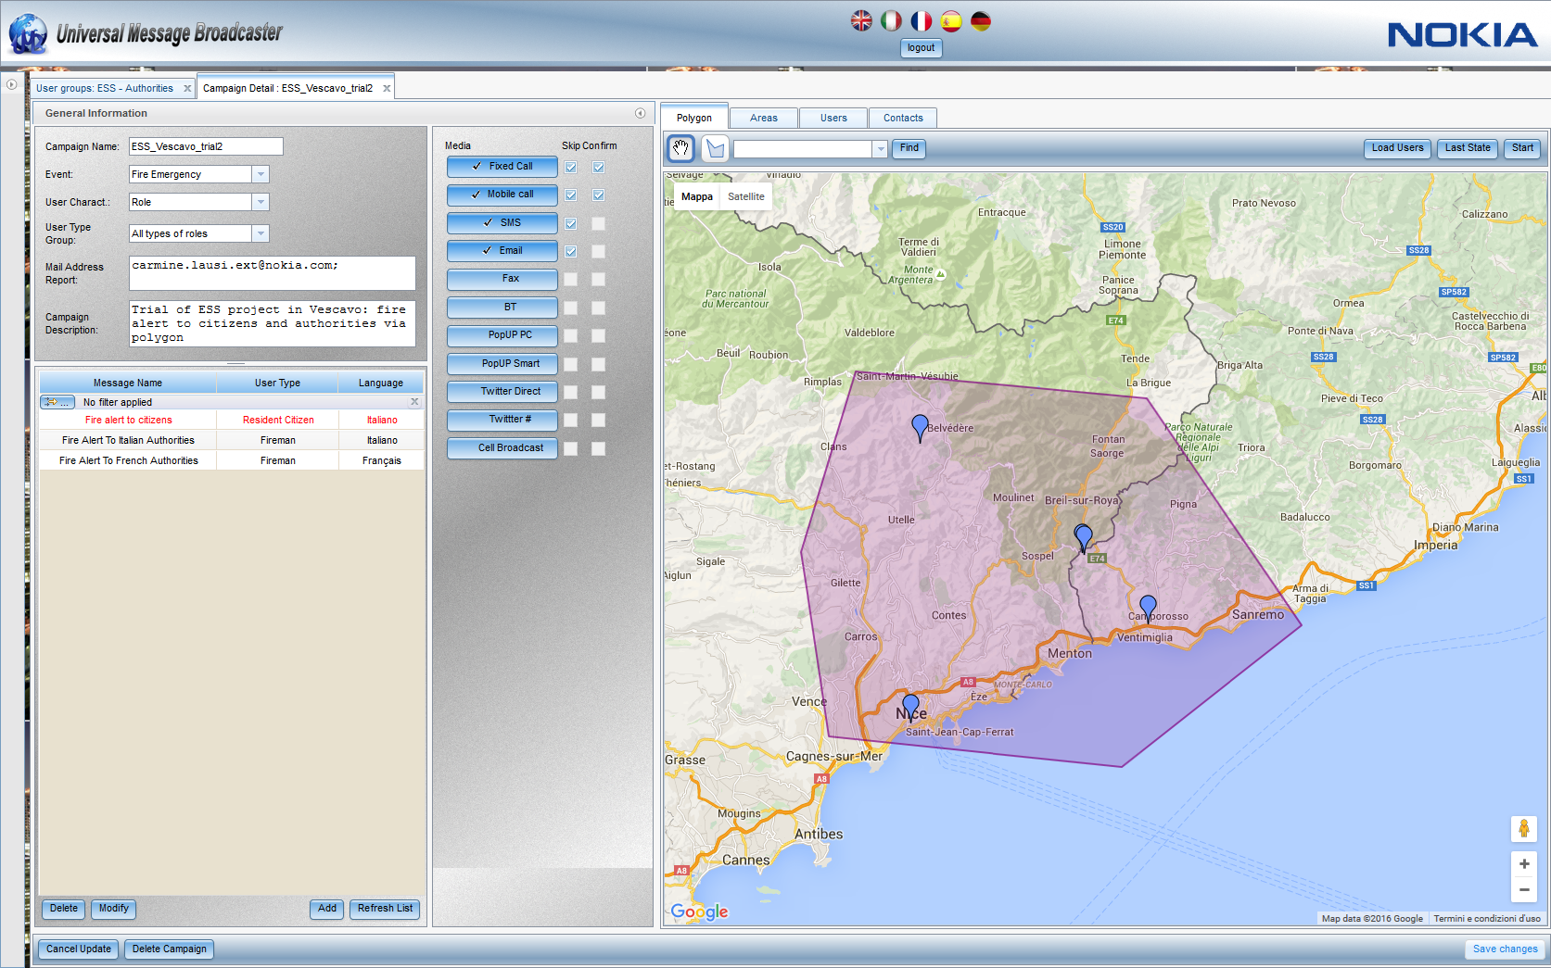
UMB multi-channel alerting campaigns
Users types
selection
Users identified and dissemination
status (via colors)
Messages, communication media
and destinations changeable in real time

Slide 10
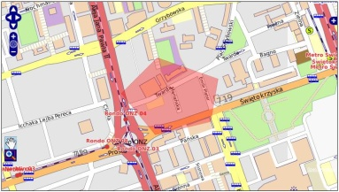
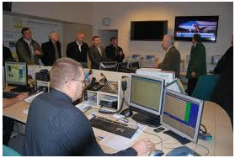
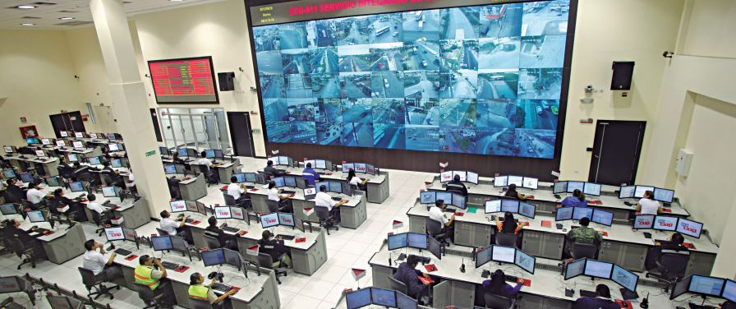
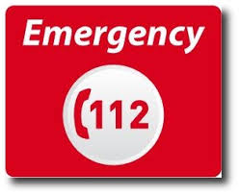
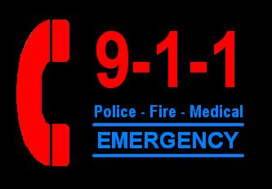
UMB architecture and stakeholders
SERVICE PROVIDERS
GOVERNMENT
Universal Message Broadcaster
Cellular
Broadcaster
(e.g. BMC)
Crisis Management Centre
Sends the message
to the threat zone
Broadcast
Zone 1
Broadcast
Zone 2
E112 / E911
People located in the threat zone receive MULTI-CHANNEL messages
CITIZENS
CITIZENS

Slide 11
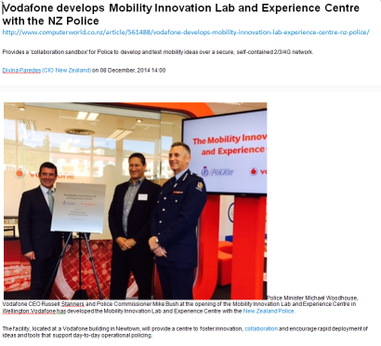
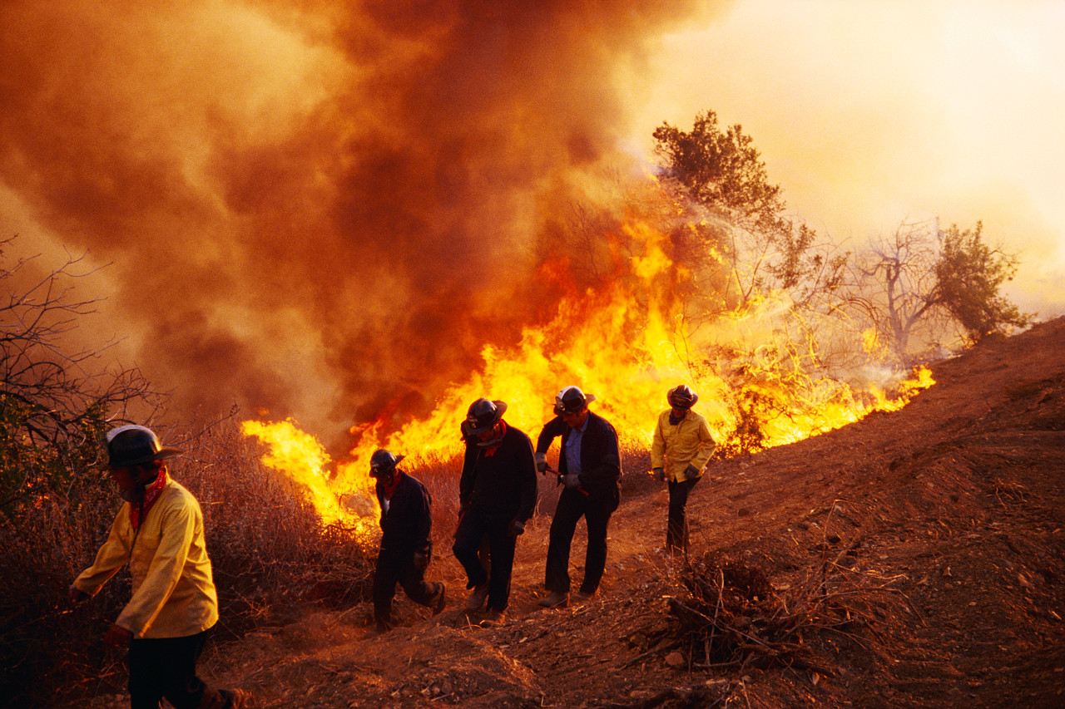
Emergency communication beyond multi-channel alerting
Deployable LTE networks
Use case
Private LTE network as a deployable system for public safety forces (police, firefighters, disaster recovery)
Compact and robust, can be mounted into even small vehicles
Fully autonomous system, no backhaul required
eNodeB
NIB
Internet

Slide 12
About Nokia
Technology
Enablers
for Emergency
Telecom
Cooperation
Agreement
with ITU
Notes:
First we will present an overview of the service portfolio, then cover our offerings in more detail, with key sales messages, references and capabilities. Thereafter we cover key topics re G2M, portffolio changes and contract consolidation, and of course contacts and sources for more information.

Slide 13
Cooperation Agreement ITU-Nokia within IFCE
Basic principles
ITU and Nokia are launching a Cooperation Agreement within IFCE (ITU Framework for Cooperation in Emergency), in order to allow all ITU countries to get benefits from UMB services for own emergencies management
Nokia UMB (Universal Message Broadcaster) platform will be available for some months in ITU data center in Geneva (cloud SaaS model) allowing interested Countries/Entities to get the benefits of UMB solution for Emergency Communications.
Candidates (Countries/Entities) interested in ITU-Nokia pilot will get access to UMB solution training, on demand support, emergency communication scenarios of interest, end-users provisioning and UMB solution on a pilot basis to support their own internal emergency procedures.

Slide 14
Cooperation Agreement ITU-Nokia within IFCE
Message dissemination to all countries via UMB in ITU data center
ITU IFCE
Data Center

Slide 15
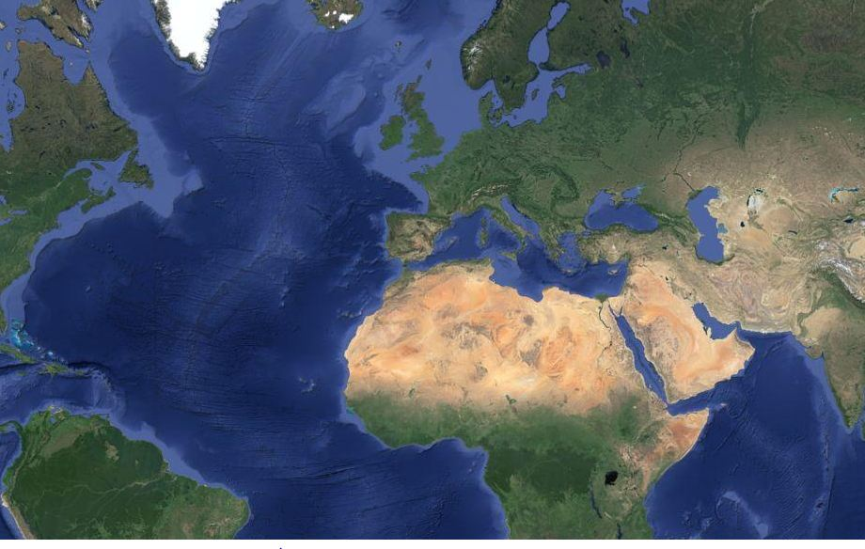
Cooperation Agreement ITU-Nokia within IFCE
Use case#1: messages autonomously sent by a National authority
In case of emergency in a country, the system will be immediately available for that country, for its autonomous emergency management, without any need to transport and install equipments.
2. Messages
1. Command
National
Authority

Slide 16
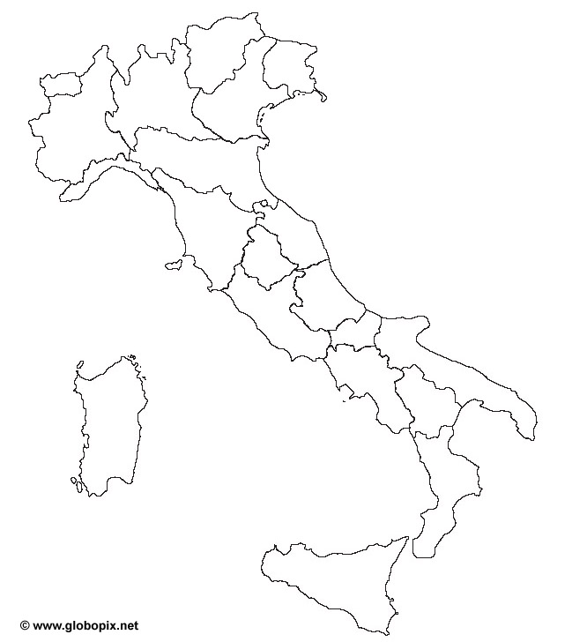
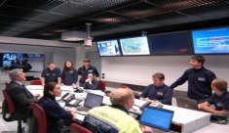
Cooperation Agreement ITU-Nokia within IFCE
Use case#2: a possible application for the Italian Civil Protection model
1. International
Emergency
Organization
Citizens
4: City
2: Government
3: Region

Slide 17
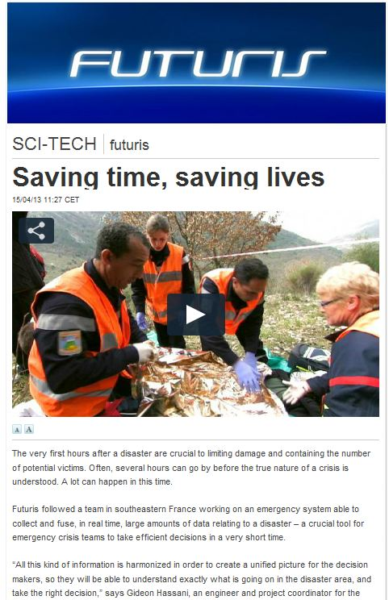
Nokia Services is your expert advantage
TAKE AWAY #1
A true multi-channel alerting communication (sms, fixed, mobile, fax, mob app, pop-up, cell broadcast, social media, etc) is a key factor: not only sms!
Remote hosted platform paving the way to an easier deployment
For more info on UMB and other Nokia solutions:
visit Nokia booth at this Forum
send a mail to broadcast.info@nokia.com

Slide 18
Copyright and confidentiality
The contents of this document are proprietary and confidential property of Nokia. This document is provided subject to confidentiality obligations of the applicable agreement(s).
This document is intended for use of Nokia’s customers and collaborators only for the purpose for which this document is submitted by Nokia. No part of this document may be reproduced or made available to the public or to any third party in any form or means without the prior written permission of Nokia. This document is to be used by properly trained professional personnel. Any use of the contents in this document is limited strictly to the use(s) specifically created in the applicable agreement(s) under which the document is submitted. The user of this document may voluntarily provide suggestions, comments or other feedback to Nokia in respect of the contents of this document ("Feedback"). Such Feedback may be used in Nokia products and related specifications or other documentation. Accordingly, if the user of this document gives Nokia Feedback on the contents of this document, Nokia may freely use, disclose, reproduce, license, distribute and otherwise commercialize the feedback in any Nokia product, technology, service, specification or other documentation.
Nokia operates a policy of ongoing development. Nokia reserves the right to make changes and improvements to any of the products and/or services described in this document or withdraw this document at any time without prior notice.
The contents of this document are provided "as is". Except as required by applicable law, no warranties of any kind, either express or implied, including, but not limited to, the implied warranties of merchantability and fitness for a particular purpose, are made in relation to the accuracy, reliability or contents of this document. NOKIA SHALL NOT BE RESPONSIBLE IN ANY EVENT FOR ERRORS IN THIS DOCUMENT or for any loss of data or income or any special, incidental, consequential, indirect or direct damages howsoever caused, that might arise from the use of this document or any contents of this document.
This document and the product(s) it describes are protected by copyright according to the applicable laws.
Nokia is a registered trademark of Nokia Corporation. Other product and company names mentioned herein may be trademarks or trade names of their respective owners.

