Slide 1
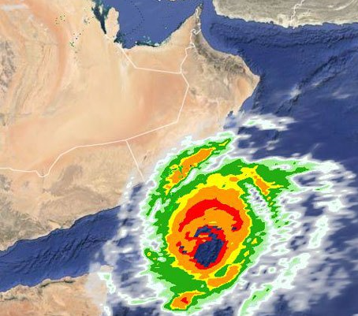
Oman Experience on Telecommunications Emergency Plan
Ibrahim Hamdan Al Maawali
Telecommunications Regulatory Authority (TRA)
Monday, January 25, 2016

Slide 2
Table of Content
National Emergency Management System
Four Stages to implement Telecom Emergency Plan
Guideline for Operators in Forming the Telecommunication Emergency Plan
Four Phases of Telecom Emergency Management
Prevention and Mitigation
Preparedness
Response
Recovery

Slide 3
National Emergency Management System (NEMS)
NEMS
National Center
Monitoring Centers
Local Committees
Sectors
Sub Committees

Slide 4
Monitoring Centers (MCs)
MCs
Earthquake Observation
Dept. of Communicable Disease surveillance & Control
Networks for Radiation Monitoring
Forecasting & Observation
National Center of Multi Risks

Slide 5
Sectors
Basic Services Sector
Hazardous Material Sector
Victims & Missing Persons Affairs
Relief & Shelter Sector
Medical Response & Public Health
Media Sector and Public Awareness
Search & Rescue Sector

Slide 6
Four Stages to implement Telecom Emergency Plan
2009
2010-2011
2012
2013-now

Slide 7
Guideline for Operators in Forming the Telecommunication Emergency Plan
“Guideline for Operators in Forming the Telecommunication Emergency Plan” issued in Decision No.109/2009 in order to provide guidance to Class I and Class II licensees on how to form their Emergency Plan.

Slide 8
Guideline
Licensees to submit their emergency plan and update it yearly.
Four phases of disaster management:
Prevention and Mitigation
Preparedness
Response
Recovery

Slide 9
Prevention and Mitigation
The following elements are the minimum to be considered by the licensees as prevention and Mitigation stage:
Internal Rules and Procedures
Policy on emergency management
Emergency Management Procedures
Emergency Management Governance Framework for taking actions during emergency
Competency requirement for the Emergency Management Team members.
Critical Infrastructure Protection
Identify critical infrastructure elements in the network through risk assessment
Identify the vulnerabilities (e.g. single point of failure) , inter-dependency or support elements ( Power supply, fuel access generators, physical access…etc) or lack of capacity
Identify critical facilities (e.g. fire safety, building management systems, physical security for IT data center, network data center, offices, warehouses…etc).

Slide 10
Preparedness
The following elements are the minimum to be considered by the licensees as preparedness stage:
Developing Emergency Telecom Response Plans
Activities on how to react to an emergency, how to minimize the consequences of the emergency and how to provide adequate support to first responders (e.g. Identification of the Public Protection organization, Identify the Services for relief and rescue operations, Priority Routing of calls of the emergency responders, ensuring availability of basic services during emergency…etc)
Warning Systems
How licensees can assist in alerting the public and disseminating information regarding emergency as received from authorized officials in the country (e.g. SMS, website, fax ..etc)
Inventory of Responses
Agreement with vendors and suppliers for equipment availability and support during emergency.
SPOC details of the vendors
Availability of spare of critical network equipment
Mutual agreements with other operators for support in emergency situations

Slide 11
Preparedness…
The following elements are the minimum to be considered by the licensees as preparedness stage:
Exercises and Training
Exercise mechanism and Testing Plans
Employees training
Emergency Operations Center (EOC)
Focal communication point a the time of emergency.
Well facilitated
Secondary EOC
Business Continuity Plan (BCP)
Identify critical functions, applications, Recovery Point/Time Objectives…etc.
Link BCP with the agreements with vendors and suppliers.
Identify all the risks

Slide 12
Response
The following elements are the minimum to be considered by the licensees as response stage:
Emergency Declaration
Criteria for activation of the Emergency plans (e.g. By relavent authority in the country OR major network or service failure)
Emergency Declaration Standard Operating Procedure (DSOP)
Emergency Telecom Activation
Emergency Operations Standard Operating Procedure (EOSOP).
Mechanism to ensure availability of telecommunication requirements for the public protection organizations

Slide 13
Recovery
The following elements are the minimum to be considered by the licensees as recovery stage:
Recovery Plans for Recovery of IT and Network infrastructure
Main challenges faced and lessons learned
Review and update of the emergency plan shall be carried out based on assessment of strength and weakness in the earlier plan.

Slide 14
Thank you for your attention

