Slide 1
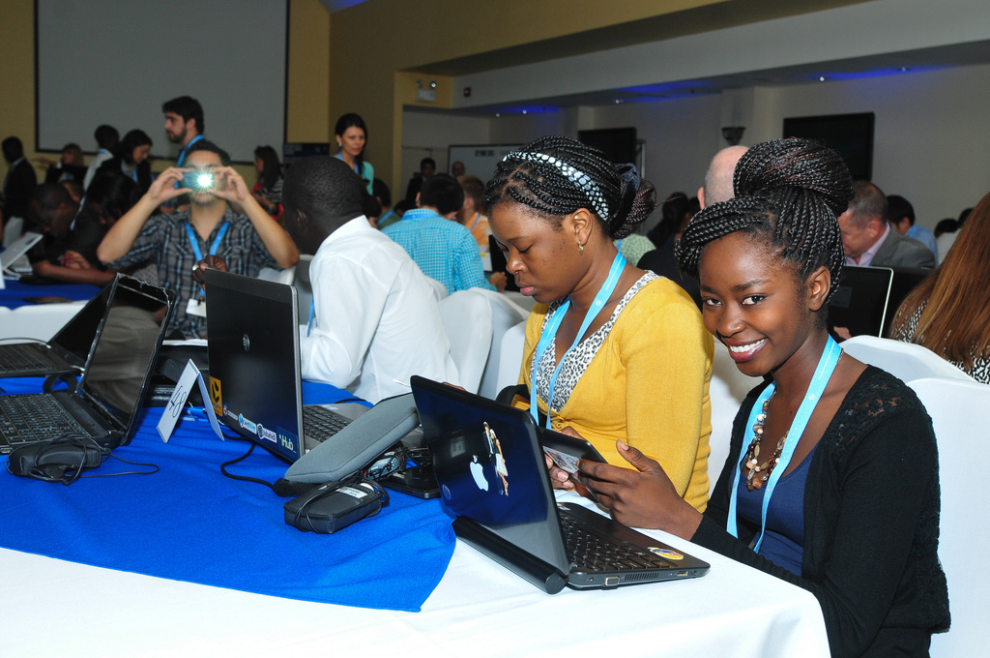
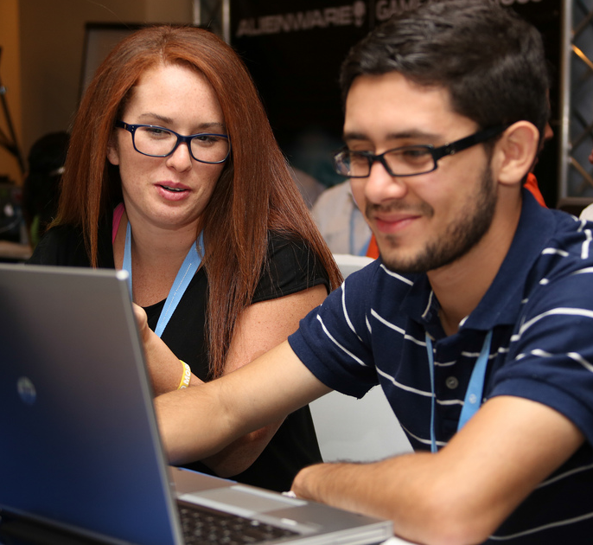
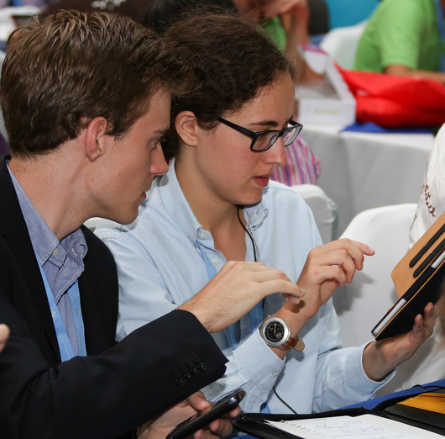
Skills required by the Market
and Employability
Rouda Alamir Ali
International Telecommunication Union

Slide 2


Today’s youth are facing unemployment challenges
73 MILLION
YOUTH ARE UNEMPLOYED GLOBALLY
In Middle East: More young women are unemployed…
42.6 % Unemployed Young Women
- 28.3 per cent in the Middle East
- 23.7 per cent in North Africa
(ILO, 2013)
24.5 % Unemployed Young Men
Notes:
Youth make up 17 per cent of the world’s population and 40 per cent of the world’s unemployed. Currently, 73 million young people are unemployed worldwide. A further 621 million youth are said to be “idle” — not in education or training, and not looking for employment.
Middle East has the highest youth unemployment rate of all regions. More than one in four economically active young people are unemployed.
The employment situation is particularly bleak in Jordan and the Occupied Palestinian Territory, where 29.9 per cent (2011) and 38.8 per cent (2010) of young people in the labour
force were unemployed. Furthermore, in Saudi Arabia and the Islamic Republic of Iran, 28.3 per cent (2012) and 23.0 per cent (2008), respectively, of 15–24-year-olds in the labour
force were unemployed.
As in the Middle East, the youth unemployment rate in North Africa is very high, at 23.7 per cent in 2012. The unemployment rate for young women is even higher, at 37.0 per
cent.

Slide 3
Landscape we are in today…
Youth unemployment
Today’s youth are “Digital Natives”
Rapid advancements in ICTs
  Demand for digital literacy
Changing the nature of work
Transforming old sectors
  New innovative sectors emerging
  Opportunity for youth
    ICTs can open doors to employment and entrepreneurship opportunities
  Beyond employment and entrepreneurship
    ICT is a cross-cutting enabler of social and economic development
Notes:
In today’s landscape, while youth are facing employment challenges, we also see how ICTs are transforming the economy and thereby creating new opportunities.
Basic ICT skills are becoming essential for jobs not only in ICT sector but across all sectors.
ICTs can open doors to better and more employment and entrepreneurship opportunities.

Slide 4
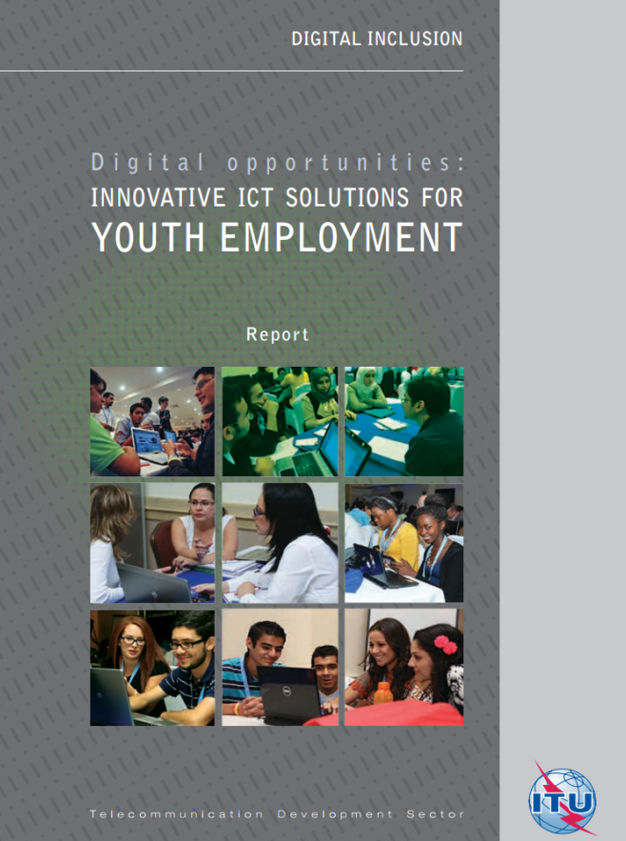
Youth Employment and Entrepreneurship Initiative
ITU conducted an extensive research on Digital Opportunities to find “Innovative ICT solutions for Youth Employment”
Mapping of:
  ICT-enabled careers for youth
  New entrepreneurship options
  New learning opportunities
  Action by Governments, Private Sector, NGOs
ITU recently launched a new Youth Employment and Entrepreneurship Resources Database at http://www.itu.int/ITU-D/sis/Youth/Resources/
Notes:
In response to global youth employment challenges, ITU identified promising solutions in the digital landscape for youth through the “Digital opportunities: Innovative ICT solutions for youth employment” Report.
BDT also created the new Youth Employment and Entrepreneurship Resources Database (available at: www.itu.int/ITU-D/youth) to assist young people to find and use these digital opportunities. This database contains resources for finding employment, becoming an entrepreneur, learning technical and soft skills, finding a mentor, searching for funding, networking, and many other valuable services.

Slide 5
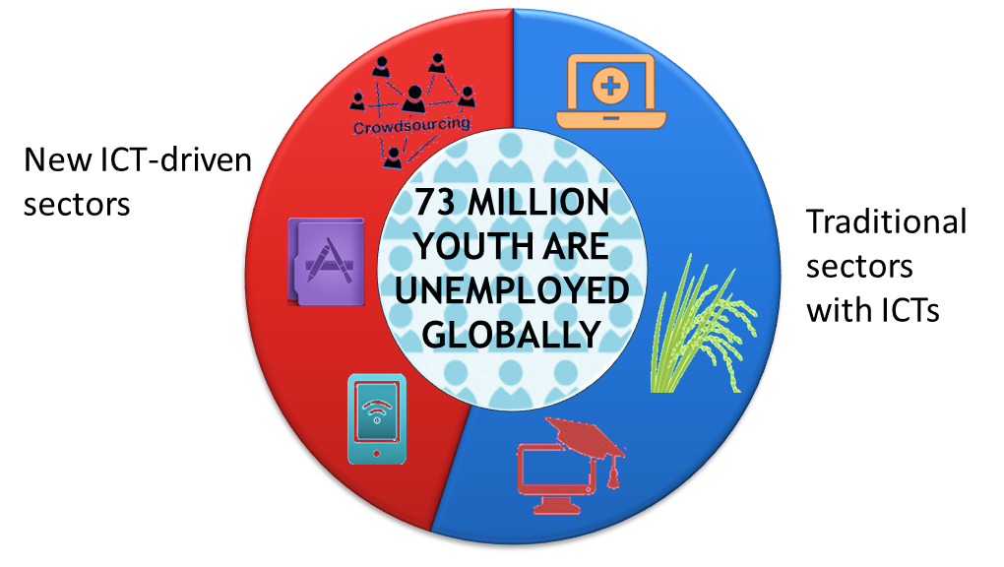
Digital Opportunities for Youth
Notes:
The diffusion of ICTs is occurring across all economic sectors and job categories. In today’s job market, ICT skills are considered essential to enter the workforce and to find a better job. Demand for ICT skills cuts across sectors - from agriculture and construction to education and service industries.
Information technology, business processes and industry-specific services can all be outsourced thanks to ICTs. The offshore services industry employs about 4.1 million people around the world, offering good salaries and careers for graduates and professionals, and the opportunity to incorporate unemployed youth, rural women and other marginalized groups into the labour market.
New approaches to outsourcing like crowdsourcing and microwork are providing young people worldwide with task- and project-based work opportunities many of which are not restricted to highly skilled developers, but can also extend to semi-skilled and low-skilled workers with access to a relatively basic digital infrastructure.
The World Bank estimates that the global microwork market generates USD 450 to 900 million annually, employing 1.45 to 2.9 million microworkers.
New markets like app economy have inspired a new class of entrepreneurs. From 2007 up to July 2013 app economy has generated roughly 752, 000 app-related jobs in the United States and 530, 000 jobs in the 28 European Union countries.

Slide 6
Becoming ICT-savvy
To benefit from these digital opportunities, youth need to become ICT-savvy.
Learning Models:
Blended Learning (virtual classrooms)
Self-directed learning (OCW, MOOCs)
Collaborative (or peer) learning
Learning Places:
Coworking spaces and technology hubs
Hackerspaces or makerspaces
Certifications
Badges
Notes:
What skills are required to take advantage of these new digital opportunities?
The popularization of Web 2.0, social media, mobile apps, and other ICT advancements have created the need to re-think and update the types of ICT and ICT-related skills that are required to succeed in today’s world.
Basic computer literacy is not sufficient to pursue the majority of new digital opportunities. New curricula and training programs have emerged to cover the broader set of skills contained within these new frameworks.
Today, young people learn differently thanks to the adoption and widespread use of increasingly sophisticated technologies and applications that are available on smart phones, tablets and personal computers. New ways of interacting and learning are emerging through virtual classrooms, Massive Online Open Courses (MOOCs), technology hubs, coworking spaces, hackerspaces and makerspaces. These new learning opportunities are now accompanied by new accreditation models like online certifications and “badges”.

Slide 7


Putting women at the forefront of ICTs
Gaps women are facing:
- Affordability - Capacity
Solutions:
  Ensure women at the bottom of the development pyramid are included.
    ITU - Telecentre.org: Digital Literacy Campaign
  Ensure women become creators of ICTs.
    Girls in ICT Day
Notes:
For women specially, ICT has proven to be life-changing. It has broken traditions and social prejudices, expanded their roles in society and home, given many a new economic and social freedom that has redefined them as persons of stature and value in their communities.
Seeing mothers, disadvantaged women, and young girls actively participating in the knowledge economy shows what can be for many other women.
But too many women remain disconnected from the global technological revolution. Most women can’t afford access to ICTs. Some are trapped in traditional family roles. And often these women lack basic digital literacy.
How do we most effectively put women at the forefront of the emerging knowledge economy?
We need to include women who are at the bottom of the development pyramid to be part of the ICT revolution. → Digital Literacy efforts
We need to enable women to become creators of technology. → Girls in ICT efforts

Slide 8
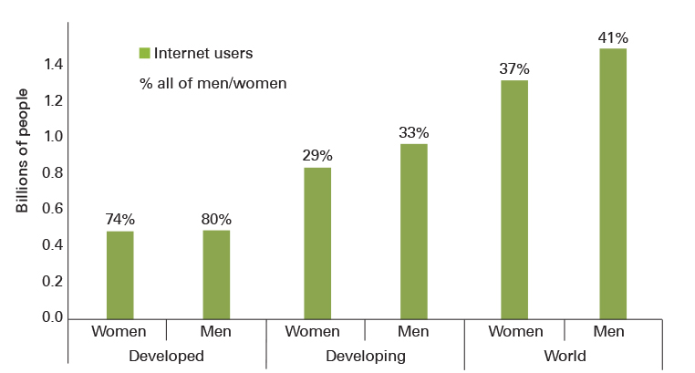
More men than women are Internet users
Source: 2013 ITU World Telecommunication /ICT Indicators database
200 million fewer women online than men
16% fewer women than men use the Internet in developing countries
2% fewer women than men use the Internet in developed countries
Notes:
Are women and men equally active Internet users? The answer is no. There is still a global gender gap. The fact is that more men than women use the Internet.
Recent research by ITU estimates that there are currently 200 million fewer women online than men –
of the world’s 2.8 billion Internet users, 1.3 billion are women, compared with 1.5 billion men.
The gap is more pronounced in the developing world where 16% fewer women than men use the Internet compared with only 2% fewer women than men in the developed world.
Put differently, globally, 37% of all women are online, compared with 41% of all men.
[The developing world is home to about 826 million female Internet users and 980 million male Internet users.
The developed world is home to about 475 million female Internet users and 483 million male Internet users.]

Slide 9
Few women are creators of ICT, but that’s where the jobs are!
Only 20% of European women aged 30 with ICT-related degrees work in ICT sector
  900,000 unfilled ICT jobs in Europe
  In the US only 20% of women earn computer science degrees
  1,000,000 unfilled IT jobs in the US
Women are underrepresented in many high-growth fields like science, technology, and engineering, which are important to countries' innovation, connectedness, and competitiveness in global markets.
Women’s share of the ICT workforce is less than 1/3 in Jordan and only around 1/5 in South Africa, Sri Lanka and the UK.
Notes:
Now let’s think about the creators and developers of ICT.
Who are the faces that come to mind when we think about some of the most prominent ICT innovators?
Steve Jobs of Apple. Bill Gates of Microsoft. Mark Zuckerberg of Facebook. I could name many more men, as I’m sure you could.
Now, can we name some women?
We have Marrisa Mayer of Yahoo, Sheryl Sandberg of Facebook, who has become a women’s activist, Meg Whitman at Hewlett Packard and of course Nellie Kroes, the European Commission Vice President and Digital Agenda commissioner.
But these women are the exception. In Europe, 20% of women aged 30 with ICT-related bachelor degrees work in the sector, while only 9% of women above 45 years old with these degrees do so, according to the October 2013 European Commission Report, Women Active in the ICT Sector. This reports also predicts 900,000 unfilled ICT jobs in Europe by 2015!
These figures mirror an almost identical situation in the U.S. where the number of women with computer science degrees has fallen since 1980. Back in 1980, young women were earning 37% of computer science degrees. Today that number has fallen to below 20%. As in Europe, there is an estimated skills shortfall of 1 million tech jobs in the US for the period 2010-2020.
According to World Bank, 2014 report, Gender at Work, Women are underrepresented in many high-growth fields like science, technology, and engineering, which are important to countries' innovation, connectedness, and competitiveness in global markets. Women’s share of the ICT workforce is less than 1/3 in Jordan and only around 1/5 in South Africa, Sri Lanka and the UK.

Slide 10
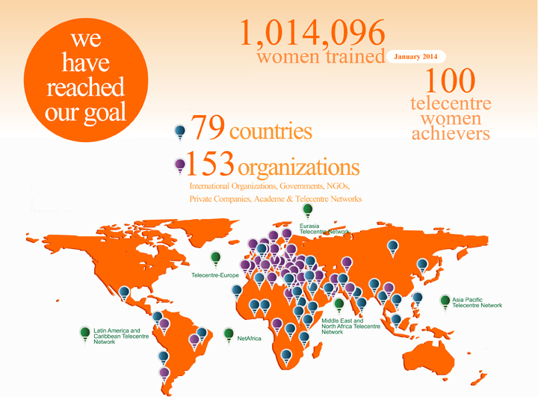
Over 1,000,000 women at the bottom of the pyramid are now digitally literate!​​
ITU-Telecentre.org "Telecentre Women: Digital Literacy Campaign”
Notes:
Reaching out to women and girls at the bottom of the pyramid requires more than merely ensuring access to ICTs and broadband networks.
Women need training to become digitally literate.
Digital literacy training opens the door to other essential skills needed to operate in a broadband environment, including financial skills, as well as career training.
Such training enables women to set up online businesses, or to use broadband services, such as social networking sites, to enhance their ongoing livelihood and economic activity.
ITU has developed a range of training materials to promote women’s digital literacy and the use of ICTs to promote women’s economic activities.
The Women’s Digital Literacy Campaign, launched in 2011 with a target of training one million women around the world, leveraged the combined reach of Telecentre.org Foundation’s global network of telecentres and ITU’s Member States and Private Sector Members.
The campaign reached its goal earlier this month with a total of 1,014,096 women trained in basic computer skills, through the efforts of 153 participating organizations and 20,000 telecentres around the world.

Slide 11

  ITU Plenipotentiary Resolution 70 backed by all ITU Member States calls for the celebration of International Girls in ICT Day on 4th Thursday of April every year.
  2,700 events in 121 countries, empowering over 70,000 girls and young women globally.
In the Arab Region, 9 countries celebrated Girls in ICTs days (Bahrain, Egypt, Jordan, Lebanon, Morocco, Oman, Qatar, Saudi Arabia and UAE). Some of these events were co-organized together with ITU-D Sector Members, such as Ericsson and Cisco.
24 April
Notes:
We want women to take advantage of growing ICT-related job opportunities. We also want to ensure that women will become creators of technology.
To achieve this, we need to increase the number of girls and young women who receive STEM education and who want an ICT career.
That is why ITU members created International Girls in ICT Day to encourage girls and young women to study STEM fields and enter ICT careers.
In the past few years, we’ve seen over 2, 700 events in 121 countries with an outreach of 70,000 young women and girls.
Together we can empower girls and young women to take their rightful place in our communities, countries, and throughout the world by celebrating International Girls in ICT Day 2014.

Slide 12
Thank You!

