Slide 1

Council Working Group on child online protection
Twenty-first meeting – From 30 September (p.m.) to 1 October 2024
Document CWG-COP-21/INF/16
24 September 2024
English Only
Report by Council of Europe
LANZAROTE CONVENTION 2ND MONITORING ROUND:
FINDINGS AND RECOMMENDATIONS
Ekaterina Malareva
Legal Advisor
Lanzarote Committee Secretariat
Council of Europe
Purpose
Presentation of the Lanzarote convention.
Action required
This report is transmitted to the Council Working Group on child online protection for information.

Slide 2
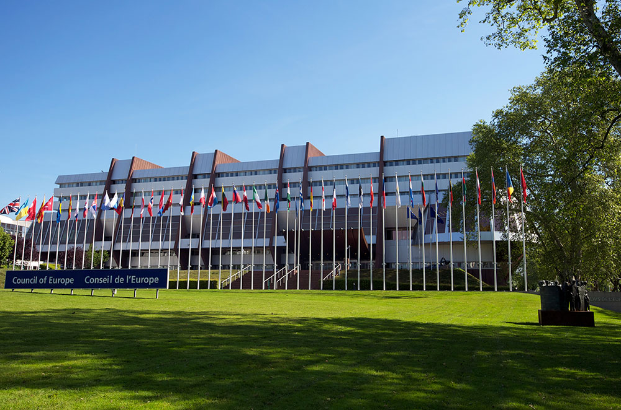




Council of Europe
Council Working Group on child online protection
Twenty-first meeting – From 30 September (p.m.) to 1 October 2024
Intergovernmental organisation promoting:
Human Rights
Democracy
Rule of Law
Established on
5 May 1949
46 member
States
Based in
Strasbourg
(France)
Notes:
One of the areas in which the Council of Europe works is protection and promotion of children’s rights. It does this work mostly through its Children’s Rights Division. The work of the children’s rights division is organised around three sectors, and one of these sectors is providing technical assistance to the Committee of the Parties to the Lanzarote Convention. So what is this Convention all about?

Slide 3
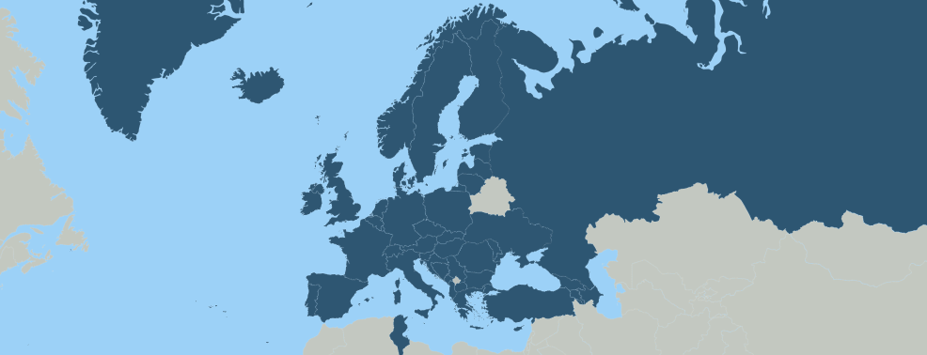

Lanzarote Convention
Council Working Group on child online protection
Twenty-first meeting – From 30 September (p.m.) to 1 October 2024
Convention on the Protection of Children against Sexual Exploitation and Sexual Abuse
2007
opened for signature
2010
entry into force
2024
48 State Parties
The most holistic international treaty for the protection of children against sexual exploitation and sexual abuse
)
Link to the Convention on the Protection of Children against Sexual Exploitation and Sexual Abuse
Notes:
After the last sentence - What does it mean?

Slide 4
Lanzarote Convention
4 Pillars
Council Working Group on child online protection
Twenty-first meeting – From 30 September (p.m.) to 1 October 2024
Prevention
Awareness raising for children and general public
Screening and training of professionals
Intervention programmes and measures for potential and actual offenders
Protection
Reporting suspected child sexual exploitation and sexual abuse
Assistance to and protection of victims and their families
Prosecution
Criminalisation of all forms of child sexual exploitation and sexual abuse
Child-friendly investigations and judicial proceedings
Recording and storing national data on convicted sexual offenders
Promotion of national and international
co-operation
Implementation of integrated policies at national level
International cooperation between State Parties to share data and good practices
Notes:
We say that the Convention is structured around 4 Ps which taken together cover all aspects of law and policy necessary to effectively protect children against sexual exploitation and sexual abuse.

Slide 5


Lanzarote Committee
Council Working Group on child online protection
Twenty-first meeting – From 30 September (p.m.) to 1 October 2024
Monitoring the implementation
of the Convention
All States monitored simultaneously in thematic monitoring rounds on the basis of questionnaires (peer review)
Information from States, but also CSOs and NHRIs
Implementation reports adopted by the Committee with general and country-specific recommendations of different levels (“require”, “request”, “invite”)
Implementation of recommendations is monitored via compliance procedures
Link to the Lanzarote Committee
Notes:
After 2nd indent give example of monitoring rounds which have been completed and are underway
Only 1 completed compliance procedure so far, another one to be launched in October

Slide 6
2nd monitoring round
Council Working Group on child online protection
Twenty-first meeting – From 30 September (p.m.) to 1 October 2024
Protection of children against sexual exploitation and sexual abuse facilitated by information and communication technologies (ICTs): addressing the challenges raised by child self-generated sexual images and/or videos (CSGSIV)
2022 annual report of the Internet Watch Foundation (IWF):
of the 255 000 CSAM actioned over the year, 78% contained self-generated imagery
Implementation report adopted in March 2022 (child participation)
10 chapters
43 States monitored
Thematic and country factsheets
Compliance procedure launched October 2024
Notes:
After 2nd indent give example of monitoring rounds which have been completed and are underway
Only 1 completed compliance procedure so far, another one to be launched in October

Slide 7
Legal frameworks
Council Working Group on child online protection
Twenty-first meeting – From 30 September (p.m.) to 1 October 2024
Main findings:
Many States criminalised production and/or possession of self-generated material by children
Most States criminalised transmission/distribution of self-generated material by children
Only 1 State criminalised using force, threats or deception, and/or exceeding or abusing powers to obtain sexual material from a child
Recommendations:
To use the term “child sexual abuse material” (CSAM) instead of “child pornography”
To avoid prosecuting children for possessing own self-generated material and that of another child obtained with informed consent or without asking, and for distribution/transmission that is voluntary, consensual and intended solely for private use
To create a specific offence of sexual extortion of children involving the use of self-generated sexual material
To consider criminalising solicitation of children for sexual purposes (“grooming”), even when it does not lead to either a face-to-face meeting or to producing child sexual abuse material
Notes:
After 2nd indent give example of monitoring rounds which have been completed and are underway
Only 1 completed compliance procedure so far, another one to be launched in October

Slide 8
Jurisdiction rules
and
international co-operation
Council Working Group on child online protection
Twenty-first meeting – From 30 September (p.m.) to 1 October 2024
Transnational character of ICT-facilitated sexual offences against children: more intense international cooperation is required
Main findings:
Most States required a report from the victim or a denunciation from the authorities of another States where the offence was committed to initiate prosecution for the category of offences examined
More than ¼ States required dual criminality
Recommendations:
To remove the above requirements for prosecution
To establish jurisdiction over transnational cases of child sexual exploitation and abuse facilitated by ICTs, when one of the constituent elements of the offence has taken place in a State’s territory
To assess, strengthen and develop cooperation with a view to preventing and combating related offences between Parties and with other States, with intergovernmental bodies and transnational networks
Notes:
After 2nd indent give example of monitoring rounds which have been completed and are underway
Only 1 completed compliance procedure so far, another one to be launched in October

Slide 9
Prevention
Council Working Group on child online protection
Twenty-first meeting – From 30 September (p.m.) to 1 October 2024
Main findings:
Few public awareness-raising programmes on risks of online sexual abuse and exploitation of children, even less so on risks of self-generated sexual material
Little mention of risks of self-generated sexual material in sexuality education programmes aimed at children
Little national and local coordination of awareness-raising activities
Lack of (continuous) training for education professionals and other persons working in contact with children
Recommendations:
To expand cooperation with civil society
To ensure that children at all education levels receive information about the risks of ICT-facilitated CSEA
To ensure that persons working with children have an adequate understanding of the risks
Notes:
After 2nd indent give example of monitoring rounds which have been completed and are underway
Only 1 completed compliance procedure so far, another one to be launched in October

Slide 10


Council Working Group on child online protection
Twenty-first meeting – From 30 September (p.m.) to 1 October 2024
18 November
Annual day to raise awareness about child sexual exploitation and sexual abuse (recognised by the UN as the World Day)
2024 theme
Protecting children from sexual exploitation and sexual abuse in the context of emerging technologies BUT your action does not have to be related to this theme
Private companies can take action to raise awareness by adding this day to their communication calendars and speaking about safety actions and policies they already have in place via:
A blog post
A banner with a message on their website
A comm push or targeted action to raise awareness about national safety measures or reporting mechanisms available (medial package available on the dedicated webpage)

Slide 11
Contacts
Council Working Group on child online protection
Twenty-first meeting – From 30 September (p.m.) to 1 October 2024
Thank you for your attention!
Facebook: Council of Europe Children
X (Twitter): @CoE_children
Contact us: lanzarote.committee@coe.int
Notes:
After 2nd indent give example of monitoring rounds which have been completed and are underway
Only 1 completed compliance procedure so far, another one to be launched in October

