Slide 1

ITU-Regional Development Forum for the Arab States
ICT 4 SDGs Implementation
Khartoum – Sudan, 29 Jan 2017
Dr. Safa Nassereldin Chairwoman of FTTH Council MENA

Slide 2


FTTH Council MENA in Few words
With More than 50 members companies and major partners since 2011 FTTH Council MENA is fully committed to accelerate the deployment of FTTH in the Middle East and North Africa Region.

Slide 3
Our Committees
Market Development & Intelligence Committee
Chaired by Jan Schindler
latest FTTH market data and evolution of FTTH/FTTB of the MENA region.
Policy & Regulatory
Committee
Chaired by Christine Beylouni
follow and lobby relevant policy and regulatory development in the MENA region in terms of broadband deployment and FTTH roll-out>
Smart Cities Apps &Ops MENA
Chaired by Ammar Sabbagh
accelerate deployment of ultra high-speed FTTH – highlighting deployment approaches, applications and the benefits for Smart Cities, campuses and other real estate developments in the MENA region.
Technology & & Training Committee
Chaired by Gamal Hegazi
the pillar for promoting FTTH in the MENA region with an agnostic view of the FTTH technology and the know-how through its certified training.

Slide 4
FTTH Market in MENA
More than 48 FTTH/B projects in MENA at Sept 2016
Incumbents and Alternative operators are the main actors involved in FTTH/B rollout
National programs should boost FTTH/B market in MENA in the middle to long term
Total FTTH/B Homes passed in MENA at September 2016
Incumbents | National companies / Municipalities / Utilities | Alternative operators / ISPs | Housing companies / RE owners
4 546 776 | 137 700 | 901 600 | 152 100
79,2% | 2,4% | 15,7% | 2,7%
Source: IDATE for FTTH Council MENA

Slide 5
Main trends in MENA’s FTTH/B market
Source: IDATE for FTTH Council MENA

Slide 6
FTTH/B in MENA – Overall Figures
Source: IDATE for FTTH Council MENA
Notes:
The Ranking is based on economies with at least 200000 households.
As for the highest Take up rate (FTTH subscribers vs. FTTH Homes passed) UAE is the highest with 78%, followed by Qatar 77% and then Saudi Arabia and Oman .

Slide 7
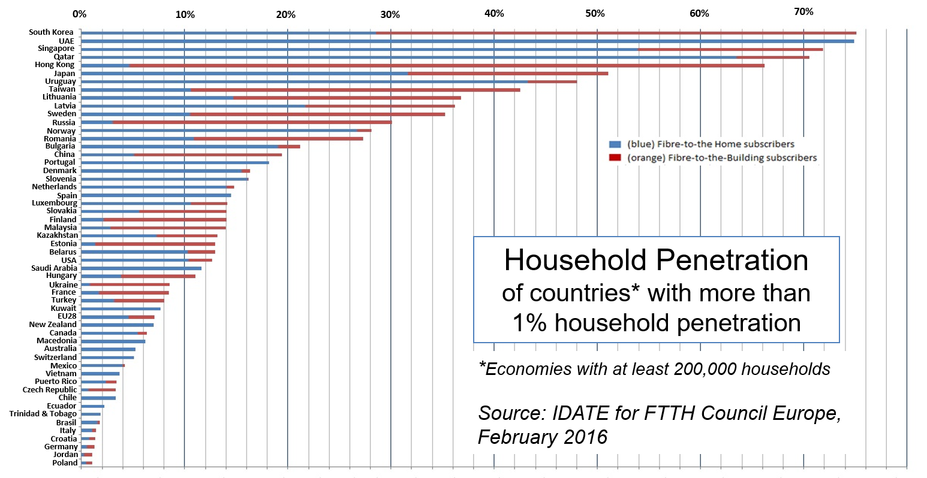
MENA in the global ranking
UAE and Qatar still among World Leaders
Two countries entering global ranking at September 2016:
- Bahrain : 12,5%
- Oman : 2%
6 MENA countries in total

Slide 8
FTTH Market Drivers
Several drivers propel MENA’s FTTH/B market
Mobile backhaul
MENA’s government are becoming more and more aware of the benefits of NGN
Their involvement is a way to compensate and stimulate the current lack of large scale private initiatives
Low quality of existing networks
The copper networks are generally not efficient enough to support the provision of value-added services such as TV and video
Cloud services
Some players are beginning to adopt a regional strategy in terms of Broadband and superfast Broadband
As an example, Zain is already present in Jordan, Iraq, Kuwait…
National plans
Leapfrog from 2G to LTE is possible, such as it could happen in other regions
Fibre will be necessary to deal with the development of mobile data consumption
New housing programs
The growth of the Real Estate market is one of the highest, notably in GCC countries
Higher competition
SMEs and SOHOs are heavy users of new and innovative services among which cloud storage solutions
FTTH networks are more and more often considered as a commodity
The trust in networks is a key parameter and FTTH/B infrastructure is a good answer

Slide 9
Right to Health Care
is among the most important human rights,
Continued deployment of traditional methods is not a sustainable option.
Rising costs,
ageing population,
climate change and
a rise in the demand for quality care
Health care faces numerous challenges in the modern day:

Slide 10
Technology and Healthcare
Technology would empower and personalize health care;
Will deliver health care tailored to patient needs with the best responses and highest safety margins to ensure better patient care.
Technology can support us in making healthier choices, monitoring our health, optimizing exercise, sleep and nutrition patterns.
Notes:
Poor communication is one of the biggest problems in healthcare. The time lost trying to find physicians, clinicians or nursing colleagues and inefficient channels of communication result in billions of dollars lost in the sector. Modern communication solutions help healthcare systems increase efficiency and revenue by improving communication across their medical staff.
Connectivity is not limited to locating physicians or hospitals, but also incorporates placing a heart monitor on a patient who is being nursed at home or leads a normal life but requires constant observation. The Internet of Things is helping in gathering timely information about his/her condition, blood pressure, temperature, heart rate, among other vital sign, and sending data to a processing center for analysis and reporting on what needs to be done to improve the patient’s quality of life.
Other technologies like 3D printed prosthetics and implants from various materials used in them including titanium and human tissue are a boost for the healthcare sector. These also include the reconstruction of bone and human body parts in forensic pathology and recreating heavily damaged piece of evidence acquired from crime scene investigations.
​
Big data is big in healthcare. Will be discussed later! One of The biggest project engaged currently is the Human Genome. 20 research centers, institutions, hospitals, and corporations work collectively on this project to draw the map of the human complete nucleic acid encoded in DNA within the chromosomes of humans.

Slide 11

Communication to enable a truly “HealthCare experience”
  Healthcare organization interaction or collaboration
    Data Access virtualization through electronic information exchange and storage (e.g. EHR)
    Remote medical consultations
    Remote delivery of education and training
    Coordination of the Healthcare delocalized in the territory
  Improved continuity of patients care inside and outside the Healthcare structure
    Improved communication capabilities of any patient from inside hospitals
    Improved security inside the healthcare premises
    Remote assistance and diagnosis
Communication to reach the Operational excellence while minimizing the management cost.

Slide 12


Communications to enable HEALTHCARE SERVICES
Users
Patients
Citizen
Carer
Primary Health Care
HEALTHCARE SERVICES
Secondary Health Care
General Practitioner (GP)
Local Hospitals
Pharmacist
Day-Hospitalization
Community nursing
Communication
HEALTHCARE SERVICES
HEALTHCARE SERVICES
Diagnostic Laboratories
Paramedical
Emergency Rooms
Clinics
In-Patient Care
Home Visits
HEALTHCARE SERVICES
Medical Specialists
Tertiary Health Care
Specialist Hospitals
Regional Centers
Source: Alcatel.Lucent
Communications are the “Glue” enabling the effective interaction of all the different actors of the HealthCare Eco-system.
Notes:
The healthcare sector comprises a complex mix of institutions, businesses, professionals and users.
Health care delivery
Medical care delivery is classified into primary, secondary and tertiary care.
Primary care medical services are provided by physicians or other health professionals who has first contact with a patient seeking medical treatment or care. These occur in physician offices, clinics, nursing homes, schools, home visits and other places close to patients. About 90% of medical visits can be treated by the primary care provider. These include treatment of acute and chronic illnesses, preventive care and health education for all ages and both sexes.
Secondary care medical services are provided by medical specialists in their offices or clinics or at local community hospitals for a patient referred by a primary care provider who first diagnosed or treated the patient. Referrals are made for those patients who required the expertise or procedures performed by specialists. These include both ambulatory care and inpatient services, emergency rooms, intensive care medicine, surgery services, physical therapy, labor and delivery, endoscopy units, diagnostic laboratory and medical imaging services, hospice centers, etc. Some primary care providers may also take care of hospitalized patients and deliver babies in a secondary care setting.
Tertiary care medical services are provided by specialist hospitals or regional centers equipped with diagnostic and treatment facilities not generally available at local hospitals. These include trauma centers, burn treatment centers, advanced neonatology unit services, organ transplants, high-risk pregnancy, radiation oncology, etc.
Modern medical care also depends on information - still delivered in many health care settings on paper records, but increasingly nowadays by electronic means.

Slide 13
Healthcare Initiatives
Telemedicine
Electronic Health Records (HER)
Hospital Management Systems
Health Surveillance System
Emergency Medical Services
Facility and Data Security

Slide 14

Building an Hospital management Information system
APPOINTMENT Scheduling
PATIENT Registration
Objective
Use automation to improve the response time to the demands of patient care and the daily workflow
Pushing on simplicity
Keep info, staff, processes always under control
PATIENT Admission/Discharge/Transfer
PATIENTS Billing
DOCTORS Mobility
Advantages
BED Management
Less number of Staff to care more patients
Increase the profitability of the organization
Controlling costs
NURSE call
OUSEKEEPING/LAUNDRY Management
HOSPITAL Administration

Slide 15





Improving Health Surveillance System
High-bandwidth, Reliable Network Infrastructure enables GRID-based Real-time health surveillance systems
Grid-based real-time distributed collaborative geo-processing could also form the basis of a next-generation solution to data and computationally intensive geo-processing applications that are extremely difficult to execute on conventional systems and networks.
Specialized Hospital
Foreign Hospital
Optical Backbone
Infrastructure
Research and Education
University

Slide 16
Key Vendors in MENA Market
CareFusion Corp., Cerner Corp., Carestream Health Inc., and Philips Healthcare.
Other vendors mentioned in the report are: GE Healthcare Ltd., Siemens Healthcare, Computer Sciences Corp., InterSystems Corp., Fujifilm Holdings Corp., Sectra AB, ICT Health Technology Services, Pulse System Inc., Dell Healthcare and Life Sciences, 3M Health Information Systems Inc., and Toshiba Medical Systems Corp.
Source: TechNavio's report, the Healthcare ICT Market in the MENA Region 2012-2016

Slide 17
Big Data in Health
“Big Data in Health refers to large routinely or automatically collected datasets, which are electronically captured and stored. It is reusable in the sense of multipurpose data and comprises the fusion and connection of existing databases for the purpose of improving health and health system performance. It does not refer to data collected for a specific study.”
Source: GÖ FP
Notes:
Source: GÖ FP: Gesundheit Österreich Forschungs- und Planungs GmbH

Slide 18
The value chain of Big Data consists of:
generating and collecting data,
storing and processing, and,
the distribution and analysis of the relevant data.

Slide 19
Application of Big Data
Either prospective data monitoring or retrospective data analysis and to contribute to:
earlier disease intervention,
reduced probability of adverse reactions to medicines,
less medical errors,
determination of causalities, understanding of co-morbidity,
cross-linkage of health care providers and professionals,
fusion of different networks such as social networks, disease networks, medicine networks,
intensification of research networks, and
increasing the effectiveness and quality of treatments by e.g.:
widening possibilities for the prevention of diseases by identification of risk factors for disease at population, subpopulation, and individual levels, and by improving the effectiveness of interventions to help people achieve healthier behaviours in healthier environments,
the improvement of pharmacovigilance and patient safety through the ability to make more informed medical decisions based on directly delivered information to the patients,
prediction of outcomes, e.g. containment and improvement of chronic diseases, global infectious disease surveillance through evolving risk maps and better understanding of demographic challenges and trends as well disease transmission pathways,
knowledge dissemination, e.g. help physicians to stay current with the latest evidence guiding clinical practice, and
reduction in inefficiency and waste, improvement in cost containment.

Slide 20
Policy actions for Big Data in Health
Legal aspects
Stakeholders
Privacy and data protection
Open data and data sharing
Standards and protocols
Technological development
Data sources
Data analysis
Applications
Communication
Human capital
Funding

Slide 21
Policy actions for Big Data in Health
Source: GÖ FP
Notes:
Source: GÖ FP: Gesundheit Österreich Forschungs- und Planungs GmbH
Legal frameworks and internal policies: Should be aligned and clarified, specifically regarding:
privacy and data-ownership,
secondary use of health data,
cloud services and
institutions hosting and managing Electronic Health Records (EHR)

Slide 22
Recommendations to develop ten relevant fields:
awareness raising,
education and training,
data sources,
open data and data sharing,
applications and purposes,
data analysis,
governance of data access and use,
Technical standards,
funding and financial resources,
legal aspects & privacy regulation.

Slide 23
FTTH/B
Fiber deployment in modern hospitals and clinics
Passive optical LANS are now becoming a trend for bandwidth hungry hospitals, Trend in EU now to build hospitals that are wired with Fiber
§Increased bandwidth demand at hospitals
§Connecting hospital information systems
§Connecting remote doctors to hospitals and operation rooms
§Medical imaging and scan transfer and exchange and analysis
§Entertainment system like IPTV for patients at hospital

Slide 24
Contact
THANK YOU
شــكــرا“
Safa.nassereldin@ftthcouncilmena.org

