Slide 1
ICTs and Driving SDGs in the Arab Region
The ICTs technologies, its evolution and development
By Nermine El Saadany
Undersecretary for International Relations
MCIT - Egypt
Regional Development Forum for the Arab States,
Khartoum, Republic of Sudan 29 January,2017

Slide 2
The Rise of the Millennium
With the rise of the Millennium back in 2000, a new vision for the Globe emerged;
There was a sort of “international will” to re shape our Societies;
The World on the highest level united to discuss and exchange views on what could or should be done to foster more development and better way of living;
Concurrently, we heard for the first time a call to discuss the World Information Society, that later on crystalized in the WSIS;
And as the MDGs shaped an influential framework for global development cooperation agenda, and in driving the allocation of resources, the WSIS successfully outlined the information society. Both received unprecedented political commitment ;
And the link between how ICT could help achieving the MDGs were well in place.
Regional Development Forum for the Arab States,
Khartoum, Republic of Sudan 29 January,2017

Slide 3
A Clear Synergy
There was a clear Synergy between the two plans,
The direct result was the realisation of many developing countries that there is a MUST to start developing their National Development Strategies within which the ICTs were a main component,
Such strategies were oriented at achieving the MDGs aligning their objectives with other national priorities,
MDGs
Information and communication infrastructure
The role of public authorities and all stakeholders in promotion of ICTs for development
Access to information and knowledge
Capacity building
Building confidence and security in the use of ICTs
Enabling environment
Media
ICT Applications
Cultural diversity and identity, linguistic diversity and local content
International and regional cooperation
Ethical dimensions of the Information Society
Substantial progress has been made regarding the MDGs. However, the achievements have been uneven.
Regional Development Forum for the Arab States,
Khartoum, Republic of Sudan 29 January,2017

Slide 4
A Starting Point: The Arab Information Society Initiatives
Arab countries as part of the WTDC regional Initiatives since 2006, have over the past decade embarked on the development and the implementation of their ICT for Development (ICT4D) policies and plans;
For most of the Arab countries, their ICT4D policies and implementation plans were targeted at a number of focus areas or pillars:
human resource development;
e-education (ICTs-in-education),
e-health,
e-agriculture,
e-government,
e-commerce,
private sector development,
legal and regulatory framework development;
ICT infrastructure development,
deployment of ICTs in the communities,
facilitating poverty reduction;
and as well as on the development of the ICT sector.
Regional Development Forum for the Arab States,
Khartoum, Republic of Sudan 29 January,2017

Slide 5
MDGs Challenges and Lessons Learned
The main challenges that remains valid for the Arab Region since we have started the MDGs till today are:
Affordability
Lack of local content
Access to knowledge and information
Cybersecurity measurements
Capacity building programs
Digital literacy
Enabling environment
Information has become a strategic resource and a foundation of every activity.
The emergence and convergence of information and communication technologies has remained at the center of global socio-economic transformations.
If implemented properly and carefully in the Arab Region, these technologies could reduce or eliminate the imbalance between rich and poor, and the powerful and marginalized within the region .
And on top of all challenges is the availability of resources to fund the MDGs implementation and foster the use of ICTs as a catalyst for growth and sustainability
Regional Development Forum for the Arab States,
Khartoum, Republic of Sudan 29 January,2017

Slide 6
The evolution of SDGs
A process was initiated to review the MDGs and to develop a new set of Sustainable Development Goals (SDGs) which will carry on the momentum generated by the MDGs and fit into a global development framework beyond 2015.
Regional Development Forum for the Arab States,
Khartoum, Republic of Sudan 29 January,2017

Slide 7
Between the Utopia and Reality
Upon reading the SDGs, one could feel like “heaven on earth kind of thing;
Yet, if there are still the same kind of “political Will on the Highest level” to endorse those goals, then we should find a way through for better even implementation and achievement than the MDGs,
And this is where the ICTs could really help. We have witnessed during the previous 15 years, how the ICTs have changed our lives;
We have seen nations, villages, and people of all kinds thriving to reach out to good internet access to innovate better way of living;
Information, knowledge and technology are increasingly becoming the key drivers for socio-economic development world-wide.
Regional Development Forum for the Arab States,
Khartoum, Republic of Sudan 29 January,2017

Slide 8
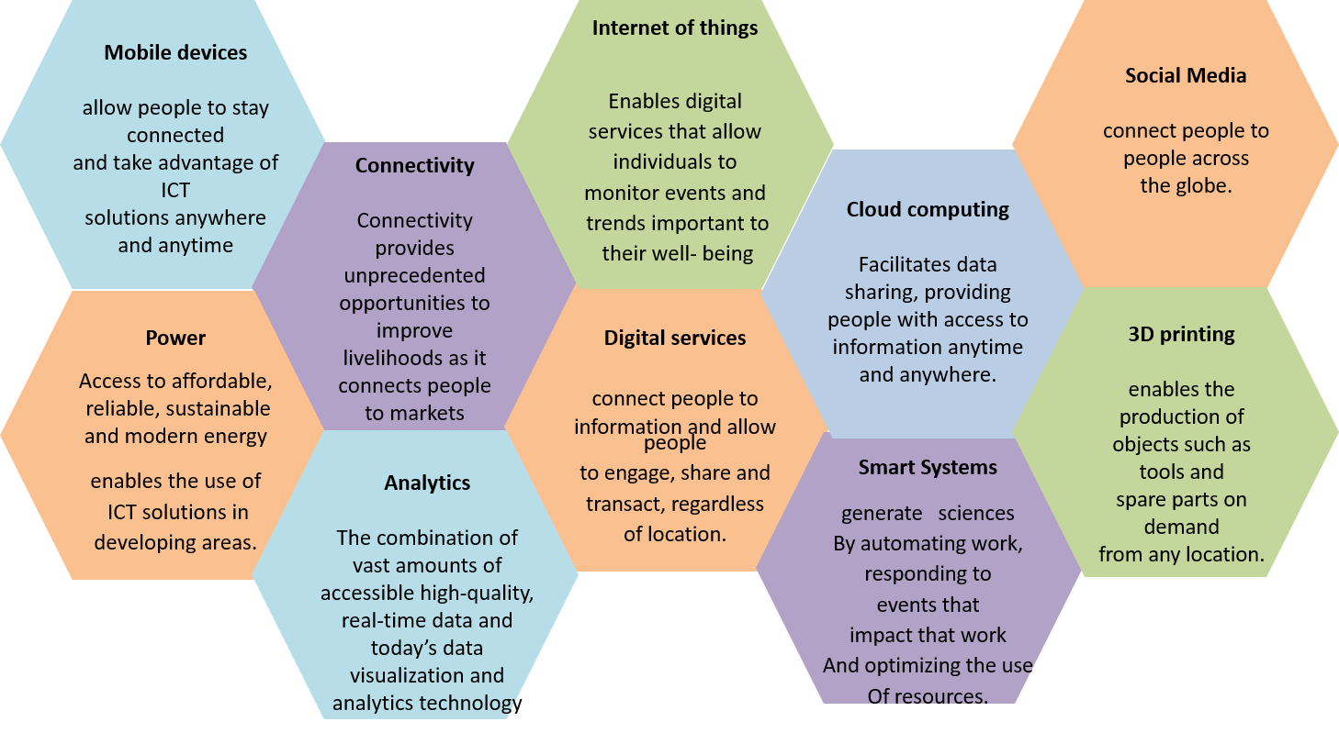
Beyond 2020: the Future of ICTs Technologies - Its evolution and development -
Regional Development Forum for the Arab States,
Khartoum, Republic of Sudan 29 January,2017

Slide 9
The Way Forward
Regional Development Forum for the Arab States,
Khartoum, Republic of Sudan 29 January,2017

Slide 10
The building Blocks of ICTs in SDGs “2015 – 2030”
Today most of the Arab region has well established ICT infrastructure, hence, the focus is now becoming more on how the ICTs could cater on:
Digital citizenship inclusion
Digital economy – secured -
Reduce poverty and achieve
social justice
ICTs Innovation & Entrepreneurship is the Arab Region Future For Economic Growth
ICT innovation play an important role in improving Arab youth's socio-economic status, where 70% of its population is Youth below 25 years old.
Furthermore, youth are 'early adopters' of ICT based technologies, and are viewed as driving growth and innovation in the sector.
Regional Development Forum for the Arab States,
Khartoum, Republic of Sudan 29 January,2017

Slide 11
On The Regional Level
The success of achieving the SDGs will rely largely on domestic public and private resources on top of everything else,
Beside the government resources, public-private partnerships, technology transfer and South- South cooperation are key in order to reach a WIN – WIN situation for all.
In order for the Arab Region to excel and benefit from ICTs social and economic impact it should unify its efforts and share the knowledge and information to build an intersectional relation that aims at helping the people in the region and optimize the usage of its valuable resources “YOUTH”.
Regional Development Forum for the Arab States,
Khartoum, Republic of Sudan 29 January,2017

Slide 12
On The Global Level: “ITU Role”
Understanding the global trends that will take place from 2020 onwards and the impact of such technologies on the future, will enable us to set up the right policies and standards to foster innovation not only in our region, but globally,
With innovation as a core development goal, and ICT as key enabler, ITU together with the key relevant Organizations have to focus on the following:
Policy frameworks to build ICT centric innovation policy with a shared understanding of the role of key stakeholders including YOUTH as ITU Sector Member
Mechanisms to develop new collaborative networks and access to markets, in addition to sharing “good practices” supporting sustainable and global competitiveness in an open economy
Encourage industry players to come together on the ITU platform to develop standards that meet their need for common platforms for growth and innovation as well as standards that works for the developing countries
Regional Development Forum for the Arab States,
Khartoum, Republic of Sudan 29 January,2017

Slide 13
Thank You Nermine nsaadany@mcit.gov.eg
Regional Development Forum for the Arab States,
Khartoum, Republic of Sudan 29 January,2017

