Slide 1



Why eHealth and its Adoption in the Eastern Mediterranean
(The WHO Approach)
Regional Development Forum (RDF)
October 28, 2013 at Manama, Bahrain
Dr. Zahid Ali Faheem
Head of AMANTELEHEALTH, Aman Health Care Services
General Secretary, Trustee and Founder Board Member
eHealth Association of Pakistan -eHAP

Slide 2
eHealth OR Electronic Health?
  e=electronic??

Slide 3
Electronic Health?
e=electronic
elitist, executive, exclusive, exhausting, and ephemeral
e=ethical
equity, efficiency, empowerment, encouragement, education, enhancement of quality, evidence-informed decisions, extension of the scope of healthcare, and enablement of information exchange and communication in standardized ways

Slide 4
What is eHealth?
WHO WHA Resolution (WHO58):
  “The cost-effective and secure use of Information Communication Technology (ICT) in support of health and health-related fields including healthcare services, health surveillance, health literature, and health education, knowledge and research”.

Slide 5
Role of ICT in Healthcare
ICT plays a significant role in the healthcare industries by ensuring that the right health information is provided to the right person at the right place and time in a secure, electronic form for the purpose of optimizing the quality and efficiency of health care delivery.

Slide 6


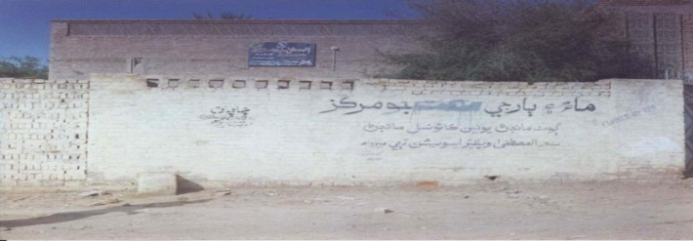

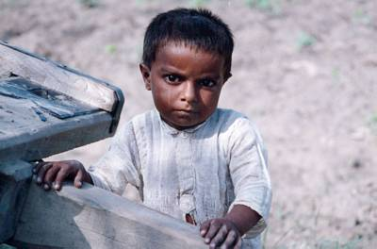


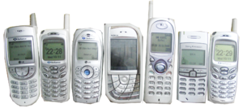



Role of ICT in Health
ICT
Health

Slide 7
Impact and Benefits of ICT in Health
Better Systems
Improved Access
High Quality
Reduced Cost
Integrated systems
ICT + Health =

Slide 8
eHealth
Telehealth
e-Learning
Health Informatics
Use of ICTs to deliver health services, expertise and information over distance
Delivery of individualized, comprehensive, dynamic learning content in real time, aiding the development of CMEs, and linking with experts.
Deals with storage, retrieval and optimal use of biomedical data, information, and knowledge for problem solving and decision-making
mHealth

Slide 9
uHealth – Ubiquitous Health
uHealth
Anytime
Anywhere
Anyone

Slide 10
Why eHealth?
During the 2003 World Summit on the Information Society (8):
  eHealth, or the application of ICTs to the field of health care, was considered a discipline that could prove useful in terms of improving the quality of life of the population.
  Recognizing ICT’s significant developmental role and cross-cutting impact in regard to all aspects of national life, including health, an ICT-related target was included in Millennium Development Goal No. 8
58th World Health Assembly eHealth Resolution (WHA58/28) URGES Member States:
  To consider drawing up a long-term strategic plan for developing and implementing eHealth services in the various areas of the health sector, including health administration, which would include an appropriate legal framework and infrastructure and encourage public and private partnerships

Slide 11
WHO approach to eHealth
  The WHO approach to e-Health followed a strategy that contributes to realizing UN Millennium Development Goal 8, Target 18:
    "In cooperation with the private sector, make available the benefits of new technologies – especially information and communication technologies.“
  WHO set directions as follows:
  Strengthen health systems in countries
    Health services, Health workforce, Health Information,
    Medical Products, vaccines, and tech., financing, leadership and governance)
  Foster public-private partnerships in ICT research and development for health
  Support capacity building for eHealth applications in member states
  Promote the development and use of norms and standards
  Promote better understanding of eHealth

Slide 12
WHO GOe Survey
The key finding shows that:
  Digital divide includes eHealth
  Member States require assistance in the eHealth domain from WHO and its partners
  Many countries expect to implement eHealth policies in the near future and will need support
  Development and support for National eHealth governance mechanisms in countries are necessary
  Public-private partnerships are increasing and effective practices should be promoted
  Citizen protection policies are needed in many countries to ensure patient data confidentiality
  Interoperability issues need to be made a priority by Member States
  Health information in electronic format needs to be provided in all relevant community languages

Slide 13
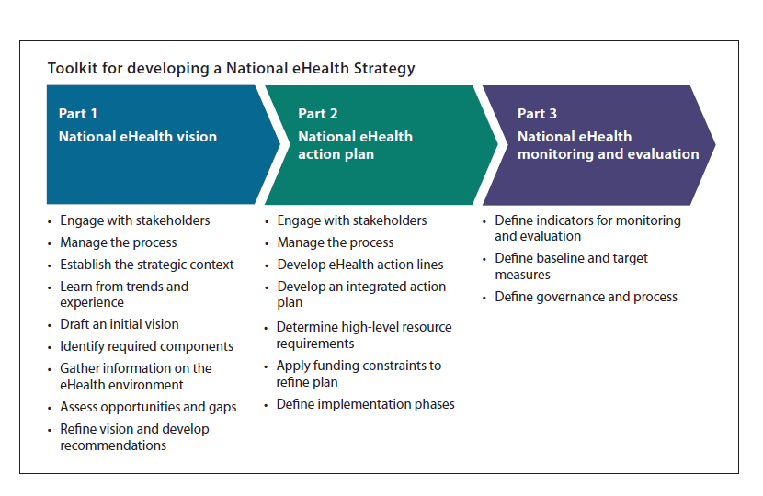
  WHO/ITU eHealth Strategy Toolkit
  A resource for developing or renewing a country’s eHealth strategy
  From countries just setting out to those that have already invested in eHealth
  A framework and method for the development of a vision, action plan and monitoring framework
  Directory of eHealth policies
  http://www.who.int/goe/policies
July 2012
Notes:
Serves as an umbrella for planning and coordinating different national e-Health efforts…
…while considering fundamental elements in terms of regulatory, governance, standards, human capacity, financing and policy contexts

Slide 14
  WHO and ITU: Why did they start?
  Many diverse, small scale eHealth applications, unable to communicate and share data
  Barriers to scale up to support a larger patient and care provider base
  Difficult for decision makers to understand the current health situation, for policy and planning
  Duplication of efforts, leading to waste and inability to integrate solutions
  → Joint WHO-ITU guidance for national strategy development
14
Notes:
14

Slide 15
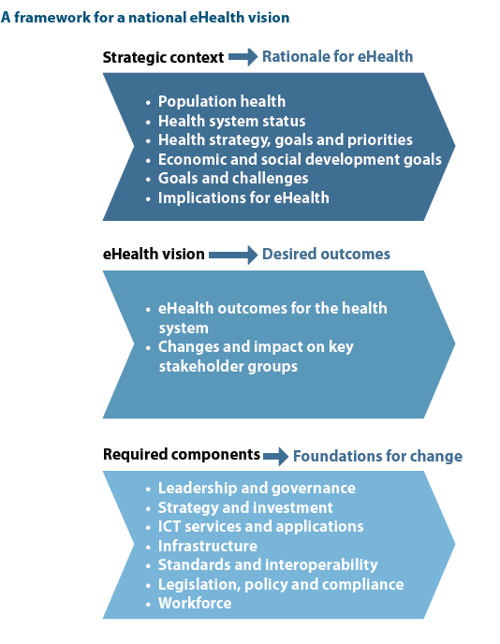
National eHealth Strategy Development
Notes:
Serves as an umbrella for planning and coordinating different national e-Health efforts…
…while considering fundamental elements in terms of regulatory, governance, standards, human capacity, financing and policy contexts

Slide 16
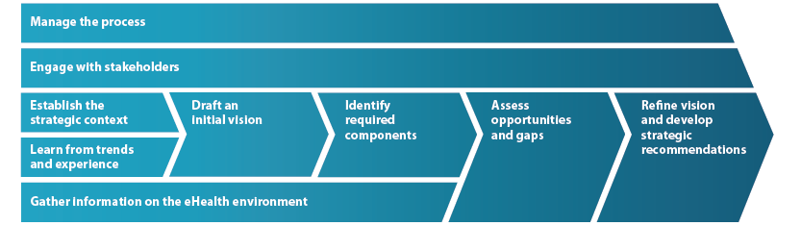
National eHealth Strategy Development
Notes:
Serves as an umbrella for planning and coordinating different national e-Health efforts…
…while considering fundamental elements in terms of regulatory, governance, standards, human capacity, financing and policy contexts

Slide 17
National eHealth Strategy at Global Level
Partial implementation ( Imp. year)
No strategy (Expected year)

Slide 18
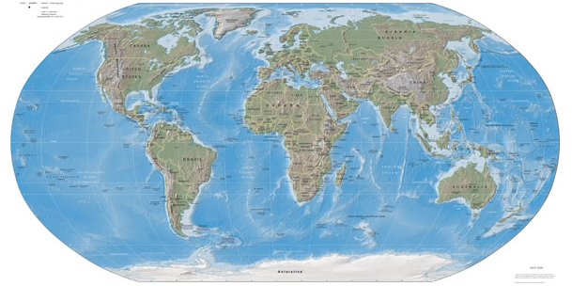
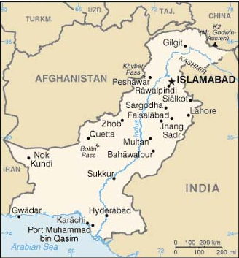



Structured eHealth Approach for Pakistan
eHealth Council

Slide 19
Present Core Board Members - eHAP
Name | Institute | Designation
Dr. Haroon Khan | PIMS- Islamabad | President
Dr. Shariq Khoja | eHealth – AKDN, Nairobi, Kenya | President Elect
Dr. Azeema Fareed | COMSATS- Islamabad | Vice - President
Dr. Zahid Ali Faheem | The Aman Foundation | General Secretary
Dr. Aijaz Patoli | Directorate of Health, Sindh | Treasurer

Slide 20
eHAP – Vision and Mission
Vision: To make Pakistan a model for collaborative, evidence-based, informed and integrated eHealth practice in the (developing) world by 2020.
Mission: To promote adoption and use of eHealth as an integral component of health services and education in Pakistan, through advocacy, evidence, access to recognized experts and resources, policy-support and capacity-building

Slide 21
Key Focus areas for eHAP
eHAP
Advocacy
Manage Resource
Policy-support
Capacity
eHealth Research

Slide 22
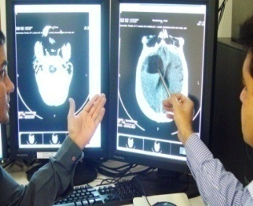
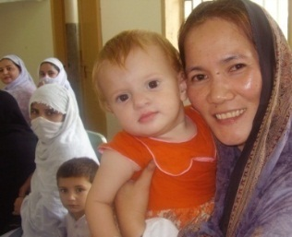
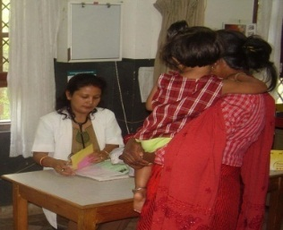
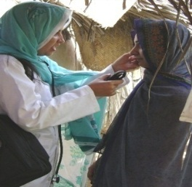
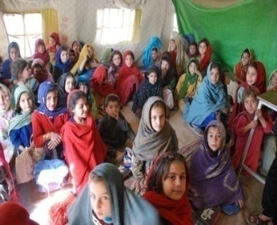
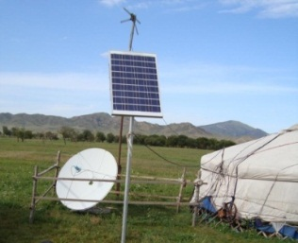
1st International eHealth Conference - 2010
“Better Health For All thorough eHealth”
at Aga Khan University, Karachi - January 23 -24, 2010
2nd International eHealth Conference - 2011
“eHealth and the Road to MDG’s”
at International Islamic University, Islamabad - January 22 -23, 2011
3rd International eHealth Conference - 2012
“Road to National e-Health Strategy for Pakistan”
at University of Health Sciences, Lahore - January 21 -22, 2012
www.ehap.net.pk

Slide 23
Recommendations from 3rd International eHAP Conference - 2012
Identification of eHealth policies relevant to Pakistan
Develop commission papers for understanding the policy issues in different domains of eHealth such as Telemedicine, Health Informatics, mHealth and eLearning.
Create awareness among relevant stakeholders of these policy issues primarily Health Care Providers, NGOs, IT Institutions and relevant Academia.
Involve relevant stakeholders at all levels in the development of eHealth strategy for Pakistan.
Change management should be an essential part of eHealth strategy.
eHealth stagey should also be focused in terms of staff time, population characteristics, ethical and cultural context.

Slide 24
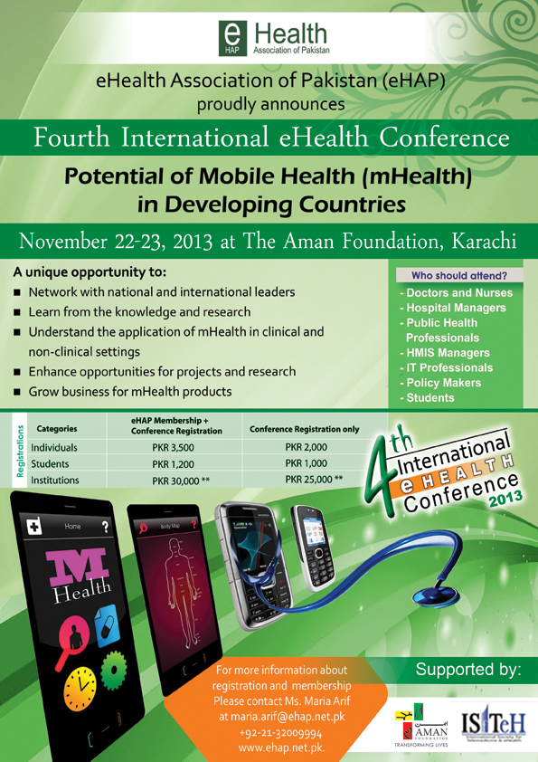

Slide 25
Theme of the Conference 2013
“ Potential of Mobile Health (mHealth) in Developing countries.”
Sub themes:
mHealth in Maternal and Child Health
mHealth for Infectious Diseases and Surveillance
mHealth for Non-Communicable Diseases
Innovations in mHealth
Strategic implementation of mHealth

Slide 26
Acknowledgement
Hani Farouk A. MOHAMED
  faroukh@who.int
  eHealth@emro.who.int
eHealth Association of Pakistan (eHAP)
  www.ehap.net.pk

Slide 27
Thanks
Dr. Zahid Ali Faheem
  faheem.shaikh@amanfoundation.org
  zafaheem32@gmail.com

Slide 28

ICT Experience in AMANHEALTH, Pakistan
(ICTs as a Catalyst for Improving Health)
www.amanfoundation.org
Regional Development Forum (RDF)
October 28, 2013 at Manama, Bahrain
Dr. Zahid Ali Faheem
Head of AMANTELEHEALTH, Aman Health Care Services
General Secretary, Trustee and Founder Board Member
eHealth Association of Pakistan -eHAP

Slide 29
THE AMAN FOUNDATION – Transforming Lives
The Aman Trust (AT) setup in 1999 with aims to champion dignity and choice for the underserved throughout the MENASA region (Middle East, North Africa and South Asia) focusing on Health & Education.
AT is funded by an initial endowment from Mr. Arif Naqvi (Founder & CEO of Abraaj Capital) and his family. It has been involved in strategic philanthropy since its inception.
AT has initiated the Aman Foundation with the seed money of USD 100 million, which is the largest single donation to social and sustainable causes in Pakistan.
Aman operates to private sector principles to achieve measurable and sustainable outcomes.
Aman’s initial focus is Karachi and its mission will be continued by other donors in future when they come to recognize the Aman approach as being long term, sustainable, ethical and transparent services

Slide 30
AMANHEALTH – Equal Access to Healthcare for All in Pakistan
Aman Ambulance
Aman Paramedic Training Academy
Aman Life Savers Program
Aman Emergency Room Program
Urban Search and Rescue Program
Community Health Workers Program
Family Planning Services
Primary Care Clinics
Emergency Care
Primary Care
Secondary Care
Health Information Communication Education
Mental Health
Aman Ghar
Family Planning
Immunization
Institute of Urban Health
AMANTELEHEALTH (24/7 Health Helpline Services)
Outreach Health Screening
Health Education Programs
Occupational Health
Aman Family Health Center
Mother and Child Health Research

Slide 31
Role of ICT in Healthcare
“… mobile technology is beginning to have a big impact in health care, especially in [developing] countries. … Soon mobile technology could play a large role in detecting, mapping and responding to epidemics. (Economist, April 10, 2008)
Over 4 billions mobile connections are in developing countries. (3G Americas, Press Release December 22, 2008, www.3gamericas.org)
Currently, over 130 millions subscribers are in Pakistan
ICT plays a significant role in the healthcare industries primarily through Health Helplines and other mHealth community solutions. These modes easily accessible to mobile phone subscribers, that can bring a major change by providing timely health information and advice in sparsely populated or low-income areas where there are few healthcare facilities and doctors available.
AMAN Health Care Services

Slide 32
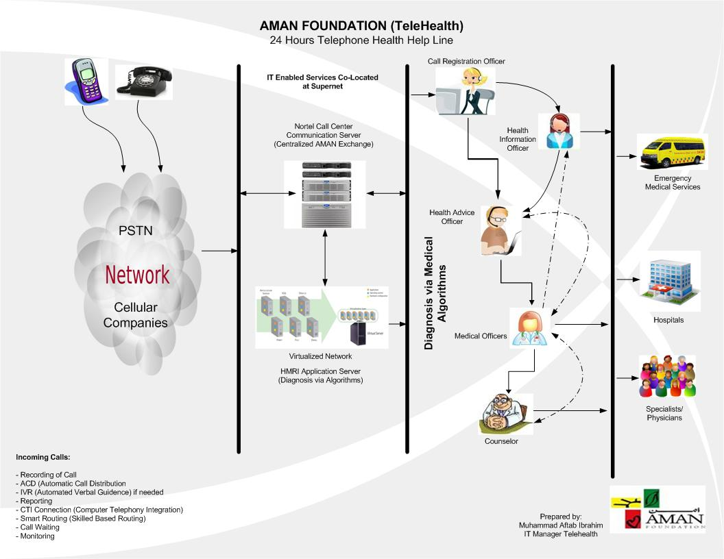
Evolution of ICT at the AMANHEALTH
AMAN Health Care Services

Slide 33
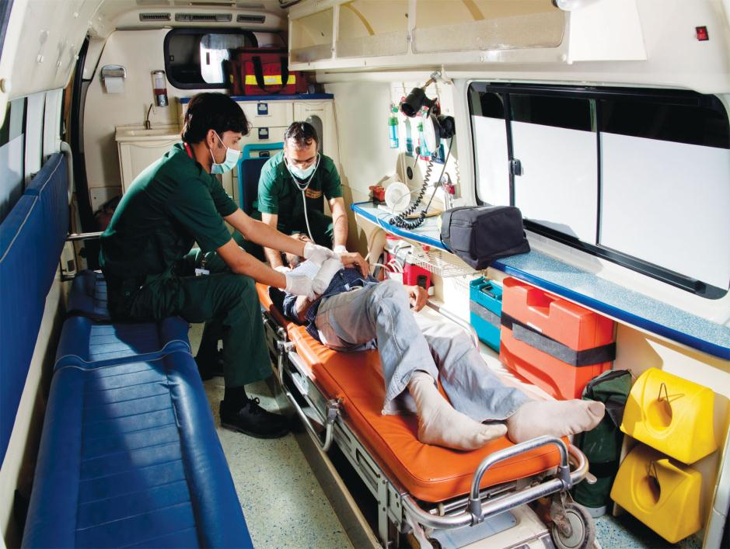
AMAN AMBULANCE – A Flagship Program
  Half a million interventions to date
  Started with One EMS Station in 2008 and over the span of (1) year it has been expanded up to 9 stations with the fleet of 100 ambulances
AMANAMBULANCE
1021

Slide 34




AMAN AMBULANCE – All stations are fully equipped with ICT Enabled Services
Ambulances are equipped with Wireless Communication and Connected to a Central Command and Control
All ambulances are connected with GIS tracking system which helps to track the vehicle and guide them accordingly
Centrally all vehicles are tracked and managed from Command and Control Room which is equipped with State of art Telephony System integrated with PROQA
    9 Stations covering all major parts of Karachi have Data/Internet Connectivity (Aman Cloud System)

Slide 35

AMANTELEHEALTH
Health Information, Communication and Education Services –
(Launched since January 2012)
AMANTELEHEALTH
021-111-11-3737

Slide 36
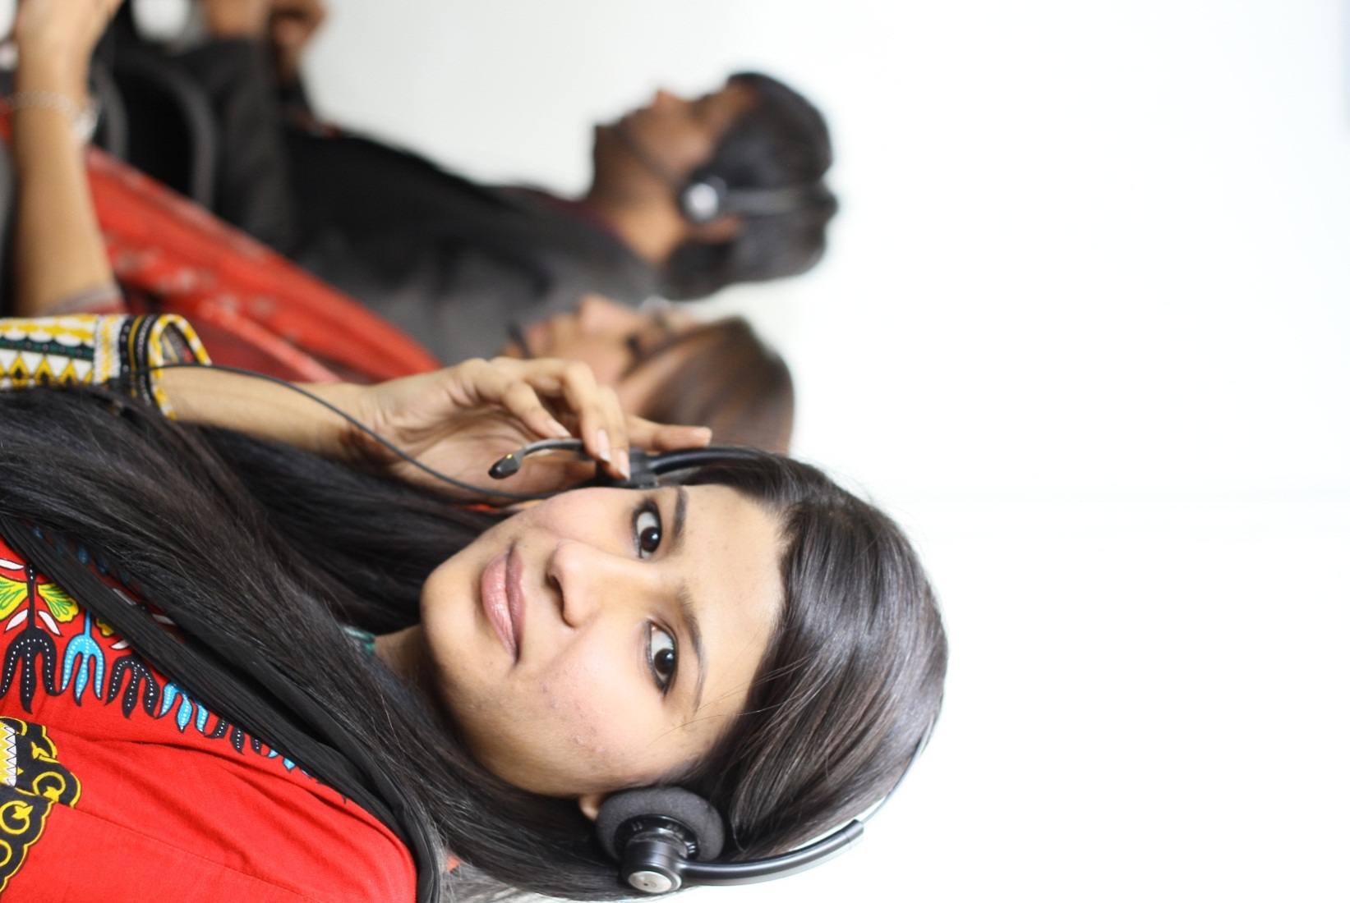

Serve as a role model for increase access to communication technology based health information, advice, screening and counseling.
The purpose of these services is for early detection of the medical conditions, timely referrals, reduce load of patients on hospitals, increase in healthy habit uptake in high risk communities, and save unnecessary direct and indirect medical expenses.
AMANTELEHEALTH
021-111-11-3737
AMANTELEHEALTH
021-111-11-3737

Slide 37
Scope of Services
Call-In Health Advice Services
Cover all aspects of health with emphasis and priority on MDGs
Accessible by majority of individual in their respective language
Call-In Health System Information
Free of Cost health advice and information via 4 digit short-code (9123)
Confidential, validated, retrievable information
Call-Out Health Education and Counseling Services
Health Screening to identify Health Risk Factors
Health Alerts to support compliance and behavioral change
Available to caller based on the needs of information , time and convenience
AMANTELEHEALTH
021-111-11-3737/9123

Slide 38
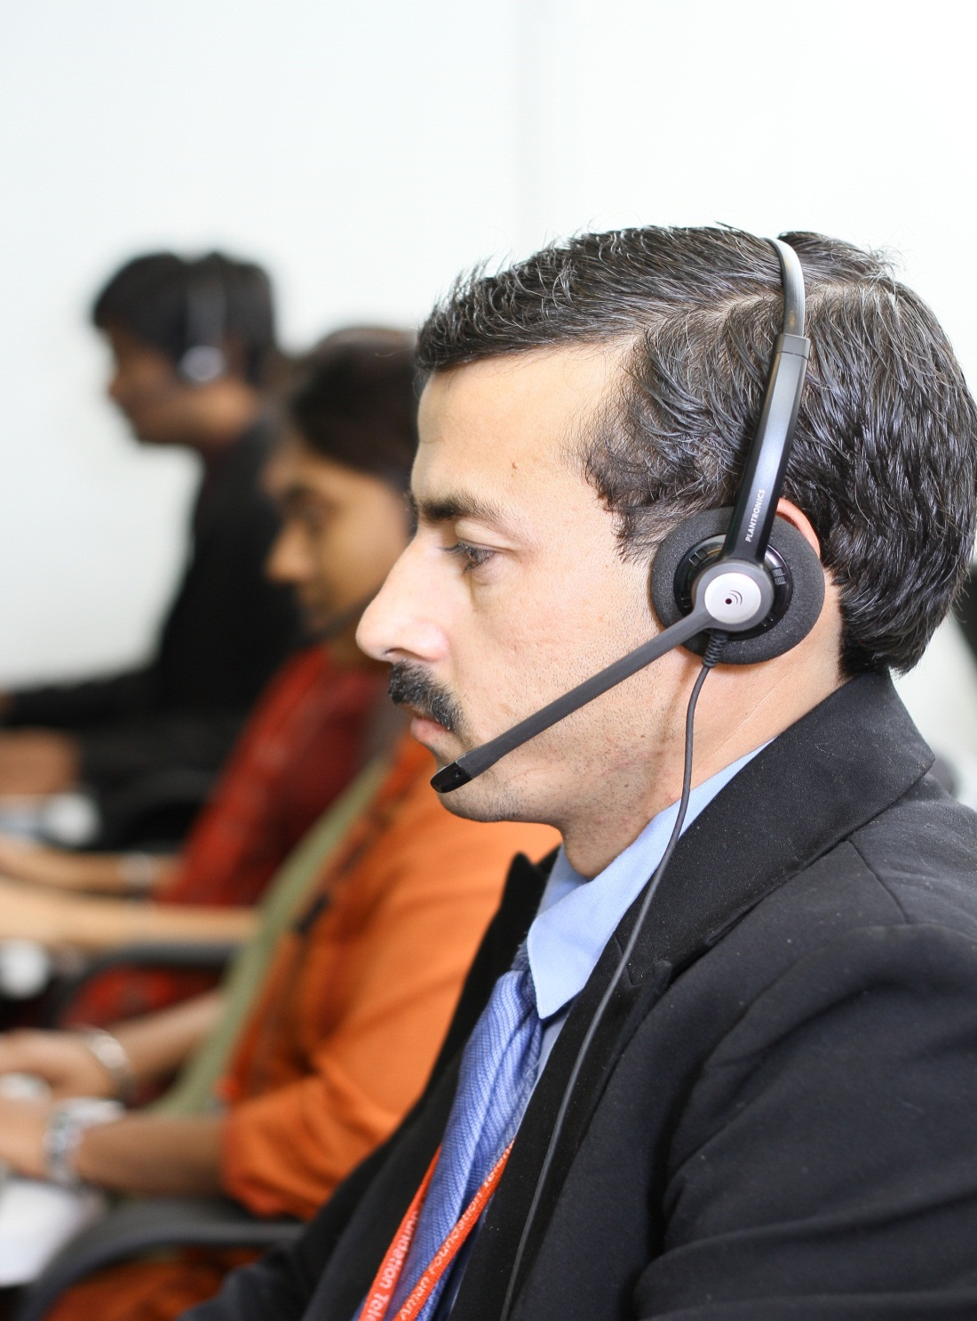
  Launched in January 2012
  State of the art Health Helpline Service operating over 3 shifts, 24/7, 365 days with:
    26 Seats (10 + 10 + 6)
    Capacity to handle 1000 calls/day
    37 trained Nurses, Counselors and Doctors
    Advice in more than 7 languages English, Urdu, Sindhi, Punjabi, Pashto, Siryaki and Hindko
    Over 85 Medical Algorithms and 600 Diseases Summaries
    Over 2400 Health Facilities and over 10, 000 Health Care Providers’ Information available for Karachi District in the form of Health Directory
    Health Alert System available for Public Health Awareness Messages via SMS
    Offer Health Screening and Education Services with focus on Factory Workers and Corporate Employees and integrate them with the Telehealth System
    IT Enabled Services i.e. Data Center for higher efficiency in AMAN Premises, Algorithm based Application and Application integrated with Nortel PBX system
AMANTELEHEALTH
021-111-11-3737/9123

Slide 39
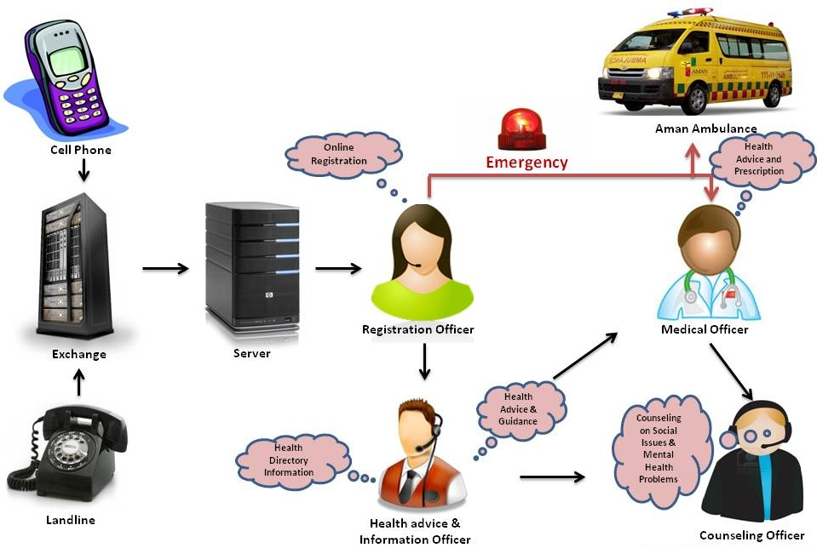
AMANTELEHEALTH
021-111-11-3737

Slide 40

Total Calls Per Month (Trend)

Slide 41
KPIs | May 16 – Dec 31, 2011 |  | Jan – Dec, 2012 |  | January – September, 2013 |  | Total
Total Calls Received | 2422 |  | 7562 |  | 57,908 |  | 67,892
Average Handling Time | 13 minutes, 57 seconds |  | 09 minutes, 24 seconds |  | 07 minutes, 02 seconds |  | 10 minutes, 08 seconds
New Calls/Repeat Calls Report | Data Not Recorded |  | New Calls | 66% | New Calls | 67% | New Calls | 66%
 |  |  | Repeat Calls | 34% | Repeat Calls | 33% | Repeat Calls | 34%
Gender Report |  |  | Male | 78% | Male | 86% | Male | 82%
 |  |  | Female | 22% | Female | 14% | Female | 18%
Age Report |  |  | Up to 5 Years | 4% | Up to 5 Years | 1% | Up to 5 Years | 3%
 |  |  | 6 – 15 Years | 3% | 6 – 15 Years | 2% | 6 – 15 Years | 3%
 |  |  | 16 - 39 Years | 68% | 16 - 39 Years | 74% | 16 - 39 Years | 71%
 |  |  | 40 - 59 Years | 20% | 40 - 59 Years | 20% | 40 - 59 Years | 20%
 |  |  | Above 60 | 5% | Above 60 | 3% | Above 60 | 3%
Call Medium Report |  |  | Mobile | 72% | Mobile | 76% | Mobile | 74%
 |  |  | Landline | 28% | Landline | 24% | Landline | 26%
Call Origin Report |  |  | Karachi | 92% | Karachi | 90% | Karachi | 91%
 |  |  | Out of Karachi | 8% | Out of Karachi | 10% | Out of Karachi | 9%
Top 3 Town (Karachi) | Gulshan Town | 16% | Gulshan Town | 16% | Gulshan Town | 13% | Gulshan Town | 15%
 | Korangi Town | 15% | Korangi Town | 15% | Saddar Town | 11% | Korangi | 10%
 | Malir Town | 10% | Malir Town | 10% | Malir | 8% | Malir | 9%

Slide 42

AMANTELEHEALTH – Impact & Outcomes
Early-stage interventions and detection of medical conditions in order to prevent the 40% of premature deaths in Pakistan
Timely referral to the right healthcare facility reduce load of patients on major Public and Private Hospitals with high-density impact on tertiary and secondary health care facilities.
Reducing the Incidence of chronic diseases by increasing healthy habit uptake in high risk communities.
  Reducing the Barriers (like transportation cost and other indirect medical expenses).
Women and Youth Empowerment by encouraging them to seek health advice on phone.
AMANTELEHEALTH
021-111-11-3737

Slide 43

ICT Goal: By using mHealth technology support CHW’s to make early decisions, enable data compilation, real-time surveillance, improve treatment compliance, epidemic management, health promotion and disease prevention.
AMAN Community Health Care Program

Slide 44

Expected Outcomes from ICT Solution:
Effective implementation of the ICT solution will enable CHW to provide quality service intervention aided by decision support system.
Tracking GPS coordinates will allow real time surveillance of field operations.
3. Report generation , KPI reporting will be in real time and more credible.
AMAN Community Health Care Program

Slide 45
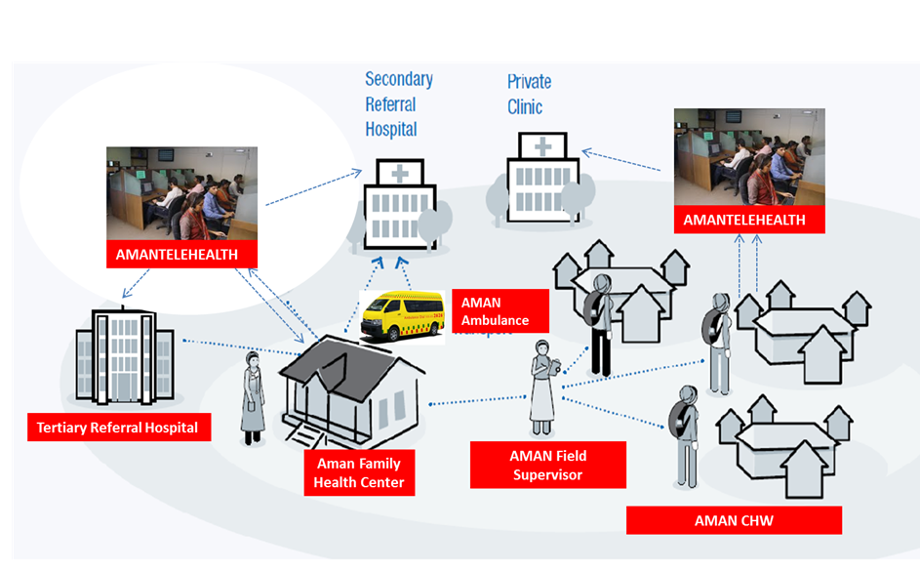
Future of ICT in AMANHEALTH
Integrated Health Echo System

Slide 46
Challenges for ICT Enabling Services of AMAN
Lack of Leadership, Governance and Policy in eHealth - No country eHealth Policy or Strategy
Legal - lack of legal frameworks to support implementation of eHealth services
Human Resources – Lack of suitably qualified or experienced professionals who can develop and implement eHealth projects and promote their use
Services and Applications –existing eHealth Applications are unaffordable, or not appropriate for our needs, require customization
Limited ICT Infrastructure – not yet adequate, accessible, or cost-effective to support desired services
6. Sustainability – Limited business development models for broad and sustainable eHealth service delivery

Slide 47
Way Forward
Development of AMANHEALTH ICT/eHealth Strategy
Enhancement of IT Infrastructure including Hardware, Software and Connectivity for integration of Health Echo System
Looking for Business Development Approach and Partnerships
Promotion of Telehealth services across Pakistan through marketing strategies.
Collaboration with eHAP for implementation of eHealth projects/initiatives for effective healthcare services

Slide 48


Transforming Lives
…together we can transform millions more
CONFIDENTIAL AND PROPRIETARY
Any use of this material without specific permission of Aman Foundation is strictly prohibited

