Slide 1
The Employment Enigma in Arab Countries
ITU Arab Regional Development Forum
(Manama, Bahrain)
Session 2: The Development of ICT for Job Creation
Abdulilah Dewachi
adewachi@ieee.org
28 October 2013

Slide 2
Major issues
ICT employment and job creation issues are part of a very large problem in the region;
Roles and responsibilities of governments;
Employment structure (supply versus demand);
Education and the job market;
Unclear and unstructured ICT sector.

Slide 3
Roles and responsibilities of governments
Badly mimicking free market economies of developed countries and the trends of globalization;
Since the 1990’s most governments have abandoned their responsibilities for jobs creation;
Lack of funds for improving government services;
Not enough incentives for private sector investments and enterprises;
Entrepreneurship and venture capital environment;
Missing effective labour market information systems (LMIS) in most countries.

Slide 4
Result: Unemployment rates by region [2008]
unemployment in the region (especially in non-GCC countries) is larger than other regions of the world

Slide 5
Result: Total and Youth Unemployment by Region (2010)
The youth bulge in the region (population aged 15-24) accounts for about 30% of the overall population (compared to 18% worldwide). It has also been shown that youth unemployment in the region is the highest compared to other regions of the world.

Slide 6


Slide 7
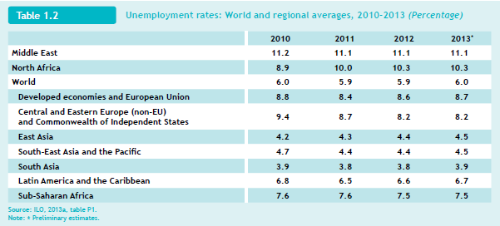

Slide 8
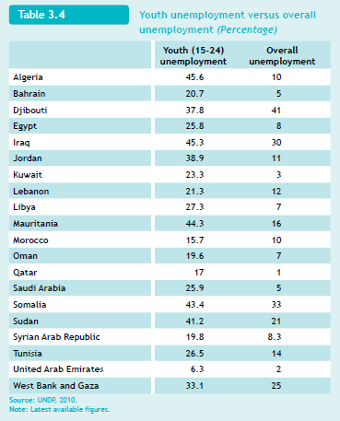

Slide 9
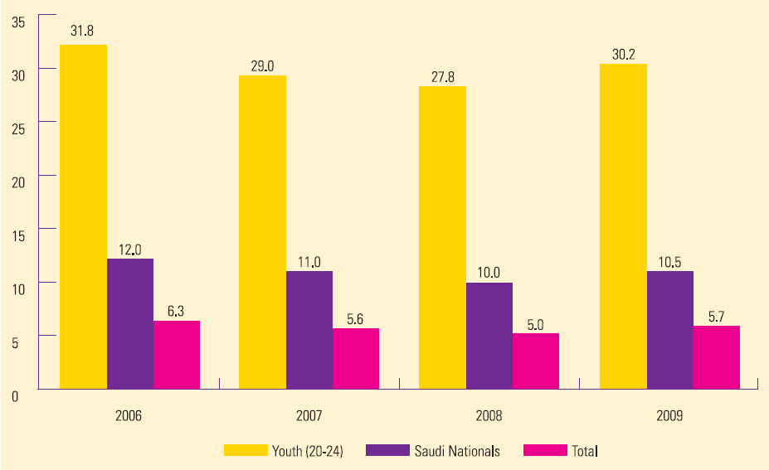
Unemployment rates in Saudi Arabia

Slide 10
The Ultimate Catastrophe
Dissatisfied masses of the young and unemployed;
Penetration of extremist and violent movements that attract the young unemployed;
Demonstrations, uprisings, peaceful and later violent regime change attempts (the so called “Arab Spring” model);
Deplorable disparity in income between high government officials the rest of government workers;
Corruption, kidnapping, crimes, protection payments, insecurity etc..;
Immigration of the young and educated professionals.

Slide 11
The General Employment structure

Slide 12
National ICT strategies in Arab countries
Not enough attention was given in the ICT strategies, of mostly all countries in the region, to national unemployment issues and how ICT could provide opportunities for job creations as well as the tools for effectively planning and monitoring the labour market

Slide 13
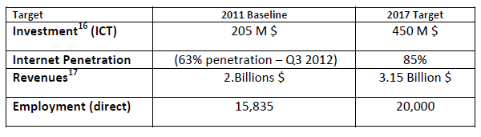
Jordan’s National ICT Strategy (2011 – 2017)

Slide 14
Education and the job market
Education curricula in universities are heavily modelled on curricula of the developed and industrial countries;
Graduates cannot relate their studies to the labour market requirements. They are therefore ready items for export;
Neither governments nor private sector companies have clear and well planned orientation and training programmes for young graduates.

Slide 15
Innovation and Entrepreneurship growth strategy (infoDev)
Strengthening National Innovation and Entrepreneurship Eco-Systems through Stakeholder Engagement
Enabling Youth Entrepreneurship through Education & Collaboration with the Private Sector
Facilitating Technology Commercialization of University Outputs
Bridging the Financing Gap for Technology Entrepreneurs through Catalyzing Action
Building Capacity for Policies, Regulations and Government Programs
Fostering SME Internationalization through Co-incubation

Slide 16
Risks and mitigating measures
Failure to build local institutional capacity, local ownership and broad-based stakeholder buy-in needed to ensure the sustainability of the incubator;
Difficulty in finding appropriate space for new incubators;
Insufficient policy support from government officials;
Failure to accurately understand the demand for services.

Slide 17
Basic capabilities requirements
A digital market maker requires policymakers to adopt a holistic ecosystem perspective. Less lip service and more field actions;
ICTs range beyond basic infrastructure, and policymakers need to look at a multilayered ICT ecosystem to understand what role they play to enable creation of digital markets;
Where the private sector does not have sufficient incentive to undertake the development of critical digital infrastructure, the state needs to play the role of a developer, becoming a participant in the market—either directly or through a public-private partnership

Slide 18
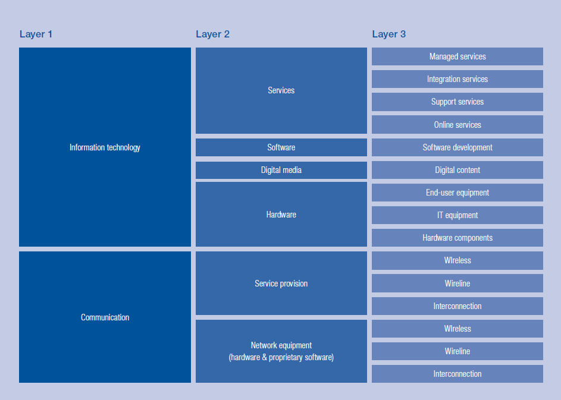
The ecosystem perspective

Slide 19
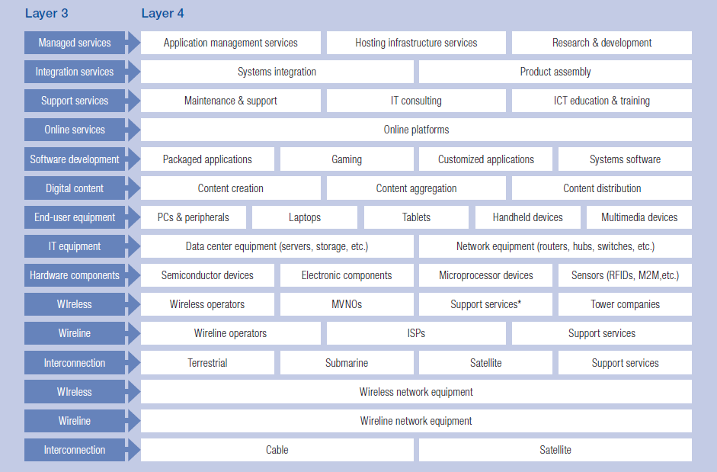
The ecosystem perspective

Slide 20
The road ahead
Governments should bear the responsibility of finding employment to their citizens through:
  Embarking on large knowledge based projects, either alone or in partnership with stakeholders in the private sector;
  Implementing effective labour market information systems which should provide monitoring facilities for following up progress and trend lines;
  Creating conducive environments for investments, entrepreneurships, venture capitals;
  Creating well structured ecosystems for the ICT sector in partnership with the private sector and educational institutions

Slide 21
The road ahead
Digitization for building advantages
  Creating digital markets and boosting digitization can yield significant economic benefits and lead to substantial social benefits to societies and communities;
  Digitization has the potential to boost productivity, create new jobs, and enhance the quality of life for society at large.

Slide 22
The road ahead
Building up a robust national ICT sector through public private partnerships
  Despite the importance of small and micro enterprises, these cannot lead to a well structured sector with high level professionals working on projects with research components and ambitious deliverables;
  Large, perhaps government initiated and funded projects are the way to create the necessary high level human resources of nations.

Slide 23
References
ILO KILMNET dataset
ILO and IMF data, as quoted in http://www3.weforum.org/docs/WEF_YouthEmployment_ArabWorld_Report_2012.pdf
ICT in Saudi Arabia, A Socioeconomic Impact Review, October 2011
infoDev | ICT-enabled Business Incubation Program, Strengthening Innovation at the Grassroots, June 2009
WEF, INSEAD, The Global Information Technology Report 2013, Growth and Jobs in a Hyperconnected World
Jordan National Information and Communications Technology Strategy (2013-2017)

Slide 24
thank you

