Slide 1
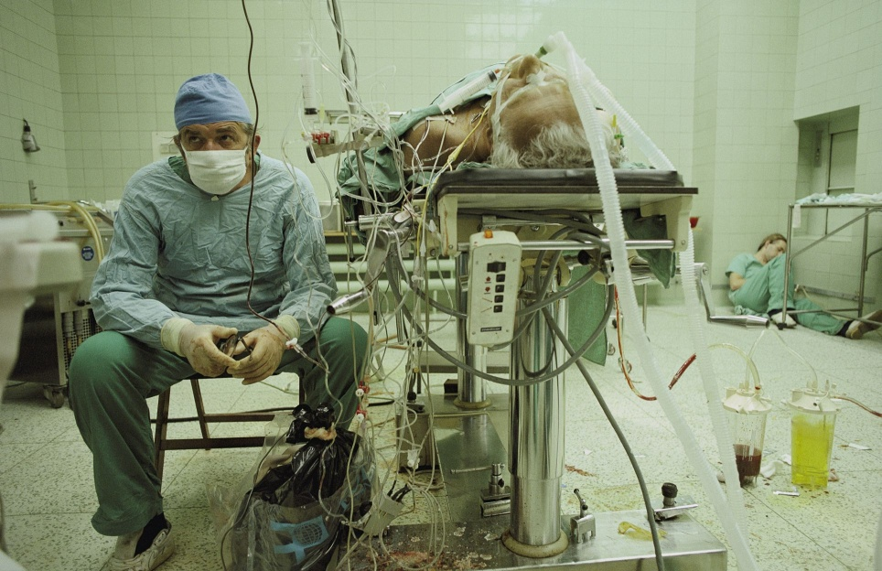
Use of ICT in the Polish health care system
Benefits for patients
Photo: James Stanfield, National Geographic
Magdalena Gaj
President of Office of Electronic Communications
Bahrain, 28th October 2013

Slide 3
ICT AND E-HEALTH
E-health development Consistent state policy
Valuable
online content
New skills and qualifications for the health sector
The EU
projects
Widespread
distance
medical services

Slide 4
E-HEALTH PROJECTS
Implementation
Two institutions
CSIOZ: Centre of Health Information Systems – unit of the Ministry of Health
NFZ: National Health Fund – unit financing public health services

Slide 5
CSIOZ PROJECTS
E-platform: collecting, analysing and sharing digital medical records
(in progress, till end of 2014)
E-platform :
sharing services and digital medical records with online businesses
(implemented)
P1
P2

Slide 6
Service for citizens
For patients
access to medical information regardless of locations
doctors, with patients permission, able to access collected data to improve treatment
ICT promotion - the information society
reinforcement of e-economy
instant access to information (pandemics, epidemics)
health promotion for welfare and social solidarity
safety and health
health awareness
P1

Slide 7
Goals
Genesis
healthcare participants unable to exchange information
Benefits
bilateral exchange of digital records
e-communications between health care enterprises and public bodies
Central Register of Doctors
Register of Public Pharmacies
e-registration and data update
e-storage of documents
public administration able to extract registers data
P2

Slide 8
NFZ PROJECTS
eWUŚ MEDICAL INSURANCE VERIFICATION SYSTEM
ZIP INTEGRATED PATIENT REGISTER
KUZ HEALTH INSURANCE CARD (in preparation)

Slide 9
Based on information exchange
between the National health Fund (NFZ)
and Social Insurance Institution (ZUS)
Verification of a patient`s health insurance within seconds
Proof of medical insurance no longer needed except a valid ID
Operating since January 1, 2013
Over 3 million patients per day

Slide 10
Registered users check their medical treatment history (2008-2013)
Over 300 000 Poles registered in ZIP
(since its launch on 1st July 2013)
24/7 access to information on your medical record, prescription and treatments
Verify your medical treatments
Access important information on prevention programmes and treatment abroad

Slide 11
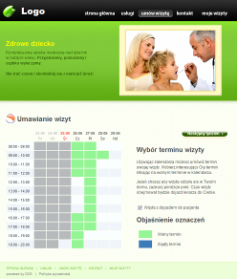
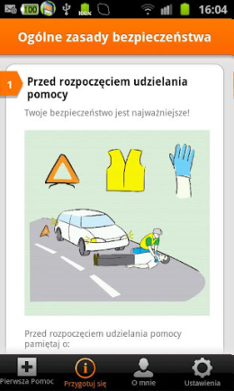
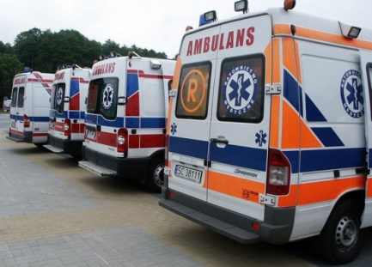
E-HEALTH SOLUTIONS PRIVATE SECTOR IN POLAND
Paging system
Virtual desk
First aid
Ambulance monitoring

Slide 12
Paging system
Modern Wireless Based on IP For efficient communication
Functions of a pager and a phone
Virtual desk
Smaller businesses
Patients book appointments online
SMS reminders
Websites for surgeries
First Aid app
Tips on first aid in emergency
Personalization (name, photo, medical info)
Ambulance monitoring
Local government (Małopolska)
Earlier arrival Better communication Effective management of medical resources

Slide 13
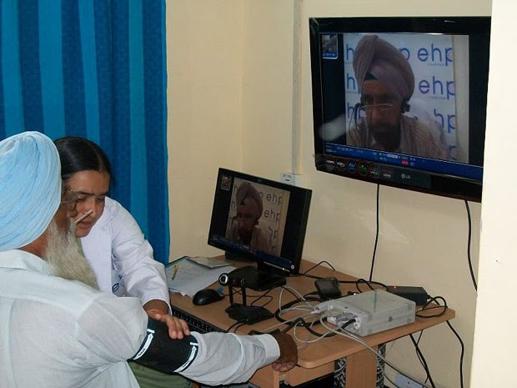
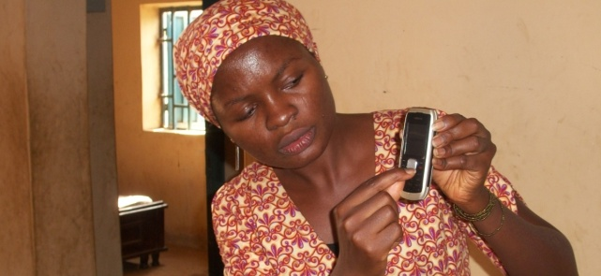
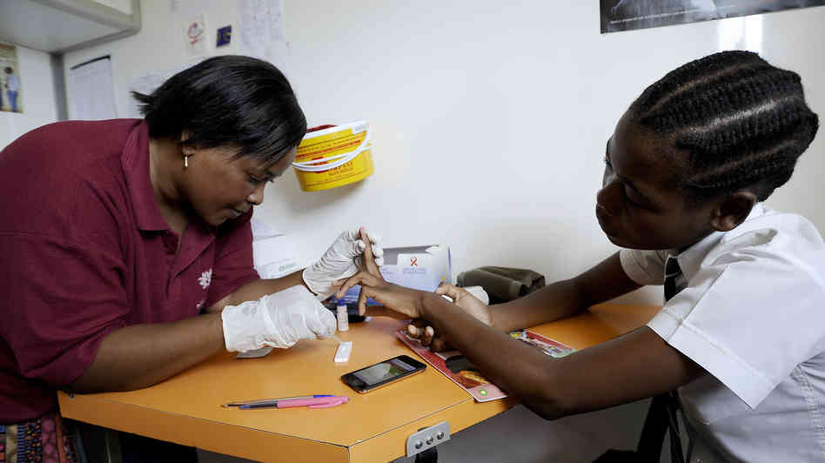
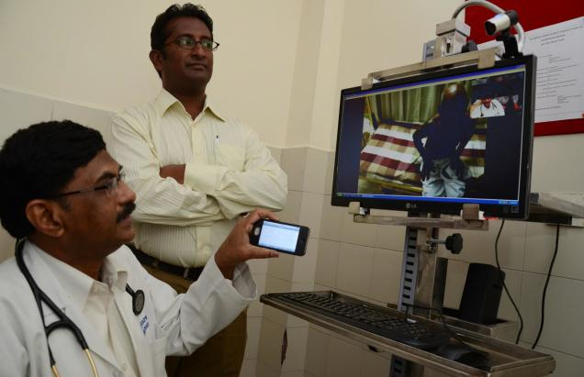
MEDICINE BASED ON ICT IS THE FUTURE
13

Slide 14
Magdalena Gaj
President
Office
of Electronic
Communications
Republic of Poland
m.gaj@uke.gov.pl

