Slide 1
ITU Arab Regional Development Forum
Session 2: The Development of ICT for Jobs Creation
ICT Business Incubators as a strategic choice for jobs creation
By : Mohammad Allam Al-Qaed
Bahrain Business Incubator Center
Manama, Kingdom of Bahrain

Slide 2
Business Incubators Quick Definition
Institution that nurtures entrepreneurs to create successful start ups and provide set of designed services to foster their growth for specific period of time.

Slide 3
Innovation & Entrepreneurship Eco-System
Social and Economic Wealth Creation
Human ingenuity
Markets
Skills
Innovation
Notes:
So the goal is to create social and economic wealth – for the individual and for the country. For that we need markets and we need human ingenuity. Human ingenuity you find everywhere. New ideas you find everywhere. So you need skills. What else?

Slide 4
Innovation & Entrepreneurship Eco-System
Finance
Infrastructure
Social and Economic Wealth Creation
Policy Regulation
Human ingenuity
Incubators
Markets
Skills
Innovation
Skills
Technology Parks
Academia
Business
Entrepreneurs

Slide 5
Innovation & Entrepreneurship Eco-System
Finance
Infrastructure
Social and Economic Wealth Creation
Policy Regulation
Human ingenuity
Incubators
Markets
Skills
Innovation
Skills
Technology Parks
Academia
Business
Entrepreneurs

Slide 6
Economic Development?!!
Ok, establish an incubator

Slide 7
Finally I established the Incubator, Now the economy of the country is fixed.

Slide 8
Shobaik Lobaik AL-Incubtor is Bain Edaik
You Have Three wishes.
Incubator Manager
Objection, 1000 wishes:
New big companies.
Jobs Creation.
High salaries Jobs
Exports.
Import Substitution.
Value Addition.
Everything.

Slide 9
Creation of sustainable Story from Bahrain
Number of jobs will be created in the incubation period.
More jobs will be created after growth.

Slide 10
Story from Bahrain
2002 BBIC initial thought to establish an ICT incubator. Market survey indicated different demand (Light Manufacturing).
2010 Expansion with more offices.
2013 Now ICT incubator RUKEN ME, new concept is born ☺, Riyadat, and more

Slide 11
Story from Turkey
Incubator have achieved to create new rule for Academic professors to start businesses.
More than 40, 000 employees.

Slide 12
ICT Incubators trends in MENA
New trend of establishing incubators in universities (Sudan, KSA, Morocco, Bahrain, etc).
Many ICT incubators are established and under establishment (Lebanon, Syria, Egypt, KSA, Bahrain, Oman, Qatar, Sudan, Tunisia etc. )

Slide 13
Source: ESCWA Benchmarking report on Business Incubators

Slide 14
Regional attention to ICT Incubators in MENA
ESCWA, May 2013.
ITU, 13th November 2014
CMI and the IESCISCO, Morocco.3rd November.
KSA 5th Conference for technology incubators. 4th November.

Slide 15
10 out of 50 are from the Arab Region (MENA)
InfoDev Top 50 Competition 2011
AlKhawarizmy Software | Egypt
DATANIL Software | Egypt
Mixed Dimensions | Jordan
Ciapple | Jordan
ADDICTS 123 | West Bank & Gaza
Ibtaker for Technological Innovation | West Bank & Gaza
s-me.com | Saudi Arabia
VoTek for Speech Recognition Solutions | Syria
Acies International | Tunisia
Chactech S.A | Tunisia

Slide 16
Recommendation
1- Business Incubators are needed in each neighborhood. Just like hospitals and schools.
2- Support creation of more ICT incubators and Techno Parks with sound business model. (for profit or not for profit).
3- Results takes time.

Slide 17
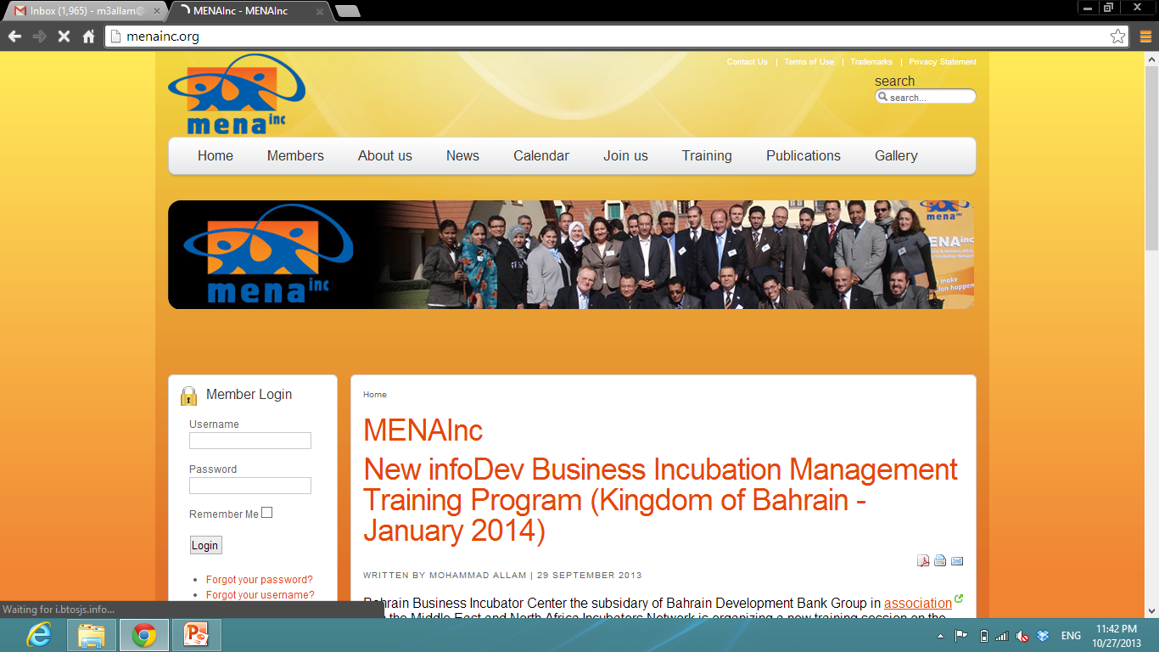
Invitation for the infoDev Training
Invitation.

Slide 18
ITU Arab Regional Development Forum
Session 2: The Development of ICT for Jobs Creation
ICT Business Incubators as a strategic choice for jobs creation
Manama, Kingdom of Bahrain
By : Mohammad Allam Al-Qaed
Bahrain Business Incubator Center

