Slide 1
S2: The Development of ICT for Job Creation
ITU Arab Regional Development Forum
(Manama, Kingdom of Bahrain)
Your Development for the career you wish
Khalid AlQoud
www.khalidalqoud.com

Slide 2
Today Facts
75 million young people are unemployed worldwide
Globally young people are on average nearly three times more likely than adults to be unemployed
Four out of every ten unemployed worldwide is a young women or man
Over 1.2 billion people in the world between 15 and 24 years of age
40 % of the world's unemployed are young people
Source: ILO, Trends Econometric Models, February 2013.

Slide 3
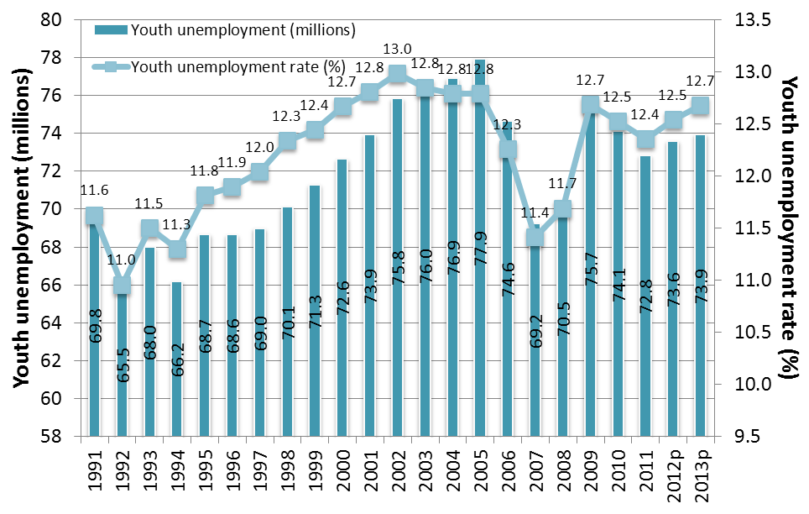
Global youth unemployment and unemployment rate, 1991-2013
Source: ILO, Trends Econometric Models, February 2013.
Source: ILO, Trends Econometric Models, February 2013.
Notes:
Global youth unemployment is estimated to stand at 73.4 million in 2013
Increase of 3.5 million since 2007 and 0.8 million above the level in 2011
Global youth unemployment rate decreased from 12.7 per cent in 2009 to 12.3 per cent in 2011, but increased again to 12.6 per cent in 2013
By 2018, global youth unemployment rate is projected to rise to 12.8 per cent

Slide 4
Bahrain has unemployment rate which remained as low as 3.8 % with the number of jobless people going down from 7222 in October to 6788 in December 2012.
Mostly Young People

Slide 5
Consequences of youth unemployment
Is likely to become more serious the longer youth unemployment crisis continues
Raise risk of future unemployment and/or protracted period of unstable employment
Valuable work experience is not acquired and professional skills may erode
Effects more severe for youth entering the workforce with education level below university level
Is likely to result in wage scars that continue to depress employment and earnings prospects
Youth are increasingly employed in non-standard jobs, including temporary employment and part-time work
Notes:
Consequences:
Little progress has been made in reducing youth unemployment
Economic and social costs of unemployment, long-term unemployment, discouragement and widespread low-quality jobs for young people continue to rise and undermine economies’ growth potential
Current youth generation has to be less selective about type of job they accept
Youth are increasingly employed in non-standard jobs, including temporary employment and part-time work
Missmatch of skills: Overeducation and undereducation

Slide 6
We should focuses on five policy areas
employment and economic policies to increase aggregate demand and improve access to finance;
education and training to ease the school-to-work transition;
labour market policies to target employment of disadvantaged youth;
entrepreneurship and self-employment to assist potential young entrepreneurs; and
labour rights that are based on international labour standards to ensure that young people receive equal treatment.

Slide 7
What works for youth?
Policiy measures
Balanced strategies for growth and job creation
Comprehensive packages of labour market measures targeting specific groups of young people
Apprenticeships, skills training and other work-training programmes
Platforms for exchanging knowledge and lessons of what works
Targeted youth employment action through a time action plans
Multiple services for entrepreneurship, social enterprises and cooperatives development
Employment services
Business Start-up Bank loans for youth
Notes:
Considerable Progress made in education, but universal access and better quality education STILL needed
Better links between education, training and the world of work
Apprenticeship and other work experience programmes are effective IN preparing young people for the labour market
Employment services
Promoting youth entrepreneurship as a career option
Cooperatives and social economy provide opportunities for youth
Much more to be done on social dialogue

Slide 8
It’s not the role of government – everyone has a role to play
Young people
Parents, carers and families
The media
Businesses
Teachers
Youth workers
Other professionals
Local authorities
Societies
Government
Notes:
8
Government cannot create a society that is positive for youth on its own. Real progress depends on everyone playing their part:
Young people – taking responsibility, making the most of every opportunity available, and speaking up on issues they care about.
Parents, carers and families – having the primary responsibility and influence to nurture young people through to adulthood.
Other adults – informally or formally in their role as Community leaders or volunteers, taking an interest in the lives of their young people and being positive role models.
The media – taking responsibility for the impact of the images of young people that they promote.
Businesses – building partnerships through which to give time, expertise, and money to projects to support young people.
Teachers – helping young people aspire and attain, and working in partnership with other services to address early any barriers they face.
Youth workers – in voluntary and statutory organisations, supporting young people’s personal and social development and helping them develop strong aspirations.
Other professionals – providing specialist early help to young people to address issues and stop them escalating and causing harm.
Local authorities – having the primary responsibility for improving young people’s outcomes and commissioning appropriate services.
Other commissioners – having a responsibility for specific outcomes such as crime and health outcomes for young people.
Government – promoting new ways of working, facilitating reform, and monitoring overall progress.

Slide 9
We should build
What this means for local authorities
What this means for YP
A positive place for YP
A stronger voice
Services for young people support key outcomes
Support for families
Community responsibility
Early help to succeed
New guidance to clarify expectations
Integration
New opportunities
Young people must have a voice
Effective early help
Open markets
A more positive place in society
Responsibility to improve
Innovative Space
Notes:
9
Positive for Youth promotes local leadership and encourages local cross
sector partnership. It does not tell local areas what kind of services to fund or
deliver to young people. This is a matter for local partners in response to local
needs and priorities. But it does identify the principles of a high quality local
system of support:
a more positive place and active role for young people in society with more recognition and celebration of their achievements;
a stronger focus on supporting whole families while respecting and nurturing young people’s growing sense of independence and personal responsibility;
a greater acceptance of responsibility in communities, including business communities, for the engagement and wellbeing of their young people and the sustainability of local provision;
a more integrated approach across different commissioners, professions, and providers of both publicly and non-publicly funded services, to release cost savings and ensure all young people get the support they need;
a stronger focus for public funding on evidence-based early help for the most disadvantaged and vulnerable young people;
a more contestable market for publicly funded services with a stronger focus on results; and
a more enterprising and innovative voluntary and community sector able to demonstrate its impact and secure diverse sources of income.

Slide 10
What this means for voluntary organisations
What this means to YOU
What this means for business
Recognition of role in lives of YP
Government is tackling youth unemployment
YOU
A stronger voice
A responsibility to help YP play positive role in society
ARE
More open public services
Business case for supporting youth organisations
THE
Opportunities for innovation and growth
Opportunities for engagement
CHANGE
Notes:
10
Positive for Youth recognises the expertise of a wide range of community, faith, and
other voluntary organisations in improving education, health, and other outcomes – often
independent of public funding. They can be particularly good at reaching young people
who are reluctant to engage with statutory agencies. The financial climate means that
many VCSOs are having to work hard and develop innovative approaches to maintain
their activities and services for young people. Positive for Youth:
Gives the VCS a stronger voice
We will continue to work with VCSOs that contributed to Positive for Youth, including through the DfE’s strategic partner, Catalyst, funded to April 2013
The Youth Action Group is bringing together government Ministers from nine departments with leaders of a number of the largest youth VCSOs to discuss the needs of disadvantaged young people
Promotes more open public services
The Localism Act creates the right to bid to take over the running of LA services
We will consult in early 2012 on revised statutory guidance to clarify expectation on LAs – including to consider and grow role of VCSOs in delivering public services
Supports innovation and growth by
helping VCSOs demonstrate their impact through new standards for evidence, and work to develop a new outcomes framework (including signposts to range of tools)
encouraging LAs and their staff to look at new forms of delivery of services of young people, including mutuals and joint venture partnerships with voluntary sector charities
Increasing access to the capital VCSOs need to grow by helping them understand and access social investment
funding Business in the Community to broker the engagement of more businesses to support VCSOs’ work with young people
Myplace and National Citizen Service present opportunities for VCSOs to lead or take part in innovative partnership-based approaches to supporting young people

Slide 11
To address youth unemployment
Employability – investing in education
Equal opportunities – for men and women
Entrepreneurship – start and run businesses
Employment creation – as part of macroeconomic policy
4E’s

Slide 12
The future needs
Local and regional action plans for youth employment.
Mobilizing financial resources for youth employment
Linking youth employment with education
Expanding on youth participation in policy and action: “No decision making without youth participating”

Slide 13
Let’s start The Youth Employment Network (YEN)

