Slide 1
Telecentres and WSIS beyond 2015
28 October 2013 Session 5 WSIS
Manama Bahrain
Ahmed M. M. Eisa
GDCO-SuNTA Sudan
Ahmed22digital@gmail.com

Slide 2
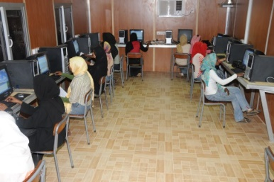
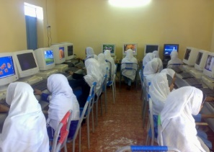
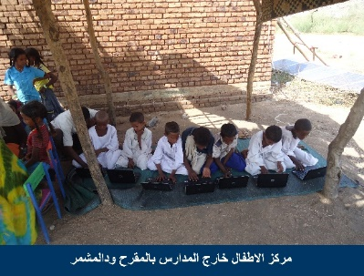
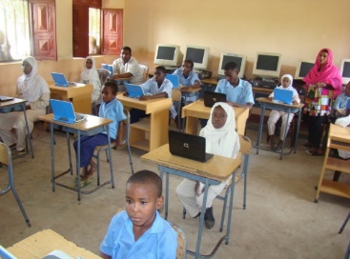
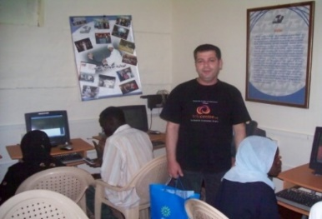
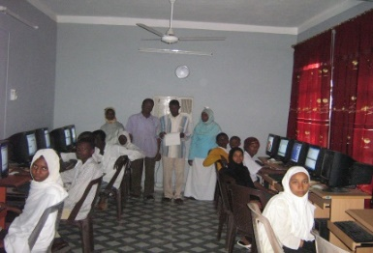
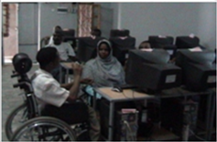
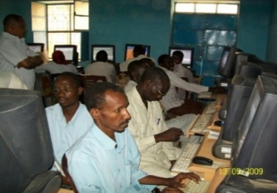
What is the Telecentre initiative?
What is Telecentre?
Telecentre.org Network?

Slide 3
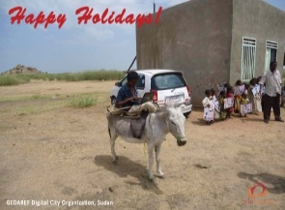
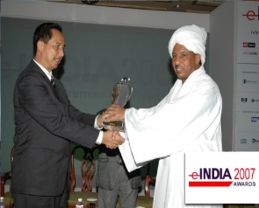
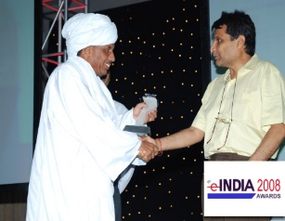
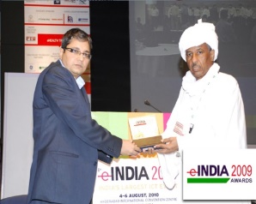
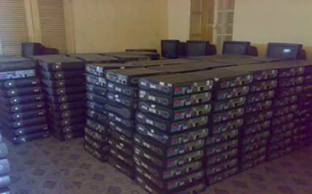
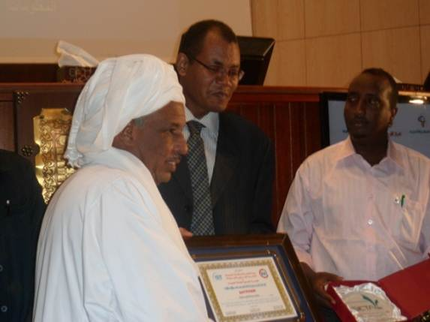
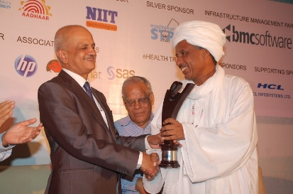
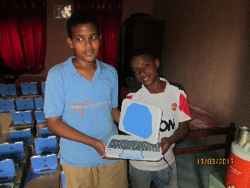
What is GDCO Sudan
GDCO is a win-win PPPP 4 sharing knowledge, experience and best practice. It is founded in partnership with DSE Netherlands 750
Founder of the first Telecentre academy in Africa, the Middle East and the 13th in the world
Winner of 8 i4d awards
(SuNTA)

Slide 4
GDCO contribution to the WSIS since 2009
Online consultation process
Country or thematic workshop
WSIS Forums Exhibitions
Iwrite4wsis initiative 4 innovation & ICT promotion
World telecom & WSIS Award Prize
Connecting Arab Summit (Doha)
ICT4all (Tunisia)

Slide 5
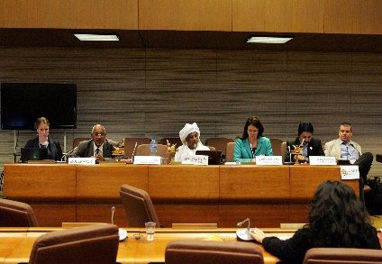
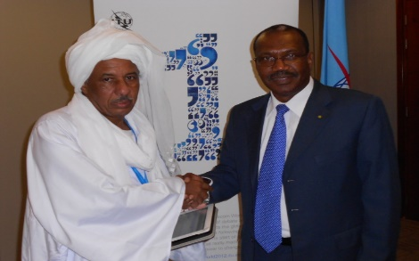
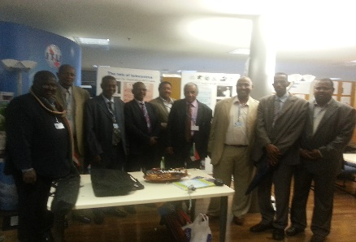
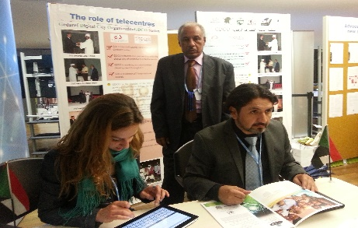
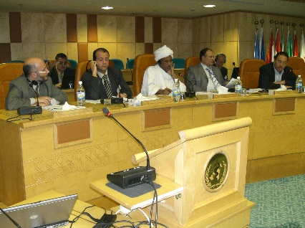
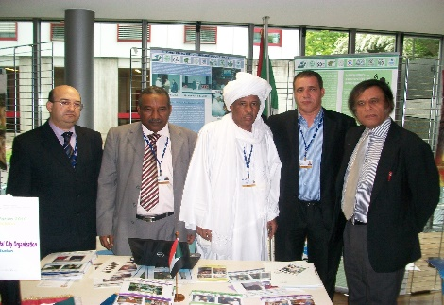
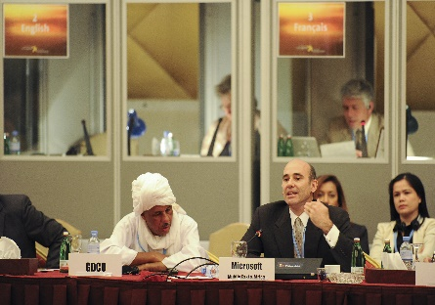
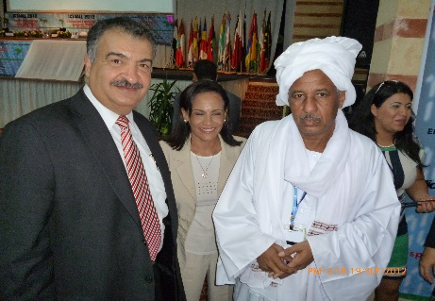
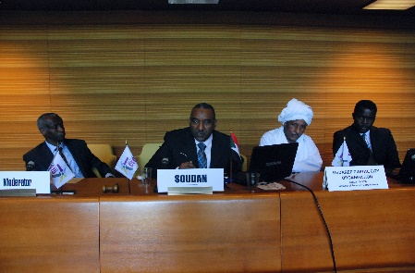
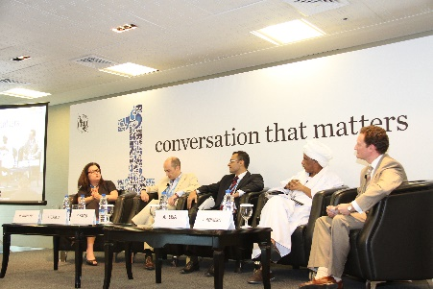
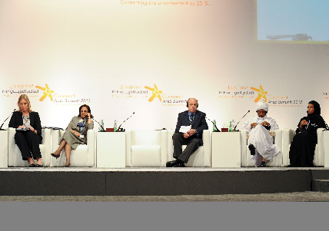
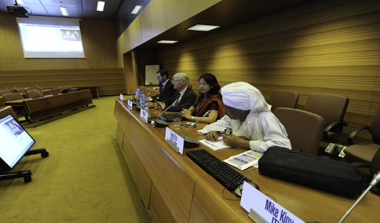
GDCO & ITU & WSIS

Slide 6
Iwrite4wsis initiative
In 2010 ITU in partnership with GDCO and other partners developed the initiative of iwrite4wsis to promote for the wsis process so we continued writing and blogging to update the wsis community with what is going on WSIS process

Slide 7
priority areas that need to be addressed Beyond 2015
Equal access to ICTs by empowering women, youth, and people with disability & marginalized communities.
Illiteracy eradication (drying resources of illiteracy)
Fighting poverty
Innovation & integration of ICTs e-services (portable Telecentre)
Increase mobile penetration @ Affordable wide broadband accessibility and improve cloud computing
Promote eHealth and telemedicine
Content (curriculum and accredited certificate)
Strong PPPP for better community SDGs through S. Telecentres

Slide 8
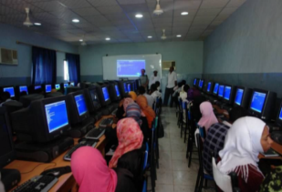
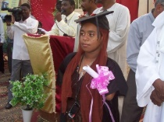
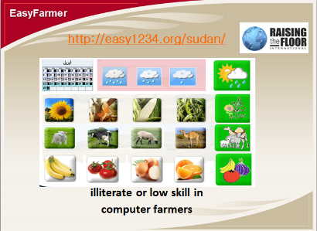
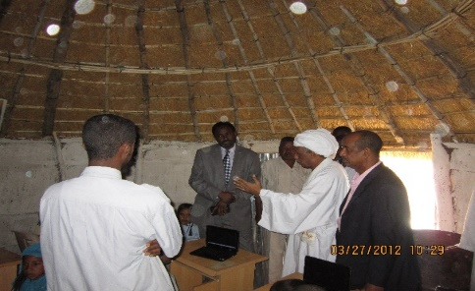
innovation and ICT promotion
illiteracy
disability
Cloud
Portable Telecentres

