Slide 1
Regional and Global Comparative
Analysis of Information Society in the Arab region
Dr. Nibal Idlebi
Chief, ICT Applications Section
UN-ESCWA
September 2013

Slide 2
The outlook of the IS in the Arab region
Main findings based on the Regional Profile of Information Society 2013
The Arab region has taken significant steps towards bridging the digital divide and building the information society.
The prominence of ICTs has grown across the region, with dramatic increases in ICT adoption and use rates.
Serious efforts for lowering the access to ICT.
Building confidence and security in the use of ICTs, and building the ICT sector are still critical issues for building IS in the region.
The region has witnessed an increasing adoption and use of ICT applications and e-services, and a greater participation of the Governments and all stakeholders in building the information society.

Slide 3
Challenges of the IS in the Arab region
  Low ICT readiness and utilization in some member countries
  Broadband penetration and affordability issues
  Lack of confidence and security in the use of ICTs
  Weak, and sometimes incomplete, legal and regulatory ICT framework
  Freedom of access to information and privacy issues
  Fragmentation of ICT applications and services for socio-economic development
  Limited production of substantive digital Arabic content
  Inadequate production of accurate and timely statistics for ICT measurement and analysis for policy-making and decision support purposes
  Human skills gap, in ICT related fields.

Slide 4
Average of Arab Region in selected areas
Information society Components | Average score 2009 | Average score 2011 | Average score 2013
Building confidence and security | 1.29 | 1.29 | 1.75
Building the ICT sector | 1.93 | 1.93 | 2.00
Media | 2.07 | 2.21 | 2.06
ICT applications | 2.21 | 2.29 | 2.12
Enabling environment | 2.21 | 2.43 | 2.31
Access to information and knowledge | 2.21 | 2.43 | 2.37
ICT capacity-building | 2.29 | 2.43 | 2.50
Cultural diversity and local content | 2.21 | 2.50 | 2.50
ICT infrastructure | 2.43 | 2.50 | 2.50
Role of Governments and stakeholders | 2.50 | 2.64 | 2.62
Overall average^{a/} | 2.13 | 2.26 | 2.27

Slide 5
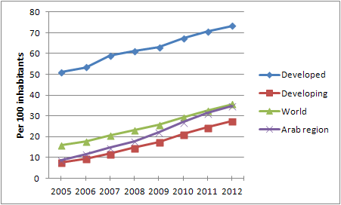
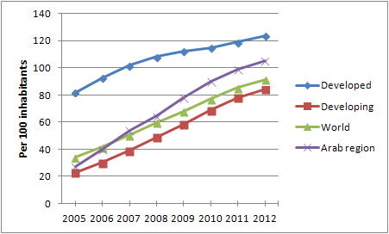
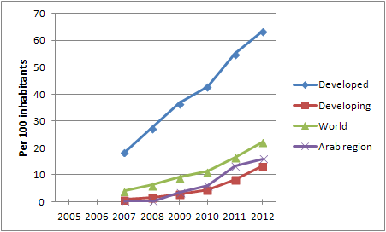
Internet, mobile and Wireless broadband penetration rates
Internet penetration.
Mobile penetration.
Wireless Broadband penetration.
Source: Compiled by ESCWA based on data from ITU. 2012a.

Slide 6
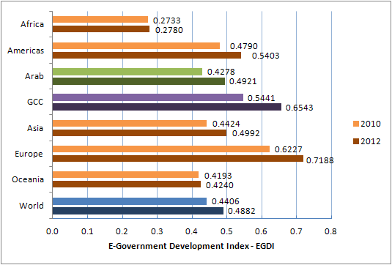
E-Government Development Index
2010-2012
Source: DESA. 2010. DESA 2012

Slide 7
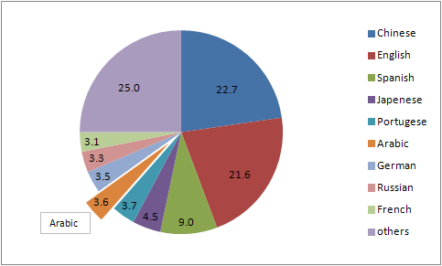
Percentage of online users by language 2012
Source: Ow.ly, available at: http://ow.ly/i/OGva/original

Slide 8
The current context of the Arab region
There are divergent economic and social differences which distinguish the GCC sub-region from the rest.
Non-GCC countries suffer from poverty and high unemployment rates, especially among women and youth.
Most countries in the region face a number of other serious issues including economic and political uncertainty, civil wars, occupation, civil unrest and terrorism.
The Arab region faces many challenges for the realization of the information society and the transition to a knowledge based economy.

Slide 9
The IS priorities in the Arab region
Countries of the region share and should focus on the following objectives:
Increase national capabilities in harnessing ICT for Development (ICT4D) and to enable integration into the global economy
Establish a leading national productive ICT sector
Address the main challenges for building Information Society and move towards knowledge economy.

Slide 10
Thank you
Contact: idlebi@un.org

