Slide 1
Job creation arising from ICT investment and use
David Hughes, Intercai Mondiale
ICT = I C Tomorrow
28th October 2013
Session 2: The Development of ICT for Job Creation

Slide 2
How ICT contributes to the economy
Production of ICT goods and services, which directly contributes to the aggregate value added generated in an economy
Increase in total factor productivity (TFP) of production in the ICT sector, which contributes to aggregate TFP growth in an economy
Use of ICT capital as an input in the production of other goods and services
Contribution to economy-wide TFP from increase in productivity in non-ICT producing sectors induced by the production and use of ICT (spillover effects)
  In the past, this contribution has not been found to be significant
Source: The Impact of ICT on Growth in Transition Economies, Marcin Piatkowski, Warsaw 2004

Slide 3
ICT investment and use generates growth
Impact of “broadband” on GDP
Source: Qiang and Rossotto for the World Bank, quoted in Broadband Strategies Handbook, ITU;
Based on 2000 – 2006 data
Source: Broadband Strategies Handbook, ITU
List of sources of impact of broadband investment: Economic Impact of Broadband Infrastructure and Services - Global Review of Evidence WSIS Lab Team

Slide 4
Various sources report that investment in ICT may result in growth of jobs
Impact of “digitalisation” on GDP and jobs, 2011
Source: Booz & Co, WEF GITR 2013
Digitalisation: A measure of ubiquitous access to affordable, reliable, fast and usable digital services by a skilled population
In North America, this estimation indicates a contribution to GDP growth of 0.1% and to jobs growth of 0.05%
The greater jobs growth in emerging markets was considered to be as a result of large populations, offshoring ,and possibly a greater impact on the economy

Slide 5
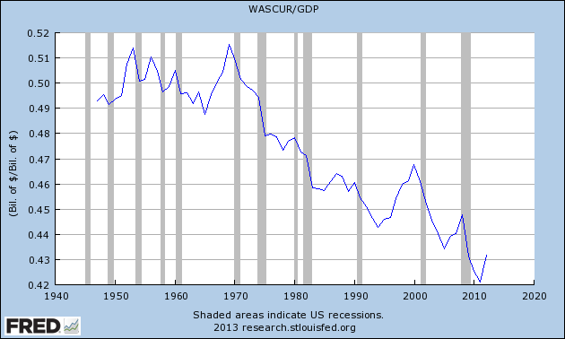
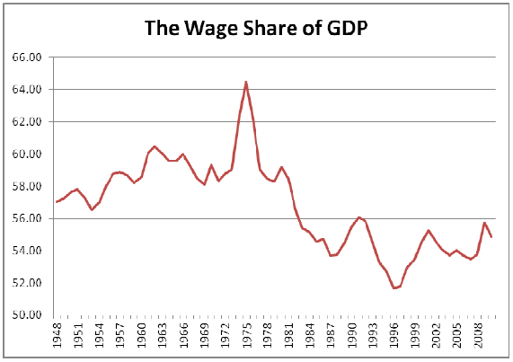
GDP growth from ICT may increase employment, wages and salaries, or it may increase profit
USA: Employee compensation as %age of GDP
UK: employee compensation as %age of GDP
44%
54%
Source: Federal Bank of St Louis
Source: The Great Wages Grab, Trades Union Congress, UK
GDP (income method) = employee compensation + operating surplus (~profit) + taxes less subsidies on production and imports
Employee compensation (wages and salaries, etc) contribute 42% to 56% of GDP
GDP growth from ICT may affect employee compensation or operating surplus
An increase in employee compensation may result in higher salaries or higher employment or both
There is no clear relationship between ICT production, investment and use, and growth in employment

Slide 6
ICT investment and use results in job losses and job gains
Impact of broadband investment and use, EU27, 2006
Source: The Impact of Broadband on Growth and Productivity conducted on behalf of the European Commission by Micus Management Consulting GmbH
Jobs lost through productivity improvements including through outsourcing
Net gain in jobs through new business activities
Overall annual employment gain of 0.05% and GDP gain of 0.71% (82.4Bn Euros)
GDP growth is higher in advanced knowledge societies in Europe and lower in less developed economies

Slide 7
ICT contribution to GDP, labour productivity and employment
Impact of ICT investment and use, EU15, USA, transition countries, 1995 - 2001
Source: The Impact of ICT on Growth in Transition Economies, Marcin Piatkowski, Warsaw 2004; Source of growth in persons employed: Intercai, based on Piatkowski
TFP = Total Factor Productivity
ICT contributed to GDP growth in all economies, but increased productivity most in the most developed economies
ICT increased employment only in the most developed economies
ICT increased employment by a small amount in comparison with GDP growth

Slide 8
ICT producing and using sectors contribution to GDP growth

Slide 9
ICT producing and using sectors contribution to increased labour productivity

Slide 10
Critical factors in stimulating ICT production and use
Possibility of deep structural reforms to
the economy
Quality of institutions and regulations
Trade openness
Direct inward foreign investment
Macroeconomic stability
Vigorous labour and product market
competition
Human capital investment
New Economy Indicators
Quality of regulations and law enforcement
Infrastructure
Trade openness
Financial system
R&D spending
Human capital investment
Labour marker flexibility
Product market competition
Openness to foreign investment
Macroeconomic stability

Slide 11
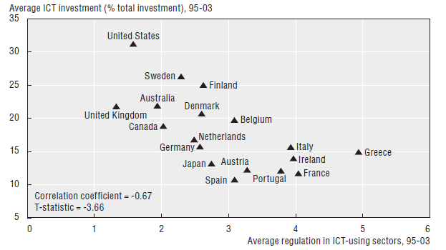
  Regulate to encourage innovation
Product market regulation
Public ownership itself does not inhibit ICT adoption
Overall product market regulation explains 12% of cross-country differences in ICT investment
Possible reasons
  Low barriers to entry create an incentive to invest in ICT to increase productivity and retain market share
  Product range expansion, service customisation, better customer response
  Improvement in production efficiency
  Competition reduces ICT costs thereby promoting diffusion
Source: OECD Economic Studies No43, 2006/2 Product market regulation and productivity convergence

Slide 12
Special taxes on telecommunications conflict with ICT development policies
Example: special tax in Jordan levied after a 16% sales tax:
  Data services: 8%
  Mobile services: 24%
Source: GLOBAL INDUSTRY LEADERS’ FORUM 2011 Draft Discussion Paper:
Taxing telecommunications/ICT services: an overview, ITU

Slide 13
Promoting ICT development
Make country market attractive to ICT businesses
  Complementary tax and other policies
  Regulate to encourage innovation
    Eservices enabling law and regulation
    Fair and equitable institutions
    Aggressive management of inefficient markets
      Don’t try to protect incumbents’ entrenched positions
Government stimulation of ICT markets
  egovernment
  Use the ICT sector’s commercial products and services
  Lead from the front – research, best practice implementations, impact assessment
  Publicise results
  Promote coordination of the ICT sectors
  Coordinate availability of investment capital
  Education

Slide 14
Conclusions
ICT investment and use results in growth in GDP and increased labour productivity
Job growth arises directly and indirectly as a result of investment in ICT
Net growth in jobs in the medium term varies
  Jobs are lost as a result of improvements in labour productivity
  Jobs are gained as a result of improved competitiveness and from innovation
ICT investment therefore changes the competitive positioning of nations and regions resulting in job migration
ICT policy implementation models use a wide variety of instruments that help in the development of ICT sectors and resultant jobs growth
Tax and regulatory instruments must be included in these implementation models to ensure that they do not act as inhibitors to ICT investment and innovation

