Slide 1
ASREN Role in Developing a Pan-Arab e-Infrastructure for Education and Research
Salem Al-Agtash, Ph.D.
Arab States Research and Education Network– Bahrain
ITU Arab RDF – Manama, 28.10.2013
alagtash@ASRENOrg.net

Slide 2
Highlights
Arab youth is estimated at about 200 million
About 1000 Arab institutions hosting 20 million students
10% are enrolled in postgraduate studies
80% of undergraduate students in humanities, 20% in science
1:150 faculty: student ratio, and deteriorating quality
1,176.8% growing rate of online education since 2000
R&D spending is 0.2-0.5% of total GDP (5% of global spending)

Slide 3
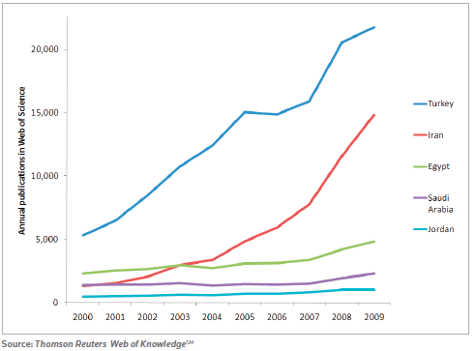
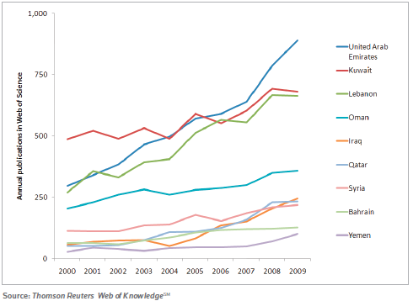
Research growth

Slide 4
Why research and education networks?
Research is increasingly becoming computationally intensive and dependent on fast communication networks
Education resources are increasingly becoming available to the global community (MOOCs, Khan Academy, Coursera, FutureLearn, MIT Bloosom)
Research has become dependent on community efforts and international collaborations to solve most pressing problems and issues
Research has become digitally dependent, for access, sharing, collaboration
Tendency to adopt available quality learning resources

Slide 5
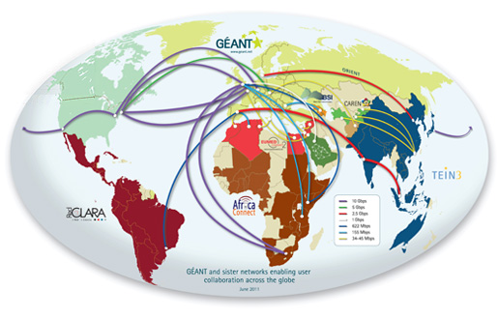
The Global Network
Global R&E connectivity

Slide 6
e-Infrastructure at «world» scale
Available resources
>340 sites in 57 countries
~337,000 CPU cores
>220 million GB of storage
~1 million jobs/day
~20,000 users in ~280 VOs

Slide 7
Access paradigm
physics community
biomedics community
astronomy community
Sharing and federating scientific data
Sharing computers, software and instruments
Linking at the speed of the light
. . . . .
Scientific resources

Slide 8
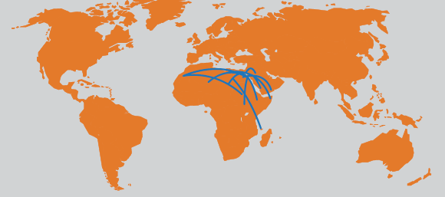
Arab States Research and Education Network
Existing shareholders
Shareholder discussions

Slide 9
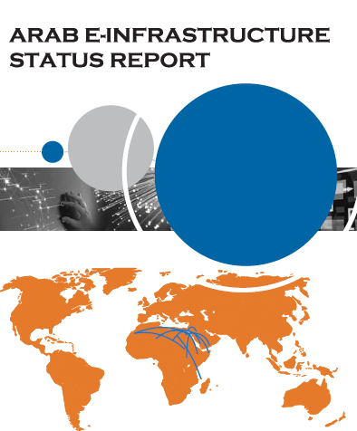
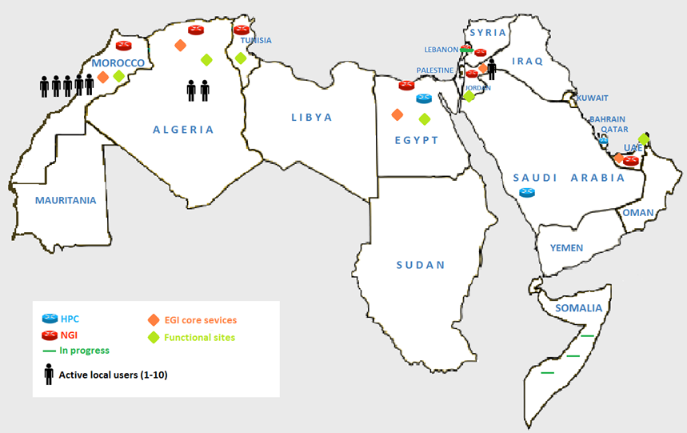
Status in the Arab region

Slide 10
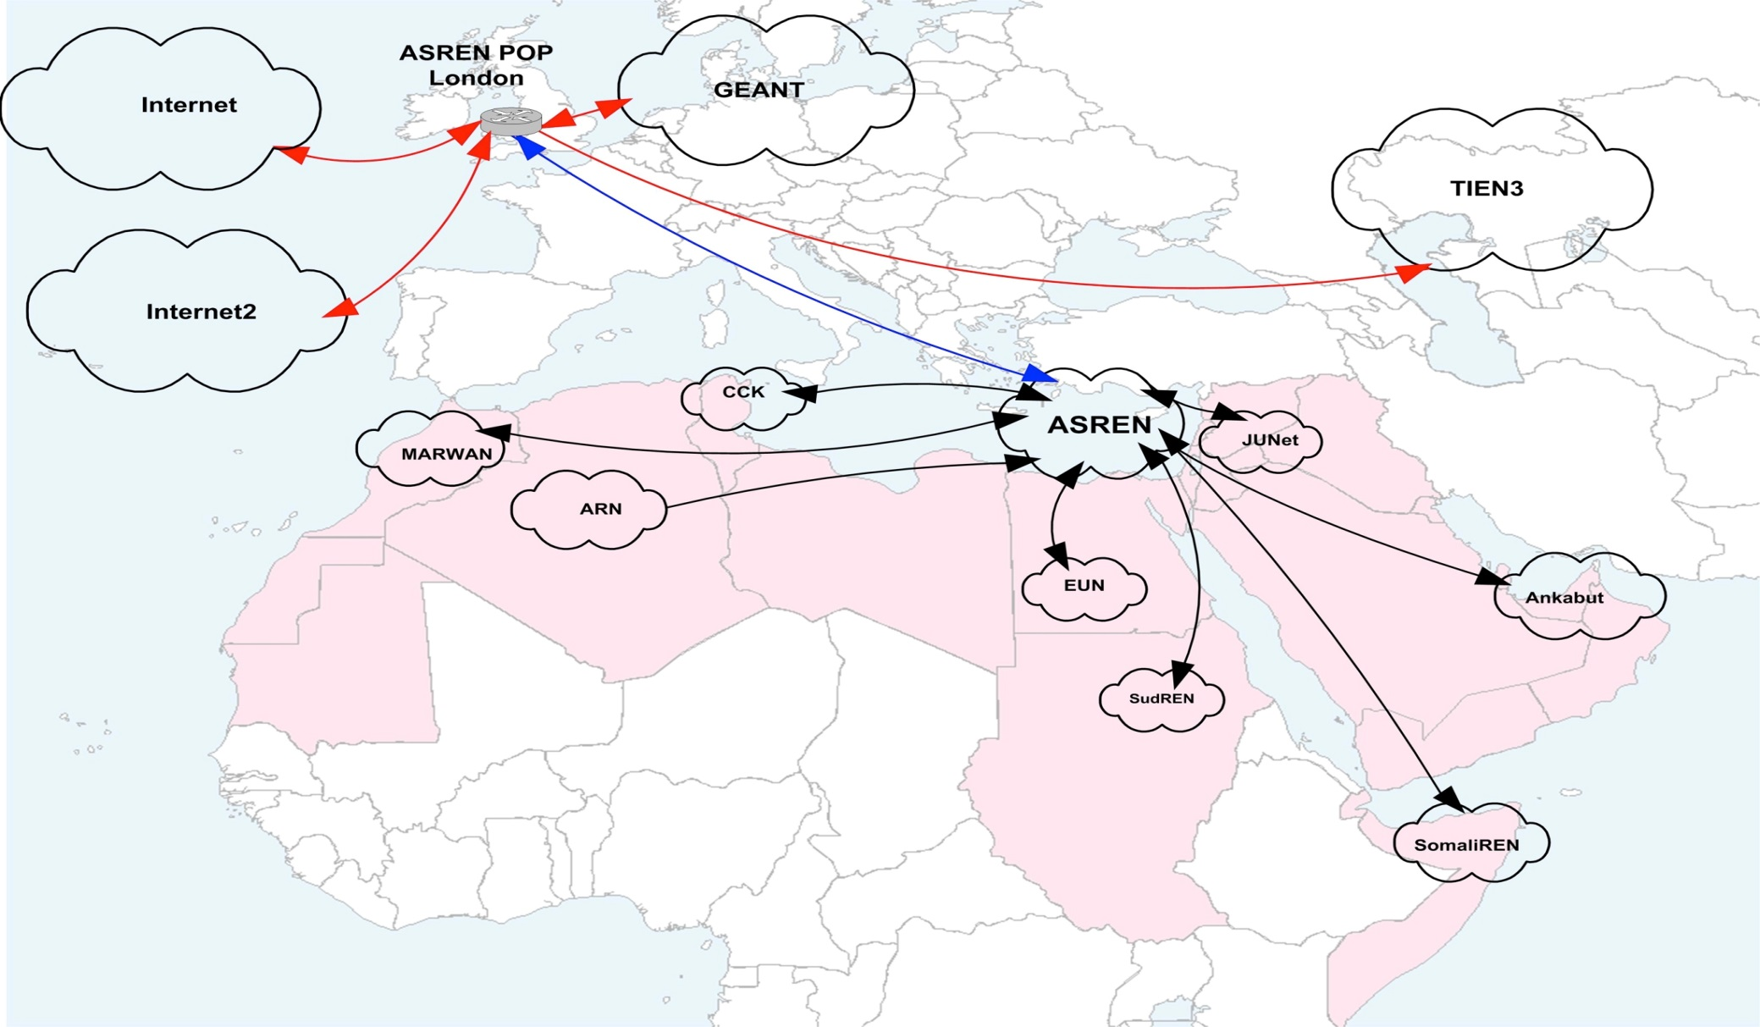
Interconnecting Arab States National R&E Networks
Egypt OLE
UAE Giga POP

Slide 11
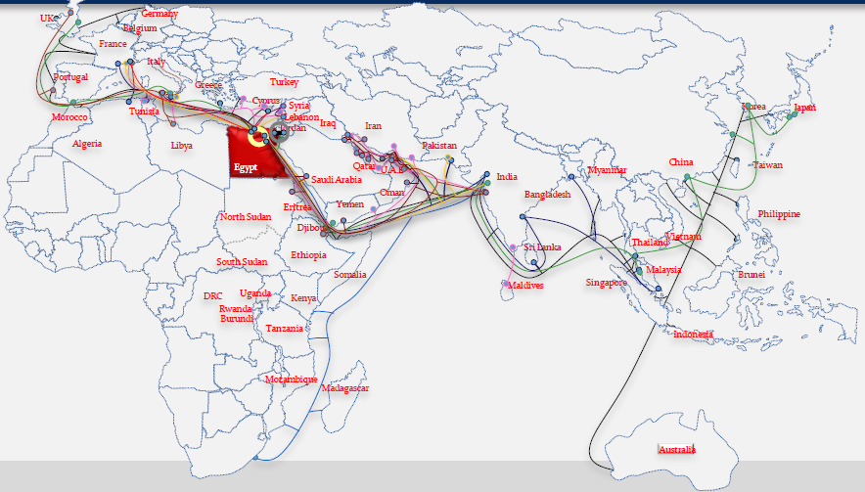
Submarine cables in the region

Slide 12
Supporting Projects funded by EC
EUMEDCONNECT3
Coordination and Harmonization of Advanced e-Infrastructures for Research and Education data infrastructures
The EUMEDGRID Support Project
Coordination and Harmonization of Advanced e-Infrastructures
Exchange Programme to advance e-Infrastructure Know-How

Slide 13
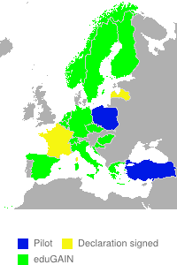
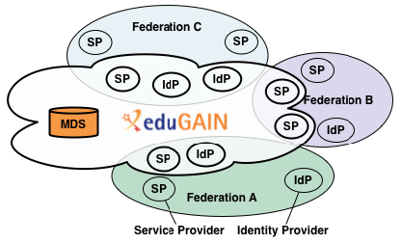
eduGAIN (www.edugain.org)

Slide 14
ASRENOrg.net

