Slide 1
ICT For Sustainable Transportation
ITU ARAB Regional Development Forum
28 October 2013,
Manama, Bahrain
Ahmed El-Dorghamy, MSc.
Strategic Concerns Programme (SCP)
Centre for Environment and Development for the Arab Region & Europe (CEDARE)

Slide 2
CEDARE – Center for Environment & Development for the Arab Region & Europe
International not-for-profit organization
Established: 1992
Decision of Council of Arab Ministers Responsible for the Environment (CAMRE)
Platform and catalyst for environmental studies and soft projects in the region (primarily) & internationally.
4 Departments:
Knowledge Management
Water Resources Management
Land-use Management
Strategic Concerns Programme

Slide 3
CEDARE’s Strategic Concerns Programme addresses new and emerging concepts related to environment and development for human welfare, with focus on:
Sustainable Consumption and Production,
Green Economy,
Green ICT,
Sustainable Transportation
Notes:
*ITU, UNEP, UNU, CEDARE Forum on Environmentally Sound Management of E-Waste, Madrid, Spain, 16 September 2013
**The International Telecommunication Union (ITU), the United Nations Environmental Programme (UNEP)/ Secretariat of the Basel Convention and the 1.
United Nations University (UNU), in collaboration with Solving the E-waste Initiative (StEP) and the Center for Environment and Development for the Arab Region and Europe (CEDARE), have launched a joint survey to collect detailed data on e-waste management, policies and standards,

Slide 4
Expanding activity into sustainable transportation as a cross-cutting field:
Supporting the WB Transportation App Challenge, 2011, Egypt.
Monitoring success stories in Sust. Transportation in the contexts of Green Economy, SCP, and Green ICT, through studies and projects implemented.
Member of UNEP-Led Partnership for Cleaner Fuels and Vehicles (PCFV) and host of its 2010 forum.
Currently conducting study on Cleaner Fuels and Vehicles in the Arab region.
Notes:
*ITU, UNEP, UNU, CEDARE Forum on Environmentally Sound Management of E-Waste, Madrid, Spain, 16 September 2013
**The International Telecommunication Union (ITU), the United Nations Environmental Programme (UNEP)/ Secretariat of the Basel Convention and the 1.
United Nations University (UNU), in collaboration with Solving the E-waste Initiative (StEP) and the Center for Environment and Development for the Arab Region and Europe (CEDARE), have launched a joint survey to collect detailed data on e-waste management, policies and standards,

Slide 5
Key Activities in Transportation
2006: Policy Development Meeting for MENAWA on Cleaner Fuels & Vehicles (CFV), Egypt.
2008: GCC Policy Development Meeting for CFV, Bahrain.
2010: Middle East CFV for Clean Air Policy Forum, Egypt:
Objectives: Awareness & facilitation to develop Roadmap for CFV.
Outcome: Recommendations to Council of Arab Minister Responsible for the Environment (CAMRE); key words: Legislation; Action Plan; Fuel Specs Guidelines.
Notes:
2010 docs: http://www.unep.org/transport/pcfv/meetings/CairoEgypt-meeting.asp

Slide 6
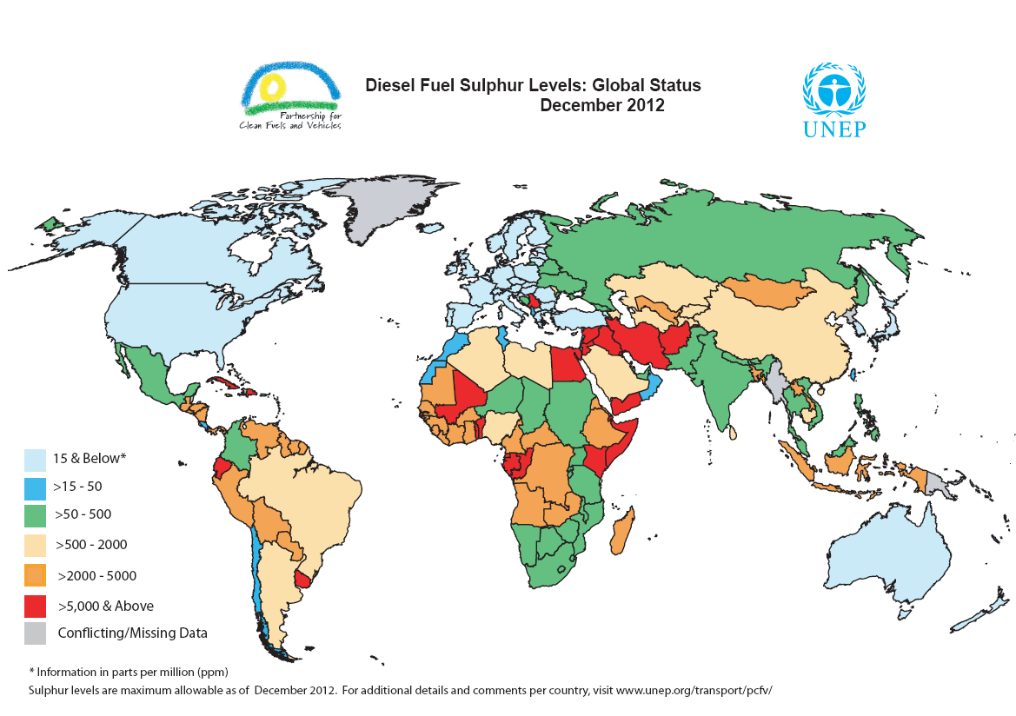
Notes:
*UNEP Initiative in Transport:
PCFV
Global Fuel Economy Initiative (GFEI)
Non-Motorized Transport
Public Transport
Sustainable UN
*Achievements mentioned in 2010 PCFV forum:
Jordan, Tunisia & Morocco gone fully unleaded
Tunisia adopted low-sulphur standards (3,000pp & 50ppm imports) from 5,000ppm
3 of the 18 countries in the region already have 50 ppm Sulphur in diesel:
Morocco,
Oman,
Israel
7 countries set dates to reach 50 ppm Sulphur:
Qatar & UAE: 2010
Algeria, Tunisia & Kuwait: 2013
Saudi Arabia: 2014
Syria: 2015
4 countries have Low-Sulphur Road Maps: Kuwait, Qatar, Saudi Arabia & Syria
Remaining 9 have not set a timetable for low sulphur
4 countries are at 500 ppm

Slide 7
Achievements noted in the 2010 Middle East Forum
Jordan, Tunisia & Morocco gone fully unleaded
Tunisia adopted low-sulphur standards (3,000pp & 50ppm imports) from 5,000ppm
3 of the 18 countries in the region already have 50 ppm Sulphur in diesel:
Morocco,
Oman,
Israel
7 countries set dates to reach 50 ppm Sulphur:
Qatar & UAE: 2010
Algeria, Tunisia & Kuwait: 2013
Saudi Arabia: 2014
Syria: 2015
4 countries have Low-Sulphur Road Maps: Kuwait, Qatar, Saudi Arabia & Syria
Remaining 9 have not set a timetable for low sulphur
4 countries are at 500 ppm
Notes:
Remaining leaded: Algeria, Egypt, Iraq, Yemen

Slide 8
Future areas of intervention: ICT For Sustainable Transportation

Slide 9
What is sustainable transportation?

Slide 10
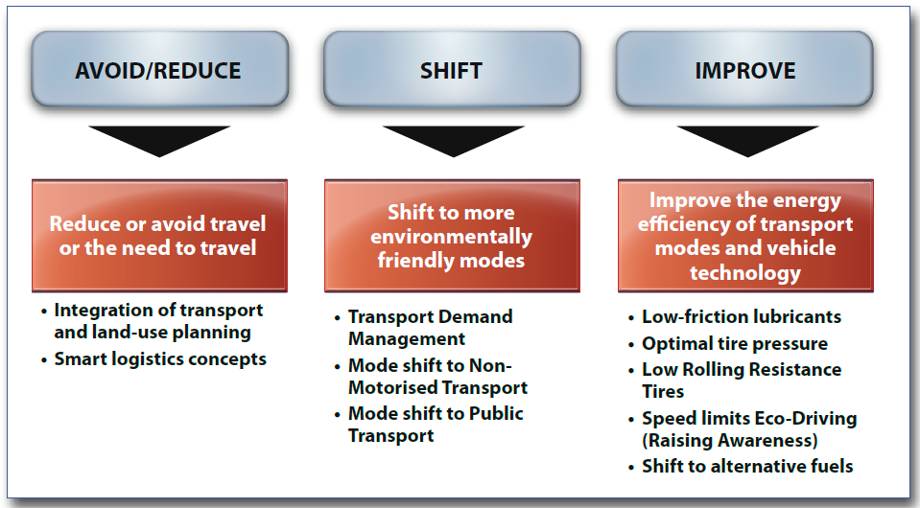
...Vision for beyond efficiency interventions Paradigm shift: The A-S-I concept
Telecommuting (teleworking, e-government services , teleshoping, etc)

Slide 11
Why the urgency of interventions for sustainable transportation?
Cars will triple by 2050 – Mostly in developing world & mistakes of earlier industrialized nations being repeated…
Today’s pressures:
Air pollution (1.3 million premature deaths/yr)
Climate change (27% of carbon emissions)
Road safety (1.2M casualties/yr, 90% in developing world)
Energy costs and subsidies (>2% annual growth since 1970, & many countries still suffer the fiscal burden of energy subsidies)
Social equity (equitable access to education, employment, health facilities, friendly public spaces & urban planning, etc)
Notes:
Road safety: …and 50 million injuries/yr
Climate change: …IPPC: for global average of 2–2.5 degrees Celsius, global GHGs must be cut by 50–85 percent by 2050! (relative to year 2000 emission levels).
Social equity: …challenge of the informal sector.
For more info, see
-State of the World Report 2012, Chapter-4
-GTZ 2002 Report: Urban Transport and Poverty in Developing Countries

Slide 12
How does ICT serve sustainable Transport?
Notes:
Climate change: …IPPC: for global average of 2–2.5 degrees Celsius, global GHGs must be cut by 50–85 percent by 2050! (relative to year 2000 emission levels).

Slide 13
1
Intelligent Transportation Systems (ITS):
…advanced applications which aim to
Provide innovative services relating to different modes of transport and traffic management
Enable various users to be better informed and make safer, more coordinated and ‘smarter’ use of transport networks
( EU Directive 2010/40 )
Involves three components: Infrastructure, Vehicles, People.
Optimizes use of the existing infrastructure (i.e. saves costs)
Notes:
ITS involves three components:
• Infrastructure – both from the surface down and above the surface (e.g. traffic signals, communications, computers, toll gates, sensors etc.
• Vehicles – types of vehicles, their safety features, their degree of use of advanced electronics and computing.
• People - human behavior, preferences and use of transport modes, regulation and enforcement.

Slide 14
Main services of ITS
1.Traveler information (supporting pre-trip and on-trip travel decisions)
2.Traffic management (to reduce the demand for motorized travel and to give priority to buses, non-motorized vehicles (NMVs) and pedestrians)
3.Freight transport management (administration, safety inspection, fleet management, etc)
4.Public Transport management (system optimization, etc)
5.Electronic payment (multi-modal transport ticketing, tolling, bicycle and car sharing schemes, congestion charging, etc)
6.Safety and security (e.g. emergency management)

Slide 15
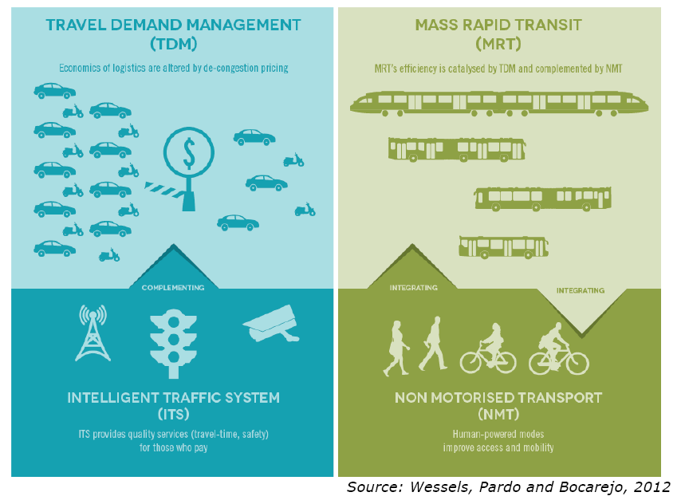

Slide 16
Examples of applications

Slide 17
Examples of applications
Source: Sayeg/Charles 2005: Intelligent Transport Systems, GTZ Sourcebook Module 4e

Slide 18
2
Other ICT areas of intervention:
Reducing/offsetting travel (teleworking and virtual meetings, online shopping, etc)
Social marketing for sustainable mobility
Notes:
Social marketing – e.g. of social media, mobile apps, etc

Slide 19
How to plan for interventions?

Slide 20
ITS Strategic plan
Components:
Current and future transport needs assessment (sustainability viewpoint)
Inventory of already existing and proposed ITS applications (typically ad hoc installations by different agencies, demonstration projects, research and development projects, planned projects, etc).
Outline of current technology infrastructure relevant to ITS applications (e.g. telecommunications & systems architecture & standards in use).
Description of institutional arrangements necessary (including roles and responsibilities and funding arrangements).
Stakeholders assessment (roles and interests).
Assessment of potential for ITS to address the assessed needs and identification of priority IT applications for deployment.
Most effective at a regional, national, or city level (rather than localized)
Notes:
*Adapted from

Slide 21
Thank you
adorghamy@cedare.int

