Slide 1













WSIS+10 High-Level Event
10-13 June 2014 (9 June – Pre-Events)
ITU Headquarters, Geneva
Side Event at WTDC-14
8 April 2014, Dubai

Slide 2







Slide 3

WSIS Overall Review: Background
The World Summit on the Information
Society (WSIS) Outcome Documents and the
UN General Assembly Resolution 60/252
resolved to conduct an overall review of the
implementation of the Summit outcomes in 2015.
The modalities for the Overall Review were discussed at the 68th Session of the UN General Assembly. Modalities are expected to be finalized by end of March 2014.
Following the guidance of its Membership (PP-10 Resolution 172 and ITU Council Resolution 1334 (Mod. 2013)), ITU has initiated the preparatory process leading towards the WSIS+10 High-Level Event to be held in 2014.

Slide 4
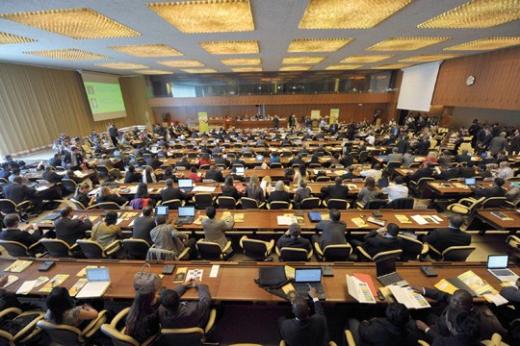
WSIS Overall Review: Background
WSIS Forum 2012 and 2013, and
the WSIS+10 Vision Challenge led
towards elaboration of the work plan
on the WSIS+10 process endorsed by the
WSIS stakeholders as well as
32 UN Agencies, members of the
UN Group on the Information Society.
Moreover templates for the 10 years implementation reports of Action Lines and Member States have been endorsed through a multistakeholder consensus.

Slide 5
Council Resolution 1334 (MOD. 2013)
WSIS+10 High Level Event
The WSIS+10 High-Level Event will be an extended version of the WSIS Forum to:
  WSIS+10 High Level Track
  address the progress made in the implementation of the WSIS outcomes related to the WSIS Action Lines under mandates of the participating agencies
  WSIS Forum Track
  provide a platform for multi-stakeholder coordination of the implementation of the WSIS outcomes, with involvement and participation of all WSIS action line facilitators, other UN agencies and all WSIS stakeholders.

Slide 6


Objectives
The WSIS+10 High-Level Event will review
the WSIS Outcomes (2003 and 2005),
in particular, related to the Action Lines
with a view to developing proposals on a
new vision beyond 2015, potentially also
exploring new targets.
The meeting will be organized taking into account decisions of the 68th Session of the UN General Assembly (negotiations on modalities started on 23 October 20013)

Slide 7
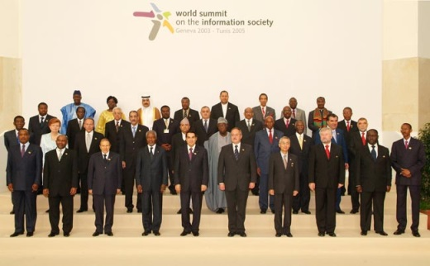
WSIS+10 High-Level Event:
Expected Outcomes
1) WSIS+10 Statement on
Implementation of WSIS Outcomes
2) WSIS+10 Vision for WSIS Beyond 2015
under mandates of the participating agencies

Slide 8
Preparatory Process for WSIS+10 High-Level Event as an extended version of WSIS Forum
Coordination Mechanism
of Co-Organizers and WSIS Action Line Facilitators
ITU, UNESCO, UNCTAD, UNDP, WHO, WIPO, DESA, ILO, ITC, UPU, UN Women, UN Regional Commissions,
CSTD Secretariat
WSIS+10-MPP
to Elaborate Outcome Documents
Open Consultation on Format and Thematic Focus

Slide 9
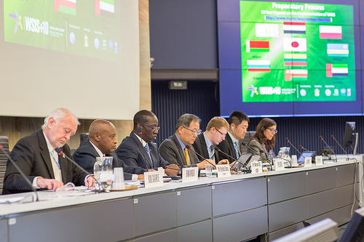
Preparatory Process
(Multistakeholder Preparatory Platform)
Phase One: July 2013 - Initiation of the
Open Consultation Process
Phase Two: 7-8 October 2013 - First
Physical Meeting
Phase Three: 16-18 December 2013 –
Second Physical Meeting
Phase Four: 17-18 February 2014 - Third Physical Meeting: 1st reading of all Action lines completed.
Phase Five: 14-17 April 2014 - Fourth Physical Meeting, ITU Headquarters, Geneva
Phase Six: 28-31 May 2014 - Fifth Physical Meeting
(pending decision of the Fourth Physical Meeting
Briefing: 19 May 2014 – Geneva

Slide 10
Update on the WSIS+10 High-level Event:
Statement and Vision
Progress of Drafts: Zero Draft, 1st Draft, 1st Reading
Three Physical meetings held till date
attended by more than 160 participants per meeting.
More than ~450 contributions processed
The commitment of Governments, Private Sector, Civil Society and UN Agencies is immense
All UN Agencies that have a mandate in WSIS (ITU, UNESCO, UNCTAD, UNDP, WHO, ILO, UNDESA, ITC, UPU, WMO, UNEP, WIPO, UN Women and Regional Commissions) are contributing to the development of the Outcome Documents.
UNWOMEN has proposed a new Action line on Gender Empowerment.

Slide 11
Update on the WSIS+10 High-level Event:
10 Year Reports
10-Year Country Reports: Argentina, Belarus, Bulgaria, Japan, Lithuania, Oman, Poland, Rwanda, Uruguay. Under preparation: UAE, India, Bangladesh and others
10-Year Action Line Facilitators reports: C2, C5 and C6 from ITU, C3, C7 e learning, C7 e science, C8, C9 and C10 from UNESCO and C7 e business from UNCTAD, ITC, UPU
A comprehensive Civil Society Report has been submitted by the Association for Progressive Communication
Final quantitative assessment report (Partnership on Measuring ICTs)
10 Years Regional Assessment Reports by Regional Commissions
WSIS Stocktaking Report 2014
WSIS Success Stories Report 2014
WSIS+10: ITUs role in the Implementation of WSIS Outcomes (10 Year Report)

Slide 12




Preparatory Process
Accountability of WSIS beyond 2015
Towards Accountability
Consensus on set of targets to ensure accountability of the WSIS process beyond 2015
Towards Final Assessment
A metadata questionnaire: Measuring the WSIS Targets - A statistical framework publication.
A full data collection of the actual data for each of the WSIS Target indicators is being conducted.
Final quantitative Assessment Report on the Achievements of the WSIS Targets, to be
Measuring the Information Society Report 2013
(official launch on 7 October 2013)

Slide 13


10 Year Anniversary of Partnership for Measuring ICT for Development
Partnership on Measuring ICT for
Development developed
a set of indicators to measure
the WSIS targets
Final assessment of progress
made towards each of the ten
WSIS targets
  Major report coordinated by
  ITU and involving many contributors
  The only quantitative global assessment of WSIS outcomes
  Based on data collection carried out in 2013 with all member states (WSIS targets questionnaire)
Launch of final report: WSIS+10 High-level Event, 10-13 June 2014, Geneva

Slide 14



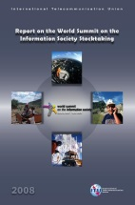




10 Year Anniversary of the
WSIS Stocktaking Process
WSIS Stocktaking Process
Publicly available database and
networking platform
More than 30.000 Active Users
More than 10.000 Entries
Regular reporting through
  WSIS Stocktaking Reports
  WSIS Success Stories
  Regional Reports

Slide 15
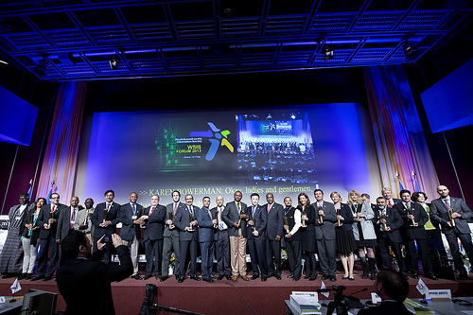

10 Year Anniversary of the
WSIS Stocktaking Process
WSIS Project Prizes Track
More than 140 projects
nominated in 17 categories
following the WSIS Action Lines
Appreciation process is underway: 18 April 2014
Ceremony at the WSIS+10 High Level Event
WSIS Project Prizes recognize excellence in the implementation of projects and initiatives which further the goals of WSIS in improving connectivity to information and communication technologies (ICTs) in line with the 11 Action Lines laid out in the WSIS outcome documents

Slide 16





10 Years Report on ITUs Contribution to the Implementation of the WSIS Outcomes
Provides yearly updates on the tasks carried out by the ITU at the operational and policy level, covering all assigned mandates with reference to the WSIS Process, in particular:
  In its capacity as leading facilitator in coordinating the multi-stakeholder implementation of the Geneva Plan of Action. (para 109 of TAIS) and primary organizer and host of the annual event in May, i.e. the WSIS Forum
  Facilitator of Action Lines C2 (Information and communication infrastructure) and C5 (Building confidence and security in the use of ICTs); as well as C6 (Enabling Environment)
  Co-facilitator of Action Lines C1, C3, C4, C7, and C11
  Partner in Action Lines C8 and C9
  Rotating Chair and Vice Chair of the United Nations Group on Information Society (UNGIS) ) (Para 103 of TAIS)
  Lead of Partnership on the Measuring the ICT for Development (Para 114 of TAIS)
  Facilitator of the WSIS Stocktaking Process (Para 120 of TAIS)
  Organizer of World Telecommunication and Information Society Day (Para 121 of TAIS)
  Lead of the Connect the World Initiative (Para 98 of TAIS)
  Others

Slide 17
Format and Thematic Focus
Open Consultation Completed
Recommendation of Speakers
Expression of interest for
organization of thematic and country
Knowledge exchange and exhibition
Key thematic aspects for HLE
Innovative suggestions on the format
19 May 2014 / Briefing Session / ITU HQ (Popov)

Slide 18
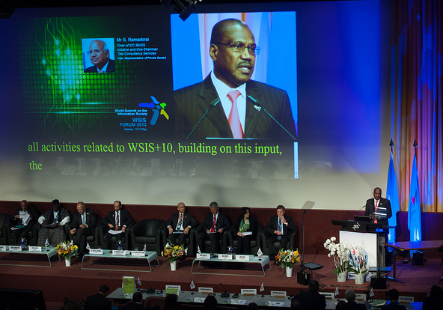
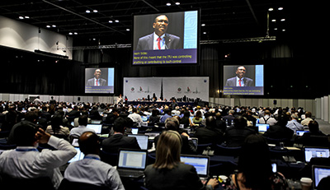
HL Event: Expected Participation
High-Level Guests:
  Heads of States (TBD)
  Ministers
  CEOs
  Civil Society Leaders
~2000 Onsite Participants
  Multistakeholder Participation
Remote Participantion

Slide 19
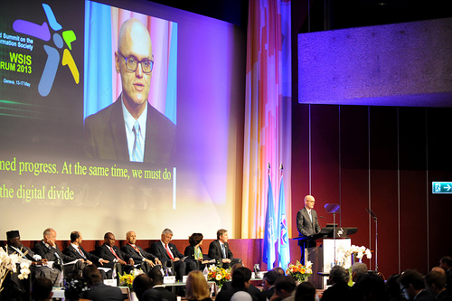
Format of Event
9 June: Pre-Events
  Up to 4 Tracks in Parallel
10-11 June: High-Level Track (CICG)
12 June: High-Level Dialogues (CICG)
  Pillars for Post 2015 Development
  Agenda with focus on Action Lines
11 June (PM) - 13 June (AM) June: Forum Track (ITU)
  AL Facilitators Meetings, Country Workshops, Ministerial Round Table, Partnership on Measuring ICT for Development (10 year anniversary) , Thematic Workshops, Knowledge Exchanges and Cafe
13 June (PM): AL Facilitators Meeting (Tunis, Para 109)

Slide 20
Preliminary Agenda
Monday | Tuesday | Wednesday | Thursday | Friday
 | HL Networking Breakfast | HL Networking Breakfast | HL Networking Breakfast
Pre-Events | HL Opening Segment | Policy Statements Forum Track | HL Dialogue Forum Track | Forum Track
Pre-Events | Endorsement of Outcome Documents WSIS Project Prizes | Policy Statements Forum Track | HL Dialogue Forum Track | Forum Track
 | HL Lunch / Inauguration of Exhibition | Ministerial/HL Lunch
Pre-events | Policy Statements | Policy Statements Forum Track | HL Dialogue Forum Track | AL Facilitators Meeting
Pre-events | Policy Statements | Policy Statements Ministerial Round Table / Forum Track | HL Dialogue Forum Track | AL Facilitators Meeting Closing Ceremony
Donors Dinner | Reception | Gala Dinner

Slide 21

Communications
Paperless approach
Web Presence and Social Media
  iwrite4WSIS
  imeetYou@WSIS
  Facebook and Twitter: #WSIS
Presence on the ITU website
  www.wsis.org/forum
  www.wsis.org/review

Slide 22
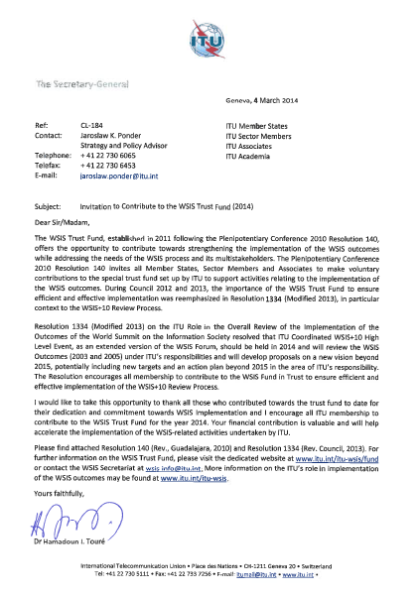
WSIS Fund in Trust of ITU: Categories for WSIS+10 High-Level Event Partnership
Partnerships
  Strategic Partner: Platinum
  Strategic Partner (Government): Gold
  Strategic Partner (Private Sector): Gold
  Partner for Specific Activities
Special Thanks:
  Japan, Kuwait, Oman, Poland, Rwanda, Switzerland, UAE and Intel

Slide 23

Call for Actions
Request for Workshops
(Country Workshops) and
Thematic Aspects
Registration: Opening of the
registration, link is available at
www.wsis.org/forum
Call for Policy Statements: Deadline for requests: 10 May
Availability of High-level Representatives
  Government : Minister, Head of State
  Private Sector: CEOs
  International Organizations: Head of Agency
  Civil Society Leaders
Call for Contributions to the WSIS Fund in Trust

Slide 24
Thank You
www.wsis.org/review
www.wsis.org/forum
www.wsis.org/stocktaking
wsis-info@itu.int

