Slide 2
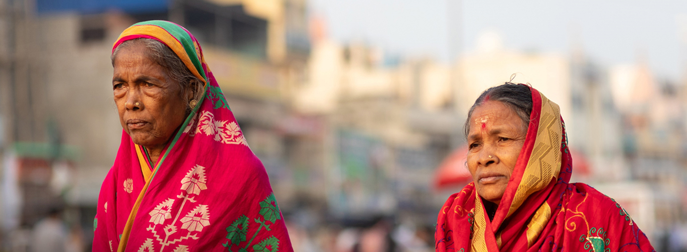
Contributing to the Partner2Connect Digital Coalition
Thursday, 24th February 2022
Virtual Meeting on Zoom
Morning Session 09:00 – 10:30 CET
Afternoon Session 15:00 – 16:30 CET

Slide 3
WTDC-17 Res. 71 (Rev. Buenos Aires, 2017) ”Strengthening cooperation Members of ITU-D…and the evolving role of the private sector in the ITU-D’’
Overview
Scope
To encourage and strengthen the participation and contribution of industry leaders in the work of ITU-D towards the implementation of the World Telecommunication Development Conference (WTDC) outcomes.
To contribute through its work the facilitation of communications between Member States and Sector Members on issues which contribute to an enabling environment for investment, particularly in developing countries.
To encourage and strengthen the participation of a wide representation of industry particularly ITU-D Sector Members, in the work of the Development Sector.
To promote partnerships and collaboration on ongoing and future ITU-D work, the implementation of global, regional, and national flagship large-scale projects in terms of co-financing and expertise.
Outcome
IAGDI-CRO meeting will adopt a statement which will be presented to the World Telecommunication Development Conference (WTDC).

Slide 4
Morning Session Welcoming & Opening
Mr. Cosmas Zavazava
Chief, Partnerships for Digital Development
BDT ITU
Ms. Doreen Bogdan-Martin
Director
BDT ITU
Mr. Bocar Ba
Chairman
IAGDI-CRO
Welcoming Remarks
Opening Remarks

Slide 5
Morning Session 1st Speaker Group
Mr. Alex Wong
Chief Special Initiatives
BDT ITU
Mr. Brandon Seir
Chief Commercial Officer
Kacific Broadband Satellites
Ms. Yolanda Cuba
Vice President for the Southern and Eastern Africa Region
MTN Group
Mr. Osamu Kamimura
Vice President,
Head of Spectrum Policy Division Softbank Corporation

Slide 6
Morning Session 2nd Speaker Group
Ms. Hayun Kang
Head, International Cooperation Research Division
Korea Information Society Development Institute (KISDI)
Ms. Philomena Gnanapragasam
Director AIBD Asia-Pacific Institute for Broadcasting Development
Mr. Rahul Vatts
Chief Regulatory Officer
Bharti Airtel
Ms. Esther Peh
Lead External & Regulatory Affairs for Asia-Pacific
AT&T Wireless

Slide 7
Thank You!
Become an ITU-D Sector Member and be a part of the IAGDI-CRO!
membershipitud@itu.int

