Slide 1
Smart Recycling
ITU GREEN ICT APPLICATION CHALLENGE

Slide 2
Contents
Proposal
Main idea
Local Waste Management: Process, Issues, Involved
Solution
Smartphone Application: Smart Recycling
Features / Benefits / Extends / User Journey
Results
Benefits for Countries
Noteworthy facts
European Union Directives

Slide 3
Proposal

Slide 4
Main Idea
ITU Challenge
Build a mobile application to mitigate climate change
Community engagement
Solution to environmental or sustainability issues
Recycling
Help to improve the system waste management (packaging) of Municipal Solid Waste - MSW
Information point for news, events and articles
“By 2020, the recycling of waste materials from households should be increased to a minimum of 50% by weight”
European Directive 94/62/CE
Notes:
Improve the System Waste Management (packaging) of
Municipal Solid Waste: access point to citizens, private/public recycling centers and garbage collectors

Slide 5
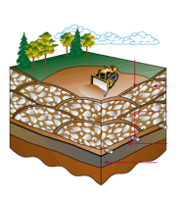
Local Waste Management - Process
MSW
Recycling Plants
Materials
Chemicals
Energy / Fuel /Power
Bioproducts
Waste separation
City
Composting
Special MSW
Recycling centers
Landfill
New products

Slide 6
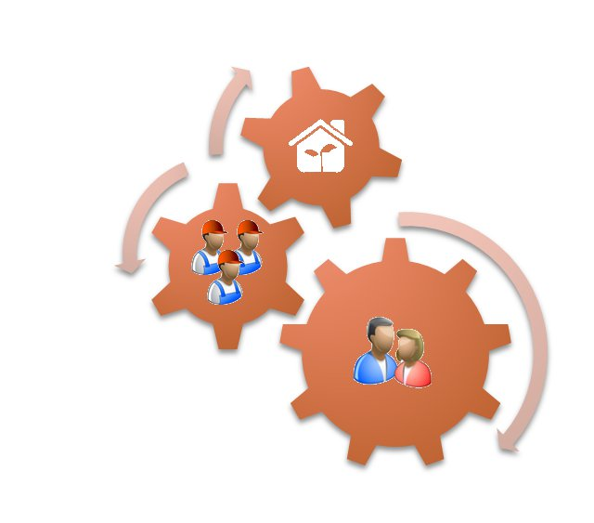
Recycling Issues
Low Efficiency in garbage collection
Citizens looking bins in the streets
Lack of promotion for recycling special materials (hazardous, e-waste..)
MSW
Waste separation
City
Special MSW
Recycling centers
Notes:
Reforzar el sistema

Slide 7
Solution

Slide 8
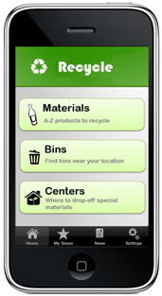
Smartphone Application: Smart Recycling
What to recycle?
Where to recycle?
What about special materials?
Reporting situations with the recycling system
Why is important to recycle?
What about private/public recycling centers?
Registration of nearest bins

Slide 9
Features (1/2)
Ubiquitous Smartphone use
Integration with Local Waste Management System
User – centered design
Information structured in logical buttons
Few screen jumps
Download delays management
Configurations options
Geo-positioning localization system
Query local places where to drop-off MSW
Get local information about the environment

Slide 10
Features (2/2)
Social Media Enabler
Integration with social networks groups to report in real-time
Local information delivery
Integrated with main local blogs about recycling
Articles information of Legislation and Directives
Events notifier in the area

Slide 11
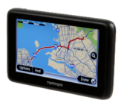
Extends
- Recycling centers
- Bins
- Articles & information
Local Garbage Collection
Smart Collection systems:
- Reporting issues
- Support routes
Smart Recycling App
Notes:
For the future

Slide 12
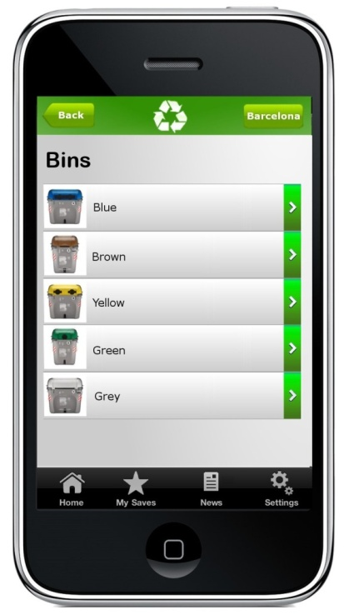
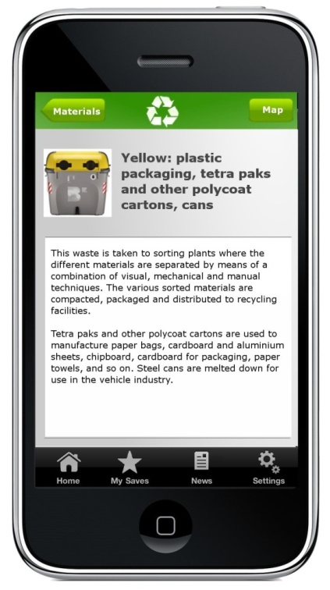
User Journey- recycling (1/3)
Home: select material, bins or centers
More information about the bin
Bins selected

Slide 13
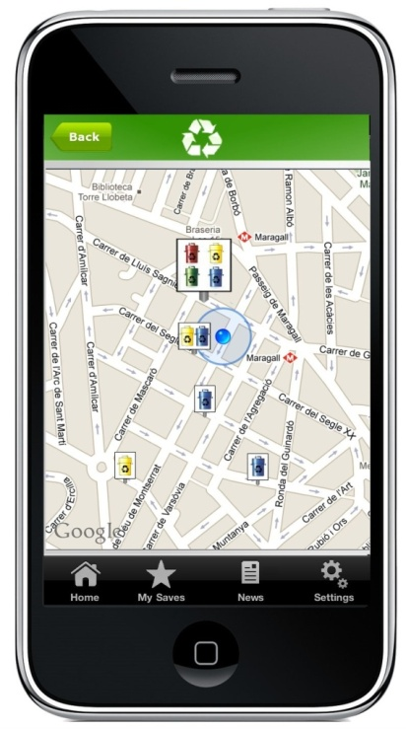
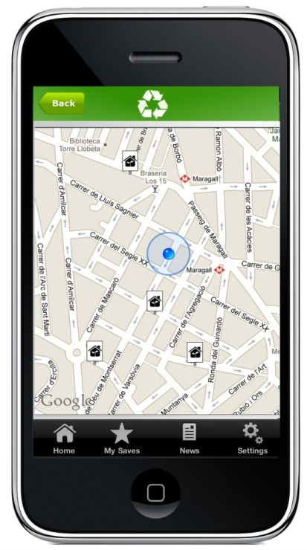
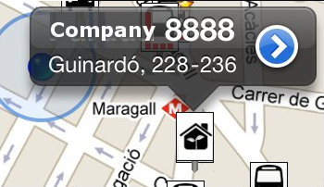
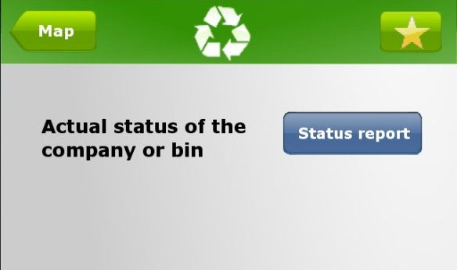
User Journey– recycling (2/3)
Click on an item on the map
Click on more info
Bins selected
Recycling Center

Slide 14
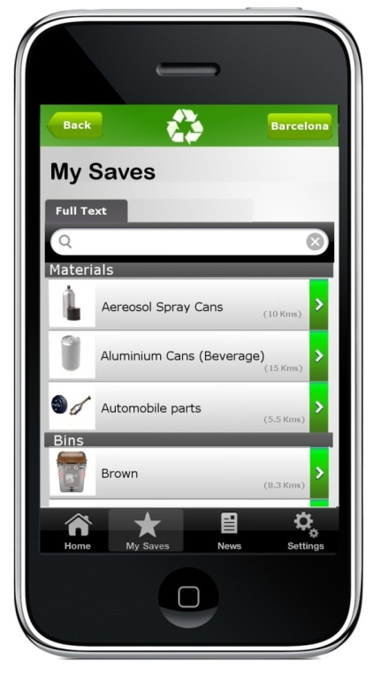
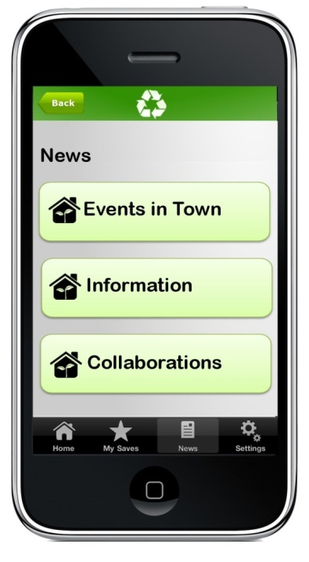
User Journey– general options (3/3)
List of materials, bins and recycling centers previously saved by the user
Events, information and collaboration partners, this information is frequently updated

Slide 15
Results

Slide 16
Benefits for Countries
Smartphone mobiles market
Powerful growth of Smartphone users
Social Network tools
Internet is accessible for everybody
Extended telecommunication network
Huge net access in cities and rural areas
Notes:
Some about developing countries

Slide 17
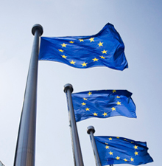
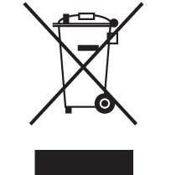
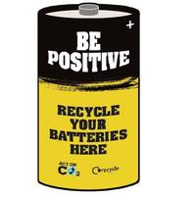
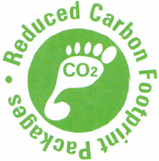
European Union Directives
Waste management policies:
Batteries
Biodegradable waste
Packaging
Waste for Electrical & Electronic Equipment (WEEE)
Others…

Slide 18
Noteworthy facts
Planet Resources
Recycling is Energy Efficiency
Recycling conserves natural resources, such as timber, water, and minerals
Society
People can get money from recycling
Recycling centers creates jobs
Notes:
General interesting points that will help the app & world

Slide 19
Thank you Grazie

