Slide 1

Accessibility of the IGF for persons with disability
Peter Major
Vice-chair, CSTD
Chairman of WGIGF

Slide 2
Commission on Science and Technology for Development
Commission of UN (ECOSOC)
Mandate
1. Science and technology for development
2. WSIS follow-up
Proposal to set up the CSTD WG on improvements to the IGF , May 2010

Slide 3
CSTD WG on Improvements
Multi-stakeholder approach
Disconnected from enhanced cooperation
Mutual trust and team work
Agreed main topics
39 recommendations
Submit report with recommendations to members of WG for approval

Slide 4
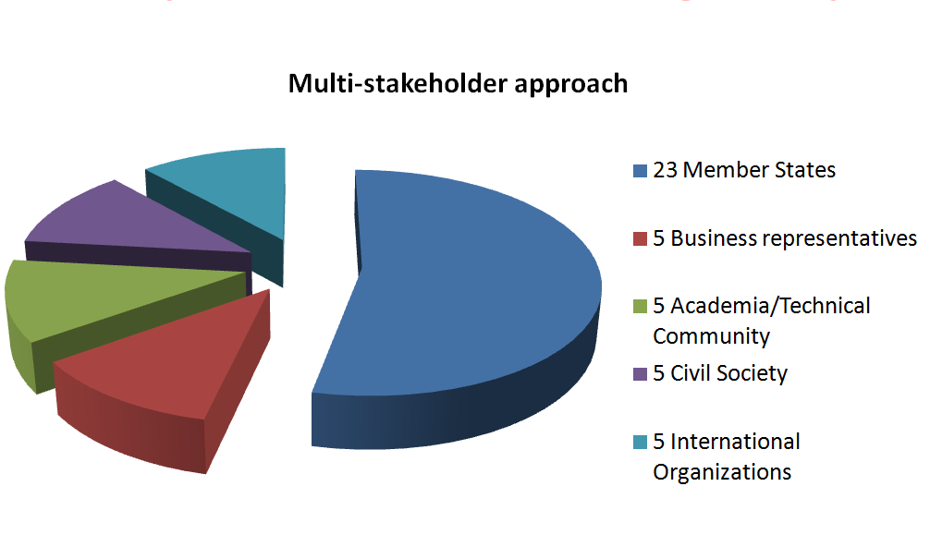
Composition of the Working Group

Slide 5
Agreed main topics
  Shaping the outcomes of IGF meetings;
  Working modalities including open consultations, MAG and Secretariat;
  Funding of the IGF;
  Broadening participation;
  Linking the IGF to other related processes/mechanisms/bodies.

Slide 6
Recommendations related to disabilities (1)
IV. Broadening participation and capacity-building
36. Although participation in the IGF has increased with time, it should be further broadened, both at the annual meeting and in its preparatory phase, to involve new stakeholders, in particular from developing countries and especially LDCs, and persons with disabilities and other underrepresented groups.

Slide 7
Recommendations related to disabilities (2)
2. Enhance measures for broader participation
42. (e) Mechanisms that facilitate remote participation, such as live transcripts, should be kept as an integral part of the IGF. Such mechanisms are invaluable not only to remote participants, but also to non-English-speakers and to persons with disabilities, whether they are on site or not.
43. It is important to ensure the accessibility of the IGF’s facilities to persons with disabilities.

Slide 8
Recommendations related to disabilities (3)
3. Improve the online visibility and accessibility of the IGF
45. A first step in this direction should be to enhance the IGF’s website by providing interactive functionalities and making it more attractive and inclusive. It should also maintain its conformance with open standards and further improve accessibility to persons with disabilities.

