Slide 1
- the UN specialized agency for ICT
ITU-T Focus Group on Audiovisual Media Accessibility: an overview Joint ITU-EBU workshop at the Internet Governance Forum: “How can we reach the media have-nots of the developed and developing worlds?” – Nairobi, Kenya, 29 September 2011 Xiaoya Yang Telecommunication Standardization Bureau
Presentation prepared by Alexandra Gaspari - ITU-T FG AVA Coordinator
Notes:
Hello everybody and welcome to this joint ITU EBU workshop on “How can we reach the media have-nots of the developed and developing worlds?”
I am Xiaoya Yang, I work at ITU the Head of the WTSA Division in ITU-T, Standardization Sector of ITU and I am here today to present an activity that has been running in my division: the ITU-T Focus Group on Audiovisual Media Accessibility. My colleague Alexandra Gaspari is the coordinator of this group and I am presenting her work.
In this panel we have preeminent members of the Focus Group: we have Mr Peter Looms, who is participating remotely to the meeting, Mr. Masahito Kawamori, who is vice-chair of the FG AVA and Working Group Coordinator of IPTV, we have two representatives from the European Broadcasting Union: Mr. Giacomo Mazzone, Head of the International Relations, Mr David Wood, who was among the initiators of the Focus Group. Mr. David Wood is Deputy Director of EBU.

Slide 2
Why promote and create accessible ICTs?
Accessibility is a human right recognized in the UN Convention on the Rights of Persons with Disabilities (UNCRPD)
Enshrined in Article 9 of the UNCRPD
Article 9 of the UNCRPD defines ICT accessibility as an integral part of accessibility rights on par with transportation and the physical environment.
Article 9 concerns all ICT products and ICT based applications and services, with a far-reaching implication for industry, governments and civil society
All of us who age will have age-related disabilities, We all (100%) can benefit from more accessible devices

Slide 3
The role of ITU in promoting accessible ICTs
ITU approved last year PP-10 Resolution 175 on “Telecommunication/information and communication technology accessibility for persons with disabilities, including age-related disabilities”
The Standardization and Development sectors of ITU have similar texts, so Persons with Disabilities can participate and contribute to the work.
In the Standardization sector, where I work, without the involvement of Persons with Disabilities it will be more difficult to create good International Standards.
Notes:
Also, you can imagine that without International Standards there will be no compatibility or inter-operability and no accessible global convergence
Secondly, without International Standards, there will be no effective means for policy makers to create effective regulations for the inclusion of Persons with disabilities in all forms of Information Communication Technology ( ICTs)

Slide 4
The latest effort – and success – of ITU-T: FG AVA
One of the latest effort of ITU in this field is the creation of a group of expert in the area of audiovisual media accessibility, which I am going to present you in the next slides.
Engineers need Disability scenarios from the persons and users who experience this in everyday life.

Slide 5
How ITU-T FG AVA started: ITU-EBU joint workshop (Nov. 2010)
Late in 2010, ITU organized jointly with the European Broadcasting Union a workshop on “Accessibility to Broadcasting and IPTV ACCESS for ALL”
The conclusions highlighted the following:
a clear need to coordinate the technologies that can be used to aid those viewers and listeners with disabilities
this coordination would gain maximum benefit from media delivered by broadcast, cable, IPTV, and Internet.

Slide 6
How ITU-T FG AVA started: the groups involved
Conclusion: a decision was taken to establish a common platform from different groups of experts, namely from the Standardization and n and the Radiocommunication Sector of ITU both ITU-T and ITU-R study groups, in particular ITU-T Study Groups 2 and 16 and ITU-R Study Group 6.

Slide 7
How ITU-T FG AVA started: the creation of the group
Participation would have been open to the constituencies of other stakeholders: user associations, broadcasters, Internet service providers, manufactures, standardization organization)
Various options were discussed: it was concluded that the creation of a FG on Accessibility under ITU-T SG 16 would be an appropriate platform.

Slide 8
ITU-T FG AVA
The original idea became a reality: ITU-T launched last May 2011 the Focus Group on Audiovisual Media Accessibility (ITU-T FG AVA)
The main objective of this Focus Group is to address the need to make audiovisual media accessible for persons with disabilities.

Slide 9
What is the challenge today that FG AVA is tackling? To make audiovisual Media accessible for all, not only few, including persons with disability, senior citizens, first-time users

Slide 10
How the ITU-T FG AVA works?
FG AVA is organized in sub-groups working on specific access services and platforms
Last meeting: 15 September 2011
Next meeting on 17 November 2011 in Spain (Barcelona)
FG AVA work is open, we look forward your contributions to the work
Details on how to participate at: http://itu.int/en/ITU-T/focusgroups/ava

Slide 11
ITU-T FG AVA structure 1/2
Working Group A: Captioning
Working Group B: Audio/Video description and spoken captions
Working Group C: Visual signing and sign language
Working Group D: Emerging access services
Working Group E: Electronic Programming Guides and on-air promotion
Working Group F: Participation and digital media
Working Group G: Digital Broadcast Television

Slide 12
ITU-T FG AVA structure 2/2
Working Group H: IPTV Working Group I: Mobile and handheld devices Working Group J: Key Performance Indicators - Sub-Group: Broadcast television - Sub-Group: IPTV - Sub-Group: Mobile and handled devices Some other items are being considered to be object of study: Electronic games
Performing Arts
Authoring Digital Audiovisual Media

Slide 13
ITU-T FG AVA: who can participate
The FG AVA is open to ITU Member States, Sector Members, Associates and Academia.
It is also open to any individual from a Member of ITU who is willing to contribute to the work, as well as other interested stakeholders.

Slide 14
Political objective: e-inclusiveness
To conclude: with FG AVA contribution
Users getting the full benefit from including TV
Notes:
TV is a good place to start as it is the most widely used device, closely followed by radio and mobile phones.

Slide 15
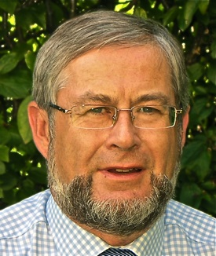
ITU-T FG AVA Chair
Peter Olaf Looms Chairman, ITU-T Focus Group on
Audiovisual Media Accessibility
E-mail: polooms@gmail.com
Mobile: +45 51 56 75 46 website: http://itu.int/en/ITU-T/focusgroups/ava
International Telecommunication Union

Slide 16
For more information on ITU-T FG AVA please contact
ITU-T FG AVA coordinator: Alexandra Gaspari email: tsbfgava@itu.int web: http://itu.int/en/ITU-T/focusgroups/ava

Slide 17
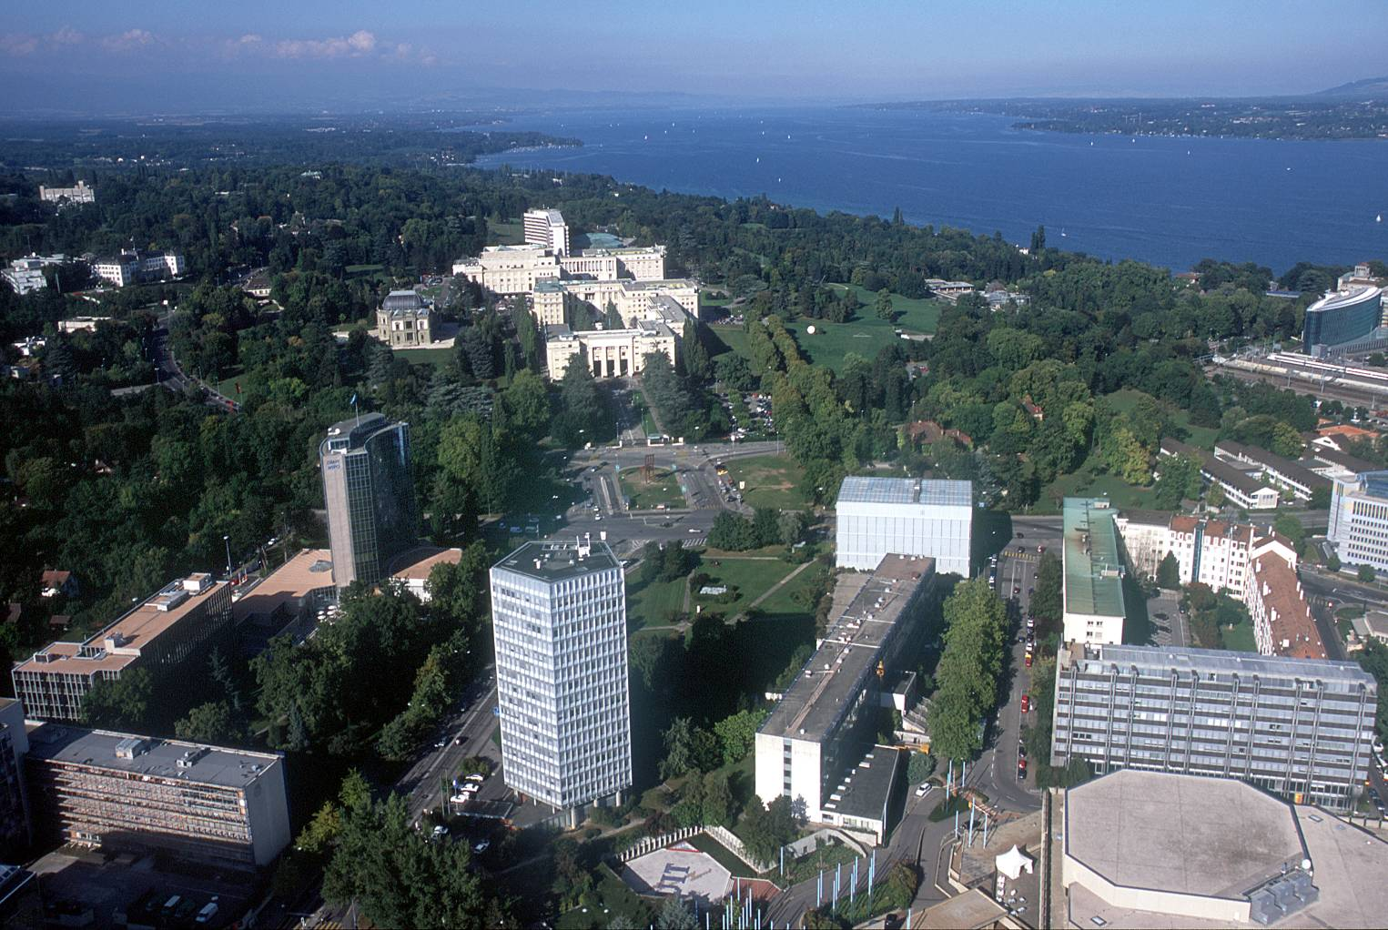
Thank you for your attention!

