Slide 1

Workshop:137
Mainstreaming the disability perspective for an inclusive society
Foundation Real-Time Text Taskforce
Arnoud van Wijk
Director Real-Time Text Taskforce
arnoud@realtimetext.org
IGF 2011 Nairobi, Kenya 27-30 September 2011
www.realtimetext.org

Slide 2
United Nations (UN) Convention on the Rights of Persons with Disabilities (CRPD)
Its purpose is to promote, protect and ensure the full and equal enjoyment of all human rights and the fundamental freedom for all persons with disabilities and to combat stereotypes and prejudices and promote awareness of the capabilities of persons with disabilities.
Persons with disabilities have existing and equal human rights, that they are able to claim those rights and make decisions for their own lives based on their free and informed choices and that they are active members of society.
Article 9: Accessibility
  1. To enable persons with disabilities to live independently and participate fully in all aspects of life, States Parties shall take appropriate measures to ensure to persons with disabilities access, on an equal basis with others, to the physical environment, to transportation, to information and communications, including information and communications technologies and systems, and to other facilities and services open or provided to the public, both in urban and in rural areas.
www.realtimetext.org

Slide 3
United Nations (UN) Convention on the Rights of Persons with Disabilities (CRPD)
These measures, which shall include the identification and elimination of obstacles and barriers to accessibility, shall apply to, inter alia:
a) Buildings, roads, transportation and other indoor and outdoor facilities, including schools, housing, medical facilities and workplaces;
b) Information, communications and other services, including electronic services and emergency services.
So, equal enjoyment of human rights, participate fully in all aspects of life.
How?
There are many kinds and levels of Disabilities.
I will focus on Persons who are Deaf or Hard of Hearing and includes persons with limited or no ability to use speech.
www.realtimetext.org

Slide 4
This world is voice centric. Voice everywhere and we all depend on it for communication:
Telephone
radio
TV
Internet
Conferences and meetings
To make all this equally usable and accessible for persons who are not able to understand voice communication:
All voice must be delivered as text and vice versa.
For users who use sign language all voice must be delivered in sign and vice versa.
The technology is ready! It is 100% possible to do this. Equality in communication using mainstream products:
www.realtimetext.org

Slide 5
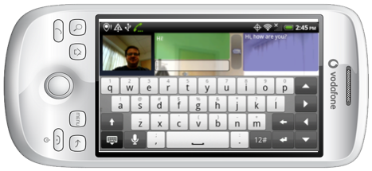
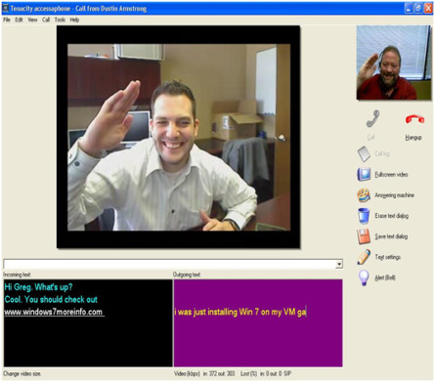
Total Conversation
Equal possibilities to communicate for all: Total Conversation
Total Conversation is a standardized concept where you can use video, real-time text and speech at the same time.
Video: See the person. Emotions,
body language, lip-reading, signing
Audio: Hear the person. Voice,
support lip-reading
Real-time text: Read the person.
Text that is sent as it is typed by the
other person. Read as it is typed.
No waiting or turn taking.
Talking by text.
100% possible over Internet and
Mobile Telephone networks!
(example on android tablet? Demo? Video clip?)
www.realtimetext.org

Slide 6
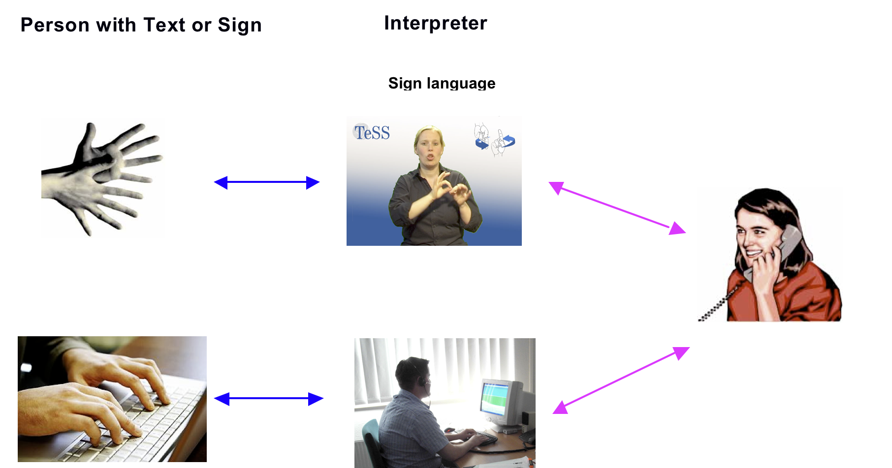
Relay Service, Interpreter via (Internet) Telephone
Connect voice with sign or text users (in support to voice or replacing voice).
The Interpreter is invisible (not part of conversation) and conveys everything in the conversation. Direct 1 on 1 conversation with the non voice user!
Best quality and everyday possible with Total Conversation.
No phone for ONLY Relay Service.
Total Conversation:
  Use for Relay
  Use to call with each
  other directly.
  Use to call the
  Emergency Services
  (112, 911).
www.realtimetext.org

Slide 7
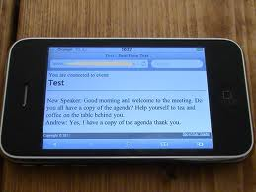
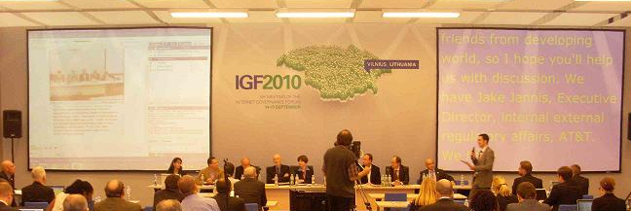
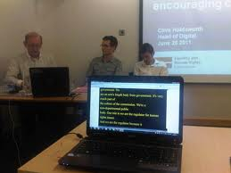
Remote Interpreting, Interpreter via Internet and Mobile telephones.
Remote captioning
Using Internet to deliver the text in Real-Time
to meetings. Interpreter listens in via phone
or VoIP
Captions supports if you cannot hear (very well) or if the speech is not in your native language.
Persons who are Deaf and Hard of Hearing are now equally able to participate and follow the meeting.
www.realtimetext.org

Slide 8
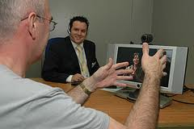
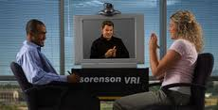
Remote Interpreting, Interpreter via Internet and Mobile telephones.
Remote Signing
Using Internet to deliver the Sign Language
to meetings. Interpreter listens in via phone
or VoIP
Persons who are Deaf and Hard of Hearing and who communicate by Signing are now equally able to participate and follow the meeting.
(Ideally show TC on a tablet with signing Interpreter)
www.realtimetext.org

