Slide 1
The 21st Century Communications and Video Accessibility Act
Christian Vogler
Director, Technology Access Program
Gallaudet University

Slide 2
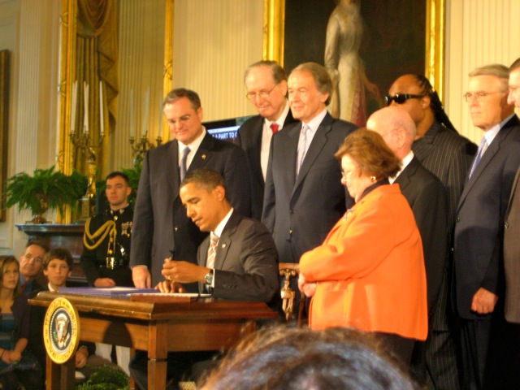
A new law is designed in the United States to make new technologies more accessible
The 21st Century Video and Communications Accessibility Act (CVAA)
  Signed into law OCT 8, 2010!
Cong. Markey, (D) Mass. championed the bill
Stevie Wonder

Slide 3
Basic Issue
Many accessibility laws passed in the 1980s and 1990s
  Required decoder for captions in TV
  Required captioned television
  Required relay services
  Required TTY access to 9-1-1
  Required Hearing Aid Compatibility (HAC) with phones
But Internet and other new technologies were not covered

Slide 4
Implementation of the law
FCC is responsible for making rules that implement the law
Some have already been promulgated, others are due very soon

Slide 5

Problems the law fixes (1)
TV show is captioned but same show is not captioned when on Internet
  Will be required (probably in 8-14 months from now)
www.cnn.com
Broadcast and cable TV = captioned

Slide 6
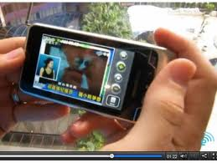
Problems the law fixes (2)
No way to turn on captions in small devices (smartphones for example)
  Will require for some or all devices (depends on FCC interpretation)
  Will take 7 months from now to several years (depends on FCC deadlines)

Slide 7

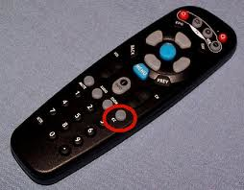
Problems the law fixes (3)
Hard to find how to turn on Closed Captions
  One well-known provider’s equipment requires TWENTY-SIX discrete steps
  Requires a “button, key, or icon” to turn on CC easily (Deadline for recommendations in February 2012)

Slide 8
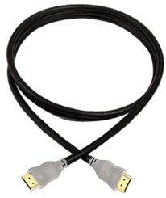
Problems the law fixes (4)
Captions get blocked… for example, HDMI cables
  Requires that connectors pass captions through so you can see them
  Alternative: set-top boxes must show the captions on the video
    (FCC may require this,
    instead, this is part of the
    proceedings)

Slide 9
Problems the law fixes(5)
Landline telecom services pay for relay services – but they are dying out
  Law requires interconnected and non-interconnected Voice over IP services to pay into the fund for relay services
  Examples: FIOS VoIP, Vonage, Skype
  Became effective just 5 weeks ago, by FCC order

Slide 10

Problems the law fixes (6)
Deaf, hard of hearing, and blind people have been left out of video telephone and conferencing systems
“Advanced Communication Services” must be accessible
  FCC issued order just five
  weeks ago
  Hardware, Services, and
  Software + Services covered

Slide 11
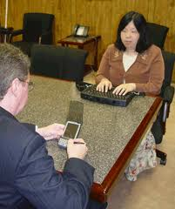
Problems the law fixes (7)
Deaf-blind people are really left out – equipment for communication access is very expensive
  National Deaf Blind Equipment Distribution Program provides “up to” $10 million/year from relay service fund to help deaf-blind
  people get equipment for telecom
  access
  Program starts in 2012, ready for
  distribution in July 2012

Slide 12
Problems not fixed
Internet-only programming NOT covered – captioning not required
Mobile access to 9-1-1, next-generation 9-1-1
  CVAA sets up a committee (EAAC) – but only recommendations, due on December 7, 2011
  However: FCC has recently issued proposed rulemaking on mobile text access. Comments due on December 10, 2011
  Note: ATIS has set up incubator for non-voice emergency services for short-term access to 9-1-1

