Slide 1
European public procurement of accessible ICT
Mandate M 376 - European Accessibility requirements for public procurement of products and services in the ICT domain
Mike Pluke
ETSI STF416
© ETSI 2011. All rights reserved
ITU-T JCA-AHF Meeting
2nd June 2011

Slide 2
What Mandate M 376 is
M 376 is a standards mandate to the European Standards Organisations
CEN, CENELEC and ETSI
M 376 will introduce
technical requirements and test methods for eAccessibility which will apply to all ICT products and services sold to the European Public sector
details of conformity assessment related to these requirements
an on-line toolkit

Slide 3
Motivations for the work
Inclusion of people with disabilities
Ageing society and workforce
Fragmentation of technical requirements
Access to skilled workforce who may be barred from entry to employment
UN Convention on the Rights of Persons with Disabilities

Slide 4
Why M 376 is important
This EC/EFTA co-funded work will lead to common eAccessibility requirements across the EU/EFTA
It aims to minimise conflicts with existing accessibility requirements
It will support and enable developing European policy
It encourages eAccessibility through public procurement
Notes:
The main objectives of the Mandate are summarised as:
to harmonize and facilitate the public procurement of accessible ICT products and services by identifying a set of functional European accessibility requirements for public procurement of products and services in the ICT domain, and to provide a mechanism through which the public procurers have access to an electronic toolkit, enabling them to make use of these harmonized requirements in procurement process.

Slide 5
Procurement of accessible ICT and M 376
Obligation to buy accessible
Legislation
Accessibility requirements
Standards
Conformity
Assessment
Declaration
Regulation - Rules
M 376
Notes:
For setting up a policy of public procurement of accessible ICT, the following elements are required:
Creating an obligation of buying accessible ICT
Typically made through legislation (the EU Directives)
Defining the accessibility requirements
Can be done in an official standard
Can also be done in regulation (government rules)
Defining how to deal with conformity
How to do the conformity assessment
Hoy to declare conformity
Mandate M 376 deals with the definition of accessibility requirements in a standard and with the declaration of conformity.

Slide 6
End-users - The ultimate beneficiaries of M 376
Public administrations represent a huge customer of ICT products and services
If they buy accessible ICT, then accessible products and services will reach the general market
However, they generally don’t know how to specify accessibility requirements
The ETSI STF has the important task of identifying accessibility requirements that are effective at preventing these barriers

Slide 7
Why M 376 is important to Suppliers
It will provide a European-wide common set of accessibility requirements for their ICT products and services
These requirements will be part of the technical specifications of calls for tenders across Europe
It will provide a template for claiming conformance with the accessibility requirements

Slide 8
Why M 376 is important to Procurers
It will provide a European-wide common set of accessibility requirements for use in technical specifications
It will provide an on-line toolkit supporting the procurement process
Guiding during the definition of technical specifications
Providing additional guidance material
It will provide a template for conformance claims of accessibility, facilitating the comparison of tenders

Slide 9
Mandate M 376 (2005)
Phase 1: Preparation
ETSI
CEN/CENELEC
Inventory of products, services and accessibility requirements
Joint approval
CEN/CLC/ETSI
Analysis on testing and conformity of products and services
Phase 2: Standardization
Joint Working Group (CEN/CENELEC/ETSI)
ETSI
CEN/CENELEC
European eAccessibility requirements & test methods for public procurement
On-line accessible toolkit
Requirements for conformity assessment, including templates
Guidelines: contract award criteria
Documents relevant to European accessibility requirements
Guidance & support material
Notes:
Mandate M376 (2005)
The Organisation and Outputs of M 376 Phases 1 and 2
Phase 1: Preparation
ETSI produced an inventory of products, services and accessibility requirements.
CEN produced an analysis on testing and conformity of products and services
The outputs were jointly approved by CEN, CENELEC and ETSI.
Phase 2: Standardization
The work is steered by a CEN/CENELEC/ETSI Joint Working Group. There are two teams of experts, an ETSI Specialist Task Force (STF) and a CEN Project Team (PT).
The ETSI STF will produce:
1. A European eAccessibility requirements & test methods for public procurement standard
2. A Guidelines: contract award criteria report
3. A report describing documents relevant to European accessibility requirements
The CEN PT will produce:
1. An on-line accessible toolkit
2. A report describing requirements for conformity assessment, including templates
3. A report that provides guidance and support material

Slide 10
Phase 2 Deliverables (ETSI)
European accessibility requirements for public procurement of ICT products and services (EN)
Standard specifying ICT accessibility requirements and testing methods in a form that is suitable for use in public procurement
Documents relevant to European accessibility requirements for public procurement of products and services
report listing the documents used in the creation of the EN and provide a source reference for any other documents needed to implement the specified test procedures
Guidelines on accessibility award criteria for ICT products and services
report giving guidance to procurers on evaluating tenders for the public procurement of ICT products and services

Slide 11
Phase 2 Deliverables (CEN/CENELEC)
An on-line accessibility procurement toolkit
giving structured access to the full content of the EN, the reports, the additional guidelines and the guidance material
A Technical Report
containing advice on product and service conformity assessment methods, together with templates for declaring or certifying conformity
Guidance and support material on procurement and accessibility policy
a description of an ICT acquisition process
conformity assessment and declaration, compliant with ISO/IEC 17050
inventory of existing Accessibility support services
specification of suppliers' accessibility capacity and ability

Slide 12
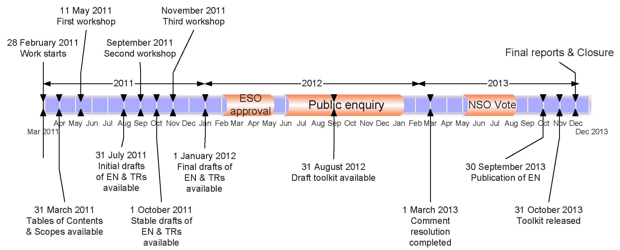
M 376 Phase 2: Indicative Time Line
Notes:
A diagram showing the major project dates:
- Teams start work: 1st March 2011
- Tables of content and document scopes available: 31st March 2011
- First public workshop: 11th May 2011
- Initial drafts of documents available: 31st July 2011
- Second public workshop: September 2011
- Stable drafts of documents available: 1st October 2011
- Third public workshop: November 2011
- Final drafts of documents available: 1st January 2012
- ESO approval period: 1st February 2012 to 30th April 2012
- Public enquiry procedure: 1st June 2012 to31st December 2012
- Comment rsolution period completed: 1st March 2013
- Formal voting period: 1st May 2013 to 1st August 2013
- Publication of EN: 30th September 2013
- Project closure: 30th May 2013

Slide 13
Even the simple is complex!
The primary aim of the work is to encourage products and services that are accessible with the minimum need for Assistive Devices to be attached
However, the ability to connect assistive devices still needs to be specified
Even this simple high-level requirement divides into several inter-related requirements related to:
the high-level requirement that say that accessibility support functions should be inbuilt
a requirement that says that it shall be possible to attach AT
a requirement that defines the permissible ways to attach
a requirement that addresses the special case of “closed functionality”

Slide 14
Consultation is vital
The ETSI STF and the CEN PT contain experts chosen for their knowledge and experience in accessibility and related areas
However, ensuring that the accessibility requirements are fit for purpose necessitates developing requirements that are:
suitable for use within existing public procurement processes
compatible with the needs of persons who experience a wide range of barriers to accessibility
capable of being met by the suppliers of products and services
To ensure that this wide range of constraints are correctly addressed the expert teams must effectively consult with:
public procurement representatives
organisations representing end-users
the producers and suppliers of products and services

Slide 15
Public Workshops
11th May 2011: to involve public procurement officials at the beginning of the activity
Provisionally September 2011: to seek feedback from stakeholders during the early drafting
Provisionally November 2011: to present stable drafts before the completion of the work

Slide 16
How to monitor or contribute to the work
By commenting on the drafts at www.mandate376.eu
Where the latest drafts for comment will soon be available
Via your National Standards Body
Via your trade association
Digital Europe for the European ICT sector
Via user and consumer organisations
Via your government procurement body
By contacting the Joint Working Group directly
accessibility@aenor.es

