Slide 1
ITU-T TSB Director’s Report 2011: Highlights
Malcolm Johnson
Director Telecommunication Standardization Bureau, ITU
TSAG, 10 January 2012

Slide 2
2011: A year in highlights
179 ITU-T Recommendations approved
Remote participation on the rise
New work:
Smart grids
Cloud
AV accessibility
Methodologies
Universal charger
Cybersecurity information exchange
New ITU-T H.264 on its way
WTSA Action Plan: On target
Bridging the standardization gap: Excellent progress
Academic membership: Great success

Slide 3
Membership increase
17 new Sector Members
22 new Associates
25 new Academia members
Retain members
Mentoring programme started
Pro-active outreach to existing members
Tutorial for Editors and Rapporteurs
Attract new members
Participation in key ICT conferences
TSB staff promote membership on mission
New promotional materials developed

Slide 4
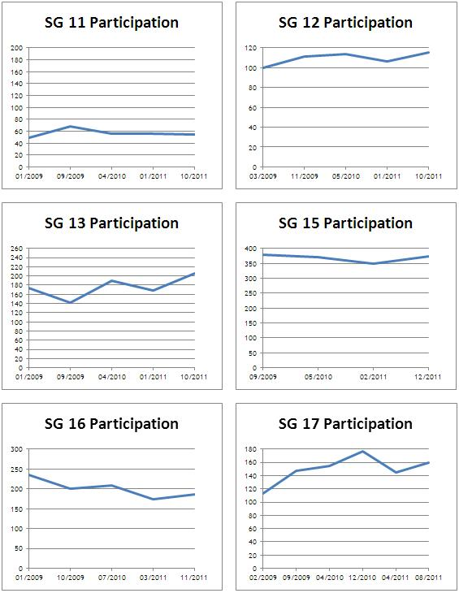
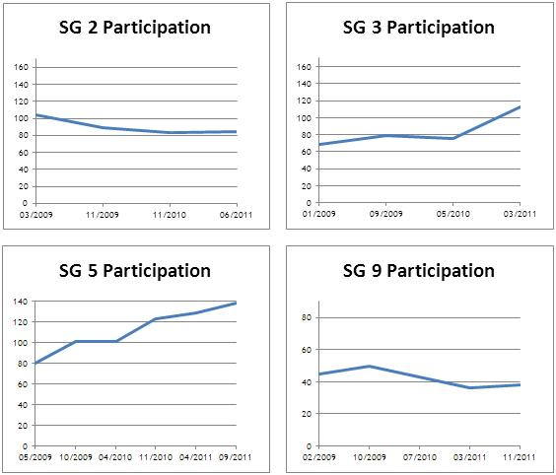
Participation Trends

Slide 5
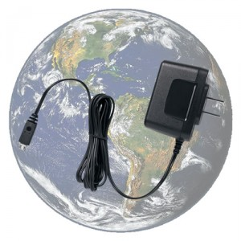
ICTs and Climate Change
Recommendations
Universal charger and methodologies
Best practices for Green Data Centers
Ongoing standards work
Intelligent transport systems; Virtualization; Smart Grid; Smart Water; Telepresence
Environmental sustainability guidelines
Guidelines for the recycling of rare-metals
Global survey on e-waste
ITU Green ICT Application Challenge
Joint task force on submarine cables
6th ITU Symposia on ICTs and Climate Change

Slide 6
International Internet Connectivity and Misuse of numbering
Supplement to ITU-T Recommendation D.50
…gives developing countries tools that will allow them to negotiate better rates (IIC)
Misuse of numbering Resources
Supplement to Rec E.156 identifies actions to counter misuse of numbering resources

Slide 7
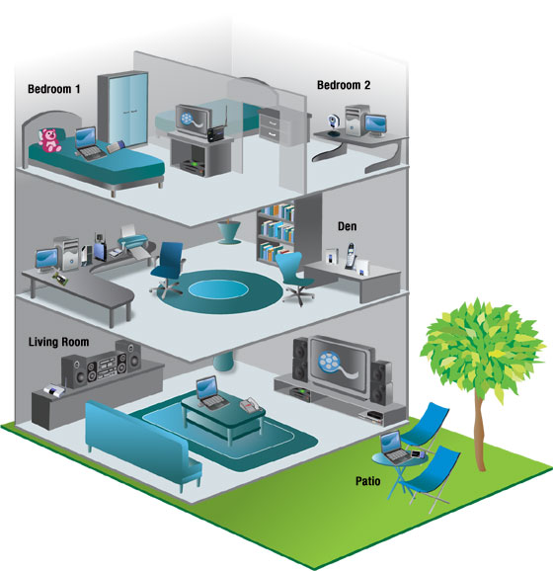
Next Gen Home Networking and Internet of Things (IoT)
ITU hosted first G.hn Interop event
Several SGs have approved home networking Recommendations
G.hnem for smart grid
IoT-GSI promotes unified approach for standards
Draft Recommendations on overview and terminology
IoT-work plan agreed

Slide 8
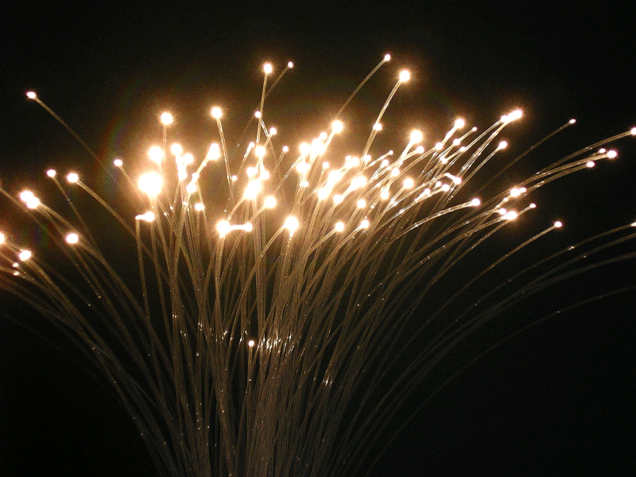
Optical transport networks and MPLS–TP
Optical transport networks
Network synchronization and time distribution performance the fastest growing Question
MPLS-TP
Extensive discussions ITU-T and IETF
First vote in an ITU-T study group meeting
ITU-T G.8113.1 to WTSA-12

Slide 9
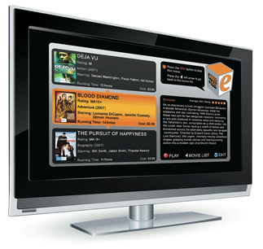
Media coding, IPTV and Telepresence
Media coding
Successor to ITU-T H.264 - H.HEVC, is expected to reach Consent in early 2013
1000 contributions to November meeting
IPTV
Specifications on conformance testing of IPTV implementations
IPTV Application Challenge
Telepresence
Plans to organize Telepresence Interop events.

Slide 10
Focus Groups
FGs on Smart Grid and Cloud Computing completed work
FG CarCOM
Speech recognition in cars
FG on Driver Distraction
1.2 million people dying annually
Focus Group on Audiovisual Media Accessibility
Focus on digital media (TV, IPTV and mobile phones).
Proposal from CTO group to create new FGs on e-Health and Resilient Networks

Slide 11
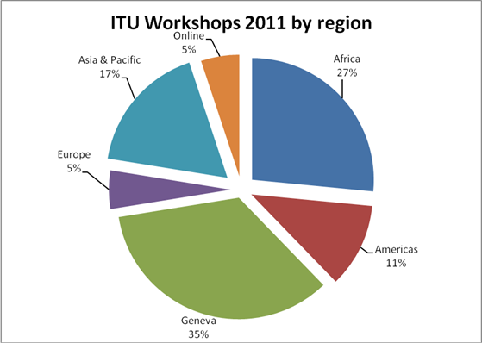
Workshops
34 events, 1885 participants
Increased use of remote participation and new standalone virtual events
Topics included:
… standards gap
IPR
IPTV
Optical systems
Conformity and Interoperability
Green ICTs
Accessibility
Digital signage
Intelligent Transport

Slide 12
Conformance and Interoperability Testing
Conformity database
Major task to increase number of test suites
Interoperability events
For IPTV and G.hn in Geneva; Rio de Janeiro and Dubai
Capacity building
In cooperation with BDT
Assistance in the establishment of test facilities
In cooperation with BDT
Questionnaire issued
Business plan being developed with KPMG

Slide 13
Four Technology Watch Reports Issued
Standards and e-Health
Optical World
Trends in Video Games and Gaming
Digital Signage: the right information in all the right places

Slide 14
Bridging the Standardization Gap
BSG Fund contributors: Nokia Siemens, Microsoft, Cisco and the Korea Communications Commission
2 Members have taken advantage of reduced fees
Handbook on Testing
Standards Q&A Online Forum
Mentoring programme for SG newcomers
BSG Workshops: Fiji, Algeria and Moldova.
14 workshops in developing countries including Tutorial on Optical Fibres, Cables, and Systems

Slide 15
ITU-T Tools
Direct Document Posting
90 per cent of SG 15’s (400) contributions
New ICT Security Standards Roadmap
Meeting Documents Sync Application
Remote participation
SG Plenary Audiocast
E-lockers
Email Printing
RFID badges

Slide 16
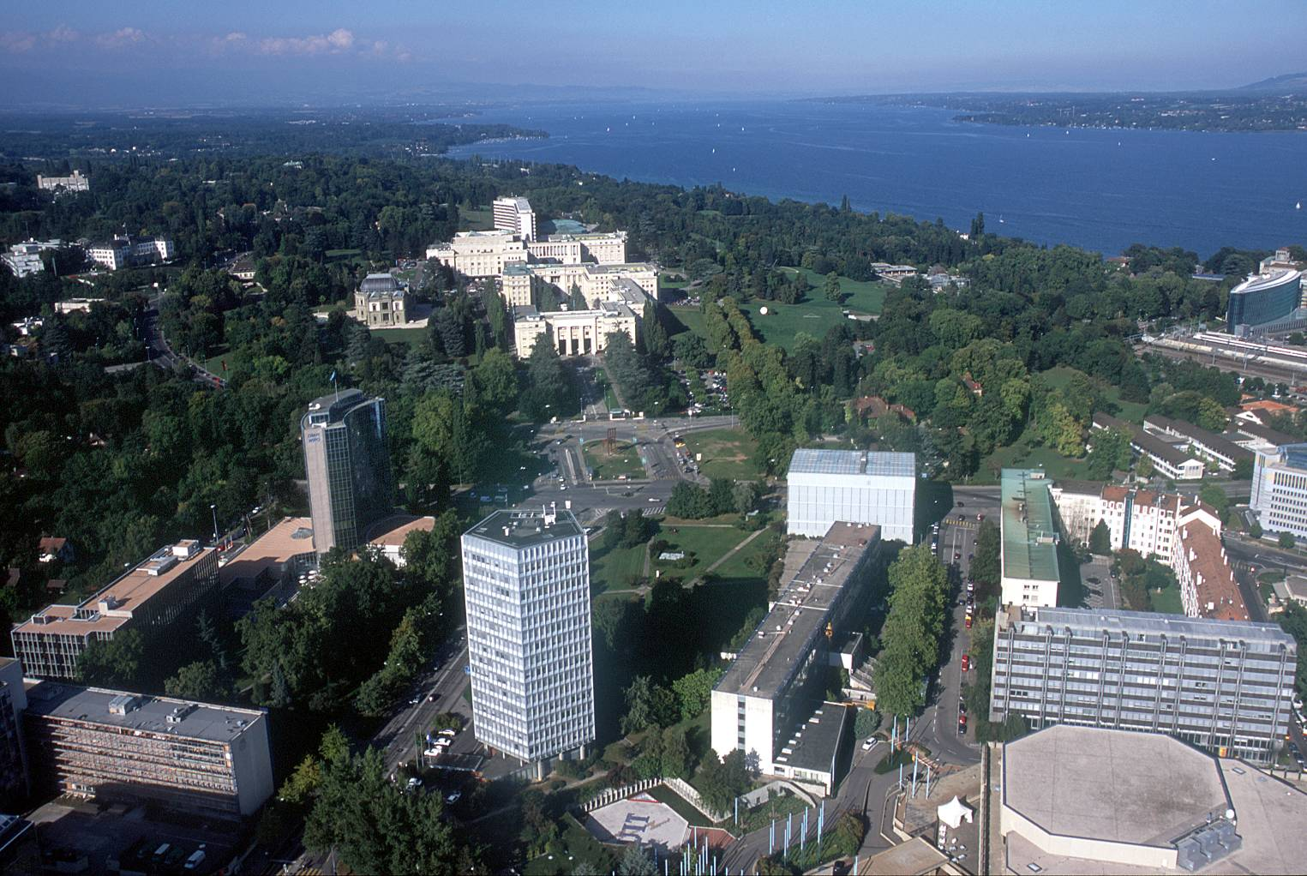
Director’s report to TSAG
malcolm.johnson@itu.int

