Slide 1
Traditional Approval Process (TAP) vs Alternative Approval Process (AAP)
7 July 2022
Notes:
ITU-T guide for new participants – available in 6 languages at https://www.itu.int/en/ITU-T/info/Pages/resources.aspx

Slide 2
Caveat and Disclaimer
This tutorial slide set is informational and is only of illustrative nature of some of the main elements of the approval processes.
The normative and authoritative full texts are contained in:
WTSA Resolution 1
Recommendation ITU-T A.8
ITU Convention
and in relevant WTSA Resolutions and ITU-T Recommendations

Slide 3
Decision-Making in ITU-T
Consensus-building ensures win-win decisions
Avoid voting (limited to Member States)
Soft decisions (agreement, determination, etc.)
Quantifiable decisions (70% affirmation of Member State consultation, etc.)
Approval processes:
Traditional Approval Process (TAP): Policy or regulatory standards
Alternative Approval Process (AAP): Technical standards
World Telecommunication Standardization Assembly (WTSA): Sensitive or difficult standards
Study group Agreement of other (non-normative) texts
The General Rules (GR) apply.

Slide 4
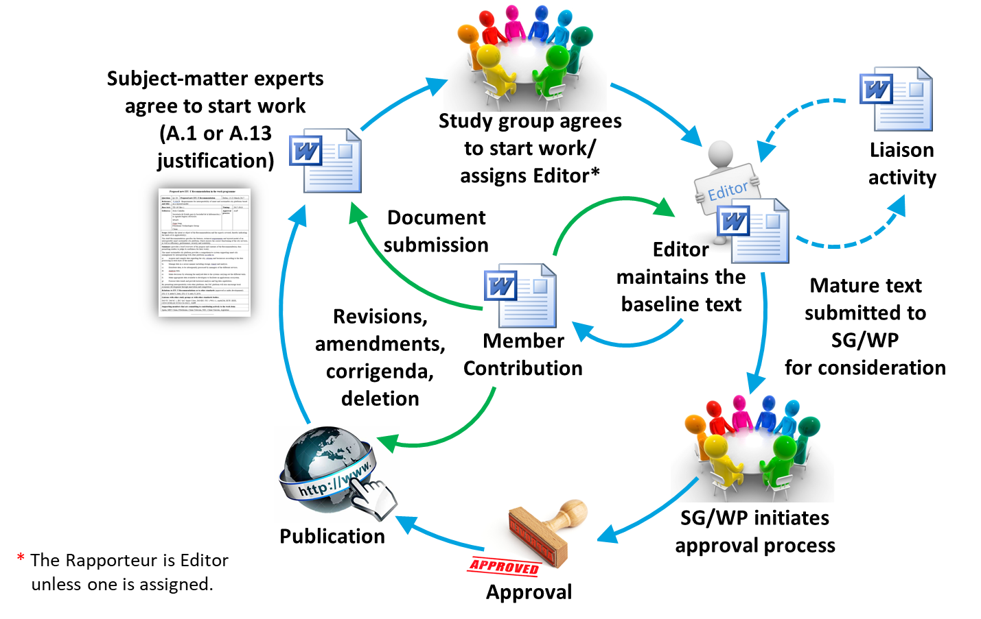
Work Item Life Cycle
Notes:
ITU-T Work Programme: www.itu.int/ITU-T/go/wpd
Resolution 1 (TAP): https://www.itu.int/pub/publications.aspx?lang=en&parent=T-RES-T.1-2022
Recommendation ITU-T A.8 (AAP): www.itu.int/rec/T-REC-A.8
Author's guide: www.itu.int/oth/T0A0F000004
ITU English Language Style Guide: www.itu.int/SG-CP/docs/styleguide.doc
Considering end-user needs in developing Recommendations: www.itu.int/oth/T0A0F000003/en
Manual for Rapporteurs/Editors: www.itu.int/oth/T0A0F000006

Slide 5
Online Resources
ITU-T Work Programme
WTSA Resolution 1 (TAP)
Recommendations under TAP
WTSA Resolution 40 (Regulatory and policy aspects)
Recommendation ITU-T A.8 (AAP)
Recommendations under AAP
AAP Announcements
Recommendation ITU-T A.13 (non-normative texts)
Author's guide
ITU English Language Style Guide
Considering end-user needs in developing Recommendations
Manual for Rapporteurs/Editors

Slide 6
Approval and Agreement
Traditional approval process (TAP)
Approval process for international standards (Recommendations) that require formal consultation of Member States having regulatory or policy implications or where there is any doubt (CV/Art.20 246D, 246H, Res.1 §8.1, 8.1.1, 9.1, Res.40 resolves)
Alternative approval process (AAP)
Approval process for technical Recommendations (A.8 §1.1)
WTSA
WTSA may approve texts when all else fails (Res.1 §1.11.2)
Agreement
Used for non-normative texts (A.13 §6.2) (Appendices, technical papers, technical reports, guides, supplements, etc.)

Slide 7
Prerequisites
“Default approval process” SGs (typically at the first SG meeting) shall define for each Question an indication (aka assignment of the default approval process) if any resulting Recommendation shall be under TAP or AAP (ref. CV/Art.20 246A).
A NWI takes into account the default approval process, but may have a different approval process if so necessary. (A.1 Annex A)
A draft Recommendation text should be sufficiently mature, be relevant and complete, and has been reviewed by the experts to meet the quality criteria, before a decision is taken to AAP-consent or to TAP-determine it. (Res.1 §9.1.2, 9.2.1, A.8 §2.1)
If a draft Recommendation falls within the mandate of more than one study group, the Chairman should consult and take into account the views of any other SG Chairman concerned before proceeding with the application of the approval procedure. (Res.1 §9.3.7, A.8 §3.5)
The ITU-T approval processes support ITU as an intergovernmental organization in which Members States and Sector Members, having well-defined rights and obligations, cooperate for the fulfilment of the purposes of the Union. (CS/Art.1 Preamble, CS/Art.2 20)

Slide 8
Selection of Approval Process
The selection of the approval process for a draft Recommendation can be changed (TAP <-> AAP) (ref WTSA Res.1 Section 8)
Objections (by a Member State or Sector Member) are to be sent in writing to the (next) SG meeting, and must be seconded/supported by a second MS or SM, for reconsideration of the selection. (Res. 1 §8.2, 8.3)
If no consensus is reached, a voting situation results! (Res.1 §1.13, 8.1.1)
The approval process cannot be changed during Last Call, or during TAP consultation, but the approval process can be changed during or at a subsequent study group meeting. (Res.1 §8.3, §8.3.4 A.8 §5.2)
The decision of a changed approval process shall be announced by the Chairman, and recorded in the meeting report and be reflected in the work programme. (Res.1 §8.3.3)

Slide 9
Some Criteria (per WTSA Res.40)
TAP applies if a draft Recommendation or a new work item or a study Question
has policy or regulatory implications or considers topics such as: (Res.40 resolves)
or any other relevant matters where there is any doubt about their scope (CV 246H).
AAP applies for a draft Recommendation
that does not require formal MS consultations, or is of technical nature only. (A.8 §1.1)
The right of the public to correspond;
Protection of telecommunication channels in installations;
Use of the limited numbering and addressing resources;
Naming and identification;
Secrecy and authenticity of telecommunications;
Safety of life;
Practices applicable to competitive markets;
Misuse of numbering resources;

Slide 10
Traditional Approval Process (TAP): Regulatory and Policy Issues

Slide 11
TAP Consultation
TAP consultation (for at least 3 months) starts with the publication of the corresponding TSB Circular. (Res. 1 §9.4.1))
The determined draft Recommendation is published in all 6 ITU official languages (Res.1 §9.3.3, 9.3.5).
No technical changes are made during TAP consultation after the text has been determined. (Res.1 §9.5.2)
Only Member States are eligible to formally respond with a TAP reply to the TAP consultation. (Res. 1 §9.4.1, 9.4.3) (yet other members can contribute to the next SG meeting).
Member States carefully review the text under consultation, and reply if their Administration assigns/not assigns authority to the study group to consider the text for approval at its next meeting. (Res.1 §9.4.1, 9.4.4)
If authority is not assigned, Administration should advise their reasons, and indicate possible changes. (Res.1 §9.4.4)

Slide 12
TAP Consultation- cnt’d
Member States cannot reply after the TAP consultation deadline (7 working days before the SG meeting). (Res.1 §9.4.1)
Member States cannot express other conditions than Yes or No in their TAP reply (yet comments could be attached). (Res.1 §9.4.1, 9.4.4)
For the SG to proceed with considerations for approval, at least 70% of the received replies must be in support of approval. (Res.1 §9.4.5)
If the threshold of 70% is not met, the SG cannot approve the text at this SG meeting; (Res.1 §9.4.6) but the SG may want to progress the text and seek approval at a future SG meeting, or determine a revised and stable text if many technical changes were made having major impact. (Res.1 §9.5.2)

Slide 13
SG Resolution and Approval
SG considers outcome of TAP consultation, of received contributions or of liaison statements. (Res.1 §9.5.2)
A resolution process is started to address the written comments and proposals; (Res. §9.5) on- and off-line consultations typically occur with negotiations to reach stability of the (revised) text, and to avoid opposition at the approval phase. This is a sensitive process that requires good amount of time among all involved proponents.
The Editor develops revised text using track changes based on the published Report of the determined text.
The SG seeks a decision among Member States to approve the final text. (Res.1 §9.5.3) A decision must be reached (Res. 1 §9.5.5)
The SG decision must be unopposed. (Res.1 §9.5.3)
A delegation may register degree of reservation (is recorded in the meeting report, and will be appended to the published Recommendation). (Res.1 §9.5.4)
Exceptionally, a delegation may request more time to consider its position; whereby to raise formal opposition for disapproval to the TSB Director within 4 weeks. (Res.1 §9.5.5, 9.5.5.1)

Slide 14
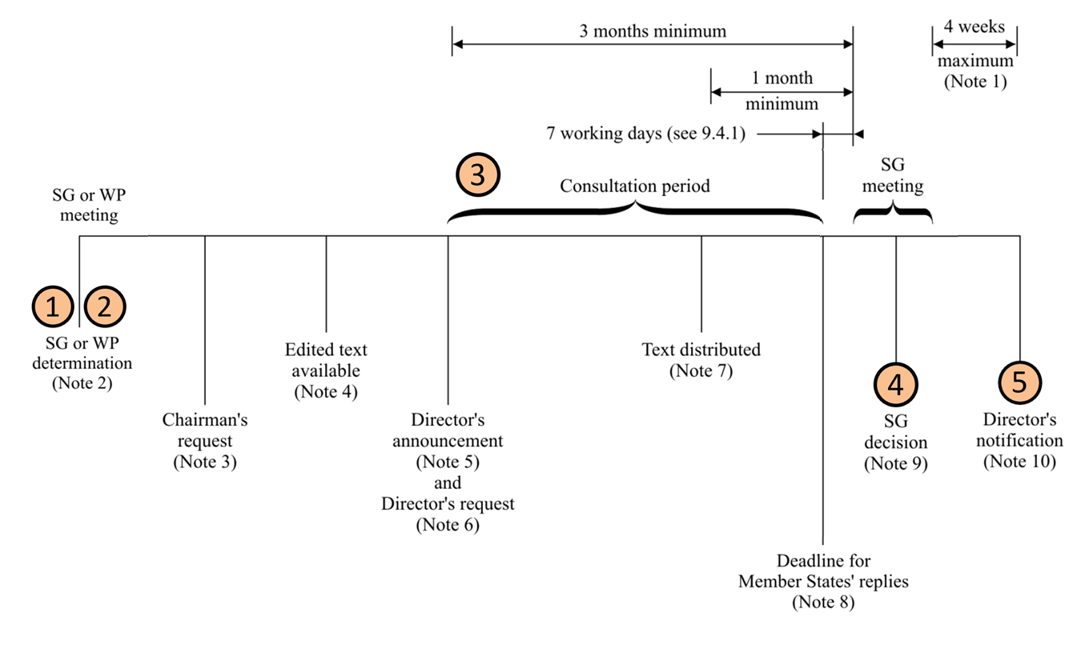
Traditional Approval Process (TAP): Details (Res.1)
Notes:
NOTE 1 – Exceptionally, an additional period of up to four weeks would be added if a delegation requested more time under 9.5.5.
NOTE 2 – SG or WP DETERMINATION: The study group or working party determines that work on a draft Recommendation is sufficiently mature and requests the SG chairman to make the request to the Director (9.3.1).
NOTE 3 – CHAIRMAN'S REQUEST: The SG chairman requests that the Director announce the intention to seek approval (9.3.1).
NOTE 4 – EDITED TEXT AVAILABLE: Text of the draft Recommendation, including the required summary, must be available to TSB in final edited form in at least one official language (9.3.3). Any associated electronic material included in the Recommendation must also be made available to TSB at the same time.
NOTE 5 – DIRECTOR'S ANNOUNCEMENT: The Director announces the intention to seek approval of the draft Recommendation at the next SG meeting. The invitation to the meeting with the announcement of the intention to apply the approval procedure should be sent to all Member States and Sector Members so as to be received at least three months before the meeting (9.3.1 and 9.3.3).
NOTE 6 – DIRECTOR'S REQUEST: The Director requests Member States to inform the Director whether they approve or do not approve the proposal (9.4.1 and 9.4.2). This request shall contain the summary and reference to the complete final text.
NOTE 7 – TEXT DISTRIBUTED: Text of the draft Recommendation must have been distributed in the official languages at least one month before the announced meeting (9.3.5).
NOTE 8 – DEADLINE FOR MEMBER STATES' REPLIES: If 70% of replies received during the consultation period indicate approval, the proposal shall be accepted (9.4.1, 9.4.5 and 9.4.7).
NOTE 9 – STUDY GROUP DECISION: After debate, the study group reaches unopposed agreement to apply the approval procedure (9.5.3 and 9.5.2). A delegation can register a degree of reservation (9.5.4), can request more time to consider its position (9.5.5) or can abstain from the decision (9.5.6).
NOTE 10 – DIRECTOR'S NOTIFICATION: The Director notifies whether the draft Recommendation is approved or not (9.6.1).

Slide 15
Alternative Approval Process AAP: Quick and flexible

Slide 16
AAP Last Call (LC)
AAP Last Call is occurring every two weeks (1. and 16. of a month)
AAP Last Call is announced via TSB Director’s AAP Announcement letters (showing the list of texts entering Last Call, and AAP status and outcome of approval decision). (A.8 §3)
The AAP approval process primarily proceeds electronically virtually outside of study group meetings.
The AAP Last Call period for review of the text lasts four weeks starting from the time of the AAP Announcement. (A.8 §4.1)
The text under AAP Last Call is not modified.
Member States or Sector Members have the right to submit their concerns in writing including advising the reasons for disapproval, and indicating possible changes that would facilitate approval. (A.8 §4.4)
It is not necessary to express any form of support.
Received AAP Last Call comments are published on the AAP Announcement web page.

Slide 17
AAP Last Call Judgment (LJ)
If no concerns other than indicated typographical errors (misspellings, syntactical and punctuation mistakes) are received, then the text is considered approved, and is announced. (A.8 §4.4.1)
Otherwise, the AAP Last Call Judgment phase begins where the SG Chairman in consultation with TSB consider: (A.8 §4.4.2)
If a SG meeting is close enough to consider the resolution of comments and where to complete the approval, or
SG Chairman initiates the resolution of the comments in collaboration with the comment submitters, SG experts and SG leaders.

Slide 18
AAP Last Call Judgment (LJ) – cnt’d
Within 2 weeks typically after end of Last Call, the Editor assists the Rapporteur in preparing revised text, and in preparing a comment resolution log to document the proposed and reached disposition for each comment/proposal. (A.8 §4.4.3, A.8 Annex A)
The edited text and the comment resolution log are published on the AAP web page. (A.8 §4.4.3)
The SG Chairman in consultation with TSB consider: (A.8 §4.4.4)
If a SG meeting is close enough to consider the approval of the revised text, or
To initiate the AAP Additional Review (AR) phase.

Slide 19
AAP Additional Review (AR)
The AAP Additional Review period for final review of the edited text lasts three weeks starting from the time of the AAP Announcement. (A.8 §4.5)
The scope of the additional review covers only those portions of the text that were modified in consequence of the resolved Last Call comments. (A.8 §4.5)
The text under AAP Additional Review is not modified.
If no concerns other than indicated typographical errors are received, then the text is considered approved, and is announced. (A.8 §4.5.1)
Otherwise, if concerns were received, the text is delegated to the next SG meeting for approval. (A.8 §4.5.2, 4.6, 5)

Slide 20
AAP Procedure at Study Group Meeting (SG)
The SG consider the material from Last Call and/or Additional Review, contributions and liaison statements and tries to resolve the comments and find solutions to the problems. (A.8 §5.2)
Upon request of a Member State, the approval process can be changed to TAP. (A.8 §5.2)
The SG seeks a decision to approve of the final text. A decision must be reached. (A.8 §5.6)
Approval must be unopposed and every effort should be made to reach unopposed agreement. (A.8 §5.3)
However, if unopposed agreement is not possible, the text is still considered approved, following consultations with their Sector Members present, if no more than one Member State opposes the text. (A.8 §5.4)

Slide 21
AAP Procedure at Study Group Meeting (SG) – cnt’d
Member State or Sector Members can register a degree of reservation (A.8 §5.5).
Exceptionally, a Member State may request more time to consider its position; whereby to raise formal opposition for disapproval to the TSB Director within 4 weeks. (A.8 §5.6, 5.6.1)
The SG may authorize additional work to address the remaining issues. (A.8 §5.4)
If the text is not approved but more work is necessary, the Chairman may request initiation of a new Last Call. (A.8 §5.8)

Slide 22
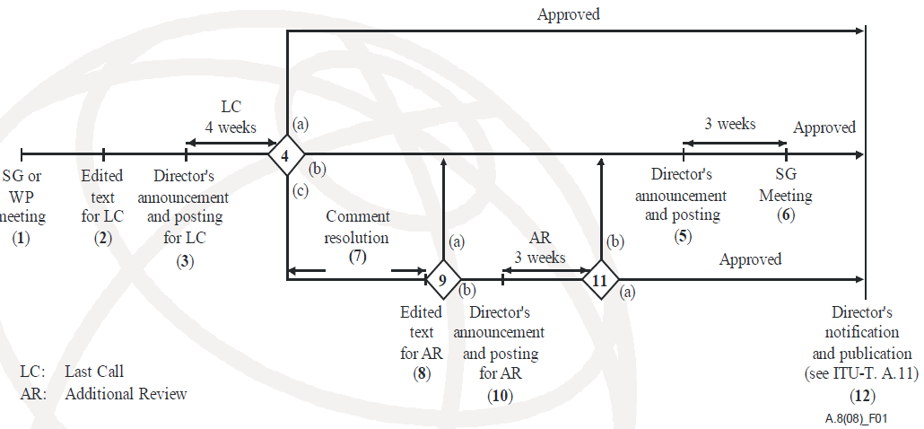
Alternative Approval Process AAP: Details (A.8)
Notes:
1) SG or WP consent – The study group or working party concludes that the work on a draft Recommendation is sufficiently mature to begin the alternative approval process and to initiate the last call (clause 3.1).
2) Edited text available – The final, edited, draft text, including summary, is provided to TSB, and the study group chairman requests the Director to initiate the last call (clause 3.2). Any associated electronic material included in the Recommendation must also be made available to TSB at the same time.
3) Director's last call announcement and posting – The Director announces the beginning of the last call to all Member States, Sector Members and Associates, with reference to the summary and complete text. If the draft Recommendation has not already been electronically posted, it is done at this time (clause 3.1).
4) Last call judgement – The study group chairman, in consultation with TSB, makes the judgement whether:
a) no comments other than those indicating typographical errors have been received. In this case, the Recommendation is considered as approved (clause 4.4.1);
b) a planned study group meeting is sufficiently close to consider the comments received (clause 4.4.2); or
c) to save time and/or because of the nature and maturity of the work, comment resolution should be initiated leading to the preparation of edited texts (clause 4.4.2).
5) Director's study group announcement and posting – The Director announces that the next study group meeting will consider the draft Recommendation for approval and will include reference to either:
a) the draft Recommendation (the edited text (LC) version) plus the comments received from the last call (clause 4.6); or
b) if comment resolution has been carried out, the revised draft Recommendation text. If the revised draft Recommendation has not already been electronically posted, it is done at this time (clause 4.6).
6) Study group decision meeting – The study group meeting reviews and addresses all written comments and either:
a) proceeds under WTSA Resolution 1 or clause 5.8, as appropriate, if there might be policy or regulatory implications (clause 5.2); or
b) approves the draft Recommendation (clause 5.3 or 5.4); or
c) does not approve the draft Recommendation. If it is concluded that a further attempt at addressing comments received is appropriate, then additional work should be done and the process returns to step 2 (without further CONSENT at a working party or study group meeting) (clause 5.8).
7) Comment resolution – The study group chairman, with assistance from TSB and experts, via electronic correspondence and rapporteur and working party meetings, where appropriate, addresses the comments and prepares a new edited draft Recommendation text (clause 4.4.2).
8) Edited text available – The revised edited text, including summary, is provided to TSB (clause 4.4.2).
9) Next step judgement – The study group chairman, in consultation with TSB, makes the judgement whether:
a) a planned study group meeting is sufficiently close to consider the draft Recommendation for approval (clause 4.4.3 a); or
b) to save time and/or because of the nature and maturity of the work, an additional review should be initiated (clause 4.4.3 b).
10) Director's additional review announcement and posting – The Director announces the beginning of the additional review to all Member States and Sector Members, with reference to the summary and complete text of the revised draft Recommendation. If the revised draft Recommendation has not already been electronically posted, it is done at this time (clause 4.5).
11) Additional review judgement – The study group chairman, in consultation with TSB, makes the judgement whether:
a) no comments other than those indicating typographical errors have been received. In this case, the Recommendation is considered approved (clause 4.5.1); or
b) comments other than those indicating typographical errors have been received. In this case, the process proceeds to the study group meeting (clause 4.5.2).
12) Director's notification – The Director notifies the members that the draft Recommendation has been approved (clause 6.1 or 6.2).

Slide 23
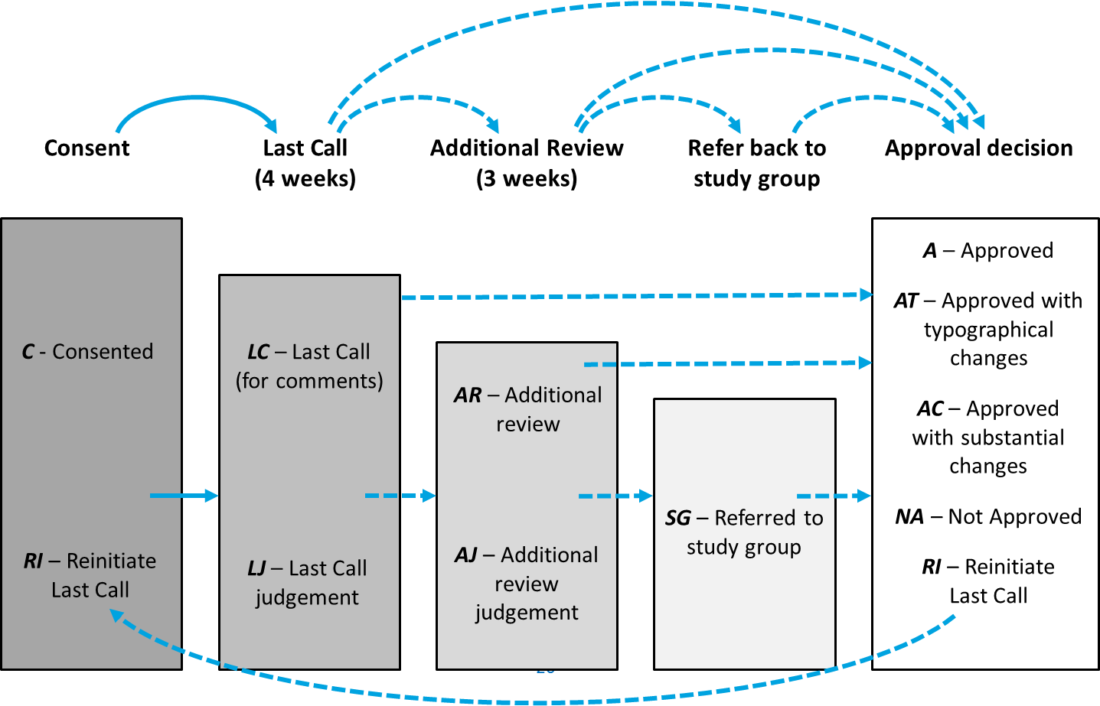
Alternative Approval Process AAP: In Practice

Slide 24
Agreement: For Non-Normative Texts
Non-normative (or “informative”) texts include:
Supplements
Implementers’ guides
Handbooks
Technical reports
Technical papers
Appendices
Notes:
Implementer’s guide:
(Ref. clause 3.2.1 of ITU-T A.13)
An informative (non-normative) document which records all identified defects (e.g., typographical errors, editorial errors, ambiguities, omissions or inconsistencies, and technical errors) associated with a Recommendation or a set of Recommendations and their status of correction, from their identification to final resolution.
NOTE – An implementers' guide is issued by ITU-T following agreement by a study group, or following agreement by a working party with the concurrence of the study group chairman. Typically, defect corrections are first collected in an implementers' guide and, at a time deemed appropriate by the study group, they are used to produce a corrigendum or are included as revisions to a Recommendation
Supplement:
(Ref. clause 3.2.2 of ITU-T A.13)
An informative (non-normative) document which contains material which is supplementary to and associated with the subject matter of one or more Recommendations but which is not essential to their completeness or understanding and implementation.
Handbook: (Ref. clause 3.1.1 of ITU-T Rec. A.13)
A text which provides a statement of the current knowledge, the present position of studies or good operating or technical practice, in certain aspects of telecommunications, which should be addressed to a telecommunication engineer, system planner or operating official who plans, designs or uses telecommunication services or systems, paying particular attention to the requirements of developing countries.
NOTE – It should be self-contained, and require no familiarity with other ITU‑T texts or procedures.
Technical paper or technical report:
(Ref. clause 3.2.3 of ITU-T A.13)
An informative (non-normative) publication containing technical information, prepared by a study group on a given subject within its mandate.

Slide 25
Defer Approval to WTSA
Typically, study groups execute the TAP or AAP process for draft Recommendations (Res.1 §9.2.2);
Then the SGs sends the text to WTSA for approval (Res.1 §1.11.2).
Except when:
the text is of an administrative nature concerning ITU-T as a whole;
SG prefers WTSA to debate and resolve particularly difficult or delicate issues;
attempts to achieve agreements have failed due to non-technical issues such as differing views on policy.

Slide 26
WTSA: Full Decision-Making Power

