Slide 1


ICT Sector Guidance to the
GHG Protocol Product Standard
Gabrielle Ginér & Tom Okrasinski
20 September 2012

Slide 2















Development of GHG Protocol Standards

Slide 3
Sector Guidance
Builds upon the overarching methodology to provide more specificity for a sector
Created by a group of stakeholders convened to build consensus on guidance for performing a product GHG inventory within their sector
Product rules and sector guidance are not required for conformance with GHG Protocol standards
Sector Protocols:
  Forestry and Land Use (Based on Corporate Standard)
  Electricity (Based on Corporate Standard)
  Public Sector (Based on Corporate Standard)
  Cement Sector (Based on Corporate Standard)
  Waste (Based on Corporate Standard, under review)
  Construction (Based on Corporate Standard, under review)
  ICT (Based on Product Standard, under development)
  Chemical Sector (Based on Corporate and Scope 3 Standards, under development)

Slide 4
Who is involved in the ICT Sector Guidance
Initiative jointly convened by:
  WRI (World Resources Institute)
  WBCSD (World Business Council for Sustainable Development)
  GeSI (Global e-Sustainability Initiative)
  Carbon Trust
Steering Committee:
  EU Commission, MIT, ITU-T, CDP, Gartner, ICT Companies
Companies participating in the Technical Working Group (TWG):
  Alcatel Lucent, BT, Capgemini, Cisco, Deutsche Telekom, EMC, Ericsson, Fujitsu, HP, Microsoft, NetApp, Telstra
TWG also has invited experts
Stakeholder Advisory Group (SAG)
  Over 200 participants, 50 companies and 45 countries
Carbon Trust is acting as facilitator and coordinator

Slide 5
ICT Sector Guidance - Chapter Structure and Scope
Introduction
Introduction & General Principles
Telecoms
Network
Services
Desktop Managed Services
Cloud and Data Center Services
Enabling Effect: Transport Substitution
Services
Chapters
Networks
Technical Support Chapters
Hardware
Software (Energy Used by)
Data Center (Standalone)
References
Appendices
Glossary

Slide 6
Chapter Development and Review Process
2011 2012
Initial Draft Development | Technical Work Group Review | Draft Refinement | Steering Committee Review | Draft Refinement | 1st SAG Review | Draft Refinement | 2nd SAG Review | Final Publication
SAG comments
Generally positive comments – such as…
  “Overall we wish to commend the Working and Technical Groups for a significant piece of work executed thoroughly and pulling together a wide range of best practice from across the industry” – British Computer Society (BCS)
  “I would like to thank all involved for producing such a comprehensive and excellent guidance” – CMG Consultancy
A number of very detailed comments that will improve the overall structure and document clarity – but not significantly affect guidance principles

Slide 7
Introduction chapter

Slide 8
Summary of Introduction Chapter
Context for ICT
  long and complex global supply chains
  Complex ICT services
  Significant use phase
  Current best practice
Overview of chapter structure
Relation to other standards
Key principles (relating to the Product Standard)
Boundary Setting (what to include and exclude)
Allocation
Assurance
Reporting
“Infrastructure Summaries”
  Hardware; Networks; Software; Data Centers

Slide 9
Telecommunications Network Services (TNS) chapter

Slide 10
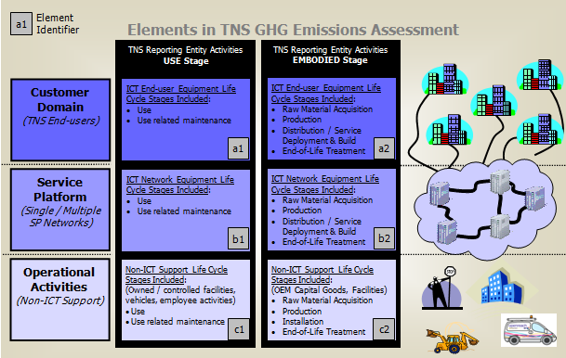
Telecommunications Network Services (TNS) Guide
GHG emissions elements

Slide 11
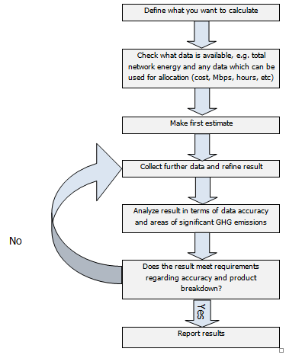
Telecommunications Network Services (TNS) Guide
Flowchart for calculating GHG emissions of a TNS

Slide 12
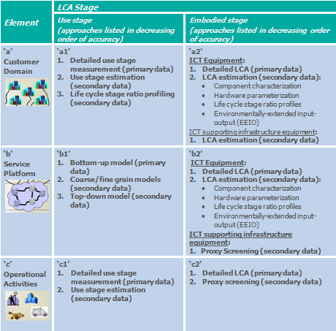
Telecommunications Network Services Guide
GHG Emissions Elements – Customer Domain; Service Platform; Operational Activities

Slide 13
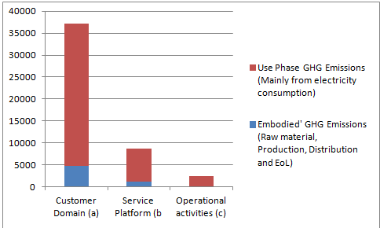
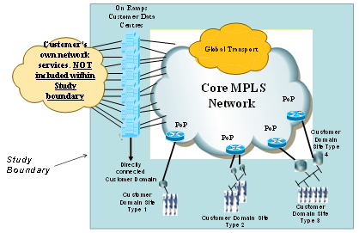
Telecommunications Network Services Guide
Case study analysis
Results
MPLS Analysis
MPLS = multi-protocol label switching

Slide 14
ABC pilot study background
Methodologies tested: GHG Protocol, ITU, ETSI
Pilot objective: test workability and compatibility of methodologies and estimate GHG emissions associated with Wholesale Broadband Connectivity (WBC) Service to understand GHG reduction opportunities
Status: calculation methods, results and audit report submitted to EC’s consultant (Ecofys) on 26 March 2012

Slide 15
Main findings
Similarities: methodology fundamentals are the same and pilot application delivered same numerical results (based on experienced LCA practitioners performing analysis)
Differences: how inventory gathering and calculation approaches are broken down into component parts; guidance offered; and optional approaches / methods offered to aid practitioners
Challenge: most resources were spent collecting specific data and conducting detailed LCAs of hardware for determining the embodied (other than “use”) stage GHG emissions
Highlight: using GHGP LCA estimation techniques such as common component / equipment characterization and LCA stage ratios saved considerable resources and time (and delivered results within 10% of detailed LCAs)

Slide 16
Conclusions
A company using different methodologies would get same results, but different companies using same methodology may not get the same result
ICT industry is not yet at a point where only one GHG assessment methodology can be selected and/or others discarded
Organizations should be able to pick whichever methodology works best for them (suited to their requirements at the time)
Overall goal is identification of GHG emissions reduction opportunities and the means to assess enabling effects of ICT applications
GHG measurement / Life Cycle Assessment methodologies are not at the point where they can be used for product comparison, marketing, labelling or threshold level comparisons
Expectation: it will take a few years before we have more experience and therefore more clarity on GHG measurement / Life Cycle Assessment
The market* should be allowed to choose the role of each of the standards. It will signal what is the most productive reporting scheme
    *combination of customer requirements, analyst and advocacy practice, and academic/conference proceedings

Slide 17
Contact details and additional information
Gabrielle Ginér: gabrielle.giner@bt.com
Tom Okrasinksi: tom.okrasinski@alcatel-lucent.com
http://www.ghgprotocol.org/feature/ghg-protocol-product-life-cycle-accounting-and-reporting-standard-ict-sector-guidance

