Slide 1
Overview of
ITU-T Study Group 5 “Environment and Climate Change”
Ahmed ZEDDAM France Telecom Orange Chairman, ITU-T Study Group 5
ITU Green Standards Week
17-21 September 2012, Paris

Slide 2
ICTs play a double role in climate change
ICTs are part of the problem…
The Bad News: ICT Accounts for Approximately
3%
of Global CO2 Emissions
But ICTs are also part of the solution…
The Good news: ICT has the potential to reduce emissions in other sectors by
15%
Smart buildings, Smart metering, Smart Motor systems, Smart Logistics plus Dematerialisation of Transport
VS

Slide 3
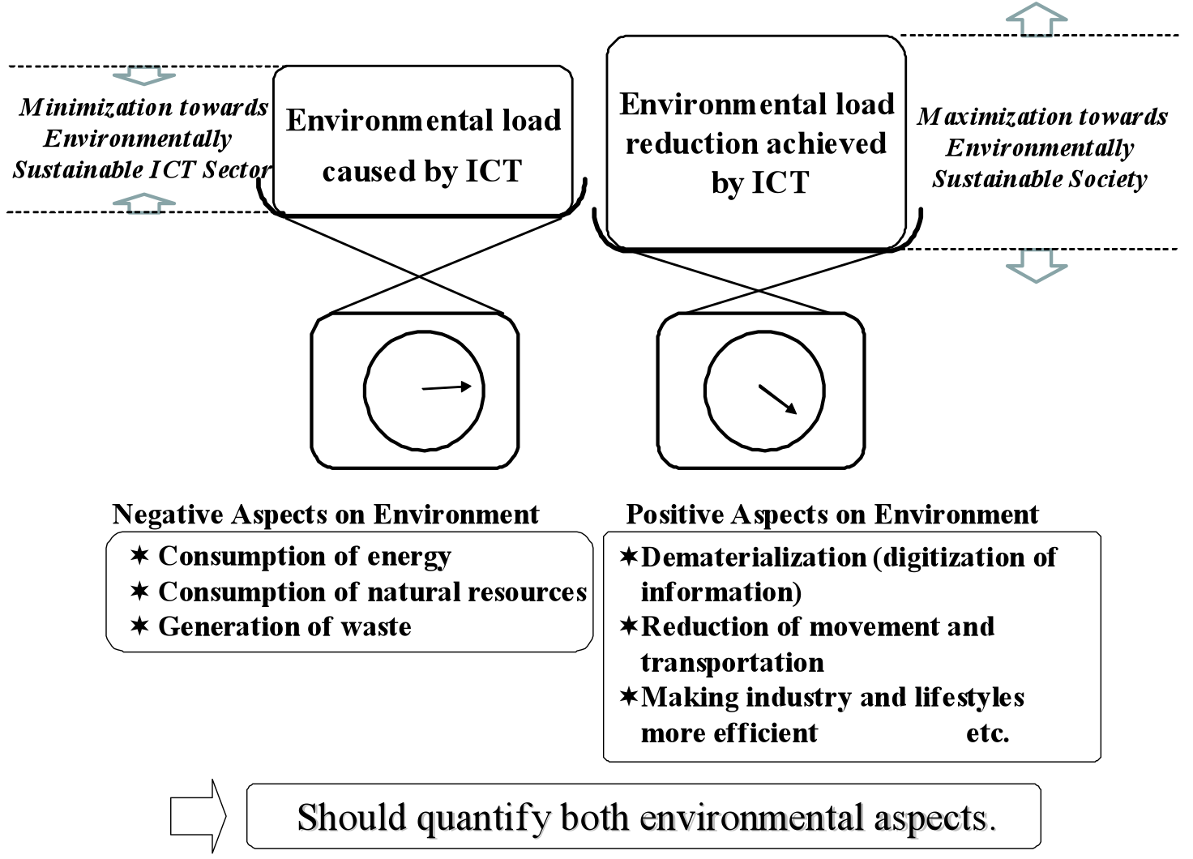
Environmental aspects of ICT

Slide 4
Structure of ITU-T Study Group 5
ITU-T SG5
“Environment and climate change”
Q.14 Terminology
WP1/5
Damage prevention and safety
WP2/5
Electromagnetic fields: emission, immunity and human exposure
WP3/5
ICT and climate change
7 Questions
7 Questions
7 Questions
Notes:
Kindly note that WP3 has 8 question if we count the new Question of Gilbert.

Slide 5
ITU-T Study Group 5 “Environment & climate change”
ITU-T SG5/WP3’s work areas:
Q 17/5 - Energy efficiency for ICT equipment and Climate Change standards harmonization
Q 18/5 - Methodology of environmental impact assessment of ICT
Q 19/5 - Power feeding systems
Q 21/5 - Environmental protection and recycling of ICT equipment/facilities
Q 22/5 - Setting up a low cost sustainable telecommunication infrastructure for rural communications in developing countries
Q 23/5 - Using ICTs to enable countries to adapt to climate change
New Question- Leveraging and enhancing the ICT environmental sustainability (pending WTSA approval)
Working Party 3 “ICT and Climate Change”
Continuing and expanding the work of ITU-T Focus Group on ICT and climate change

Slide 6
Highlights on deliverables of WP3/5
Important green ICT standards have been developed by SG5 WP3 during the current study period. These are namely:
Recommendation ITU-T L.1000: Universal power adapter and charger solution for mobile terminals and other hand-held ICT devices
Recommendation ITU-T L.1100: A method to provide recycling information of rare metals in ICT products
Recommendation ITU-T L.1200 : Direct current power feeding interface up to 400V at the input to telecommunications and ICT equipment
Recommendation ITU-T L.1300: Best practices for green data centers
Recommendation ITU-T L.1310: Energy efficiency metrics and measurement for telecommunication equipment
Recommendation ITU-T L.1400 : Overview and general principles of methodologies for assessing the environmental impact of information and communication technologies
Recommendation ITU-T L.1410 : Methodology for environmental impacts of Information and Communication Technologies (ICT) goods, networks and services
Recommendation ITU-T L.1420 : Methodology for environmental impacts of Information and Communication Technologies (ICT) in Organizations

Slide 7
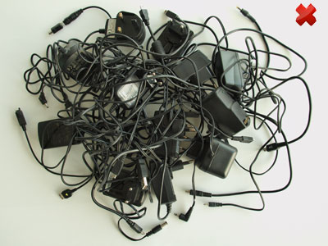
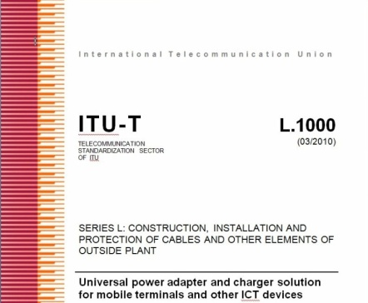
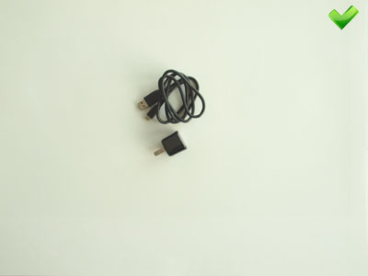
Waste management with smart ICT standard
“Universal power adapter and charger solution for mobile terminals and other ICT hand held devices” (Recommendation ITU-T L.1000)
Future version will cover other ICT devices
Saves 82,000 tons of waste per year
Contributions are needed to develop Common External Power Supply (Phase 2)

Slide 8
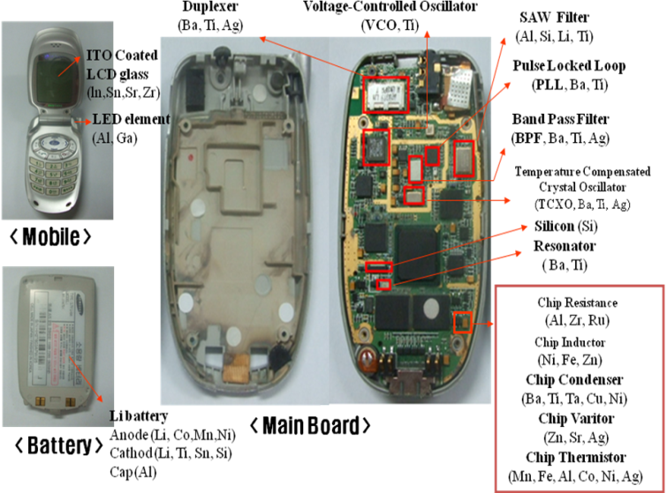
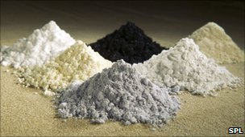
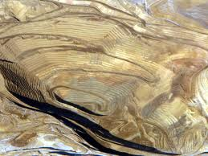
Recycling rare metal in ICT products
ITU-T L.1100 Recommendation on Rare Earth Metals outlines key considerations in all phases of the recycling process, and provides guidelines as to how organizations may fairly and transparently report on rare metal recycling.

Slide 9
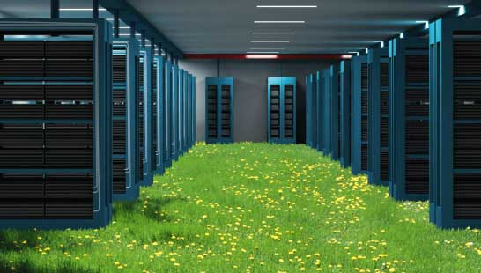
Best practices for green data centers
Recommendation ITU-T L.1300 states that reducing energy consumption and GHG emissions should be considered in the design and construction of data centres, and that constant monitoring will be required to consistently manage and improve energy consumption while the data centre is in operation. (Approved in January 2012)
Best practices are outlined for the use, management and planning of data centres, for cooling and power equipment, for the optimum design of data centre buildings, and for the monitoring of data centres after construction.
For example, applying best practice to cooling could reduce the energy consumption of a typical data centre by more than 50 per cent.

Slide 10
ITU-T Methodologies
Common set of methodologies for the assessment of ICT carbon footprint
Without, it will be impossible to provide meaningful comparisons
Helps to establish the business case to go green
3 Recommendations published :
L.1400 Overview and general principles, available on the ITU-T website
L.1410 Environmental impact of ICT goods, networks and services available on the ITU-T website
L.1420 Environmental impact of ICT in organisations available on the ITU-T website
3 Recommendations under preparation :
L.1430 Environmental impact of ICT projects (consent expected in 2012)
L.1440 Environmental impact of ICT in countries (consent expected in 2013)
L.1450 Environmental impact of ICT in cities (consent expected in 2013)
Developed in cooperation with UNFCCC Secretariat, EC, and over
40 organizations etc..

Slide 11
Joint Coordination Activity on ICTs & Climate Change (JCA-ICT&CC)
The purpose of the JCA-ICT&CC is to provide a visible contact point for ICT and Climate Change activities in ITU-T, to seek co-operation from external bodies working in the field of ICT & CC:
Next meeting dedicated to “Climate Change Adaptation & ICTs” will be held on
11 October 2012 during WP3/5 meeting in Geneva
Physical Participation: ITU Headquarters, Geneva (Switzerland)
Remote Participation: https://www1.gotomeeting.com/register/747584744

Slide 12
Links & Additional Information
ITU-T/SG5 “Environment & Climate Change”
http://www.itu.int/ITU-T/studygroups/com05/index.asp
ITU-T and climate change http://www.itu.int/ITU-T/climatechange
ITU Symposia & Events on ICTs and Climate Change http://www.itu.int/ITU-T/worksem/climatechange
ITU and climate change
http://www.itu.int/climate

Slide 13
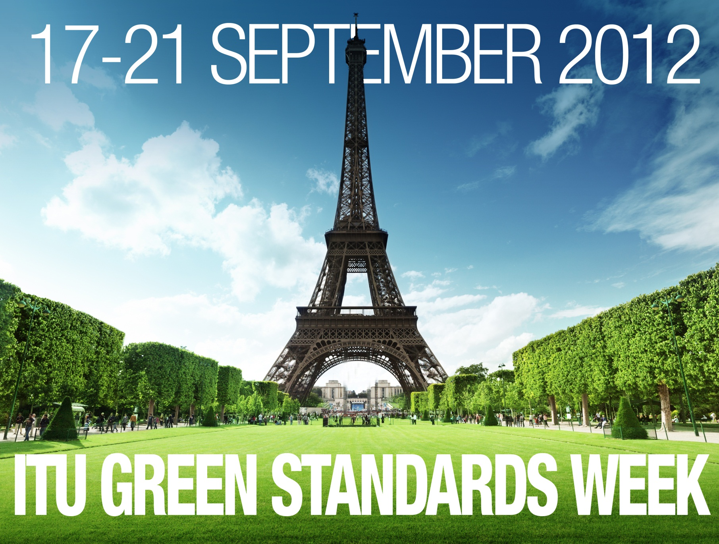
Thank you!

