Slide 1
GUIDANCE ON
GREEN ICT PROCUREMENT
GUIDANCE FOR SUPPLY CHAIN
MANAGEMENT & LIFE CYCLE
ASSESSMENT (LCA) APPROACH
FOR THE ICT INDUSTRY
Aimee Torres

Slide 2
WHY GREEN ICT PROCUREMENT?
ICT’s increasing proliferation and demand of energy/material consumption → concerns environmental impact
ICTs → major linchpin to climate change abatement
Improvement of internal energy efficiency
Development of green ICT solutions
ICT sector must step forward with change and innovation → sustainable economic growth
Environmental impact generated by ICT sector → related to procurement practices.
Procurement decisions → greener perspective.

Slide 3
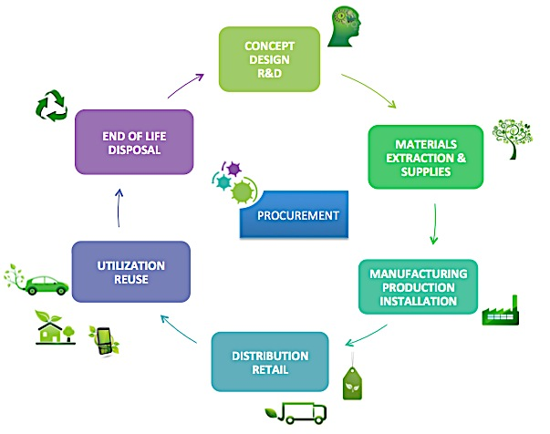
OBJECTIVES
Provide relevant guidance for the inclusion of energy efficiency, environmental protection and carbon emission offset and reduction criteria in the design and implementation of efficient and sustainable procurement processes.
Propose systematized series of guiding principles for ICT organizations, to improve and promote environmental sustainability in the ICT sector ́s procurement transactions

Slide 4
GREEN ICT PROCUREMENT
RELEVANT CONSIDERATIONS
 | Green ICT procurement PROCESS considerations
 | ICT sector green considerations for SUPPLIERS
 | ICT sector green considerations for PRODUCTS and SERVICES

Slide 5
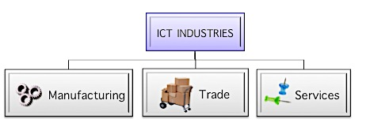
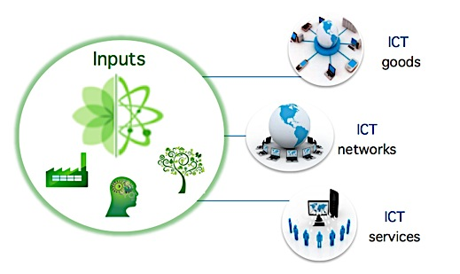
ICT PROCUREMENT PROCESS
Define your company, products and services according to Standards
Allocate organization in industry category
Perform detailed analysis and data collection of inputs, products and services (GNS)
ICT Sector definition (ISIC Rev.4, 2007)
ICT Products/ICT Services Classification (2009,2007)

Slide 6
ICT PROCUREMENT PROCESS
An environmental life cycle assessment (LCA) approach according to standards

Slide 7
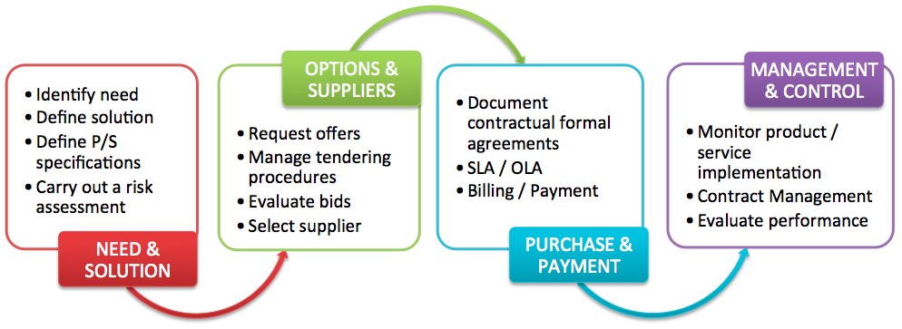
ICT PROCUREMENT PROCESS
Define your procurement process map

Slide 8
ICT PROCUREMENT PROCESS
Procure environmentally-friendly and energy efficient products and services.
Assess environmental impact in terms of energy consumption and GHG emissions.
Implement more innovative / environmentally friendly procurement practices and businesses.
Cost savings
Service Enhancements
Profitability
ITU-T L.1410
ITU-T L.1420
ISO 14064-1

Slide 9
GREEN ICT PROCUREMENT
RELEVANT CONSIDERATIONS
 | Green ICT procurement PROCESS considerations
 | ICT sector green considerations for SUPPLIERS
 | ICT sector green considerations for PRODUCTS and SERVICES

Slide 10
ICT PROCUREMENT FOR SUPPLIERS
Develop matrix of criteria to guide product development, procurement and supplier management.
Evaluate ICT activities and GNS of suppliers and partners.
Evaluate goods, networks and services.
Quantify and report energy consumption and GHG emissions of suppliers and partners.
Encourage suppliers to:
Reduce waste production and management costs
Reduce GHG emissions
Enhance product reusability
Promote green products design
Reduce the use of hazardous materials.
Purchase “green” label products.
ITU-T L.1410
ITU-T L.1420 Annex A
ITU-T L.1420

Slide 11
GUIDANCE ON GREEN ICT PROCUREMENT
 | Green ICT procurement PROCESS considerations
 | ICT sector green considerations for SUPPLIERS
 | ICT sector green considerations for PRODUCTS and SERVICES

Slide 12
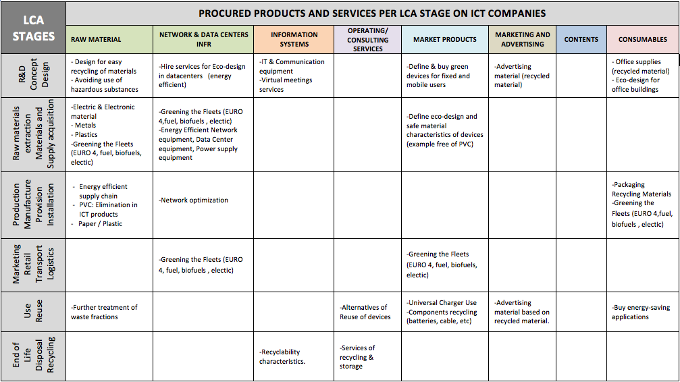
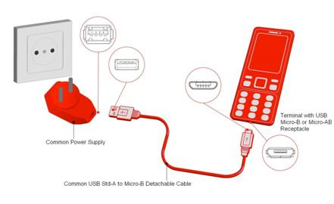
ICT PROCUREMENT PRODUCTS/SERVICES
Ensure sustainable exploitation of natural resources.
Decouple economy growth from the use of natural resources.
Innovate world’s system of production, trade and consumption.
Procure environmentally-friendly products and services.
ITU-T Rev. L.1000
Green considerations for ICT procurement for products/services per LCA stage

Slide 13
Thank you
Links and additional information
Information on ITU-T’s activities on ICT and Climate Change: http://itu.int/ITU-T/climatechange/
Contact Aimee Torres and Cristina Bueti (ITU): greenstandard@itu.int

