Slide 1
Driving the Sustainable Future The commitment to sustainability of the European Telecommunications Network Operators’ Association Danilo Riva – ETNO WG Corporate Responsibility Chairman
2nd ITU Green Standard Week
ITU-ETNO Forum on Environmental Sustainability for the ICT Sector
Paris, 20 September 2012

Slide 2
Our Vision
Sustainable development is a global strategic goal, which seeks to achieve economic growth that promotes a fair and just society while conserving the natural environment and the world’s scarce, non-renewable resources for future generations.
It is our belief we, given our position in and impact on the economic, social and technological scenario, can play an important part in making this happen.

Slide 3
Milestones
November 1996 – ETNO launches its Environmental Charter
November 1998 – ETNO publishes its first Environmental Report
November 2004 – ETNO launches its Sustainability Charter and joins the Global Compact
January 2007 – ETNO launches its first Sustainability Report
September 2012 – ETNO launches its Corporate Responsibility Charter

Slide 4
Charter Basic Commitments
The Charter embodies its signatories’ commitment to sustainable development via:
a sustainable provision of ICT based solutions with significant environmental, social and economic benefits, with a particular focus on enabling the reduction of environmental impacts of other industry sectors and society at large and improving citizens’ quality of life;
a determined effort to integrate our business activities with environmental, social, and economic responsibilities — minimizing, where practicable, any negative impact these activities may generate.

Slide 5
Our Pledge
We, as Sustainability Charter signatories, whether individually or collectively, are committed to continuous improvement and the sharing of best practices via action in the following areas:
Regulatory Compliance
Awareness
Research and Development
Procurement
Accountability
Cooperation
Management Systems
Employee Relations

Slide 6
The 21 Signatories of the ETNO Sustainability Charter
Deutsche Telekom
Magyar Telekom
Slovak Telekom
Czech Republic

Slide 7
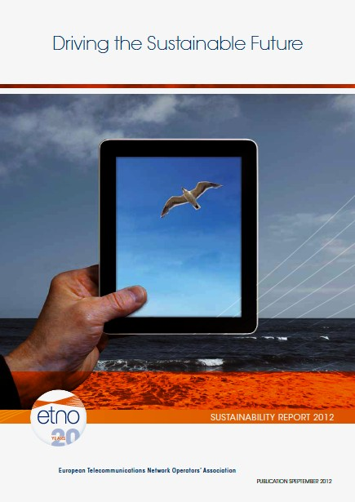
The new ETNO Sustainability Report
Embracing Corporate Responsibility demands commitment to continuous improvement and regular performance assessment. Thus, our reports will offer stakeholders a means to judge how effective our improvement programmes have been. Moreover, the spread and reach of telecommunications across contemporary society imposes on us, as responsible corporate citizens, the social obligation to demonstrate transparently that this commitment is reflected in the way we plan and run our businesses.

Slide 8
Sustainability Report Highlights
Environmental Policy approved at Board level: 100% (53%)
Environmental Management System: 86%(19%) in place, 10% (29%) in progress, 81% (5%) certified
Main Board member with environmental responsibility: 71% (57%)
Manager responsible for coordinating programmes of environmental improvement: 100% (71%)
Suppliers involved in in active cooperation programmes aimed at improving performance and environmentally responsible development/management of purchased goods/services: 76% (14%)

Slide 9
Our Next Pledge
We, as Corporate Responsibility Charter signatories, whether individually or collectively, are committed to continuous improvement and the sharing of best practices via action in the following areas:
Regulatory Compliance
e-Inclusion
Awareness and Training
Research and Development
Resource Efficiency
Sustainable Supply Chain Management
Accountability
Cooperation
Management Systems
Employee Relations
Customer Safety and Security
Human Rights
Corporate Governance

Slide 10
The 21 Signatories of the new ETNO Corporate Responsibility Charter
Deutsche Telekom
Magyar Telekom
Slovak Telekom
Czech Republic
Orange
Polska

Slide 11
The ETNO Way
While the “business of business” remains the primary goal for corporations worldwide, the way the business is carried out can make a real difference.
Collectively, our companies’ combined turnover represents a significant proportion of European trade, which offers a unique opportunity for ETNO member companies and the signatories of the Corporate Responsibility Charter in general to co-operate actively with policy-makers and Governments to make a real difference. We believe we can offer a significant contribution to sustainable development.
Our stakeholders will judge our performance, and determine our success

Slide 12
Conclusions
The ETNO Environmental and Sustainability Charters have gained wide recognition over the years and have contributed to raise awareness.
This initiative demonstrates that cooperation is possible, even in a highly competitive marketplace.
Working together Charter Signatories have significantly improved their performance.
Whilst a lot has been achieved, it is important to keep the momentum and join up to drive Europe’s sustainable future together (Paul Timmers).

Slide 13
Effects of Global Warming, Year 2050
LADIES
AND GENTLEMEN,
THE GREENHOUSE
EFFECT IS WORSENING,
AND THEY’RE ASKING US
TO REDUCE OUR GHG
EMISSIONS…
NO!
NO!
NO!
NO!
NO!
NO!
NO!
NO!
NO!
NO!
Source: Le Canard Enchaîné

