Slide 1
E-waste Management in the Arab Region: Status and Opportunities
Hossam Allam, Ph.D.
Regional Programme Manager
Strategic Concerns Programme
Centre for Environment and Development for the Arab Region and Europe

Slide 2
Current Consumption Rates Patterns
Two planets are needed by 2050
1900
2002
2050
2100

Slide 3
ICT Facts and Figures

Slide 4
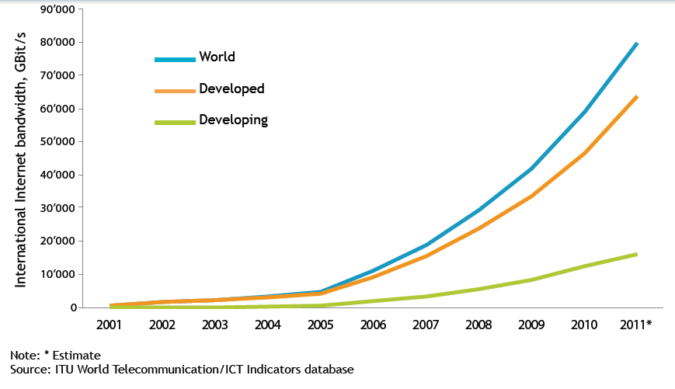

Slide 5
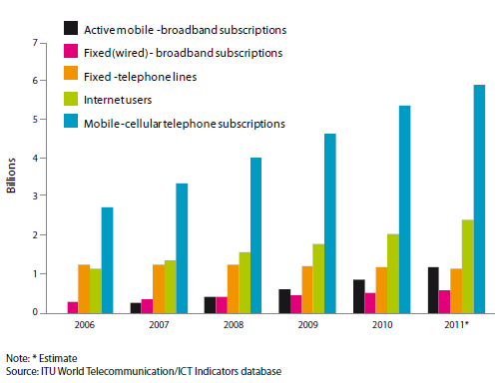

Slide 6
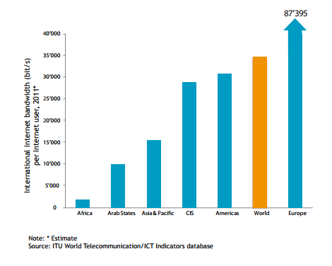

Slide 7
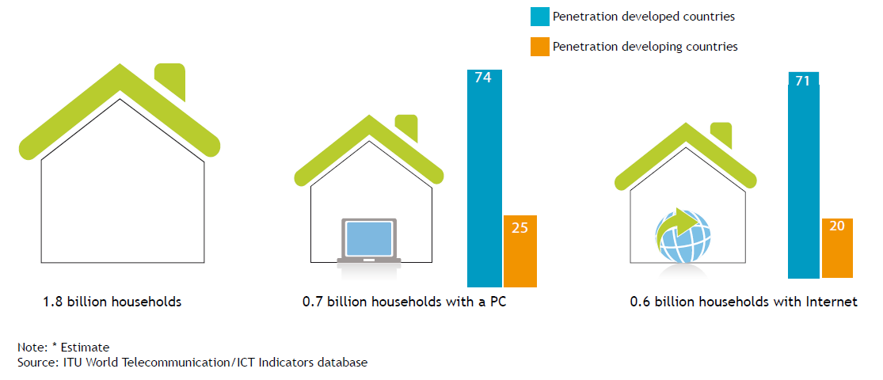

Slide 8
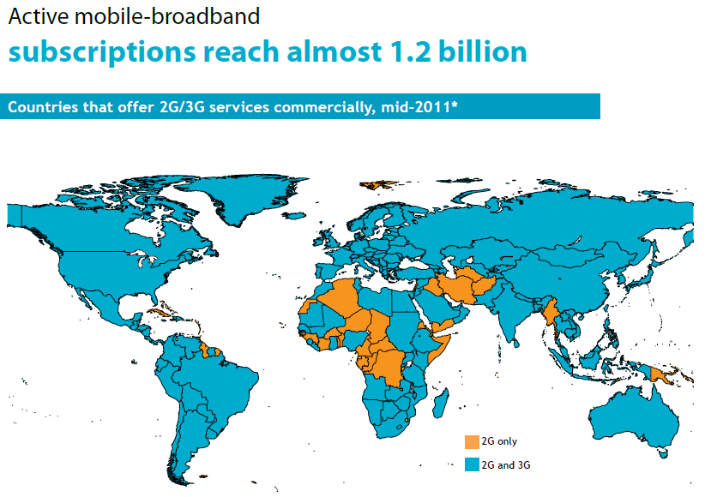

Slide 10
ICT Industry in the Arab Region
Mobile phone subscribers (MPS) –ITU Statistics 2010
Internet Users(Millions), World Bank Data and Indicators 2010
Notes:
10

Slide 11
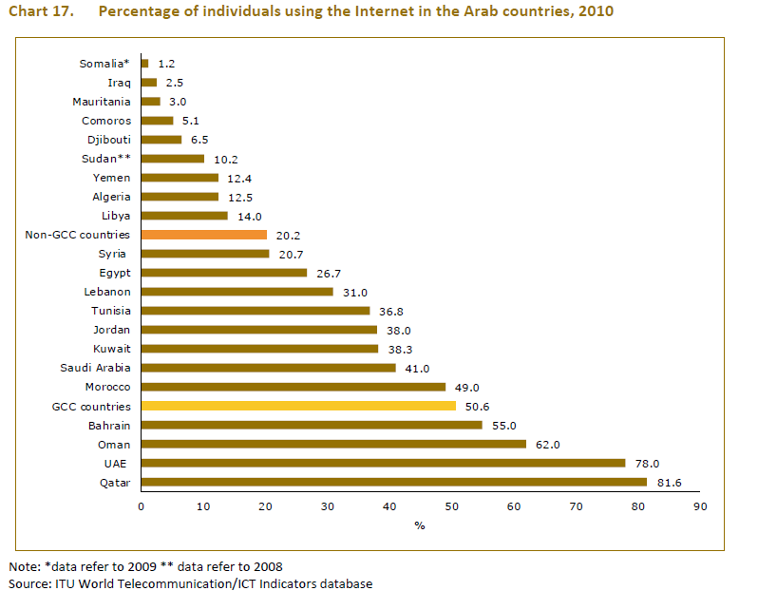

Slide 12
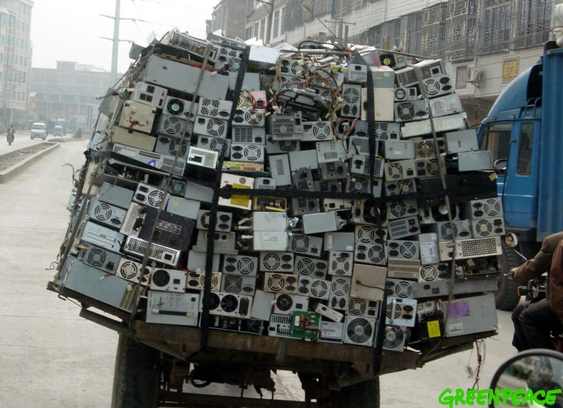
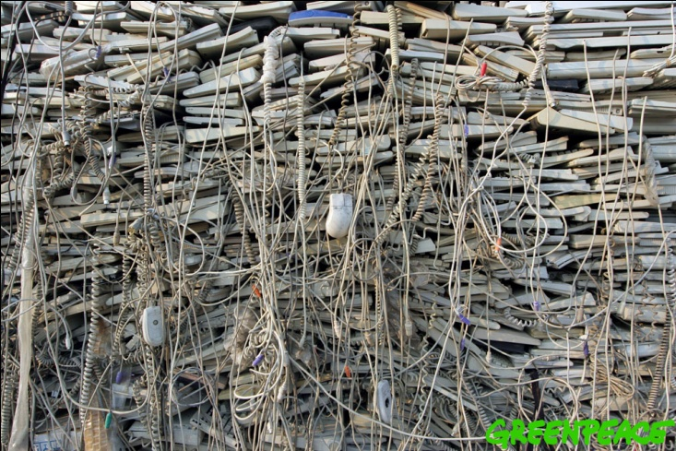
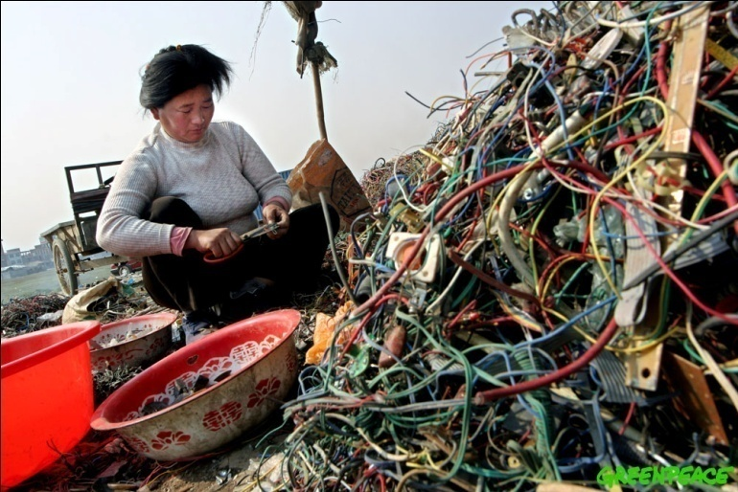
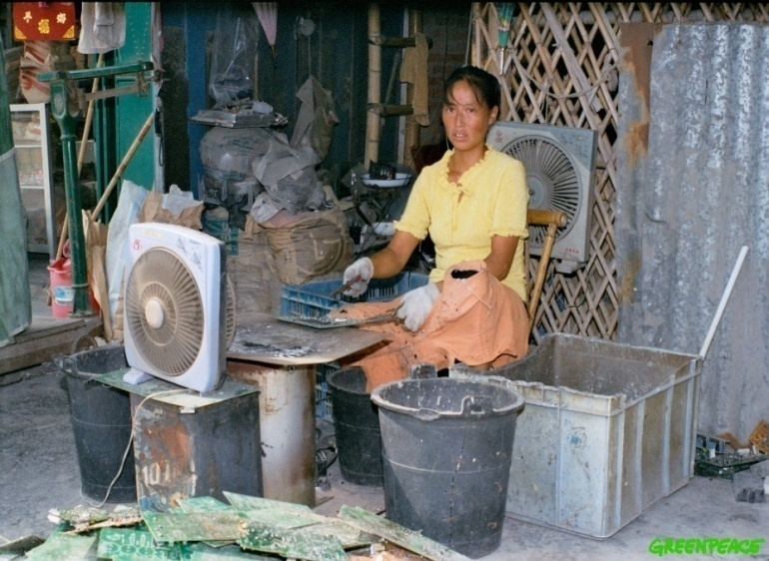
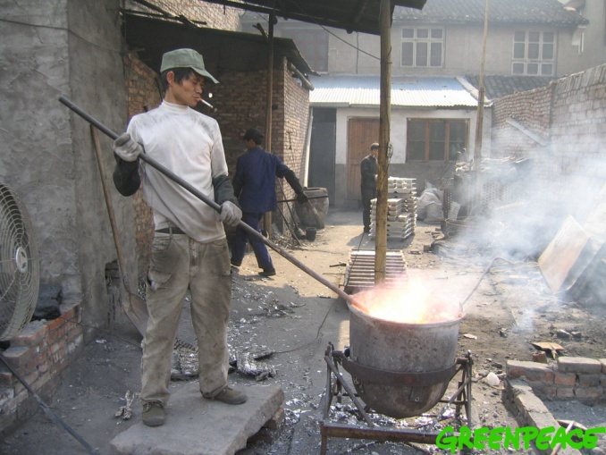

Slide 13
Challenges
Volumes
Increasing sales of EEE, decreasing lifetimes
~40M tons e-waste generated worldwide
EU in 2007: ~2.5M tones recycled, 8.3 - 9.1M tons generated (EMPA)
Material Content
Valuable and energy-intensive precious metals
Toxic materials

Slide 14
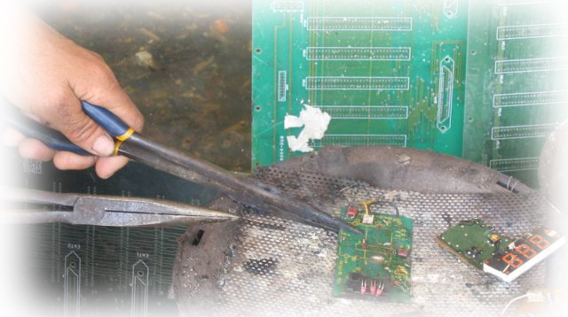
Environmental & occupational safety problems
Ramifications:
Toxic emissions from burning
Soil & water contamination from chemical disposal
Inefficient recovery of precious metals
Notes:
In many industrializing and developing countries, growing numbers of people earn a living from recycling and salvaging electronic waste.

Slide 15
Material | Occurrence in E-waste | Health and Environmental Impact
Beryllium (OECD 2003, Taylor et al. 2003) | copper-beryllium alloys, springs, relays and connections; | beryllium sensitization/chronic beryllium disease human carcinogens released as beryllium oxide dust or fume during high temperature metal processing
Cadmium | Contacts, switches, nickel-cadmium (Ni-Cd) batteries, printer inks and toners | persistent and mobile in aquatic environments (ATSDR 2000) damage to the kidneys and bone toxicity, released if plastic is burned or during high temperature metal processing
Lead | Circuit boards/ cathode ray tubes CTR (1 – 3 kg per CRT); | Risk for small children and fetuses Damage to the nervous system, red blood cells, kidneys and potential increases in high blood pressure; Incineration can result in release to the air
Mercury | Lighting devices that illuminate flat screen displays, switches and relays | Impacts the central nervous system Land filling and incineration of flat panel displays results in the release to the environment
PCBs (polychlorinated biphenyls) | Insulating fluids for transformers and capacitors, flame-retardant plasticizers | Suppression of the immune system, liver damage, cancer promotion, damage to the nervous system Damage to reproductive systems

Slide 16
Some Facts
One ton of recycled cell phones can generate up to 230 grams of gold
More than 70% of a mobile phone can be recycled.
Current mass of phones being recycled is only about 0.001-0.003% of the total weight of waste electronic equipment each year.

Slide 17
Electronic Waste Life Cycle
Take Back
Refurbishment
Metal Recovery
Sorting
Recycling
Re-use
Manufacture

Slide 18
E-waste Management Activities Survey in the Arab States
National Authorities
Private Sector Enterprises
NGOs
Non-Arab Enterprises

Slide 19
E-waste Management Activities
Algeria
Assessment of E-Waste and E-Waste Recycling Facilities 2006 – 07, BCRC
Egypt:
MCIT and MoE: launching “Green ICT” Initiative
Egyptian Electronic Recycling Co. (EERC) is the first electronic equipment recycling facility in Egypt
Spear Ink is a pioneer in inkjet and toner environmental friendly refilling and remanufacturing

Slide 20
E-waste Management Activities
Jordan
UNEP/Basel-PACE: Recycling of used computers
Assessment of E-Waste and E-Waste Recycling Facilities, 2006 – 2007, BCRC
Project of re-using computers, Jordan Environment Society (JES)
Morocco
Managem : E-waste treatment plant
Managem and Al-Jisr: “GREEN CHIP” Project for collection of used digital equipment and E-waste recycling
CMPP: Assessment of the current situation in Morocco, 2007

Slide 21
E-waste Management Activities
Syria
Temporary E-waste disposal facility (2007)
Tunisia
Recycling facility is operating, Anged
Collection and transfer of E-waste with a capacity of 1000 tons/year
Yemen
Proposed project for compiling an E-waste/Inventory(2011)

Slide 22
 | Legal Framework | Inventory | Collection | Recycling & Reusing Technology
Level 1 – LOW | No legal framework, strategy, or norms | There is no inventory | There is no collection | There is no recycling/reusing mechanism
 | Iraq, Kuwait, Lebanon*, Syria, Yemen | Egypt, Iraq, Jordan, Lebanon*, Kuwait | Egypt, Iraq, Jordan, Lebanon*, Yemen | Iraq, Kuwait, Syria, UAE*, Yemen
Level 2 | There is only plan to develop legal framework | There is the inventory for municipal solid waste, but no designated inventory for E-waste. | E-waste is locally collected by local recyclers, scavengers, etc. without any legal framework. Only recyclable E-waste is well collected | Only recyclable and reusable E-waste is recycled and reused by local stakeholders
 | Bahrain, Egypt, Syria | Bahrain, Syria, UAE*, Yemen | Kuwait, Syria, UAE* | Jordan
Level 3 | A legal framework is being prepared and will be issued/enforced in very near future | E-waste inventory is being prepared | E-waste is well collected by local collection mechanism. Pilot separation and collection systems have been setup | There is a plan to set up E-waste facility
 | Jordan, Tunisia*, UAE* |  | Tunisia* | Bahrain, Egypt
Level 4 | Enforcement, but the legal framework is not well conducted | E-waste inventory is conducted, but lack of information and data | Collection system for E-waste is operational and includes environmentally sound disposal | There is E-waste Recycling facility, but not achieve to full operation for all E-waste in the country
 |  | Morocco*, Tunisia | Bahrain
Level 5 – HIGH | Full enforcement and model legal framework for other countries | E-waste inventory is fully conducted and available on website | Collection systems are fully operational. Our collection is recognized as a model system by other countries | E-waste recycling facility is fully operated for all E-waste in the country and the model as the stat oft the-art recycling facility
 |  |  |  | Tunisia*

Slide 23
Potential Areas of Cooperation
Enhance Awareness
E-waste Status: Quantity and Type
Establishing Legal Framework
Pilot Projects
Sustainable Business Solutions and Infrastructure

Slide 24
Potential Partners: National Authorities
Bahrain: Public Commission for the Protection of Marine Resources, Environment and Wildlife
Egypt: Ministry of State for Environmental Affairs, Ministry of ICT
Iraq: Ministry of Communication
Jordan: Ministry of Environment
Kuwait: Environment Public Authority
Syria: Ministry of State for Environmental Affairs
Yemen: Ministry of Water and Environment, Environment Protection Authority
National Cleaner Production Centers: Egypt and Lebanon

Slide 25
Potential Partners: Private Sector
Egyptian Electronic Recycling Co. (EERC) - Egypt
Spear Ink – Egypt
CID Consulting - Egypt
Mobinil - Egypt
Managem - Morocco
IBM - Germany
Nokia - International
QTEL - Qatar
Umicore - Belgium
AER Worldwide
Masdar - UAE

Slide 26
Potential Partners: Arab NGOs
The Royal Marine Conservation Society (JREDS) – Jordan
Jordan Environment Society (JES), Jordan
Al-Urdun Al-Jadid Research Center - Jordan
Environment Society of Oman
Al-Jisr Association – Morocco
CMPP - Morocco
RECYCLE IT – Bahrain
Spirit of Youth – Egypt
Egyptian Association for Scientific and Technical Experts
Jawwal

Slide 27
Potential Partners: Non-Arab Organizations
EMPA
GTZ
Austrian Society for Systems Engineering and Automation
World Bank
UNEP

Slide 28
E-waste Management Programme
Work Package 1: Rapid Assessment of E-waste in the Arab Region
Work Package 2: Establish Multi-stakeholder Partnership for E-waste Management
Work Package 3: Implement Awareness Campaign about E-waste Threats and Opportunities
Work Package 4: Develop and Enhance capacities for Environmental Friendly E-waste management System
Work Package 5: Establish E-waste Recycle Trading System

Slide 29
CEDARE’s E-Waste Activities
Knowledge Sharing and transfer
StEP Initiative: Regional Focal Point for Middle East and North Africa
Technical Secretariat for the Arab Region E-waste Group
E-waste Management Forum
E-waste 2009: 9-10 February 2009, Cairo, Egypt
E-waste 2010: 23-24 November 2010, Marrakech, Morocco
E-waste Assessment
E-waste Management Practices in the Arab Region (CEDARE and UNEP) 2008 – 2010
CEDARE and EMPA Team for E-waste Assessment

Slide 30
CEDARE’s E-Waste Activities
Capacity Building
E-Learning Course: Introduction on E-waste Management (eacademy.cedare.int)
E-Learning Course: How to create collection and dismantling centre
Technical Assistance
Provide expertise to governmental organizations and ICT private sector enterprises.
SECO/EMPA Inception Report for E-waste management needs in Egypt
“Global circular economy of strategic metals - best-of-two-worlds approach (Bo2W) - Germany”

Slide 31
Ewaste Global Survey
http://www.surveymonkey.com/s/ewastesurvey2011
The aim of this survey is to collect necessary data to inform about the e-waste issue, the respective policies and standards
Quantities
Activities
Policies

Slide 32
Thank you hallam@cedare.int

