Slide 1
Counterfeiting and e-waste
Keith Mainwaring – ITU Consultant

Slide 2
Counterfeiting – a major problem
International trade in counterfeits
US$250 billion; 1.95% [OECD 2007]
US$600 billion; 5-7% [ICC Counterfeit Intelligence Bureau]
Wide range of products
Food, pharmaceuticals, clothes, electronic and automotive components, all manner of consumer products, even a whole store….
Use of counterfeit products can be extremely dangerous
ICT industry
US$100 billion [KPMG & AGMA 2007]
200 million mobile phones [MMA 2010]
Corresponds to about 13% of the mobile phone market in 2011

Slide 3
Counterfeit electronic components
US Senate Armed Services Committee – fall 2011
Department of Commerce’s Bureau of Industry and Security report:
Estimated 1,800 cases of counterfeit electronic components being introduced in defence contract supply chains, involving more than a million components.
The number of incidents rose from 3,868 in 2005 to 9,356 in 2008.
More than 70% of the cases were traced directly to China, in particular to the Shantou district in Guangdong Province, and some 20% to the UK and Canada, “known resale points for counterfeit electronic parts from China”.
Informal sector recycling of components.

Slide 4
E-waste
Largest and fastest growing manufacturing waste
41.5 million tons in 2011
Expected to rise to 93.5 million tons in 2016
In spite of the Basel Convention, much e-waste is exported
77% of that from England and Wales is exported to Africa (primarily Ghana and Nigeria)

Slide 5
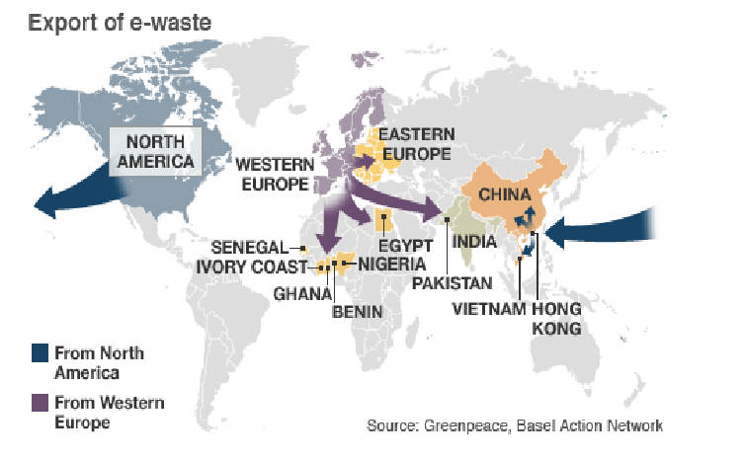
Source: BBC

Slide 6
Example - Mobiles
Many used and scrap mobile phones are shipped to countries in Africa from the EU under the guise of reuse.
Some of these are repaired and find their way back into the market (although they may not meet the specifications of the manufacturer).
Most are recycled in the informal sector.

Slide 7
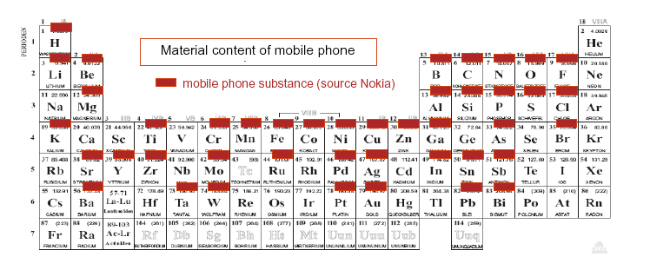
Metals in mobiles
40 elements including copper, tin, cobalt, indium, antimony, silver, gold and palladium.
Combined sales of mobile phones and PCs in 2007 accounted for 3% of the world mine supply of gold and silver, 13% of palladium and 15% of cobalt.
Source: UNEP.

Slide 8
Conclusions
Improved handling of e-waste will alleviate some counterfeiting problems
Some solutions can be used for both combating counterfeiting and controlling e-waste
Equipment lifecycle management (both supply chain and end-of-life)
Cross-sector standardised solutions essential

