Slide 1
The Practicalities Of Working In The Sustainable ICT Supply Chain : A Recyclers Point Of View
Date: 18th September 2012

Slide 2
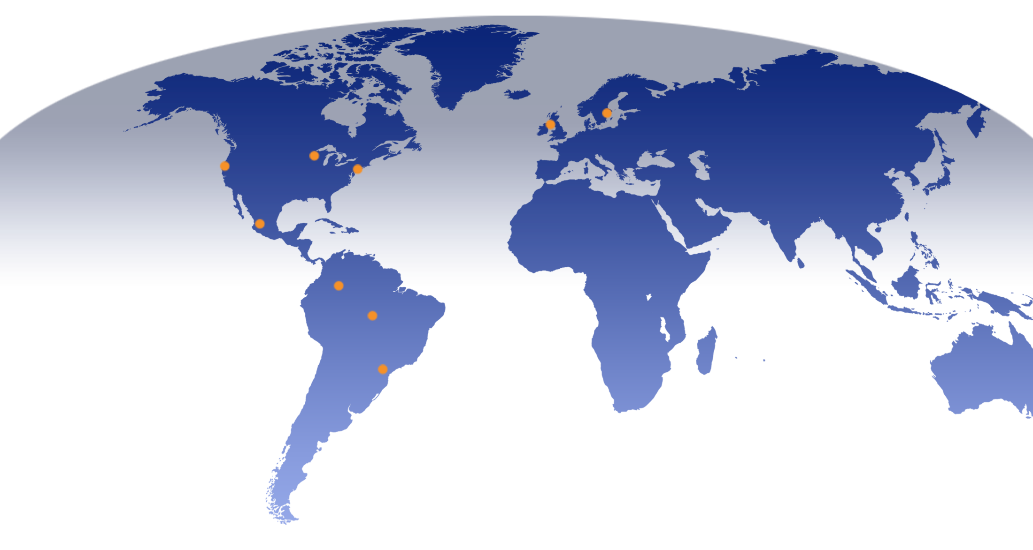
Global Presence & Support
Elk Grove Village, IL
Northbrook, IL
Chicago, IL
Kristinehamn, Sweden
Kilwinning, Scotland
Hayward, CA
Bridgewater, NJ
Guadalajara, Mexico
Bogota, DC
Colombia
Manaus, Brazil
Singapore
São Paulo, Brazil
Notes:
Similar map with locations in different colors, sort of a combo between map and org chart- Adding Sweden - Kristinemamn

Slide 3
Business Solutions for ICT Products
Reuse of materials in original build
Asset Management
Precious Metals Recovery
Data Wiping
Resale and
Remarketing
Base Metals
Recovery
Parts Harvesting
Legislation !
Reverse logistics/TFS
Notes:
Global feeling on these slides. Will place imagery to match-in general
3

Slide 4
About DATEC
Who are we?
Leading European Electronics Recyclers & Asset Management Company, servicing a wide range of clients from SMEs, medium sized OEMs, through to large Blue Chip Clients.
Our Mission
To “take back” electronics, subassemblies & components in the most responsible environmental manner.
Objective
DATEC Technologies offer bespoke solutions designed to maximise client revenue whilst minimising negative environmental impacts through long-term business relationships.

Slide 5
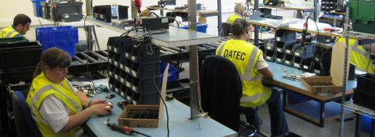
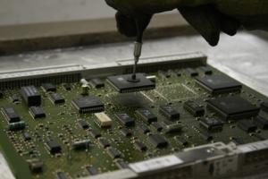
Customer Type Datec
*OEMs,
*CEMs
*Operators
*Repair/Service
*Logistics
*OEM Take Back Programs

Slide 6
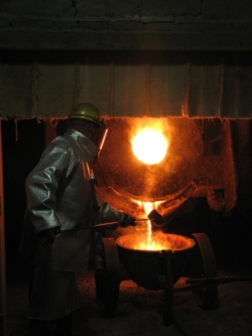
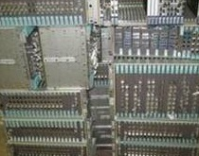
A Recycler needs to be more than just a recycler of
metals & plastics etc.
OEMs require a broad based electronics recycling solutions provider that has financial security coupled with sound environmental, social and ethical practices with a global or near global capability.
Operating right across Manufacturing Supply Chain and Associated Channels
Registered waste management company and waste carrier
ISO Certified: 9001-2000, 14001 , 18001, 27001 plus a host of other accreditations
Compliance/knowledge of environment, CSR, WEEE, RoSH, EuP, Transfrontier Shipments, Dangerous goods, Financial Intrastat, Dual Use Trade Control Restrictions, etc, etc, in fact any legislation that may come back and bite them!
Value for Money!!!
minimising negative environmental impacts and environmental offsetting.
Recovery of materials for first stage remanufacture (including rare earths)

Slide 7
Customer Expectations but reality strikes
Ecodesign – yes to emission reduction but how many design engineers ever consult or visit a dedicated recycler!
Developing take back in regions that are historically difficult like Russia & Africa is possible
World refiners for electronics or complex materials limited
Refining electronics – Au, Ag, Pd, Cu payable – Considerably more is recovered
Carbon Footprint – good as a bench mark indicator and improvement of overall environmental impact
Trans-boundary Movement (TFS) difficult but doable, due to difference of country interpretation, varying costs and time frames
ICT Recycled materials can be use to generate brand new products within the Telecommunications industry or other products , to plumbing or even jewellery

Slide 8
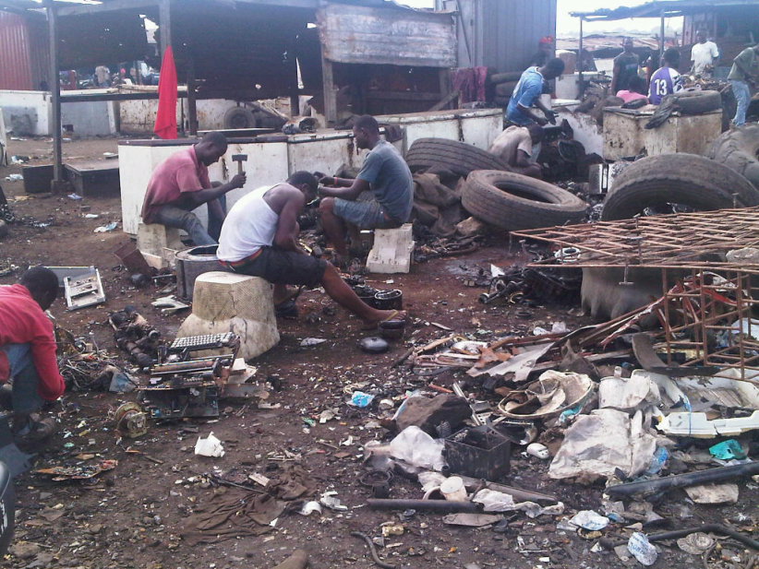
Customer Expectations but reality strikes
OEMs expect this from all of their supply chain
Most other members of the supply chain require the same but economic pressures and other factors can create compromise.
Materials sold on auction
Materials exported to Africa, Far East etc
Materials sold for recycling only but receive resale pricing, (no due diligence/duty of care)
Value for money!!!

Slide 9
Environmental Excellence &
Social Responsibility
The product life cycle is a series of ‘direct footprints’
Large organisations wishing to carry out life cycle carbon footprints will need to look at the various stages in supply chain
Raw Materials
Transport
Production
Distribution
Storage & Retail
Transport
Storage & Consumption
Recycling
Business Travel
Company Vehicles
Outbound Waste
In and Outbound Freight
Energy Processing
DATEC Carbon Foot Print.

Slide 10
Why Calculate Carbon Footprint?
The main drivers for Datec Technologies were as follows:
Cost Reduction
Risk Mitigation
Corporate Social Responsibility
Enhance Reputation
End User Pressure
Supply Chain Pressure
Competition
Drivers

Slide 11
Carbon Footprint Scopes
Steps

Slide 12
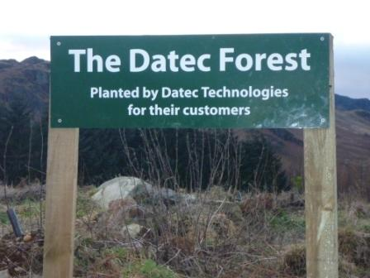
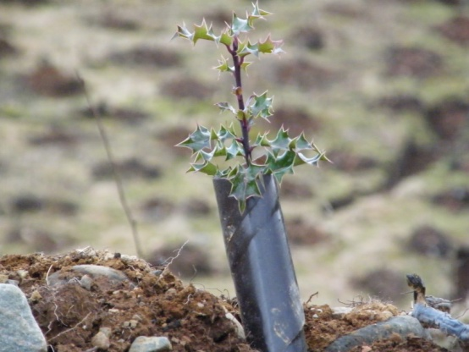
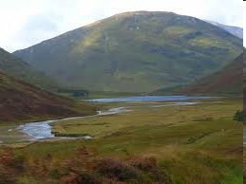
CO2 Emissions Offsetting Possibilities
Datec are working
to be able to offset the CO2 Emissions from
our customer
Offset the emissions where they are generated

Slide 13
Networks
Mobile phones
Prototypes,
ICT equipment disposal
Reverse Logistic Development support
Transfrontier Shipment & Environmental Compliance
IT Asset Management with Secure destruction of materials and Data
Testing of products and boards & component recovery\refurbish for resale or return
Re – supply of parts to Manufacturing
Sales of new/obsolete parts/components
Reuse and Recycle of ITC equipment
Recycling, Base & Precious metal refining/metals return
Green supply Chain for new products
CO2 measurement and offsetting
Global reporting
In Short…

Slide 14
Jeff Borrman
jeffb@datectech.co.uk

