Slide 1

Greening ICT Supply Chains
ITU/UNU Survey on
conflict minerals
due diligence initiatives
John Smiciklas
ITU Consultant
Principal, MJRD Assessment Inc.

Slide 2
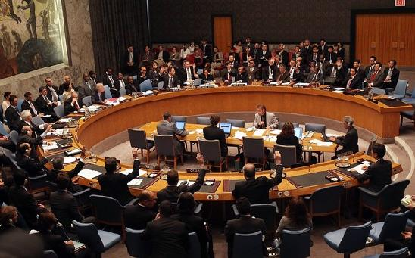
Supply Chain Due Diligence Background
UN Security Council
Resolution 1291 (2000), in June 2000
UN Security Council (UNSC) first established the Panel of Experts to investigate the illegal exploitation of DRC’s natural resources and identify any potential links between natural resources and the ongoing conflict in eastern DRC
UNSC has consistently highlighted the connection between armed groups, conflict and their impact on the environment

Slide 3
Supply Chain Due Diligence Report Purpose
  Describe African Great Lakes Region supply chain transparency and due diligence initiatives
  Assess these initiatives for their ability to manage environmental and other sustainability issues
  Stimulate a conversation on if and how the ICT sector can improve sustainability by exercising more due diligence in mineral supply chains

Slide 4
Supply Chain Due Diligence Relevance to the ICT Sector
  Tin, tantalum and tungsten ores, and gold (the “3TG”) are used in numerous ICT products from smartphones to laptops
  The ITC sector consumes:
    50-60% of global tantalum
    Up to 26% of global tin
    9% of global gold
  The African Great Lakes region, and more specifically the DRC, is home to significant stores of each of these minerals

Slide 5

Supply Chain Due Diligence Background
International Conference on the Great Lakes Region
A Regional Certification Mechanism for conflict minerals (RCM)
Harmonization of national legislation in and across Member States
Regional Database on Mineral Flows
Formalization of artisanal and small-scale mining
Promotion of the Extractive Industries Transparency Initiative (EITI) within the region and
A whistle-blowing mechanism

Slide 6
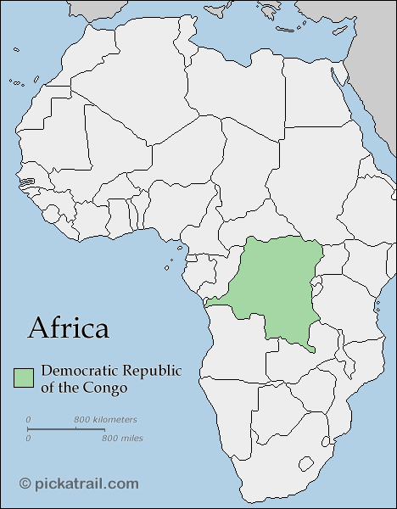
Supply Chain Due Diligence Background
Democratic Republic of Congo
The Congolese Ministry of Mines hosts a number of working groups to coordinate traceability and certification efforts. There is a working group on statistics and another on certification, a commission to combat fraud and the Groupe Thématique des Mines.

Slide 7
Supply Chain Due Diligence Background
Democratic Republic of Congo
Programme for the Stabilization and Reconstruction of Zones Coming Out of Armed Conflict (STAREC)
Jointly executed by the Government of DRC and the United Nations Organization Stabilization Mission in the DRC (MONUSCO).
A key component of STAREC is the Centres de Négoce (Mining Business Centres) project, which was launched in 2009.
Trading posts where the government envisages to price, trade, analyse and tax the minerals, subject to whatever tracking or traceability system.

Slide 8
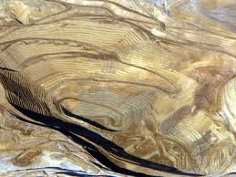
Supply Chain Due Diligence Legislation
United States Dodd-Frank Act (DFA), Section 1502
DFA requires companies to declare whether any “columbite-tantalite (coltan), cassiterite, gold, wolframite, or their derivatives; or any other mineral or its derivatives determined by the Secretary of State to be financing conflict in the conflict in the Democratic Republic of the Congo or an adjoining country.

Slide 9
Supply Chain Due Diligence Legislation
European Commission proposed revision of the Transparency and Accounting Directives Legislation
25 October 2011, the European Commission adopted a revision of the Transparency and Accounting Directives to “insert some [proposals] regarding disclosure of all payments done by EU extractive and forestry industry in Africa…. it will oblige all multinationals active in oil, gas, mining and forestry in Africa to be more transparent.

Slide 10
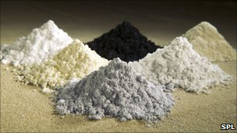
Supply Chain Due Diligence Legislation
Canada The “Trade in Conflict Minerals Act” (Bill C-571), first introduced to Parliament in 2010
The California Transparency in Supply Chain Act (SB 657)

Slide 11
Supply Chain Due Diligence Initiatives
Chain of custody standards that allow for the mineral’s origin and chain of custody to be known
Issue(s)-based standards that promote best practice in risk management on specific issues only.
Risk management standards that promote best or good practice in risk management on a wider range of social and environmental issues than issue-based standards
Sustainability standards seek to mitigate risks and optimize on the development opportunity that the mineral capital presents. This mineral can be called ‘sustainable’.

Slide 12
Supply Chain Due Diligence Initiatives
OECD’s Due Diligence Guidance
The OECD DDG is a framework and guidance that provides management recommendations that have been endorsed by the OECD Council
The intention is to incentivise “global responsible supply chains of minerals in order for companies to respect human rights and avoid contributing to conflict through their mineral or metal purchasing decisions and practices

Slide 13
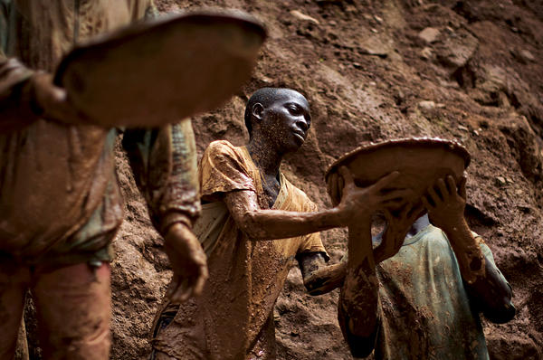
Supply Chain Due Diligence Initiatives
iTSCi is a joint initiative between ITRI and the Tantalum-Niobium International Study Centre (TIC). It assists upstream companies or individuals (e.g., artisanal miners) of all scales and at all supply chain tiers from mine to smelter to “institute the actions, structures, and processes necessary to comply with [all five steps of] the OECD DDG”.

Slide 14
Supply Chain Due Diligence Initiatives
International Conference on the Great Lakes Region’s (ICGLR) Regional Certification Mechanism (RCM)
The Regional Certification Mechanism of the International Conference on the Great Lakes Region aims to break the link between mineral returns and rebel financing in order to deprive armed groups from their sources of income
The RCM incorporates BGR’s CTC and the OECD DDG

Slide 15
Supply Chain Due Diligence Initiatives
BGR’s Certified Trading Chains and analytical fingerprint technology
The World Gold Council’s (WGC) Conflict-free Gold (CFG) standard
Electronic Industry Citizenship Coalition (EICC) and Global e-Sustainability Initiative’s (GeSI) Conflict-Free Smelter Program (CFS)
The Responsible Jewellery Council’s (RJC) Code of Practices (CoP) and Chain of Custody (CoC) standards
The ARM/FLO Fairtrade and Fairmined (FT/FM) Standard for Gold from Artisanal and Small-scale Mining (ASM), including Associated Precious Metals
The London Bullion Market Association (LBMA) responsible gold guidance

Slide 16
Supply Chain Due Diligence Conceptualizing the meaning of ‘responsible sourcing’
Sustainable gold
Ethical gold
Conflict-free gold
Conflict-managed gold
Conventional gold
‘Bad’ gold
Improvement

Slide 17

Supply Chain Due Diligence
Many efforts in place
Main areas of focus
  Traceability
  Conflict / financing dimension
  Human Rights
Environmental sustainability is missing in many programs
Potential large impact on the local/ regional and global environment

Slide 18
Supply Chain Due Diligence ITU-T Study Group 5
Study Group 5 has the potential to lead efforts to determine the feasibility of strengthening (or introducing) environmental sustainability & climate change dimensions into existing supply chain initiatives.

Slide 19

More information
ITU-T & Climate Change: http://www.itu.int/ITU-T/climatechange/
Contact: Cristina Bueti (greenstandard@itu.int)
Toolkit : http://www.itu.int/ITU-T/climatechange/ess/index.html

Slide 20
Thank YOU!

