Slide 1
Towards smart and energy efficient systems
The Role of Standardization for Smart Grids in Realizing Their Energy-Efficiency Potential and Their Enabling Effect in Developing Access to Electricity in the Third World
Vida Rozite

Slide 2
Benefits and opportunities of ICT, smart grids and smart systems
Automated energy management
Remote access and control
Enhanced industrial process control
Security of supply
Deployment of sustainable energy solutions
Energy savings
New applications and services
Access to energy and services
But what are the net energy implications?

Slide 3
Rapid development and deployment projected
More than 5% of global electricity consumption is ICT related (end-use products account for a large and rapidly growing share)
ICT-related energy consumption could increase three-fold by 2030
More than 100 billion products connected by 2030
Really?
1 billion cell phones with network capability
90 million smart meters (490 million by 2015)
1.8 million home automation systems (12 million by 2016)
1 in 50 have a PC (1/3 by 2020, 1 in 20 households with broadband by 2020)
Huge opportunities for new services – but also new load

Slide 4
Global networked standby power estimated savings potentials (TWh)*
850 TWh (2020)
3.5% of total final electricity consumption
Savings potential
~ 550 TWh (2020)
Source: Bio Intelligence Service, 2011 *embedded, end-use, residential

Slide 5
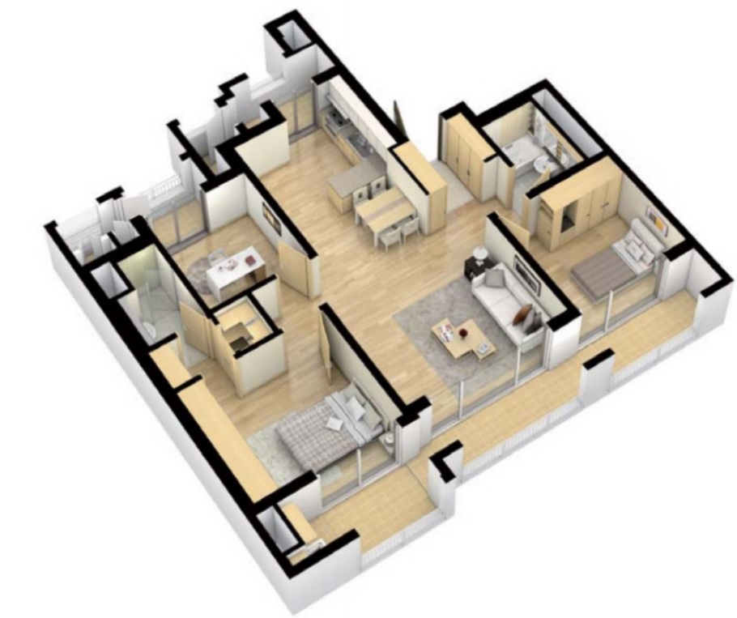
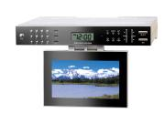
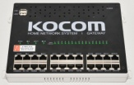
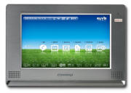
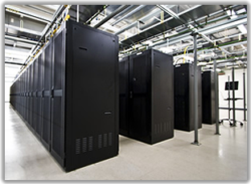
Developing energy efficient systems
EMBEDDED ENERGY IN COMPONENTS AND SYSTEMS
SMART APPLIANCE
SMART HOME
SMART GRID
Boiler
* How do we ensure that each component is as efficient as possible?
* How do we integrate energy efficiency into the development of systems?
* How do we optimise systems from an energy efficiency perspective?
INDUCED ENERGY

Slide 6
How?
Technically complex – interfaces – requires systems-based approach
Multiple stakeholder engagement
Integrated policy approaches
Data
Understanding interactions
Communication protocols & energy management
Technical standards play a key role – but energy efficiency needs to be part of the process
Need for concerted & international efforts both in terms of policies and supporting measures

Slide 7
IEA and partners
IEA Implementing Agreement for Energy Efficient End-use Equipment (4E) Standby Power Annex & Clean Energy Ministerial Super Efficient Appliance Deployment (SEAD) initiative working group & IEA networked standby project
Plans: technical workshop in March 2013, conference in September 2013, publication 3Q 2013
New topics and areas?
Contact: vida.rozite@iea.org

