Slide 1
The Role of Standardization for Smart Grids in Realizing Their Energy-Efficiency Potential and Their Enabling Effect in Developing Access to Electricity in the Third World
Alicia Carrasco, Regulatory Director, eMeter, a Siemens Business

Slide 2
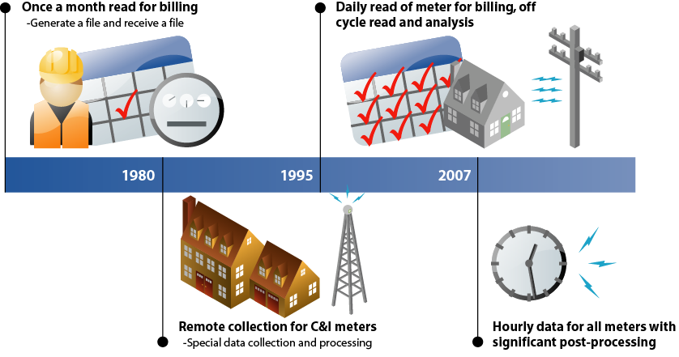
Metering over the Years
1990 1995 2000 2010

Slide 3
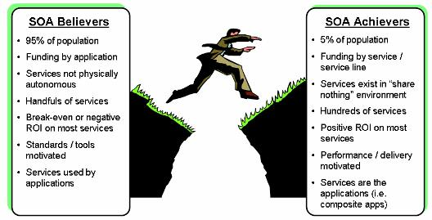
Smart M
Before Smart
Batch files
Forecasts and models using static data
Point of sale data once a month
Flat, average prices
Customer communications on monthly/quarterly bill
With Smart
Real-time data files
Actual, timely data used in Smart Grid operations
POS data daily
Time-based pricing options
Customer engagement through online data and appliance controls
Notes:
**Find out how regulated the REP bills are in Texas

Slide 4
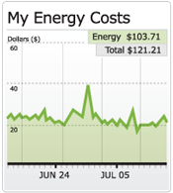
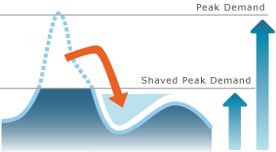




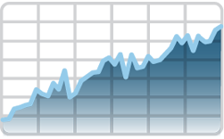


It is not all about Smart Metering System, Smart Grids Solve Critical Problems
Balancing Renewables
Customer Operations
Peak Management
Generation
Load
RENEWABLES
PROSUMERS
Reduction of System
Losses
Outage Prevention / Restoration
Efficiency
Generation
kWh
$, €
Notes:
Customer Operations – add to the top line
Market Operations
Grid Operations
AMI Operations

Slide 5



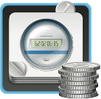

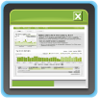

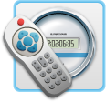


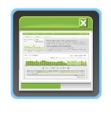
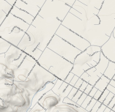


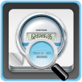

Based Applications of Market Participants
Retail Customer Operations
Analytics
Register Billing
Interval Billing
Prepayment Support
Customer Service Portal
Energy Engage
Revenue
Protection
Grid Operations
Remote Connect/ Disconnect
Outage Management
Network Loss
Surgical Load Curtailment
Demand Response
Management
Analytics
Smart
Meter
Operations
Market Operations
Analytics
Network Loss
Settlements
Demand Response
Management
Analytics
Device Lifecycle Management
Consumers
Information & Choice
EE /Savings
Automation
Demand Responsee
EV

Slide 6
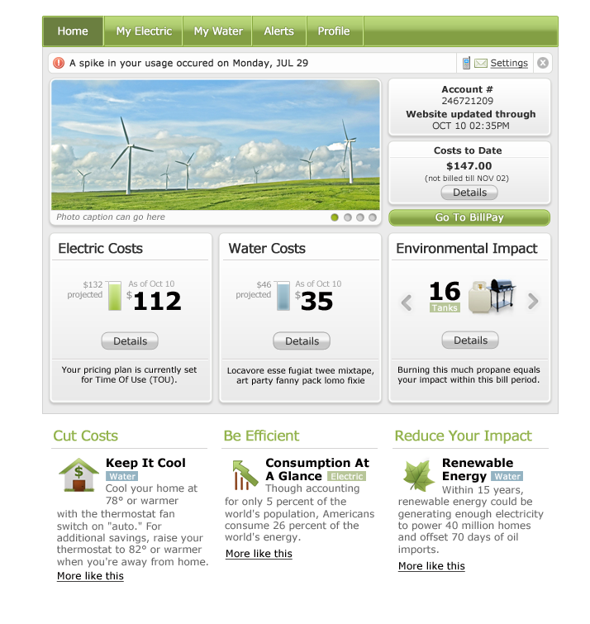
Consumers Engagement and Empowerment Triad
Energy Engag
I. Information Feedback
• Usage details
• Consumption timing
II. Pricing Options
• Peak price incentives
• Off-peak discounts
• A reason to shift load
• A reward for shifting load
III. Automation
• “Set-and-forget” devices and systems
• Programmed response to price signals
• Results are savings and convenience

Slide 7
When?
Mandates deadline (SM, EE, CO2, Renewables & EV)
Willingness to move forward: Money & Clear Return
Regulatory support, clear message and incentives: Certainty
Country specific and utility specific
SG is in constant development ongoing with different stakeholders involved (like Expert Group EU, SG Models)
Short Pilot with clear objectives, test multi- stakeholders integration, and GO
Advise to start earlier to gain competitive advantage
HOWEVER…..the most important it is not when but how
Notes:
Use or not?

Slide 8
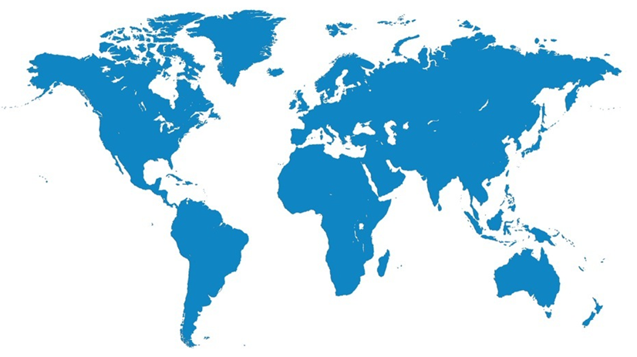
Prepayment metering market
70 years – 4m meters
Asia
<100% electrification
30% > non tech losses
Post paid problematic
Privatisation of energy
Great Britain
Canada
N Ireland
Belgium
Turkey
USA
Iran
China
Bangladesh
Circa 50 countries
India
Philippines
Malaysia
Nauru
Electricity predominant
Singapore
Australia
Argentina
South Africa
New Zealand
19 years – 6m> meters

Slide 9
The UK experience
Prepayment is popular:-
Choice - monitor & control
Supply Licence condition
Fuel poverty
16% of customers
  3.6M Electricity PP meters
  2.5M Gas PP meters
Debt prevention
22% PPM - Social Groups D&E
  52% PPM
  32% Standard Credit
  16% Direct Debit
Expected increase and demographic change with Smart Metering.

Slide 10
Disadvantages
Self disconnection:-
Inconvenience
Vulnerable customers
Affects 10 – 25% customers
  Once a year
  1 day or less
Cost
Hardware
PPMIP
$190 / year
USA
Strong opposition to PP, but starting to be more favorable
  Regulators
  Politicians
  Consumer groups
47m UK SM by 2019:-
More payment options and reduced operating cost expected.
C

Slide 11
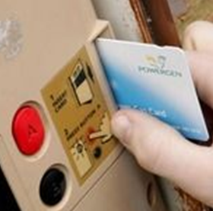
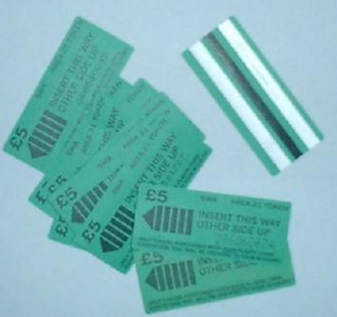
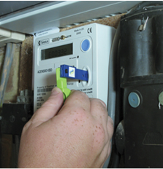
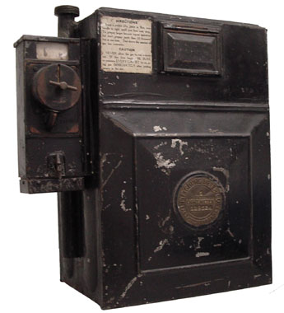
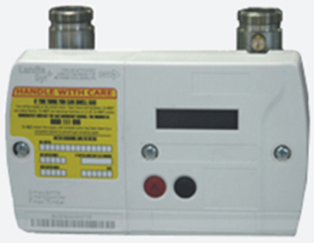
PP evolution
UK Smart Meter
AMR
Credit – PP Switching
Remote credit adjust
Connect/Disconnect
Load limiting
Disconnect monitoring
Emergency/Friendly
Display
Low credit warnings
Manual backup
In Home Display
Coins
Tokens
Keys
Smart Card
Smart Meter

Slide 12

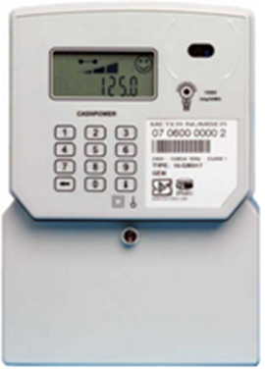
Case study NIE
4% discount
  Cost reflective
    Debt Management
    Bad debt
    Call centre
Friendly credit
Payment Channels
  Cash
  Online
  Phone
30% customer take up
    58% low income
    32% middle income
    17% higher income

Slide 13
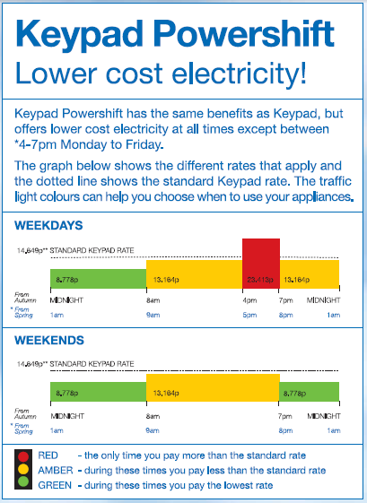
Load shifting
Jack and Rhonda Wilkinson from Ballymena recently had a NIE ‘pay as you go’ keypad meter installed, which could be the key to powerful savings.
Jack Wilkinson, who is already seeing savings said: “It’s great having a keypad meter, you don’t have to worry about bills – just pay as you go along. Our local shop is only a few doors away and we can buy electricity credit there. It’s very handy. We leave any washing until after 7pm when the electricity is cheaper. It’s brilliant!”

Slide 14

Smart PP opportunity
Mandate to roll out Smart Meters
Improve customer service
Reduce costs
Wider acceptance
Consumer engagement
  Energy savings & load shifting
Solve industry issues
  Misdirected payments
  Erroneous debt recovery

Slide 15
Benefits from Smart Prepayment
Utility
Revenue assurance
Reduced cost
Improved cash flow
Customer Satisfaction
Consumer
Monitor usage
Control spend
Customer Service
Security
Regulator
Flexible tariffs
Energy management
Increased competition
Disconnects monitored
Conservation
Consumers engaged
Energy reductions
Load shifting

Slide 16


Acceptance of prepayment services
Perception of PAYG..
Historic - Option of last resort
Mobile telephony
Wireless broadband
Transportation
Prepaid debit cards
Download vouchers
..is changing C

Slide 17
Alicia Carrasco
Regulatory Director
eMeter, a Siemens Business Unit
Twitter: SmartEnergyEurope @alicia_carrasco
Blog: www.emeter.com/smart-grid-watch/

