Slide 1
A contribution from ITU-T SG5
The Role of Standardization for Smart Grids in Realizing Their Energy-Efficiency Potential and Their Enabling Effect in Developing Access to Electricity in the Third World (Paris, France, 17 September 2012)
Paolo Gemma,
SG5 Q17/5 Rapporteur
Senior Expert, Huawei paolo.gemma@huawei.com

Slide 2
Smart grid will change the world of energy utilizing ICT to improve its management

Slide 3
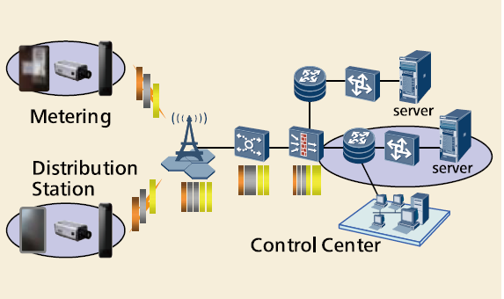
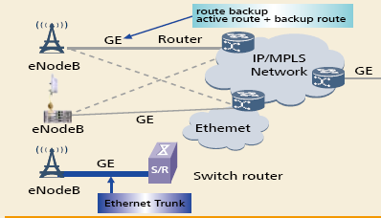
Different possible architecture
Different requirement of security

Slide 4
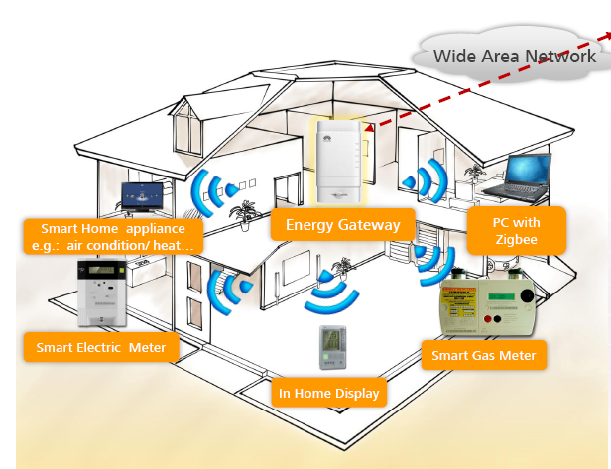
The role of standardization
Interoperability of different solutions
Propose different architectures/solutions

Slide 5
ITU Study Group 5
In next study period SG5 proposes to look at studies and analysis on most energy efficient architectures and solutions related to the use of ICT in the context of smart grids.

Slide 6
Questions
Which is the most efficient architecture and solutions related to the use of ICT in the context of smart grid?
Which is the reduction of power losses when applying ICT based smart grid technology?
What is important to obtain?

Slide 7
Conclusion
Work jointly with other standard organizations at national and international level.
Maximize the synergies between different bodies to obtain a good result in the shortest time

Slide 8
Thank you very much for your attention

