Slide 1
CERT C& Testing Experience A Regional Solution Proposal for the Region
ITU Information Session on Conformity and Interoperability
Geneva, Switzerland, 12 January 2012
Centre d’Etudes et de Recherche des Télécommunications -Tunisia

Slide 2
CERT
Telecommunication Research and Studies Center
Created since 1988
Public Consultancy Company
Technical assistance to IT sector institutions (operators, regulator..)
In Charge of Terminals Homologation (Type approval)
Own laboratory (tests benches)

Slide 3
CERT Positioning
Main activities
IT Research
Type Approval
Technical Services
Consultancy
Technical Acceptance
Technical Assistance
Studies and Engineering
Know how transfer and Capacity Building

Slide 4
CERT Positioning
Activities within Regions
ITU Arab Region CoE Unit –Wimax, LTE, QoS-
Capacity building activities (Gabon, Burkina Faso, Congo, Burundi, Cameroun..)
Consultancy and Technical Assistance
Saudi Arabia, Libya, Algeria, Morocco, Mauritania
Benin, Burkina Faso, Mali, Senegal, Congo Brazzaville, RDC, Tchad, Niger,

Slide 5
Type Approval- Tunisia Framework
To guarantee the quality of the data-processing devices park in Tunisia
To take care of the respect of the international standards of the data processing equipments
To assist concerned public services (customs, trade, etc) with the identification and the classification of the data processing equipments
To work out annual statistics regarding the evolution of the data-processing park

Slide 6
Type Approval
Mandatory for terminals to be commercialized
Special authorization for temporary admission
Special authorization for equipment to be used internally (Conformity Certificate)

Slide 7
Type Approval
Phase 1 : Homologation
Importer/vendor send samples and technical documentation
Samples tested using test beds (protocols tests)
Certificate delivered/not delivered – 3 years validity
Phase 2 : Consumption Authorization
Shipping (Importer/vendor)
Sampling (CERT border offices)
Conformity check (vs Homologated Terminals)
Authorization delivery

Slide 8
Type Approval
For Telecom Operator
No Homologation requested (Own uses)
A Conformity Certificate is needed
On Border Control
Technical Procedure is currently discussed
No Mutual Agreement is considered

Slide 9
NEXT
EMC and LVD directives
R&TTE directive
Mutual Recognition Agreement will be considered
Objectives:
Improve the competitiveness of Tunisian industry
Protect the Tunisian consumer (A posteriori control)
Environment protection from electromagnetic radiation
Implement a national quality systems (industrial exportation)
Increase awareness

Slide 10
NEXT
Control System Evolution Phases
Phase 1
Free entrance of CE marked terminals from Europe to Tunisia and other side (80% of Tunisian Electrical Exportation to Europe)
Suspected terminals will be controlled
Other origins will be controlled
CERT lab, provide conformity testing services to tunisian suppliers
Phase 2
Only CE marked terminals will be allowed for entrance
Suspected terminals will be controlled

Slide 11
CERT National Lab
EMC Laboratory (ongoing)
SAC- Semi Anechoic Chamber -10 m
FAC- Fully-Anechoic test Chamber -5m (phase2)
SAR- Specific Absorption Rate Lab (phase2)
Metrology Lab
Low Voltage Directive Lab
Open area test site
Accreditation in Compliance with
ISO EN 17025 (Testing and Calibration Lab Competence)

Slide 12
CERT National Lab
Coverage
Telecommunication equipments
Information technology equipment
Measurement devices
Car’s electrical devices
Household electrical products
Hospital equipments

Slide 13
CERT National Lab
Main services and activities
Conformity testing
Supporting suppliers in the development of terminals
Drafting tests suites

Slide 14
CERT National Lab
Actual Situation
New specific building (60%)
Laboratory Facilities (bidding phase)
Training (50%)
Tests protocol (90%)
Accreditation (0%)
Milestones
March 2012 : Site Ready
June 2012 : Laboratory Equipped
End of 2012 : Accreditation (ambition)

Slide 15
CERT Regional Lab
CERT National Lab
Expertise
Experience within the Region
Laboratory
Implementation Progress
Regionalization
Opportunity

Slide 16
CERT Regional Lab
CERT plan to
Participate actively to all ITU initiatives, among others:
C&I portal
C&I database
Sharing technical results
Active contribution within study groups
Hosting ITU interop event
Set up capacity building program
Arab Region
African Regions

Slide 17
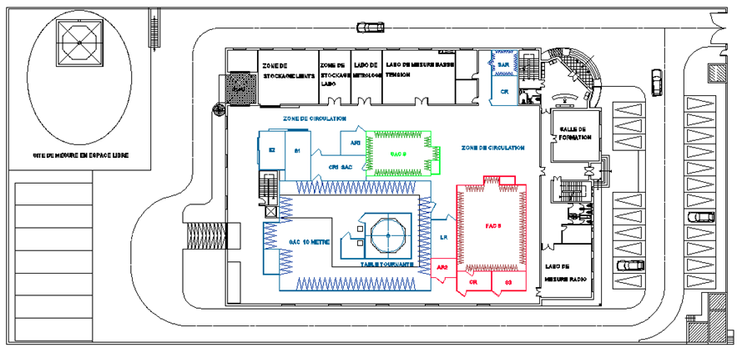
GROUND FLOOR PLAN DRAWING

Slide 18
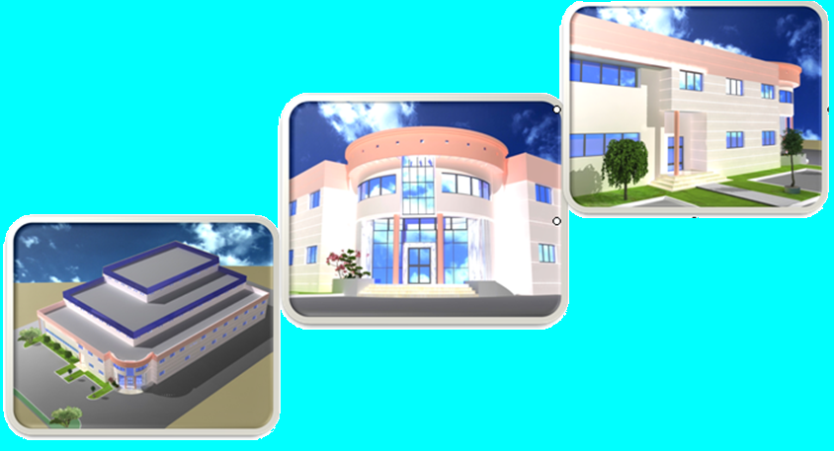
FRONTAL FACE

Slide 19
Thank you sami.trimech@cert.mincom.tn M: +21698381738 D: +21670834701 F: +21670835835 Skypeid: strimech

