Slide 1

Conformity Assessment and Interoperability;
Arab Region Perspectives
TSAG Information Session
On Conformance Assessment &
Interoperability
(Geneva, 13 January 2012 )
Sherif Guinena,
Advisor to the Exec. President,
National Telecom Regulatory Authority of EGYPT

Slide 2
Outline
The Standardization environment and the motives.
What is happening in the real life, the CIT consultation in the Region.
Progress and impediments to the implementation of ITU CIT Resolutions.
What are the Arab Region needs?

Slide 3
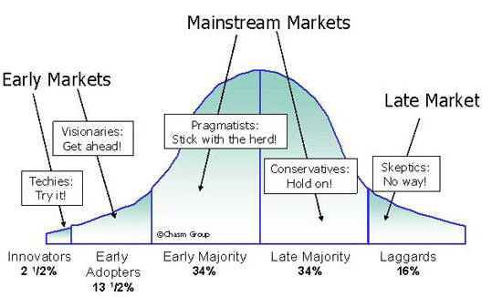
Roger’s Theory for
Innovation Adoption
Industry is investing and struggling to be among the early innovators and rush their products as early as possible in the market.

Slide 4
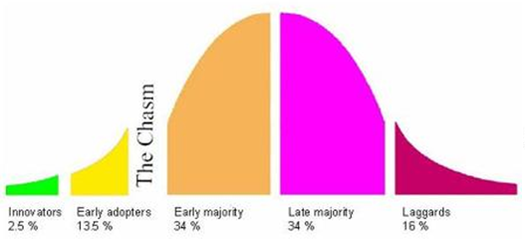
Moore’s adjustment : The Chasm
Remove Market Barriers
Reduce Cost to Compete
Reduce Entry Time
However industry is subject to the “Chasm” phenomena as defined by “Moore”; where a product or a technology can either survive, or Die!
Hence it is a matter of survival !!!

Slide 5

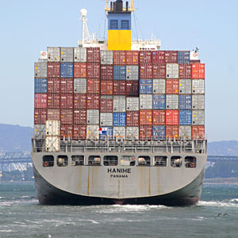




The Global Environment
WTO/TBT/BTA
Non Binding ITU Recomm
Minimum CIT Obligations
RAW
Economic Recession Calls for More Openness
Some Keys to Open International Markets
Innovation and High Productivity
International Markets highly Needed

Slide 6
The ECO System
SDO
SDO
SDO
Regulator
License & Monitor
Performance,
Conformance,
Interoperability
Consumer Protection
Iterop
Operator/
Service Provider
Service Delivery
Consumer
Equipment Type Approval
Network Equipment
User Terminal Equip.
Vendor

Slide 7
Conformity Assessment and Certification
ISO/IEC Assessment Procedures
Self-assessment Procedures
Route 1
Route 2
Route 3
Route 4
Conformity Assessment
& Certification
Tests performed in
a lab agreed by an Accredited
Certification Body
(ISO/IEC guide 65)
(Rec. ITU-T X.290)
Tests performed in
a lab selected by an
ITU-T A.5 agreed SDO/Forum/MoUs
(Rec. ITU-T X.290)
ITU Members Only
Tests performed in
a 1st, 2nd or 3rd party lab.
Tests performed by an accredited lab
(ISO/IEC 17025)
(Rec. ITU-T X.290)
Conformity Statement issued by the test Lab
Self-Declaration of Compliance issued by the Supplier
Conformity Certificate issued by the Certification Body
Conformity Certificate issued by the test lab
Declaration of
Conformity (SDoC)
(ISO/IEC 17050)
The User

Slide 8
What is Happening in the Real Life?

Slide 9

The Market Players
Emerging
Entrants
Giants
2nd tier & SMEs
Counterfeit
Operator’s Tender
“Assumed” Axioms:
  Big Vendors, assumed “Reputable”.
  Doing business for Profit$$$.
  Market Openness be mandated by WTO.
Emerging entrant changed the equation.
& Little chance for [Local] entrepreneurs and local vendors.
Entrepreneurs & Local Vendors

Slide 10

Conformance & Interop : in Real Life !
Here is the nice looking certificate you have asked for !
Go and contract now for the Pre-Standard; for sure it will be conforming by the next release !
Don’t worry, eventually it will Iterop !
(@ Some Time !)
& with
(Some Extra Cost !)
If it ever comes
It is compliant with the Standard !
of a SQUARE
Of main concern to DCs :
  Unfortunately not all suppliers play it fair !
  DCs can not afford a try and error approach!
Its Cheap!
Believe me! I Swear!

Slide 11
Concerns of Developing Countries
What Happened in the African
ITU CIT Consultations ?
(Nairobi, Kenya 30-31 July 2010)

Slide 12
Operators & Integrators Question.
Equip. Category ⁽¹⁾ | Description of the problem ⁽²⁾ | Reasons ⁽³⁾ | Effects/Impact on ⁽⁴⁾
1) Category of Equipment:
  (Optical interface, repeaters, xDSL, GPON/BPON, OTN equipment, wireless access, maintenance, monitoring…….etc)
2) Description of the Problem (examples):
  1 = Hardware
  2 = Software
  3 = Both H & S
  4 = Partial/Total non conformity for expected functionalities
  5 = QoS: low Quality of Service – BER related issues
  6 = LEG: poor/no legacy with existing equipment/services/infrastructures
  7 = Errors in maintenance data
3) Main reasons:
  1 = no conformity to standards
  2 = poor interoperability equipment same vendor
  3 = poor interoperability equipment different vendors
  4 = poor interoperability same operator/service provider
  5 = poor interoperability different operator/service providers
4) Effects/impact on:
  1 = Cost increase due to the need to replace some/all old existing equipment or to buy additional equipment to solve problems (e.g. interfaces)
  2 = Additional costs for maintenance/operation/restoring
  3 = Negative impact on customers/new markets
  4 = Loss of business / market opportunities / image with respect to competitors
  5 = Limited or No access to required services

Slide 13
Network Integrator A
Equip. Category ⁽¹⁾ | Description of the problem ⁽²⁾ | Reasons ⁽³⁾ | Effects/Impact on ⁽⁴⁾
Wireless Access (WiMax 802.16d) | 5 QoS: low Quality of Service – BER related issues | 3 poor interoperability equipment different vendors | 4 Loss of business / market opportunities / image with respect to competitors
CDMA Backhauling Via VSAT | F Frame structures / key bytes | 3 poor interoperability equipment different vendors | 2 Additional costs for maintenance/operation/ restoring

Slide 14
Network Integrator B
Equip. Category ⁽¹⁾ | Description of the problem ⁽²⁾ | Main Reasons ⁽³⁾ | Effects/Impact on ⁽⁴⁾
Analog Voice Gateway | Can’t forward dialed digits to next devise. | Feature not supported and not mentioned on Data Sheet although it is basic requirements for operation. | Another devise should be used.
Voice interface Card | Caller ID feature is not working on certain mode of operation although it is globally mentioned on Spec. Sheet that it is supported. | New hardware interface card should be used. | The customer was unsatisfied and switched to another vendor.
Data Switch | Per Packet load sharing on multi-trunk lines is not working although it is mentioned in the Spec. Sheet | Function not available in current software release. | Additional devices need to be used to support the required function.
WiMAX Base-station | Antenna diversity should be supported... It is available on the configuration menu but not working. | The diversity is actually not working when it was enabled on the software | support Team stated that the diversity is not working in the current software and may be active in next version

Slide 15
Mobile Operator A
Equip. Category ⁽¹⁾ | Description of the problem ⁽²⁾ | Reasons ⁽³⁾ | Effects/Impact on ⁽⁴⁾
OMC | Signaling | no conformity to standards | Negative impact on customers/new markets
Announcement Machine for subscribers | Signaling | no conformity to standards | Cost increase due to the need to replace some/all old existing equipment or to buy additional equipment to solve problems (e.g. interfaces)
IN | Partial/Total non conformity for expected functionalities | no conformity to standards | Negative impact on customers/new markets
NGN (RNC/MGW) | Software | poor interoperability equipment of different vendors | Negative impact on customers/new markets
Mobile Switching Center | Signaling | poor interoperability equipment of different vendors | Loss of business / market opportunities / image with respect to competitors

Slide 16
Mobile Operator B
Equip. Category ⁽¹⁾ | Description of the problem ⁽²⁾ | Main Reasons ⁽³⁾ | Effects / Impact on ⁽⁴⁾
Optical Interface | 2 | 3 | 5,6
Voice Codec | 2 | 3 | 4,D
RAN | 2 | 1 | 5,8
Signaling | 3 | 3 | 1,2
Signaling | 2 | 1 | 5,9

Slide 17
Far Eastern Vendor in Egypt
Product Type:
  Microwave from ( X) need to be connected to another microwave from ( E)
Interface name:
  OSPF over DCC
Brief Description:
  Both X and E can support OSPF over DCC for management, but when the OSPF is enabled , some areas covered by this microwave is not working although when we connect X with any other suppliers all the areas working fine .
Now (JUL 2010) issue still under investigation and we will be waiting for next steps to solve this problem.

Slide 18
South Africa; FIFA World Cup2010
Interoperability challenges between IMAX (Multi-Service Access Node) and the Soft-Switch in a multi-domain environment.
Network operator is expected to resolve the interoperability and systems integration issues/problems.
Minimized C&I issues/concerns by adopting a single vendor strategy for national/regional optical fiber transport technology platform.
Not the most optimum solution from a Total Cost of Ownership (TCO) (CAPEX+OPEX+ all other hidden costs) perspective.

Slide 19

What we see is the top of the Ice Burg
Notes:
Some operators were reluctant to report because they were afraid that their relation with Big Vendors may deteriorate !!!!.

Slide 20


The Market : Negotiation Power ?
=
Equipment standard list prices
Big Multinational
Operator
Big
Vendors
WTO
SNP
Trade Barriers
Tender/Certificates
Local Big Affiliates
Local DC Markets
SNP
Counterfeit
Equipment
Smaller
operators
Local Small
Operators;
Network Integrators
EMC/Health/Safety
IoP
SNP: Significant Negotiation Power

Slide 21

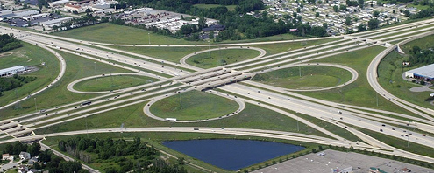
WTSA Res. 76
WTSA-08 Res.76 lead to four TSB Programs, supported by WTDC-10 Res.47; and finally endorsed by PP-10 Res.177 :
  Conformity Assessment Program.
  Interoperability Testing Program.
  Capacity building Program.
  Interop Test Labs.
  Studies for the ITU-MARK.

Slide 22
Implementation of PP-10 Res. 177
TSB created the conformity DB ⇨ CIT portal.
Several Interop events done.
Several Workshops/Capacity building events done.
Continued Consultations and Questionnaires.
Investigations, Studies and Guidelines for Test Labs.
KMPG Contracted for the requested // Feasibility Study.
Studies on the ITU MARK (part of KMPG contract).

Slide 23
Post-Reactions to WTSA, WTDC and PP Resolutions
TSB and BDT are fulfilling their Roles.
Industry Responses to the ITU-T DB:
  e.g. CTO meeting 29 OCT 2010: Negative Messages, even post PP-10 Res. 177 !
  Almost Boycott of the ITU-T Conformance DB !!
Some MSs and ITU-T SGs (some are Dominated by the Industry):
  Reluctance and/or concerns on implementing JCA-CIT proposal of embedding CIT Clauses in Recommendations.
Some MSs/SMs:
  Still asking “What are the Problems Facing DCs ??”.
  Assuming Crucial Role to the Feasibility Study!!.
Several MSs/SMs including DCs:
  Recognizes the importance & necessity of CIT programs (expressed in W/Shops, Consultations, Conf.……etc).

Slide 24

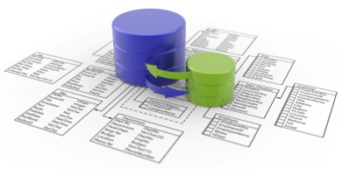

ITU Database and the DCs
Better exposure for vendors.
Opportunity for small and emerging
vendors.
Increasing portfolio to DCs = Better competition.
Assist DCs in drafting RFPs and
Evaluating Bids.
Better leveling between vendors, particularly when associated with Accreditation.
Encouraging better Quality of ITU Recom.
Recomm

Slide 25
ITU-T DB: not a new invention.
Several entities adopt similar DBs !!
  FCC part 68 - “The rules also provide for the development and maintenance of a publicly accessible database of approved TE and for labeling TE that have been shown to comply with the technical criteria. All approved TE are required to be listed in the database and to be properly labeled”. The Administrative Council for Terminal Attachments (ACTA), joint sponsorship of the Alliance for Telecommunications Industry Solutions (ATIS) and the Telecommunications Industry Association (TIA), mandate “for maintaining a publicly accessible database of all approved TE”.
Cooperative Linking to other SDOs’ Data Bases encouraged:
  Can accommodate/link to other already existing well developed SDOs’ databases, in a worldwide cooperative standardization efforts.

Slide 26
ITU-T DB: not a new invention.
IEEE – ICAP Product Conformance Registry + Labs
www.ieee-isto.org/icap-program/products
Open Mobile Alliance – Products Listing www.openmobilealliance.org/Application/ProductListing/products
FCC part 68 - www.fcc.gov/wcb/iatd/part68faqs.pdf
Doc.:FCC – 00 – 171 Notice of proposed rulemaking and https://apps.fcc.gov/oetcf/eas/reports/GenericSearch.cfm
WiMAX Forum Spectrum and Regulatory Database: www.wimaxforum.org/resources/wimax-forum-spectrum-and-regulatory-database
Wi-Fi certified products database: www.wifi.org/certified_products.php
Global Certification Forum (GCF)
http://www.globalcertificationforum.org/WebSite/public/home_public.aspx
Cooperative Linking to other SDOs’ Data Bases encouraged:
  Can accommodate/link to other already existing well developed SDOs’ databases, in a worldwide cooperative standardization efforts.

Slide 27
CTOs negative and positive messages
29 October 2010 meeting: “A number of CTOs expressed concerns about the ITU C&I Program, especially with respect to the proposed future ITU Mark and the ITU Conformance Assessment Database” .
25 October 2011 meeting: “Reaffirmed the key role that standards play as a key driver for innovation and competitiveness and their critical role in promoting economic and social growth” :
Standards Landscape:
  Faced with an ever-growing number of standards bodies and consortia;
  CTOs renewed their call a new approach, based on improved collaboration, cooperation and coordination to reduce unnecessary duplicating and conflicting standards, and promote an interoperable, seamless future global communications network;
  Encourage cooperation between SDOs when starting new business or domains;
  Enhance this cooperation by developing a harmonization phase between SDOs for common specifications, and when possible, by developing joint standards.

Slide 28



Testing, Certification & Accreditation
ISO/IEC Assessment Procedures
Self-assessment Procedures
Route 1
Route 2
Route 3
Route 4
Conformity Assessment
& Certification
Tests performed in
a lab agreed by an Accredited
Certification Body
(ISO/IEC guide 65)
(Rec. ITU-T X.290)
Tests performed
in a lab selected by an
ITU-T A.5 agreed SDO/Forum/MoUs (Rec. ITU-T X.290)
ITU Members Only
Tests performed in
a 1st, 2nd or 3rd party lab.
Tests performed by an accredited lab
(ISO/IEC 17025)
(Rec. ITU-T X.290)
Conformity Certificate issued by the Certification Body
Conformity Statement issued by the test Lab
Self-Declaration of Compliance issued by the Supplier
Conformity Certificate issued by the test lab
Declaration of
Conformity (SDoC)
(ISO/IEC 17050)
ITU C&I services
ITU Conformity
Database
JCA-CIT proposed that an sDoC would be accepted, provided
that the user is aware of the level of confidence in each track.

Slide 29
Importance of the Accreditation issue
Incremental costs added, but more long-term benefits to all, plus increased confidence in the products.
National certification should rely on accredited testing procedures to have level playing ground for all vendors.
Flourishing testing and accreditation businesses will lead to better affordable testing and accredited certification economics to all players.
Mutual Recognition Agreements, Global Certification Forum (GCF) : Test once, Use any where! Will reduce testing costs.
Confidence in technology is more important than how quickly it appears in the market.

Slide 30
Improving Quality of ITU-T Recommendations: CIT Clause
JCA-CIT proposed new clause on CIT to be added to “Relevant” Recommendations:
  C&I Testing Needs – outline of a standard CIT clause listing the possible CIT Testing Needs.
  C&I Testing Guide and Checklist – criteria to determine if the CIT issues listed in Testing Needs are relevant to a draft Rec. ; and actions to be taken if relevant.
One MSs and some SGs (9, 11) raised concerns. SG2 asked for clarifications and questions to be answered.

Slide 31
Improving Quality of ITU-T Recommendations: CIT Clause (cont.)
ITU-T should take a leading role in Standardization, every “relevant” Rec. should have a CIT clause, but without duplication of efforts with other SDOs.
Relevance of a Rec. to CIT Test Needs and its methodology can be determined by the SG experts; however, this should be according to a clear & transparent criteria harmonized over all SGs (JCA).
Note the “Dominance” of the industry in some SGs participation. Interests of Administrations and Regulators particularly from DCs regarding CIT issues should be addressed and well reflected.
JCA-CIT should continue its work to develop an agreeable “guidelines” to be considered by SGs.

Slide 32
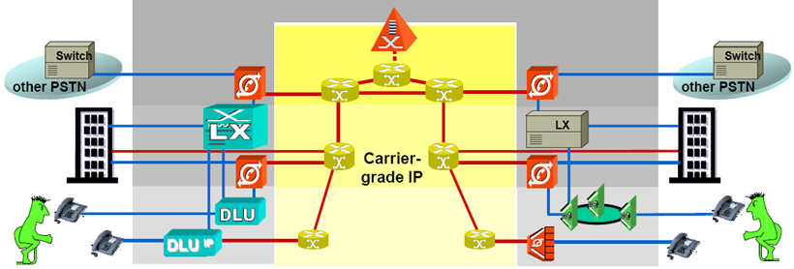
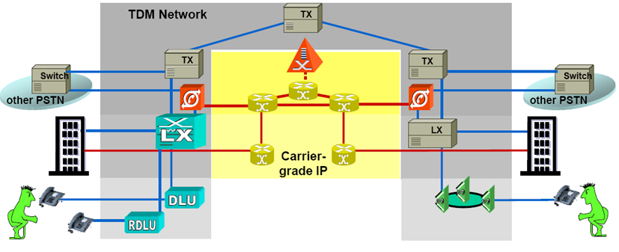



Some Concerns about the Interoperability Events
Test events are very helpful, however:
  Balance transparency vs confidentiality regarding Interoperability test results.
  A minimum of Test Environment and Equipment Configuration should be declared.
  ITU role is vital in this regard. e.g. repository for the results;
  IPR policy should be revised.
  DC practical capacity building
  to be involved in Interop testing.

Slide 33
Examples of Existing Practices in the Arab Region

Slide 34
Existing Practices in the Arab Region:
Conformance
Most Arab countries has a Type Approval mechanism.
Mostly relay on globally recognized Standards and accredited Labs.
Some have testing facilities – generally not accredited.
No interoperability requirements or testing by regulators, best effort practices by operators and network integrators.

Slide 35
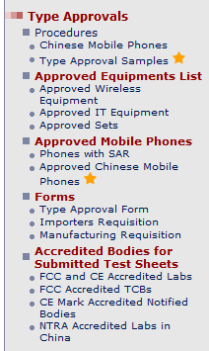
Example : EGYPT
Equipments compliance achieved through:
  Declaration of Conformity certificate “DoC” or “FCC ID”, (USA, Canada, Europe, Japan, South Korea, Australia), (light regime);
  Test reports from accredited international test labs over the 5 continents, (Other countries not including China), (tight regime);
  Verification of Conformity certificate (VoC) & Pre-shipment verification from NTRA accredited labs in China, (Special regime);

Slide 36
Reliance on International Standards
Standards | Organization
Telecom / Radio | ITU, ETSI, ASA, FCC
EMC / EMI | CENELEC, IEC, ASA
Safety / Health | CENELEC, IEC, ASA, UL, FCC

Slide 37
Counterfeit & Non-Complying Equipment
a product bearing a mark that is identical with or substantially indistinguishable from a genuine registered trademark.
  also “COPY “ , “FAKE” and “Non-Complying” products.
“Exact Copy” “misleading appearance”
Consumer exposed to money, health & safety risks.
    Disincentives for investors, International & Domestic, Reduction of Tax Revenues.
Non-competitive environment for trade and for manufacturers;
Extra burden on Service providers:
    Deterioration of QoS;
    After Sales Services.

Slide 38
Chinese products special arrangement
Certificate issued based on:
  “CE” Verification of Conformity certificate.
  NTRA Accredited labs in China:
    ( BV-ADT, CTTL, Intertek, SGS, TUV )
Based on full testing ,
or based on technical evidence submitted from an internationally recognized lab.
2010: Central EIR IMEI database solution:
  GSMA Agreement: White list Weekly update IMEI’s TAC White list;
  Combat handset theft issue;
  Health & Safety concerns;
  Illegal, Fake, NULL & Cloned IMEIs:
    3.5M one illegal IMEI (13579024681122)
    0.1M Null,0.35M zeros, .5M Fake, .25M Cloned

Slide 39





EGYPT: Central EIR IMEI database solution
NTRA ‘Master’ EIR
“NTRA database”
Develop National Black list
Management of all EIR data
Developed International White List ranges
System LVL
Lists & configuration data
GSMA Global Database (GSMA Agreement)
Master/Slave relationship (download-reporting)
Vodafone
‘Slave’ EIR
Etisalat
‘Slave’ EIR
MobiNil
‘Slave’ EIR
Network LVL
Operation / Authentication
Check IMEI requests with Black, White responses
SS7
SS7
SS7
MSC
MSC
MSC
39
Vodafone network
Etisalat network
MobiNil network

Slide 40
EGYPT: NTRA ICT TE Test Lab
Wireless TE Test Set (3 MHz to 6 GHZ) Signalling test Mobile GSM 2G/3G,CDMA 2000 FWT, Cordless Phones .9/2.4/5.8 GHz, HF/VHF/UHF Transceivers);
1.88-1.9Ghz DECT phones;
Analogue wired phones;
EMC Test system (Immunity/Emission, Semi-anechoic chamber) (RFP – Jan 2012);

Slide 41
Example: Algeria
“Counterfeit Equipment”
Counterfeit products are a health hazard to the user;
Mobile Phones (high range) are most affected by the phenomenon of counterfeiting in the field of ICT;
Counterfeit mobile phones that are on the Algerian market are mainly from Asia,
However, should make the difference between a counterfeit product and a product made ​​in China;
In Algeria, the losses generated by counterfeiting are estimated at 200 million Euros annually.

Slide 42
Example : Tunisian phased approach
“CERT” : Telecommunication Research and Studies Center, a Public Consultancy Company.
In Charge of Terminals Homologation (Type approval). Has its own laboratory (tests beds).
Phase 1
  Free entrance of CE marked terminals from Europe to Tunisia and other side (80% of Tunisian Electrical Exportation to Europe)
  Suspected terminals will be controlled
  Other origins will be controlled
  CERT lab, provide conformity testing services to Tunisian suppliers
Phase 2
  Only CE marked terminals will be allowed for entrance
  Suspected terminals will be controlled

Slide 43
“CERT” EMC Laboratory (ongoing) Tunisia
SAC- Semi Anechoic Chamber -10 m
FAC- Fully-Anechoic test Chamber -5m (phase2)
SAR- Specific Absorption Rate Lab (phase2)
Metrology Lab
Low Voltage Directive Lab
Open area test site
Next step : Accreditation in Compliance with ISO EN 17025 (Testing and Calibration Lab Competence).
Services:
  Conformity testing (CE marks,…), Supporting suppliers in the development of terminals, Drafting testing methodologies, Increasing awareness , Training and Capacity building.

Slide 44
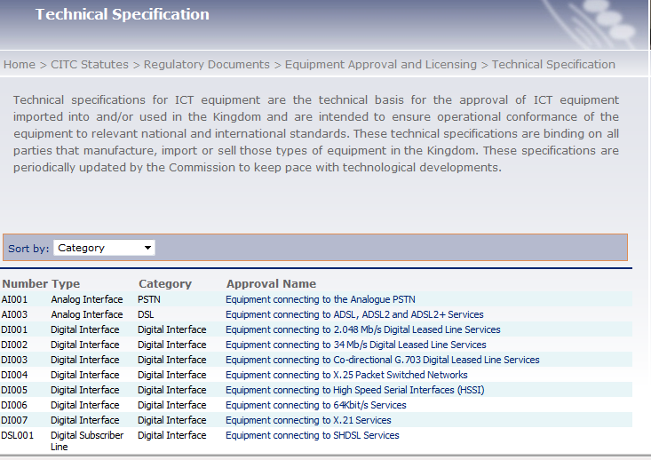
Example: Kingdom of Saudi Arabia
Certification from the manufacturer that the equipment in question conforms to the CITC technical specifications. This certification (or Declaration of Conformity) must be signed by an authorized officer of the manufacturer;
National technical specifications, are based on globally recognized Standards.

Slide 45
Concluding Remarks on the Arab Region Experiences
Most countries rely on internationally recognized Standards in their TA regimes. Identification of accredited labs is of great importance in this regard.
Counterfeit equipment is a very wearisome problem, specially in the mobile sets market (mainly Asian). Global cooperation is highly effective in this regard.
Several problems reported from users (Operators) regarding Conformance and Interoperability.
Regional Test Labs will highly help, but difficulties to specify and to finance. Some capabilities exist, need elaboration to be accredited test labs.
MRAs has advantages, but some NRAs are reluctant because of revenues reduction: loss of Type Approval fees.

Slide 46
The Message
Conformance to International Standards does not imply barrier to trade. On the contrary, it facilitates and should be a driver for “fair” trade due to increased confidence in equipment and systems.
Arabs have concerns on the reluctance of the industry to populate the ITU DB, the DB reflects transparency requirement regarding confidence in conformance of equipment to Standards.
ITU-T should take global eminent role in Standards setting. ITU-T SGs should consider JCA-CIT proposals and take concrete and responsible steps to ensure that Test Specifications are embedded in their “relevant” Rec. or included by reference to other SDOs TS.
The feasibility study should not be a tool for impeding the progress of TSB programs endorsed by PP10 Res. 177.
Nonbinding characteristic of ITU Recommendations at large – since ITRs modification, Melbourne 88 - gave room for infringements.
Conformance to International Standards does not imply barrier to trade. On the contrary, it facilitates and should be a driver for “fair” trade due to increased confidence in equipment and systems.
Arabs have concerns on the reluctance of the industry to populate the ITU DB, the DB reflects transparency requirement regarding confidence in conformance of equipment to Standards.
ITU-T should take global eminent role in Standards setting. ITU-T SGs should consider JCA-CIT proposals and take concrete and responsible steps to ensure that Test Specifications are embedded in their “relevant” Rec. or included by reference to other SDOs TS.
The feasibility study should not be a tool for impeding the progress of TSB programs endorsed by PP10 Res. 177.
Nonbinding characteristic of ITU Recommendations at large – since ITRs modification, Melbourne 88 - gave room for infringements.

Slide 47
What the Arab Region is Looking For !
Globally harmonized and coordinated standards development process.
ITU-T DB populated, linked to similar DBs ⇨ Transparency.
Comprehensive C&I Portal ⇨ one-stop shop + edu.
Confidence in compliance ⇨ the Accreditation paths.
ITU MARK ⇨ Accredited paths, only Interop parameters
Counter fighting counterfeit equipment and premature “pre-standard” equipment.
Phased approach for establishing C&I test facilities.
Capacity Building + In depth hands-on Know-How.
Fund raising (incl. Voluntary) for C/B and Test Labs.
Comprehensive technical, normative and regulatory frameworks be spread and harmonized in DCs (MRAs).
Globally harmonized and coordinated standards development process.
ITU-T DB populated, linked to similar DBs ⇨ Transparency.
Comprehensive C&I Portal ⇨ one-stop shop + edu.
Confidence in compliance ⇨ the Accreditation paths.
ITU MARK ⇨ Accredited paths, only Interop parameters
Counter fighting counterfeit equipment and premature “pre-standard” equipment.
Phased approach for establishing C&I test facilities.
Capacity Building + In depth hands-on Know-How.
Fund raising (incl. Voluntary) for C/B and Test Labs.
Comprehensive technical, normative and regulatory frameworks be spread and harmonized in DCs (MRAs).

Slide 48



Let’s Bridge the STD GAP
Thank You
Sherif Guinena, NTRA, EGYPT - Dr.Guinena@ntra.gov.eg

