Slide 1
C-RAN: innovative solution for “green” radio access networks
ITU Workshop “Moving to a Green Economy
through ICT Standards” - Rome, 8 Sept 2011
Marco Carugi, ZTE Corporation
Marco.Carugi@zte.com.cn

Slide 2
C-RAN and its benefits, including from a green perspective
Highlights and case studies of ZTE C-RAN

Slide 3


What is C-RAN ?
Centralized Baseband Pool
Cooperative Radio
Cloud Computing Architecture
Clean Network

Slide 4

Innovative C-RAN Architecture
Virtual BS Pool
Virtual BS Pool
  Real-time Cloud for Centralized Processing
…
X2+
…
PHY/MAC
PHY/MAC
PHY/MAC
PHY/MAC
  High Bandwidth Optical Transport Network
Optical Transport
Network
C
RAN
  Cooperative Multi Point Processing
RRU
RRU
RRU
RRU
RRU
RRU
RRU
  Clean Network
Distributed and Cooperative RRUs

Slide 5


Benefits of C-RAN
Save Energy Consumption,
Reduce CO₂ Emission
Optimize CAPEX and OPEX
Match Tidal Traffic Migration
Reduce Cell Interference,
Improve User Experience
Concise Network Topology
Smooth Evolution

Slide 6
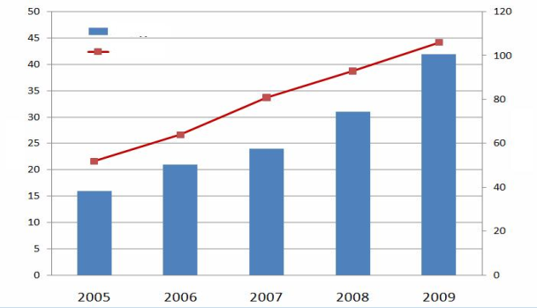
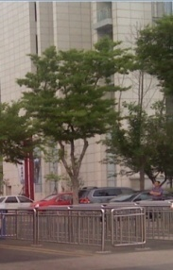
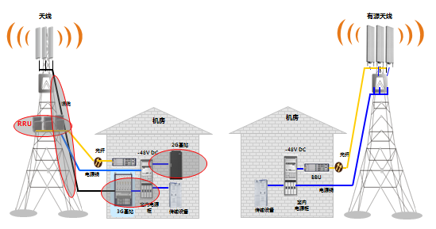
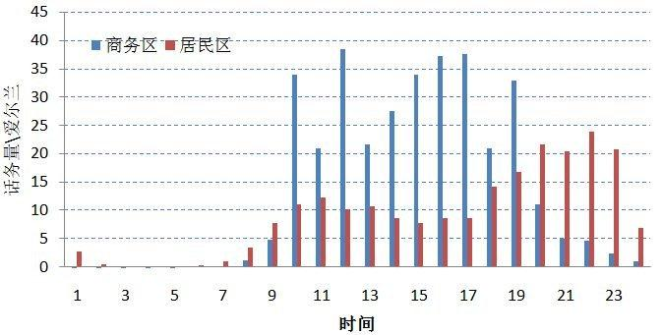
Challenges of Wireless Network Development
Rising Cost of Power Consumption due to Rapid Increasing Number of Base Stations
Difficult Site Acquisition Results in Worse Network Quality and User Experience
BS number
Power Consumption
BS Number (10,000)
Power consumption (100 million kwh)
Low Utilization Rate due to Limited Sharing of Base Station Resources
Evolution of Convergent Multi-mode Network
Business Areas
GSM
GPRS
EDGE
eEDGE
4G
Traffic Volume
Residential Areas
TD-
SCDMA
HSPA
HSPA+
TDD
MBMS
LTE
WCDMA
R99
HSDPA
R5
HSUPA
R6
HSPA+
R7
MBMS
FDD
cdma 1X
cdma 2000
cdma 2000
EV-DO
EV-DO
Rev. A
EV-DO
Rev. B
Time
802.16 d
802.16 e
802.16 m
Source: Statistic Data from a Chinese Operator 2010
6

Slide 7

C-RAN Reduces 68% Power Consumption
Scenario : China Mobile typical site model, total power consumption of traditional macro BS is 100%
RAN Energy Consumption Breakdown | Base Station | Air-conditioner | Others (MW, Lights etc) | Total | Energy Saving (%)
Traditional Macro Base Station | 48% | 46% | 6% | 100%
Distributed Base Station | 24% | 32% | 5% | 61% | 39%
C-RAN Architecture | 20.4% | 9.6% | 2% | 32% | 68%
Notes: Energy saving data may vary with regions and site models
68% Energy Saving
Notes:
7

Slide 8
How to Reduce the Network TCO Effectively ?
Data Source from China Mobile
7 Years Network TCO Analysis
OPEX
Power
Maintenance
CAPEX
60%
TCO
Site Survey &NP
CAF
Site rental
Civil work
40%
TCO
RAN equipment
Transmission
Civil work, CAF, Site Rental and Site Maintenance take over 45% of Site TCO!

Slide 9





C-RAN Reduces 23% CAPEX and 70% OPEX
Assumption: 180,000 new Sites, 350,000 CS, Typical site model of CMCC, 90% Sites have fiber resource
Item (Thousand) | Legacy Mode | C-RAN | Saving Ratio
Equipment Cost | 3,780,000 | 3,060,000 | 19%
Site Infrastructure Cost | 3,402,000 | 1,240,200 | 64%
Transmission Cost | 684,000 | 144,000 | 79%
Power Supply Cost | 1,116,000 | 651,600 | 42%
Fiber Cost | 3,942,000 | 3,942,000 | 0%
Antenna and Feeder Cost | 3,888,000 | 3,888,000 | 0%
Total (Thousand) | 16,812,000 | 12,925,800 | 23%
CAPEX
C-RAN Mode Saves 23% CAPEX in total, around 3.89billion RMB
OPEX
1.05 Billion
0.32 Billion
Legacy Mode
C-RAN
C-RAN Mode Saves 70% OPEX per year, around 0.73Billion RMB

Slide 10



C-RAN Reduces Site Rooms by 10 Times
MME
xGW
MME
xGW
HSS
PCRF
HSS
PCRF
S1
S1
C-RAN
IP Backbone
S1
IP Backbone
S1
S1
S1
S1
S1
C-RAN
S1
C-RAN Architecture
Traditional :
+ Equipment Room at each Site
+ Air Conditioner, Transmission
+ Difficult for Site Acquisition
+ Long Site Construction Period
+ Complex Transmission routes
C-RAN :
- Only Equipment Rooms for BBU Hotel
- No Air Conditioner and Transmission at Site
- Easy Site Acquisition
- Less Civil Work, Fast Deployment
- Simplified and Flat Transmission Topology

Slide 11


C-RAN Reduces Operation Cost Dramatically
X2
O&M
X2
O&M
X2
C-RAN
IP Backbone
X2
IP Backbone
X2
X2
C-RAN
X2
X2
X2
X2
Traditional
  + Hard to Manage and Monitor lots of distributed sites
  + High Site Visit and Maintenance cost
  + High Power Consumption and Room Rental Cost
C-RAN
  Centralized site Management and Monitoring
  Only BBU hotel Visit and Maintenance
  Improved Operating Efficiency
  Low Energy Dissipation and low Rental Cost for each RRU site

Slide 12
C-RAN Turns Interference into Signal
Coordinated Multi-Point Transmission/Reception
CoMP improves:
Cell coverage
  Cell edge link quality and throughput
  System throughput and spectral efficiency
  Speed of Cell selection
Serving eNB
Coordinated eNB
UE1
UE2
X2 Interface

Slide 13
CoMP Brings obvious Spectrum Efficiency Improvement
LTE-A COMP Simulation
Source：ZTE Down Link Joint Processing Simulation in Homogeneous network

Slide 14


C-RAN Applies 4G Technology to 2G Networks
RRU
RRU
RRU
Independent Physical Cell
Hand Over
Hand Over
RRU
RRU
RRU
Share Logical Cell
Cooperative
Cooperative
No Inter-Cell Interference
Diversity Gain
Interference in overlap area
No Diversity Gain
RRU
RRU
RRU
RRU
RRU
RRU
RRU
RRU
BBU
BBU
Option 1: Baseband Combination
Option 2: RF Combination

Slide 15
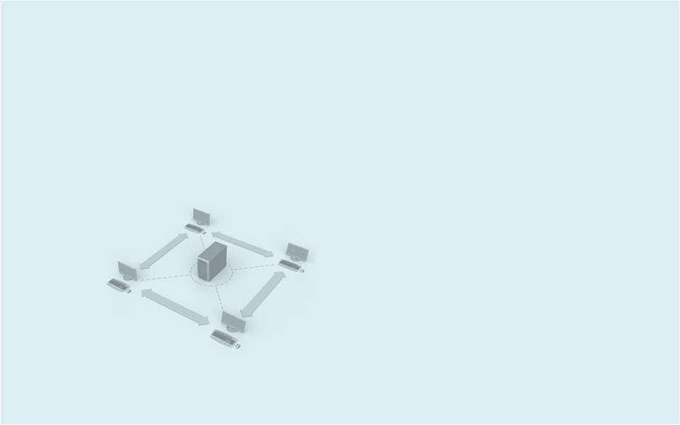

Highlights and case studies of ZTE C-RAN

Slide 16



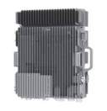
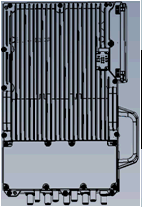
ZTE C-RAN DRA Strategy
Demand
Requirements
Architecture
One BBU support 108CS (GSM/TD-S)
BBU support dynamic resource allocation
18 Levels RRU Daisy Chain
6Gbps/10Gbps Fiber Interface
Single RRU support 12TRX
RRU support ring topology
BBU Redundancy Design
Multi-RRU share logical cell
BBU
Baseband Sharing
High Efficient IQ Bearing
Redundancy and Reliability
Cooperative Radio
B8200
B8300
RRU
R8860
R8882
R8968/8928

Slide 17

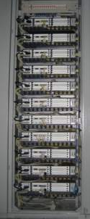

C-RAN Case Study - China Unicom Dalian
Executive summary: in Dalian, with Baseband Pool Solution, 568 BBUs are centralized and located in 53 central offices, 2337 RRUs are connected to these BBUs
    C-RAN No.1
    ZhongShan center office
    BBU: 102, RRU: 365
757
Saving of 704 equipment rooms, about 93%
    C-RAN No.2
    XiGang center office
    BBU: 72, RRU: 189
53
C-RAN network construction mode saved 9.398 million RMB for China Unicom
Innovation C-RAN construction reduced more than 80% power consumption.
BBU cabinet
11 BBUs in one cabinet

Slide 18



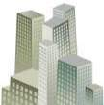
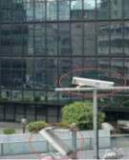


C-RAN Dalian Optimizes Performance in 3D Coverage Scenario
Main Street Coverage, 30° down tilt
Indoor Coverage
BBU
Cover age of opposite buildings, +45°up tilt
RRU
Street Coverage, Low Ant
RRU
RRU
RRU
Road Coverage
Cover age of opposite buildings by wide horizontal beam, Horizontal antenna
  Multiple RRUs combine into one super logical cell
  Baseband sharing solves the indoor and outdoor cooperative problem

Slide 19
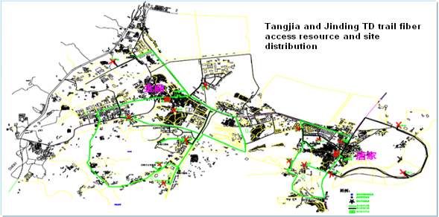

C-RAN Case Study - China Mobile ZhuHai
Tangjia Ring
S444
S444
S444
S444
S444
S444
S444
S444
S444
Jinding Ring
S444
District overview: About 30km² ,18 sites (9 new sites, 9 co-located with existing GSM sites)
District feature: Uptown, high-tech part and college park, high data traffic, obvious Tidal Traffic Effect
Site feature: Selected sites are near to the access fiber ring, few excavation and pipeline deployment work
S444
S444
S444
S444
S444
S444
S444
S444

Slide 20
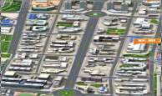
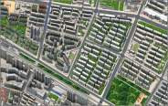

CM ZhuHai: Baseband pool reduces 50% BP Resource
At Night
Traffic migration
Daytime
Business district/Campus area
27 carriers
static
27 carriers
static
Residential area
54 carriers
dynamic
Super baseband pool and dynamic resource allocation can effectively reduce BP hardware resource, and enhance the disaster tolerance capability of RAN
Mode | BBU Number | BP Board Number | BP loading | Backup
Distributed | 9 | 18 | 75% | 1：1
C-RAN | 2 | 9 | < 75% | 7：2
Notes:
20

Slide 21
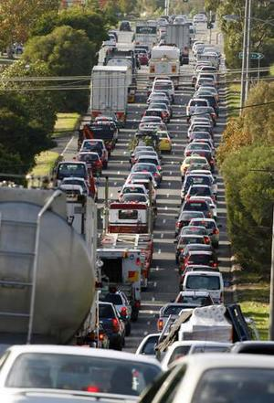
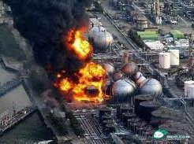

Embrace C-RAN, Keep Away from Nuclear Pollution
China Mobile 2010 Energy Consumption and Analysis
Annual CO₂ emissions of 600 thousands cars
=
=
If 50% of network uses C-RAN solution, China Mobile can save 2.93 billion KWh per year
Nuclear Energy
The annual energy output of Fukushima nuclear power plant group one
C-RAN

Slide 22
Thanks for your attention
ITU Workshop “Moving to a Green Economy
through ICT Standards” - Rome, 8 Sept 2011

Slide 23
Backup slides
ITU Workshop “Moving to a Green Economy
through ICT Standards” - Rome, 8 Sept 2011

Slide 24
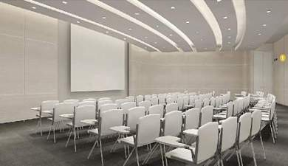
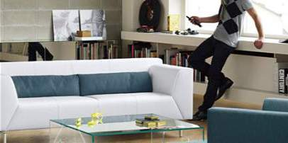
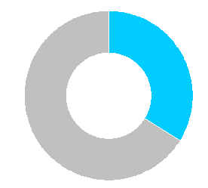
C-RAN Solves the Problem of Tidal Traffic Migration
Traffic Migration
Downtown
Uptown
Dynamic Sharing
Carrier Resource Sharing
M Carriers
  Dynamic TRX allocation according traffic migration
  Save xx carrier-sector baseband resources
  Adjustable Baseband resource allocation threshold
  Adjustable Baseband resource release threshold
Pre-Set
Allocation
N Carriers

Slide 25
Cooperative Radio
  Basic Concept of Cooperative Radio:
  Multiple nodes serve one terminal through cooperation, with the highest overall network efficiency
  Collaborative radio is a mandatory technology of LTE-A
  Collaborative radio is the basic of Mesh Networks and Cognitive Radio
Comparison between Traditional Network and Cooperative Radio
Carrier Needs in the Future | Technical Needs In the Future | Traditional Network Mode | Cooperative Radio Mode
Abundant Spectrum | Higher Frequency band, Higher Bandwidth | High Power Transmission | Low Power Transmission
Over100Mbps throughput | High order Modulation, Micro Cell | Dramatically degrade in cell-edge speed | Obviously Improve in cell-edge speed
Seamless Coverage in both outdoor and indoor | High density, cooperative between indoor and outdoor | More sites, distributed | Less sites, centralized
Smooth Evolution from 2G to 3G/4G | Multi-mode co-existence | Difficult for inter-RAT resource sharing | Possible for inter-RAT resource sharing

Slide 26




Multi-Mode C-RAN Network Evolution
GSM BTS
GSM
IP/SDH
Backbone
GSM BSC
GSM EMS
TD-SCDMA
IP/SDH
Backbone
TD RRU
TD RNC
TD BBU
TD EMS
NetNumen Unified OAM
iBSC/TD RNC Dual Mode controller
G/T/L Multi-Mode BBU Dynamic Sharing Pool
G/T/L
RRU
Converged G/T/L C-RAN Network
G
S
M
T
D
S
T/L RRU
GSM RRU
IP/SDH
Backbone
T/L RRU
GSM/TD/LTE
Unified EMS
FDD/TDD Shared IQ Fiber
GSM RRU

