Slide 1
"Footprint of ICT elements and networks in the home and - reducing GHG emission
ITU Workshop “Moving to a Green Economy
through ICT Standards”
Rome 6 – 8 September, 2011
International Telecommunication Union
Efstathia Kolentini, Flavio Cucchietti
ICCS-NTUA Telecom Italia - GeSI
SEESGEN-ICT Thematic Network

Slide 2
Main issues examined
Energy efficient and energy aware with ICT ?
What is GHG emission reduction ?
How ICT systems can encourage it ?

Slide 3
General objective of SEESGEN-ICT
General
Fostering the best use of ICT for the implementation of Energy Efficiency in the Power Distributed Generation Grids
Actions
Identify best practices, policies, process innovations at the level of Stakeholders and Member States
Cooperate in defining a EU integrated strategic roadmap
Suggest recommendations and policy actions to the Stakeholders
Project coordinator: RSE SpA –Italy
http://seesgen-ict.rse-web.it
ITU 2011
Kolentini, Cucchietti

Slide 4
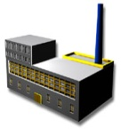


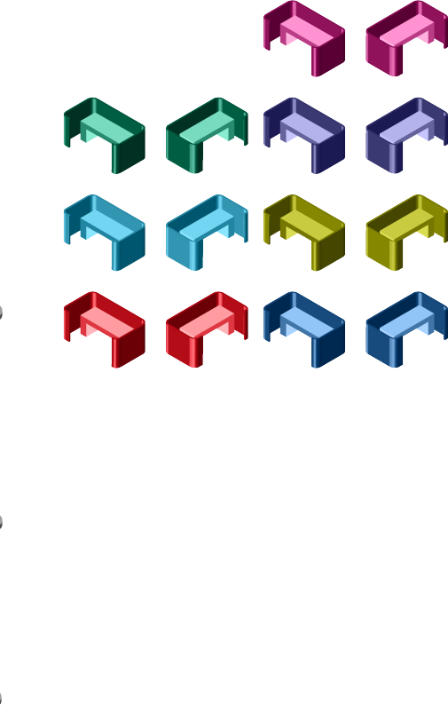



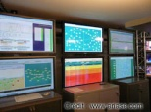


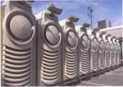











Focus
Primary
resources
Focus:
DSO -> Active Users perimeter
Short-MidTerm perspective
ICT related issues
Electric
Production
Generation Operations
Transmission
Distribution
HQ/
Finance
Retailers,
Aggregators, ESCOs
Regulators
Sales/
Marketing
Planning
Call
Center
Customers
ITU 2011
Kolentini, Cucchietti

Slide 5
Key words
Saving/Smart Use of Energy
Reduce GHGs
POSITIVE
~15%
NEGATIVE
3,5%
(could even be higher)
ITU 2011
Kolentini, Cucchietti

Slide 6
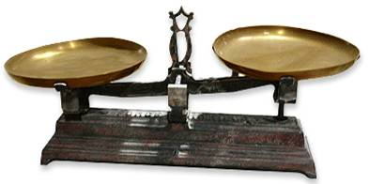
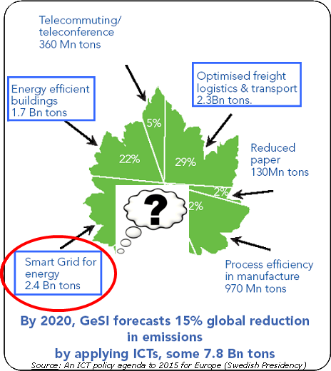
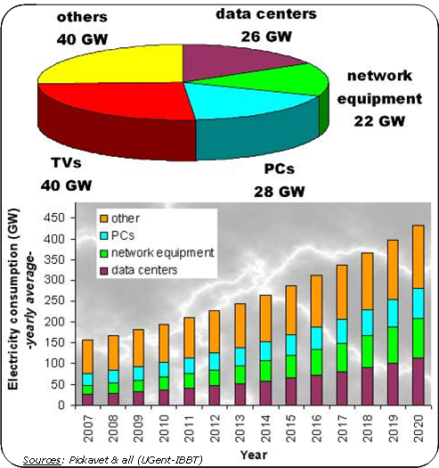
Energy Reductions enabled by ICT
Energy Consumption of ICT solutions
~8% of total electricity consumption
~15% by 2020

Slide 7
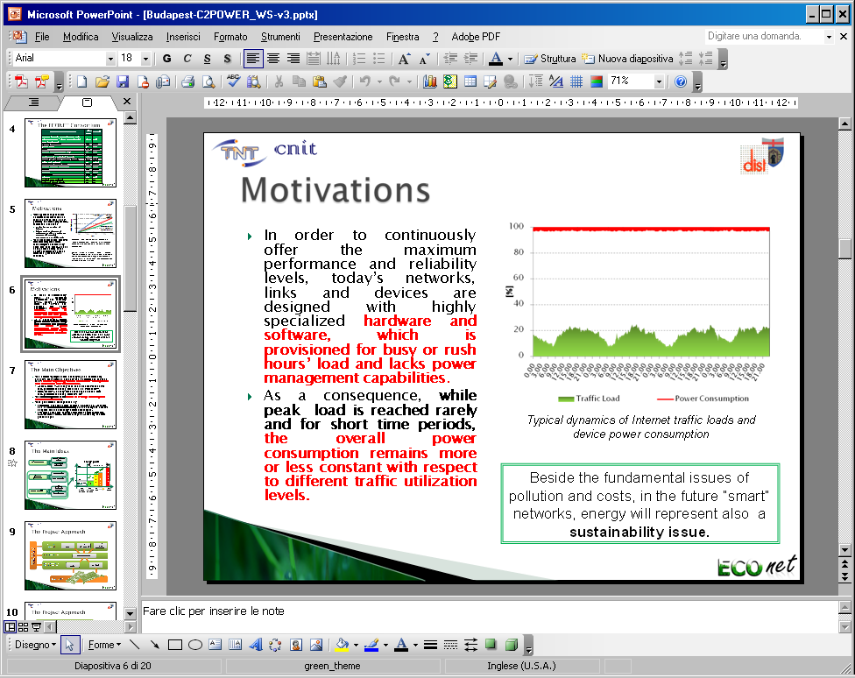
Footprint of ICT elements and networks in the home
  Today, most ICT equipment don’t have power management features
Source: EC ECONET project
Budapest – May 2011
ITU 2011
Kolentini, Cucchietti
7

Slide 8
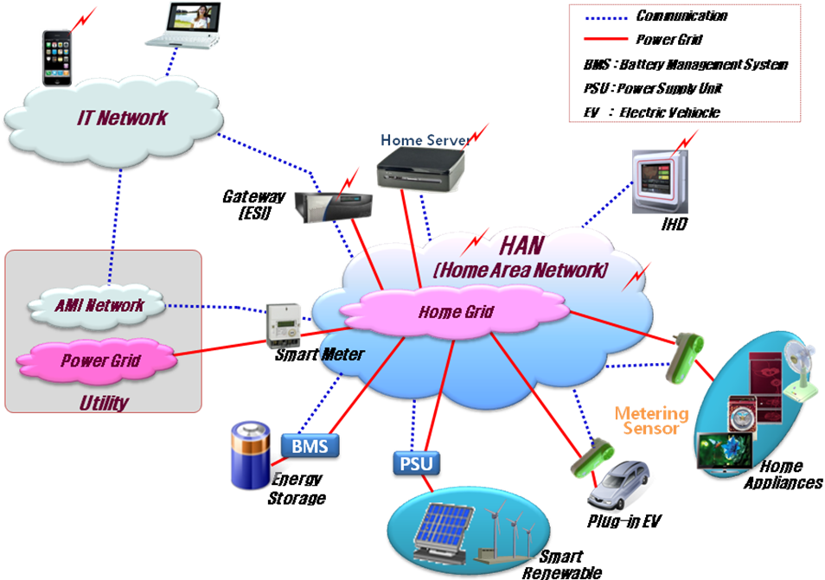
Footprint of ICT elements and networks in the home
  Most of the energy consumption will be in homes!
  Smart Grids, sensor networks, metering … will add up!
  Energy consumption in Data Centres and Networks will be an issue too!
  An example: Future broadband network’s Energy footprint estimation
2015-2020 network forecast: device density and energy requirements
(example based on Italian network)
 | power consumption (Wh) | number of devices | overall consumption (GWh/year)
Home | 10 | 17,500,000 | 1,533
Access | 1,280 | 27,344 | 307
Metro/transport | 6,000 | 1,750 | 92
Core | 10,000 | 175 | 15
Sources: 1) BroadBand Code of Conduct V.3 (EC-JRC) and “inertial” technology improvements to 2015-2020 (home and access cons.)
2) Telecom Italia measurements and evaluations (power consumption of metro/core network and number of devices)
Source: EC ECONET project
Budapest – May 2011
ITU 2011
Kolentini, Cucchietti
8

Slide 9
Footprint of ICT elements and networks in the home
  Some rough estimations: “Typical household - Starting data”
  Devices energy consumption as per the EC BroadBand CoC (or estimated on its principles) 2014 targets
  1 Home gateway (or a device capable to network the in house devices and communicate with the wide area network) 5 - 10W
  10 sensors/actuators/meters 10 x (0,3 – 2)W = 3 – 20W
  1displaying device 1 - 3W
  No standby mode considered: all devices today expected to be always on
Overall consumption per household could range between 9 and 33W
= about 10% energy
consumption increase *
33W = 289 kWh/year
(*) typical Italian household 3000 kWh/year
ITU 2011
Kolentini, Cucchietti
9

Slide 10
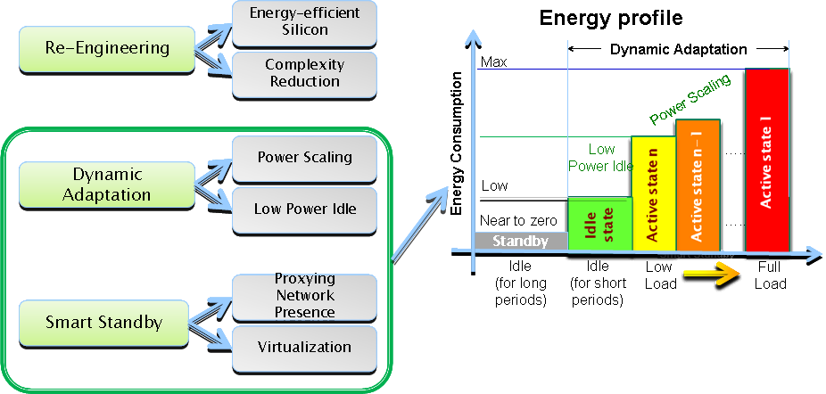
Footprint of ICT elements and networks in the home
  Optimizing energy performances:
All ICT equipment has to (and can) be energy optimized
They must adapt dynamically to the most efficient profile
Standards should be reviewed in light of the best global energy efficiency
Savings foreseen:
50- 80%
(even more in the longer term)
ITU 2011
Kolentini, Cucchietti
10

Slide 11
Footprint of ICT elements and networks in the home
  Lots of ICT equipment in homes
  Networking elements are proliferating and more are coming
  Their energy behavior must (and can) be optimized!
Question:
ICT technologies are to be used only the way we already know?
ITU 2011
11

Slide 12
The issue: CO2 emissions + Demand Response
The relationship Energy – Climate changes and Energy – Economic competitiveness can be noticed in almost all the political documents on energy and environment
In order to guide the political priorities in practice, the European Union did set a GHG reduction objectives up to 20% by 2020, in comparison with 1990
Studies prove that Demand Response (DR) alone could achieve ~ 25 of the EU’s 2020 targets concerning CO2 emission reductions.
The customers can play a critical role, participating in the CO2 market!!
ITU 2011
Kolentini, Cucchietti

Slide 13

EU ETS: how it happens..
The EU Emissions Trading System (EU ETS) is a cornerstone of the European Union's policy to combat climate change
Key tool for reducing industrial greenhouse gas (GhG) emissions cost-effectively
First and biggest international scheme for the trading of GhG emission allowances
  11,000 power stations and industrial plants in 30 countries.
Launched in 2005, the EU ETS works on the "cap and trade" principle
Sets a "cap", or limit, on the total amount of certain greenhouse gases that can be emitted by the factories, power plants and other installations
Rome 6-8/09/2011
ITU 2011
Kolentini, Cucchietti
13

Slide 14
EU ETS: how it happens..
Companies receive emission allowances which they can sell to or buy from one another as needed
The limited number of allowances available ensures that they have a value
Airlines will join the scheme in 2012 and further extension foreseen in 2013.
At the same time a series of important changes to the way the EU ETS works will take effect in order to strengthen the system.
Can ETS be applied in the domestic sector?
Rome 6-8/09/2011
ITU 2011
Kolentini, Cucchietti
14

Slide 15

ETS + Domestic sector =
ICT +CO2 measurements
There are research statements declaring that demand side management would be more efficient when integrating CO2 information in the measurement equipment of the clients
A greater effort further in the ETS implementation would be the opening to new players like the domestic sector
That would demand new ICT solutions to cover the needs of that development
ITU 2011
Kolentini, Cucchietti

Slide 16
Emsland paradigm
Assumptions for the project: Private households emit around 160 million tonnes of the greenhouse gas carbon dioxide into the atmosphere every year
In 2006 EWE and the district of Emsland launched a pilot project to allow private households to trade CO2 reduction certificates in the future.
Four years project on 150 homeowners
Participants are given CO2 credits for emissions which they manage to reduce via energy efficiency measures
This project can establish an important basis for evaluating CO2 reduction certificates in private households and send a clear message about the importance of climate protection.
ICT
ITU 2011
Kolentini, Cucchietti

Slide 17
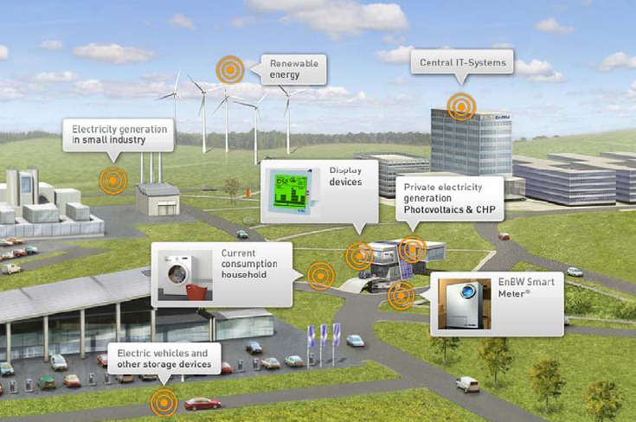
Other efforts on the same direction
The residential area accounts for the largest part of CO2 emissions
(about 35% of the energy production of power stations is consumed by households)
More ICT!
MEREGIO project (Minimum Emissions Region)
Where → In the Karlsruhe-Stuttgart region, densely populated / big manufacturing and high-tech hub
Objectives → optimized and sustainable power network (zero CO2)
Consumers will →
be able to monitor their energy consumption and CO2 footprint
adapt consumption according to
price and availability
sell surplus power from their own generators to the grid when price conditions are most favorable.
ITU 2011
Kolentini, Cucchietti

Slide 18
Other efforts on the same direction
AIM project
How to enable CO2 control mechanisms for households
Massive installation of smart metering devices could solve the problem (but extra energy use)
An alternative? The automated calibration of energy consumption
DEHEMS project
How technology can improve domestic energy efficiency.
Companies in the sector
TechniData Environmental Performance Solutions (EP) → business compliance management which covers all regulatory requirements in the environmental domain
SAP → software solutions to track, measure, and comply with emissions requirements
More ICT!
ITU 2011
Kolentini, Cucchietti

Slide 19

Barriers for the CO2 inclusion
Standardized methodology
Conversion of electrical consumption to its carbon dioxide equivalent is based most of times on a grid average (mean factor of kg CO2/kwh)
The most sophisticated methodologies within the metering systems use the electricity generation mix of coal, nuclear, gas turbines etc. and take into account grid losses
An issue : Τhe data of the emissions factors should be included in the metering systems or sent to them from the Transmission System Operator online depicting the System?
ITU 2011
Kolentini, Cucchietti

Slide 20
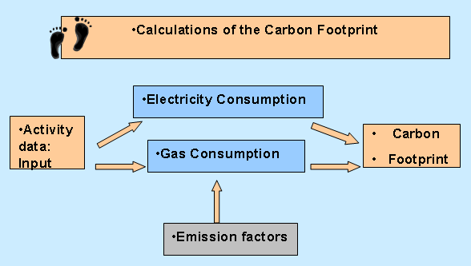
Barriers for the CO2 inclusion
There are no standardized methodologies adopted for CO2 emission calculations up to now, concerning the evaluation of CO2 emissions and energy consumption at the user side / Activities ongoing in ITU, IEC …
The standardized methodology for the CO2 footprint is even more critical in case of complex systems like cities
The calculations up to now:
Activity Data x Emission Factor = GHG emissions
ITU 2011
Kolentini, Cucchietti

Slide 21
Recommendations
Inclusion of other sectors in the ETS
The CO2 and Energy Efficiency objectives are very challenging and can be reached only through a global action joining all sectors, including the end customers
In this direction, Regulators should open the discussion towards the admission of all stakeholders to the CO2 market.
Specific recommendations should be the outcome of this activity so that companies are prepared for the market transition.
The example of early adopters like UK can be followed for the CO2 market opening to other sectors.
Companies and Consumers (HV and MV customers) that can be included in the ETS Scheme, should have the right to sell and purchase CO2 allowances.
ITU 2011
Kolentini, Cucchietti

Slide 22
Recommendations
Feasibility
Manchester City Council had to come up with appropriate and cost effective proposals for introducing Automatic Meter Reading into Council buildings.
The existing charges levied by supply companies already included a cost element for conventional meter provision, reading and data management.
When the scheme was introduced, these conventional metering charges needed to be identified, stripped out of the bill, and used to offset some of the cost of Automatic Meter Reading.
ITU 2011
Kolentini, Cucchietti

Slide 23

Recommendations
  Standardised ways of CO2 calculation should be adopted should the carbon footprint be integrated in the metering devices.
  These calculations will follow the rules that will be adopted according to the inclusion of the players (the customers) in the ETS Scheme
  An example:
  The Production Units send their emission factors to the TSO
ITU 2011
Kolentini, Cucchietti

Slide 24

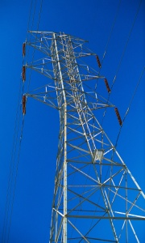
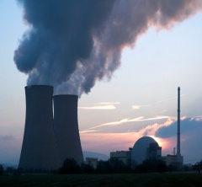

Recommendations
  The TSO send the total factor of the system to the DSO, who can be the Operator of the Metering devices, or the device directly, depending on the type of customer
  The DSO send the factor to the device
  The devices depict the CO2 emitted and informs the end user
Metering device
Production Units
End users
TSO
ITU 2011
Kolentini, Cucchietti

Slide 25

Recommendations
Linking accuracy to the application: Not the same level is needed when the scope is solely to encourage the consumers to cut their demand.
High accuracy is needed for companies participating in the Emissions Trading Scheme. In this case the metering equipment should also
calculate system losses?
Referring to low voltage consumers they have to aggregate in order to be able to trade a sufficient amount of allowances, given that they are included in such a Scheme. In this case also this type of customers will demand accuracy.
The factors can either be integrated in the equipment and updated every a certain period or sent by the TSO, again depending on the use and level of accuracy.
ITU 2011
Kolentini, Cucchietti

Slide 26
Review on the Steps towards a Low Carbon Economy
“Enablement” aspects:
Inclusion of other Sectors in Emission Trading Scheme: the CO2 market should include all stakeholders, consumers, DNOs, TSOs, energy companies, EC
CO2 metering accuracy : The accuracy level should be linked to Standards and Data that should be communicated to the customers
Standards: key to enable a common CO2 monitoring through: comparable reporting; what is measured; who the information is transmitted to; the amount and volume of data
Issues data collection / reporting / assurance: to be commonly agreed
Training players through EU projects on the topic: test operation of such a market
Data management information has to be distributed to the citizens
ITU 2011
Kolentini, Cucchietti

Slide 27
Review on the Steps towards a Low Carbon Economy
“Green ICT” aspects:
ICT is THE enabler, but could add strong further energy consumption
  All ICT equipment has to (and can) be energy optimized
  They must adapt dynamically to the most efficient profile
  Standards should be reviewed in light of the best global energy efficiency
The technical worlds of Electricity and of ICT should boost their cooperation towards such global and important goals
ITU 2011
Kolentini, Cucchietti

Slide 28
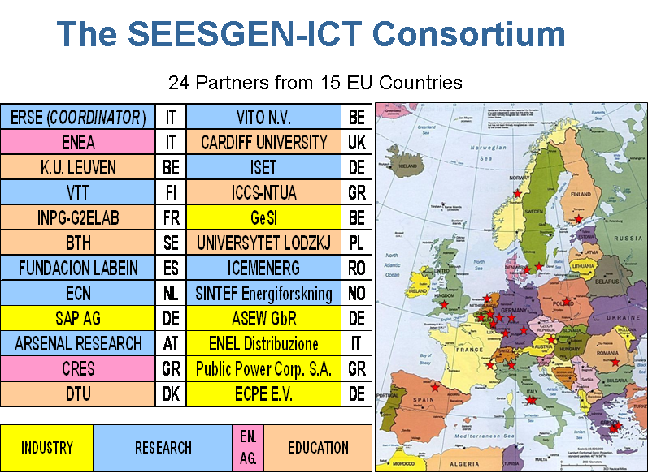
Thank you for your attention
tkoled@power.ece.ntua.gr
flavio.cucchietti@telecomitalia.it
ITU 2011
Kolentini, Cucchietti

