Slide 1


Methodologies for assessment of environmental impacts of ICT
ITU-T Study Group “Environment and Climate Change”

Slide 2





Co-operations include on methodologies :
ITU, The UN agency responsible for ICTs
192 Member States and more than 700 Sector Members

Slide 3
Question on methodologies :
6 recommendations under preparation
L.1400 Overview and general principles (consented on October 1, 2010)
available on the ITU-T website
Environmental impact of ICT goods, networks and services
(consent expected end of September 2011)
Environmental impact of ICT in organisations
(consent expected end of September 2011)
Environmental impact of ICT projects (consent expected in 2012)
Environmental impact of ICT in countries (consent expected in 2012)
Environmental impact of ICT in cities (consent expected in 2012)

Slide 4
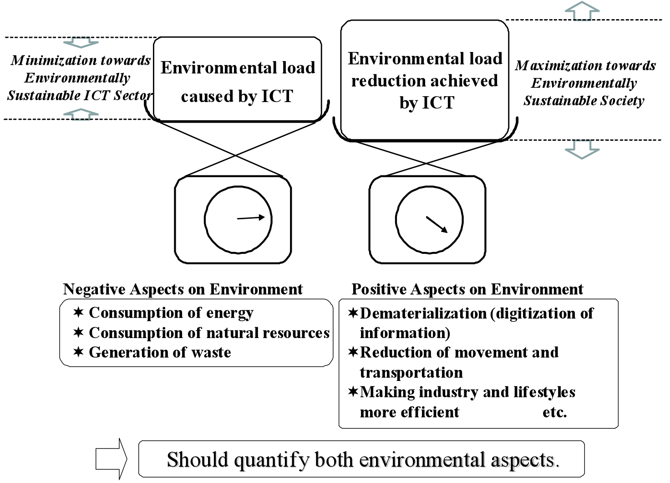
Environmental aspects of ICT

Slide 5
Environmental impact of ICT goods, networks and services
What is it ? What is it for ?
It is a Recommendation that complements ISO 14040 and ISO 14044 and provides guidance on how to assess environmental impacts of ICT Goods, Networks and Services
  It has been built with a large number of representatives from the ICT sector and governments. It has been built to be consistent with ETSI, IEC and GHG Protocol ICT supplement initiatives
There are 2 Parts in the Recommendation :
  ICT Lifecycle assessment : framework and guidance,
  Comparative analysis between ICT and baseline scenario : framework and guidance
The 2 Parts describe clear steps to follow in order to assess environmental impacts over the entire life cycle
  This will help you identify what are the major activities and life cycle stages impacting the environment, design and prepare action plans and prioritize actions
  This will help you face risks, save costs and develop new opportunities

Slide 6
Environmental impact of ICT goods, networks and services
Part I : What are the steps to follow ?
General requirements
Goal and scope definition
Functional unit definition
System boundaries definition
Cut-off rules
Data quality requirements
Life Cycle Inventory
  Data collection
  Data calculation
  Allocation procedure
Life Cycle impact assessment
Life cycle interpretation
Reporting

Slide 7
Environmental impact of ICT goods, networks and services
Part II : What are the steps to follow ?
General requirements
Goal and scope definition
Functional unit in the case of comparison
System boundaries definition
Cut-off rules
Data quality requirements
Life Cycle Inventory
Life Cycle impact assessment
Life cycle interpretation
Reporting

Slide 8
Environmental impact of ICT goods, networks and services
Practical tips
When will it be ready ?
  Consent should take place on September 28, 2011 in Seoul
  Final document will be available after ITU approval procedure
Where will you find it ?
  When available, the Recommendation will be downloadable freely from the ITU Website www.itu.int
How should you use it ?
  Please carefully read it and follow the steps indicated
  When you prepare a report or when you communicate, please state that the assessment was made “in accordance with ITU-T Recommendation”
  Please make suggestions of improvements to the Rapporteur, Jean-Manuel Canet, the Associate Rapporteur, Takafumi Hashitani or the Chief Editor, Takeshi Origuchi
What can you do if you need help ?
  Please contact the Rapporteur, Jean-Manuel Canet, the Associate Rapporteur, Takafumi Hashitani, or the Chief Editor, Takeshi Origuchi

Slide 9
Environmental impact of ICT in organisations
Agreement to focus on energy and GHG emission impacts
Agreement to establish the recommendation in compliance with ISO 14064-1 principles, including 3 scopes, and future ISO 14069
Consent expected on September 28, 2011 in Seoul
Detailed presentation to be given by Gilbert Buty, Alcatel-Lucent

Slide 10
Thanks for your attention !
We wish you nice assessments !

Slide 11
Annex

Slide 12
L.1400 : overview and general principles
The following general principles apply:
  Assessment of environmental impacts should be performed on a full life-cycle perspective for goods, networks and services
  Boundaries should be selected, quoted, documented and made available for verification
  Quantification methodologies should be selected, quoted, documented and made available for verification
  Reliable data should be researched. Used data should be quoted, documented and made available for verification
  Bias and uncertainties should be documented and reduced as far as it is practicable
  It should be noted that results of assessments may vary significantly depending upon the selection of boundaries, the quantification methodologies selected and the data used

